Slide 1
The Nail Salon Project
Creator: Kormos Áron

Slide 2
Main Goals
To make easier the reservation process both for the customers and the Client
To create a safe enviroment for the reservations
To reach more customers
To boost sales and revenue

Slide 3
Main functions
Booking system
Image uploader system
Authentication system
Navigaton system

Slide 4
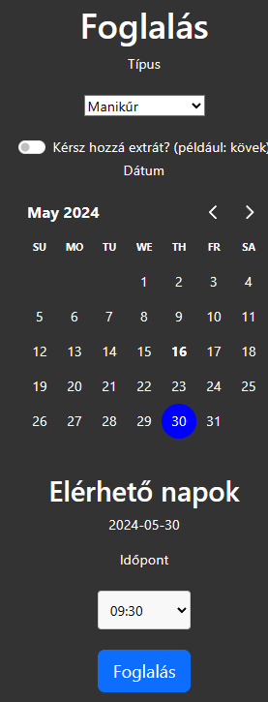
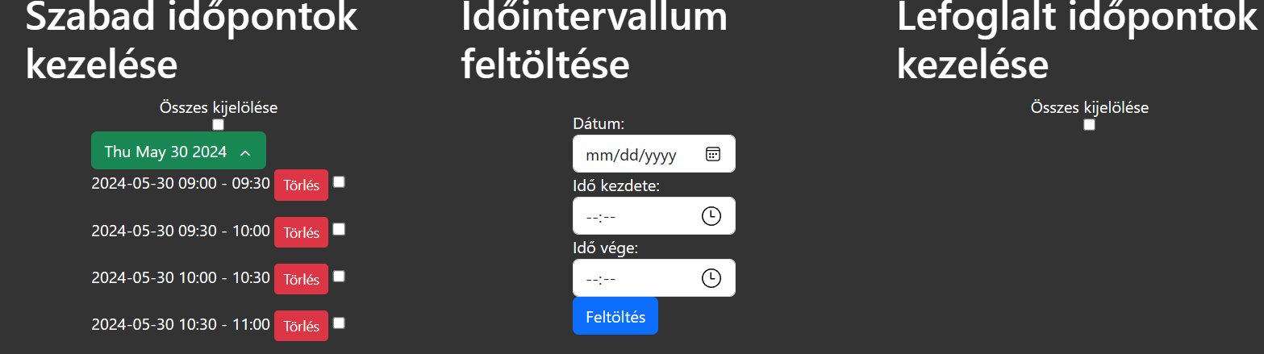
Booking system
User interface
Admin interface
This function makes the reservation an easy process.

Slide 5
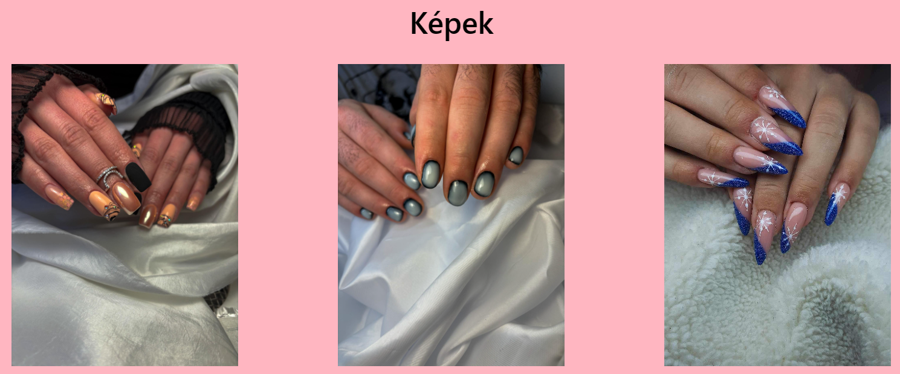
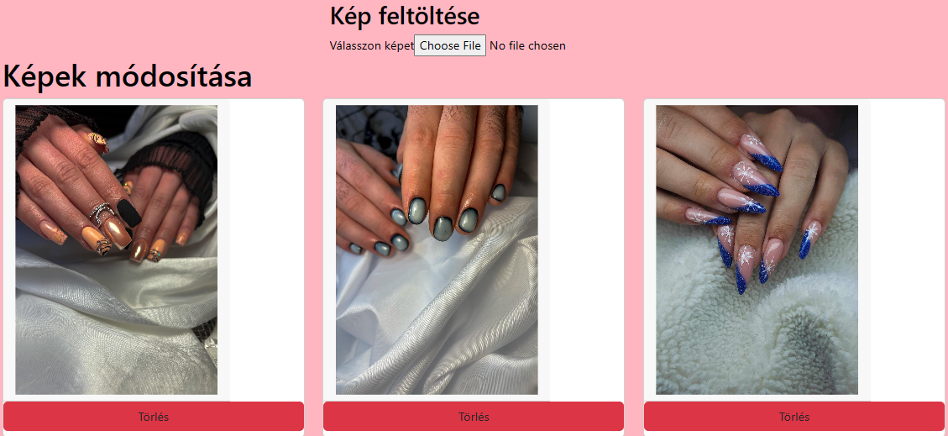
Image system
User interface Admin interface
This system helps the client to show her work.

Slide 6
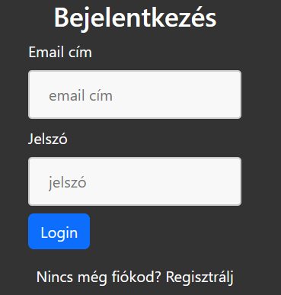
Authentication system
It creates a safe environment.

Slide 7
Navigaton system
It makes the navigation easy to use.

Slide 8
Security in the project
The admin pages are in a differect location what the customer see in default
It has a protection against http flood DDoS
Bearer token for authentication
Protection against clickjacking
Protection against web crawlers

Slide 9
Unfinished functions
Email provider for verification and reminder
Token expiration
The users and the admin cannot change their password
The admin cannot upload price or service
When the user deletes their reservation it does not creates a new appointment
The backend does not authorize the uploaded file, only the frontend does
Change language
When the admin is logged in, it does not redirect to booking

Slide 10
Thanks for the attention

