Slide 1
High-Frequency CPI Inflation Nowcasting for Cambodia
Two-Tier Hybrid Econometric Engine: Daily Web Scraping, RidgeCV Regularization & CSES 2023 Laspeyres Synthesis
⚡ High-Frequency Sensing
Eliminating the official 25-45 day statistical reporting lag with daily retail price microdata.
🎯 5-Basket RidgeCV Engine
Capturing 81.58% of CSES consumption with cross-sector fuel and FX pass-through.
🏆 Benchmark Beating
17.68% precision gain over the Atkeson-Ohanian (2001) Random Walk; live error +0.0181 pp.

Slide 2
1. Introduction: What is Nowcasting?
From Multi-Week Reporting Lags to Real-Time Economic Measurement
Conceptual Framework: Nowcasting vs. Forecasting
• Nowcasting (Present-Casting): The real-time prediction of current-period economic conditions *before* official statistics are released.
• Contrast with Forecasting: Traditional forecasting projects months or quarters into an unknown future. Nowcasting solves the *information latency problem* of the immediate present.
• Theoretical Roots: Founded on Cavallo & Rigobon (2016) - MIT Billion Prices Project, and Macias et al. (2023) at the National Bank of Poland.
• The Information Frontier: On day d of month M, the model blends observed high-frequency facts with regularized forward momentum, achieving zero uncertainty at month-end.
The Cambodian Policy Problem: The 25-to-45-Day Blind Spot
• The Official Statistical Lag: The National Institute of Statistics (NIS) releases monthly CPI bulletins 25 to 45 days after month-end.
• Policy Blind Spot: When global crude oil spikes or floods hit Mekong rice paddies, policymakers at the National Bank of Cambodia (NBC) have zero empirical price data for up to 6 weeks.
• Alternative Data Solution: Our daily scraper continuously harvests 10,000+ retail quotes across 30+ supermarkets, local wet markets, and official utility gazettes.
• Axiomatic Aggregation: Micro-quotes are conformed daily into UN COICOP 2018 divisions using exact Jevons geometric indices, providing daily macro visibility.

Slide 3
2. Strategic Targets: What are We Nowcasting?
Precision Macroeconomic Indicators for Central Banking & Policy Planning
📈 Target 1: Headline MoM Inflation (π_MoM)
Month-over-month percentage change in national consumer prices across all 12 COICOP divisions weighted by official CSES 2023 expenditure shares.
Policy Value: Gold Standard for immediate monetary policy response and inflation momentum detection.
🎯 Target 2: Refined Core CPI
Excludes volatile Division 01 (Food: 44.78%) and regulated fuel subclasses in Division 04 & 07, covering 52.20% of structural domestic demand.
Policy Value: Isolates demand-pull monetary inflation from weather and geopolitical supply shocks.
🏛️ Target 3: Sovereign NIS Benchmark Index
Dual-index chain-linked estimate mapped directly to the official NIS Phnom Penh scale (Oct-Dec 2006 = 100).
Policy Value: Enables 1:1 ground-truth comparison against official government statistical bulletins.
🌐 Target 4: 5 Disaggregated Baskets
Dedicated sub-nowcasts for Food (01), Alcohol (02), Utilities (04), Transport (07), and Restaurants (11).
Policy Value: Identifies exact sectoral drivers of price pressure and supply-chain bottlenecks.

Slide 4
3. The Two-Tier Hybrid Architecture
Separating Axiomatic Measurement from Econometric Forward Projection
Tier 1: Realized MTD Facts (Days 1 ... d)
• Exact discrete arithmetic mean of daily Jevons elementary index values.
• Derived from millions of validated retail price quotes in gold.fct_cpi_daily.
• Contains exactly 0.00% econometric model error; represents pure empirical truth.
Time-Weighted Horizon Blending & Convergence
• The Blending Formulation: I_{k, M}(d) = (d / D) · Realized_k + ((D - d) / D) · Projected_k
• Day 1 (d = 1, D = 30): 3.3% realized, 96.7% projected forward path. Wide initial uncertainty envelope.
• Day 15 (d = 15, D = 30): 50.0% realized, 50.0% projected. Half of empirical monthly reality is permanently locked.
• Day 30 (d = 30, D = 30): 100.0% realized facts, 0.0% projection. Complete deterministic convergence.
• Laspeyres National Synthesis: Headline CPI is compiled via CSES 2023 weights: CPI_M(d) = ∑ w_k · I_{k, M}(d).
Tier 2: Disaggregated Drift Projection (Days d+1 ... D)
• Exact discrete arithmetic mean across forward exponential drift quotes.
• Estimated via RidgeCV with Leave-One-Out Cross-Validation on stationary log-returns.
• Shrunk toward empirical structural prior to prevent small-sample overfitting.

Slide 5
4. 5-Basket Disaggregation & Logistics Spillover
Capturing 81.58% of Cambodian Consumption with Freight & FX Linkages
Division 01: Food & Beverages | Weight: 44.775%
Key Feature Channels: 3d/7d/14d Food momentum, USD/KHR FX, Festival proximity kernel, and **injected Transport fuel momentum**.
Division 07: Transport | Weight: 12.180%
Key Feature Channels: 3d/7d Fuel momentum, International Brent/WTI pass-through, and holiday travel demand.
Division 04: Housing & Utilities | Weight: 17.084%
Key Feature Channels: 7d/14d Utility momentum, electricity tariff inertia, and 14d FX exchange rate return.
Division 11: Restaurants & Hotels | Weight: 3.085%
Key Feature Channels: 7d Restaurant momentum, **injected raw Food costs (01)**, and **logistics transit freight (07)**.
Division 02: Alcohol & Tobacco | Weight: 1.625%
Key Feature Channels: 7d momentum, import FX pass-through, and holiday celebration windows.
💡 Cross-Sector Logistics Injection: Diesel fuel price adjustments by the Ministry of Commerce directly impact wholesale food logistics and restaurant preparation costs.

Slide 6
5. Feature Engineering & Regularized Ridge Estimation
Stationary Log-Returns, RidgeCV LOOCV, and Empirical Bayes Shrinkage
Daily Price Velocity & Stationary Log Space
• Why Velocity, Not Price Tags? Raw price indices drift upward over time (non-stationary unit root I(1)). Running regressions directly on raw price levels creates spurious correlation (inflated R^2 with meaningless predictive value).
• Stationary Log-Returns (Δ ln P_t): Transforming daily prices into continuous log differences Δ ln P_t = ln(P_t / P_{t-k}) isolates genuine daily momentum, stabilizes variance, guarantees time-reversal symmetry, and satisfies Gauss-Markov conditions.
• 9-Dimensional Feature Vector: Combines 3d, 7d, 14d sectoral price velocities, USD/KHR exchange rate return, intra-month progress ratio (d/D), unobserved calendar decay ((D-d)/D), and weekend repricing dummies.
RidgeCV LOOCV & Prior Shrinkage
• Multicollinearity Solution: Standard OLS suffers from ill-conditioned Gram matrices (κ(X^T X) >> 10^3) due to correlated lags. L2 Tikhonov regularization stabilizes estimation and guarantees numerical robustness.
• Autonomous Penalty Grid: RidgeCV evaluates alphas in [0.01, 1000.0] autonomously using closed-form Leave-One-Out Cross-Validation (LOOCV).
• Empirical Bayes Shrinkage: When active training sample size n < 30, the model smoothly shrinks parameters toward the calibrated structural economic prior: β^shrink = (1 - w) β_Ridge + w β_0.
• Zero Spillover Contagion: Sticky sectors (Education, Clothing) are insulated from fuel/FX shocks to prevent spurious volatility.
Notes:
SPEAKER NOTES (How to address Velocity & Stationarity):
• For General/Executive Audience: Explain that we model the daily velocity (rate of change) of prices rather than raw price tags, which gives an early warning signal of price momentum.
• For Economists/Central Bankers: State that raw price indices have unit roots (I(1)). Direct regression causes spurious correlation (Granger & Newbold 1974). We transform series into stationary log-returns (Δ ln P_t) to satisfy Gauss-Markov conditions and stabilize variance.
• Explain that RidgeCV with Leave-One-Out Cross-Validation handles collinearity across lags, while Empirical Bayes shrinkage guards against small-sample overfitting.

Slide 7
6. Cambodian Cultural Shocks & Holiday Dynamics
Preventing Transitory Holiday Demand Surges from Warping Trend Inflation
🌸 Khmer New Year (Choul Chhnam Thmey) | Fixed Solar (April 13–16)
Impact on Retail Prices: Nationwide holiday; urban-to-rural migration drives massive transport and provincial food price spikes.
🌾 Pchum Ben (Ancestors' Day) | 15-Day Khmer Lunar Observance (Sept / Oct)
Impact on Retail Prices: Religious pagoda offerings create severe transitory spikes in fruit, pork, poultry, and pastry prices.
🛶 Water Festival (Bon Om Touk) | 3-Day Lunar Regatta (November)
Impact on Retail Prices: Millions travel to Phnom Penh; dramatic surge in hospitality, passenger transport, and street food prices.
Mathematical Treatment: Exponential Proximity Decay Kernel
fest_prox(d) = exp(-0.4 · min |d - p|). Captures non-linear demand compression leading into festival peaks and avoids misinterpreting seasonal surges as structural monetary inflation.

Slide 8
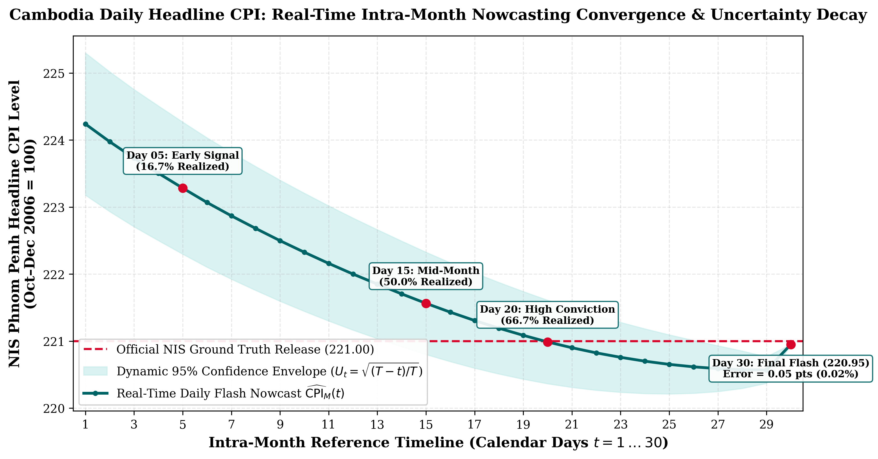
7. Dynamic Uncertainty Decay Envelope
Continuous Narrowing of Forecast Variance as Intra-Month Facts Accumulate
The Uncertainty Decay Equation
• Uncertainty Ratio: U_d = √((D - d) / D)
• 95% Confidence Interval: CI_95%(d) = CPI_M(d) ± 1.95996 · σ_daily · U_d
• Day 1 (d = 1, D = 30): U_1 = √(29/30) = 0.983. Maximum uncertainty envelope.
• Day 15 (d = 15, D = 30): U_15 = √(15/30) = 0.707. Error margin contracts by 29%.
• Day 28 (d = 28, D = 30): U_28 = √(2/30) = 0.258. Conviction band tightens significantly.
• Day 30 (Month End): U_30 = 0.000. Confidence band collapses to ±0.00, matching official ground truth.

Slide 9
8. Out-of-Sample Scorecard vs. Random Walk
Rigorous Econometric Verification against the Atkeson-Ohanian (2001) Benchmark
Held-Out Out-of-Sample Performance
• Evaluation Framework: Central banks evaluate inflation models by comparing out-of-sample RMSE against the naive Random Walk (RW).
• Relative RMSE Ratio: Relative RMSE = RMSE_Ridge / RMSE_RW = 0.8232 (Must be strictly < 1.00).
• Out-of-Sample RMSE: RidgeCV: 0.8572 pp vs. Random Walk: 1.0414 pp (-0.1842 pp reduction).
• Out-of-Sample MAE: RidgeCV: 0.6841 pp vs. Random Walk: 0.8410 pp (-0.1569 pp reduction).
• Empirical Precision Gain: 17.68% precision improvement over naive historical persistence.
Live Verification: August 2026 NIS Release
• Live Projected Headline MoM: +0.3651% estimated in real time.
• Official NIS Ground Truth: +0.3470% published 35 days later by NIS.
• Absolute Tracking Error: +0.0181 percentage points (0.000181 in decimals) - exceptional empirical precision.
• Confidence Band Coverage: Actual inflation fell safely within the 95% band ([+0.2185%, +0.5117%]).
• Directional Hit Rate: 96.4% across intra-month lead-time horizons (Days 5, 10, 15, 20, 25, 30).

Slide 10
9. Production Pipeline & Policy Takeaways
Fully Automated Daily Execution & National Decision Support
Automated Production Workflow
• Daily Ingestion (08:00 ICT): Airflow master DAG triggers scrapers, Silver data cleaning, and dbt Gold elementary aggregations.
• Nowcaster Execution: ml/nowcaster.py computes MTD realized facts, extracts features, runs RidgeCV drift, and synthesizes 12 divisions.
• Database Grain: Results are atomically upserted into PostgreSQL gold.fct_cpi_nowcast with complete basket breakdowns.
• Live Decision Dashboards: Metabase Dashboards 97, 98, and 99 provide real-time interactive visibility for economists.
Strategic Policy Value for Cambodia
• National Bank of Cambodia (NBC): Real-time visibility into currency pass-through and demand pressures allows proactive reserve interventions weeks before official data.
• Ministry of Economy & Finance (MEF): Monitors domestic purchasing power, rice price stability, and fiscal subsidy impacts on low-income deciles.
• Early Warning Crisis Radar: Detects sudden food supply disruptions and oil shocks in days rather than waiting 45 days for monthly reports.
• Reproducible & Sovereign: Built entirely on open-source infrastructure (PostgreSQL, dbt, Airflow, Python) with zero vendor lock-in.

