Slide 1

CI7104: Internet of Things
MQTT (Message Queueing Telemetry Transport)
Pramote Kuacharoen

Slide 2
MQTT
MQTT = MQ Telemetry Transport
MQTT protocol is a lightweight publish/subscribe protocol flowing over TCP/IP for remote sensors and control devices through low bandwidth, unreliable or intermittent communications.
MQTT was developed by Andy Stanford-Clark of IBM, and Arlen Nipper of Cirrus Link Solutions more than a decade ago.
ISO/IEC 20922:2016 Message Queuing Telemetry Transport (MQTT) v3.1.1.
MQTT v5.0 was released in 2018
Client libraries are available in almost all popular languages now.
https://eclipse.org/paho/
The current MQTT specification is available at:
http://docs.oasis-open.org/mqtt/mqtt/v5.0/mqtt-v5.0.html

Slide 3
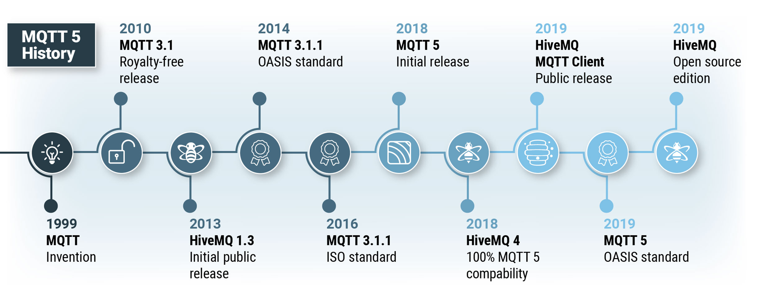

Slide 4
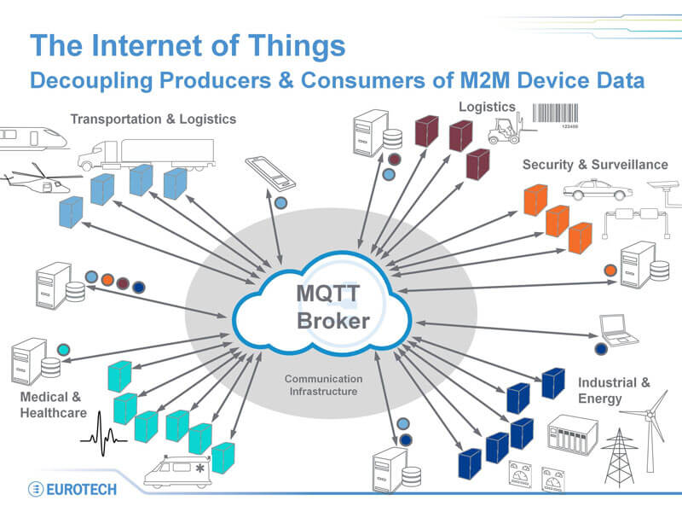

Slide 5
Projects that Implement MQTT
Amazon Web Services announced Amazon IoT based on MQTT in 2015
Microsoft Azure IoT Hub uses MQTT as its main protocol for telemetry messages
Node-RED supports MQTT nodes as of version 0.14
Facebook has used aspects of MQTT in Facebook Messenger for online chat
The EVRYTHNG IoT platform uses MQTT as an M2M protocol for millions of connected products.

Slide 6
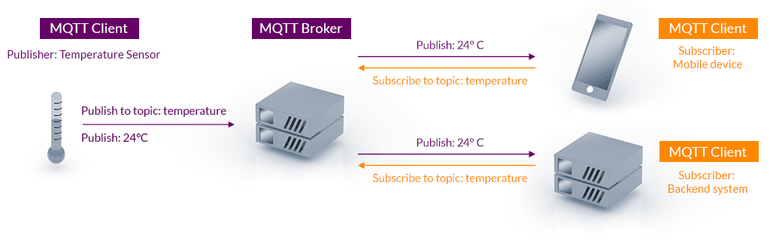
Basic concepts of MQTT
Publishers: These devices or machines are responsible for sending the collected data to the brokers.
Subscribers: These devices receive the requested sensor data from the brokers.
Broker: This intermediary device connects various publishers and subscribers by managing and routing the data.

Slide 7
Salient features of MQTT
Lightweight and efficient
Bidirectional communication protocol
Highly scalable
Reliability
Support for unreliable networks
Highly secure

Slide 8
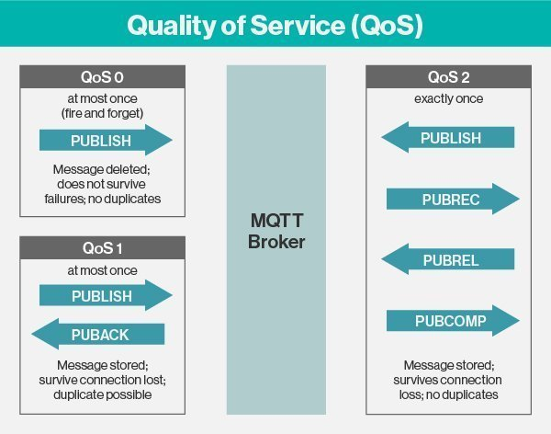

Slide 9
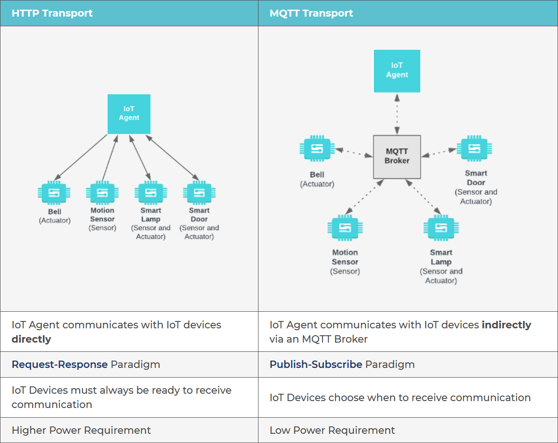

Slide 10
Clients do not have addresses like in email systems, and messages are not sent to clients.
Messages are published to a broker on a topic.
The job of an MQTT broker is to filter messages based on topic, and then distribute them to subscribers.
A client can receive these messages by subscribing to that topic on the same broker
There is no direct connection between a publisher and subscriber.
All clients can publish (broadcast) and subscribe (receive).
MQTT brokers do not normally store messages.

Slide 11

Eclipse Mosquitto™ An open source MQTT broker
Eclipse Mosquitto is an open source (EPL/EDL licensed) message broker that implements the MQTT protocol versions 5.0, 3.1.1 and 3.1.
Mosquitto is lightweight and is suitable for use on all devices from low power single board computers to full servers.
https://mosquitto.org/

Slide 12
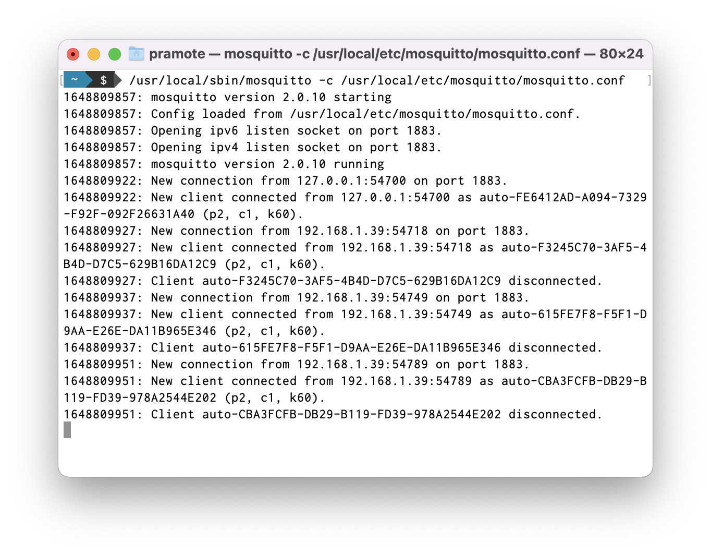
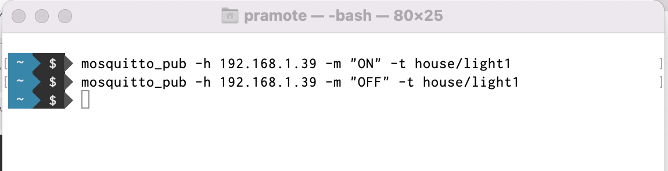
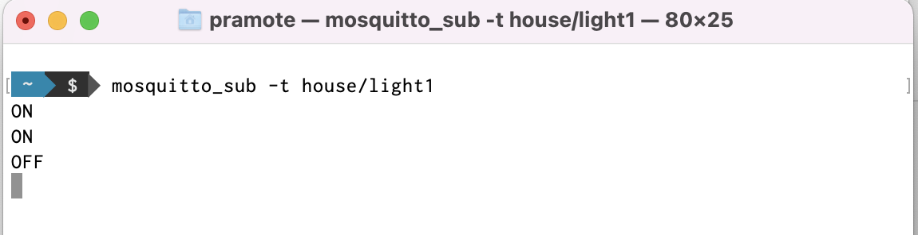

Slide 13
mosquitto.conf
listener 1883 0.0.0.0
allow_anonymous true

Slide 14
Securing MQTT Mosquitto Server
Generating a private certificate authority to use TLS with Mosquitto
Creating a certificate for the Mosquitto server
Configuring TLS transport security in Mosquitto
Testing the MQTT TLS configuration with command-line tools
Creating a certificate for each MQTT client
Configuring TLS client certificate authentication in Mosquitto
Testing the MQTT TLS client authentication with command-line tools

Slide 15
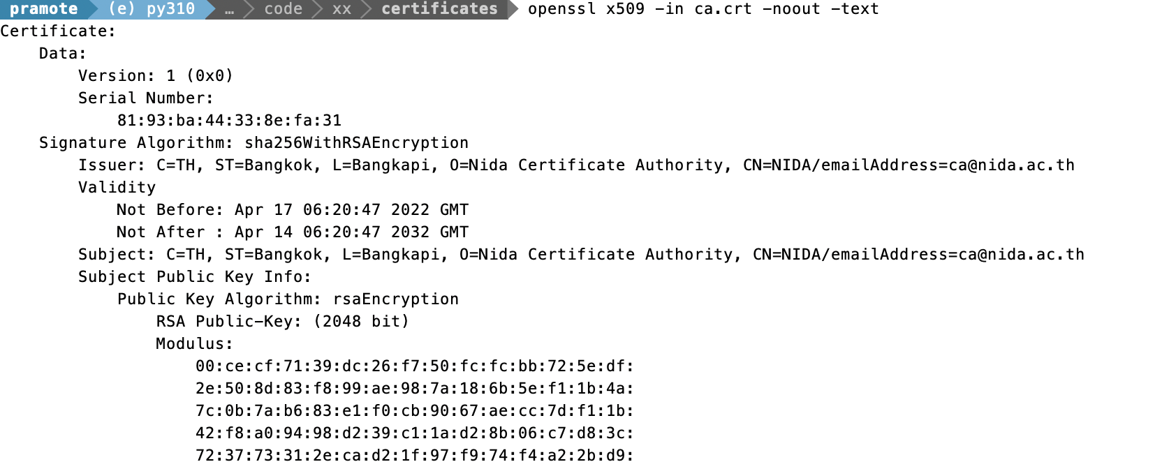
Generating a Private Certificate Authority to use TLS with Mosquitto
openssl genrsa -out ca.key 2048
openssl req -x509 -new -nodes -key ca.key -sha256 -days 3650 -out ca.crt
openssl x509 -in ca.crt -noout -text

Slide 16
Creating a Certificate for the Mosquitto Server
openssl genrsa -out server.key 2048
openssl req -new -key server.key -out server.csr
openssl x509 -req -in server.csr -CA ca.crt -CAkey ca.key -CAcreateserial -out server.crt -sha256 -days 3650

Slide 17
Configuring TLS transport Security in Mosquitto
# Create a new password file with a username
mosquitto_passwd -c <password file> <username>
# Add another user to an existing password file
mosquitto_passwd <password file> <username>
# Remove a user from a password file
mosquitto_passwd -D <password file> <username>
# Add/update a username and password in a single line
mosquitto_passwd –b <password file> <username> <password>
listener 8883
cafile /Users/pramote/workspace/iot/mqtt/mosquitto_certificates/ca.crt
certfile /Users/pramote/workspace/iot/mqtt/mosquitto_certificates/server.crt
keyfile /Users/pramote/workspace/iot/mqtt/mosquitto_certificates/server.key
password_file /Users/pramote/workspace/iot/mqtt/mosquitto_certificates/mosq_passwd

Slide 18
Testing the MQTT TLS Configuration with Command-line Tools
mosquitto_sub -h 192.168.1.35 -p 8883 -t house/motion_sensor -u pk -P iot123 --cafile ca.crt --insecure
mosquitto_pub -h 192.168.1.35 -p 8883 -m "ACTIVATED" -t house/motion_sensor -u pk -P iot123 --cafile ca.crt --insecure

Slide 19
Creating a Certificate for Each MQTT Client
openssl genrsa -out board001.key 2048
openssl req -new -key board001.key -out board001.csr
openssl x509 -req -in board001.csr -CA ca.crt -CAkey ca.key -CAcreateserial -out board001.crt -sha256 -days 3650

Slide 20
Configuring TLS Client Certificate Authentication in Mosquitto
require_certificate true

Slide 21
Testing the MQTT TLS Client Authentication with Command-line Tools
mosquitto_sub -h 192.168.1.35 -p 8883 -t house/motion_sensor -u pk -P iot123 --cafile ca.crt --cert board001.crt --key board001.key
mosquitto_pub -h 192.168.1.35 -p 8883 -m "ACTIVATED" -t house/motion_sensor -u pk -P iot123 --cafile ca.crt --cert board001.crt --key board001.key

Slide 22
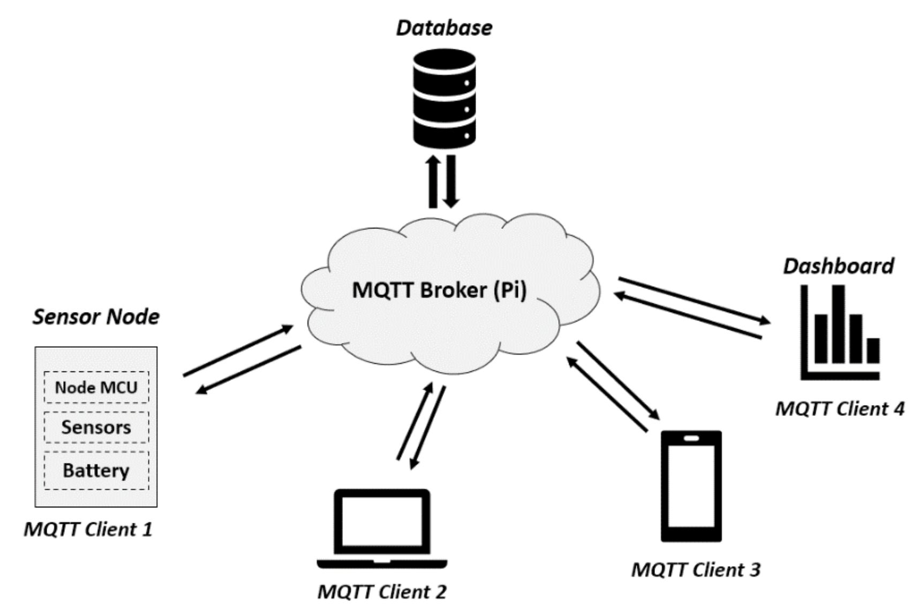
MQTT Overview

Slide 23
MQTT messages
A message is a term given to the data that’s shared between different MQTT clients. It can be some text, sensor readings, and so on.
MQTT topics
Topics are one of the essential components of this protocol. They provide you with a unique address for where your message should go. An MQTT topic is a series of strings separated by forward slashes. Each string before a forward slash indicates a new topic level.
MQTT clients
An MQTT client is any device that runs an MQTT connection package and connects to an MQTT broker over a local or internet network.

