Slide 1

Python Programming: NumPy
Pramote Kuacharoen

Slide 2
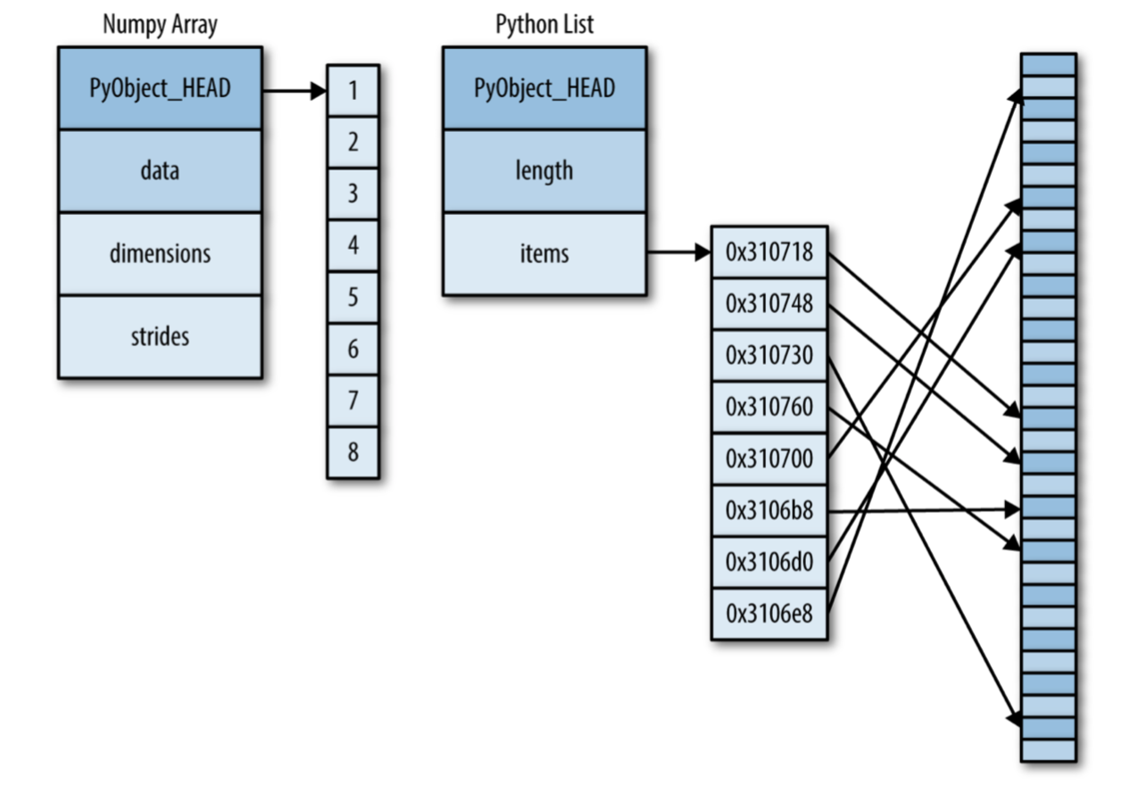
Difference between NumPy and Python Lists

Slide 3
Creating Arrays from Python Lists
NumPy arrays must contain the same type of data
import numpy as np
np.array([1, 2, 3, 4, 5])
np.array([3.14, 3, 4, 5], dtype='float32')
np.array(list(list(range(i, i+3)) for i in [2, 4, 6]))

Slide 4
Creating Arrays from Scratch
np.zeros(10, dtype=int)
np.ones((3, 5), dtype=float)
np.full((3, 5), 3.14)
np.arange(0, 20, 2)
np.linspace(0, 1, 5)
np.random.random_sample((3, 3))
np.random.normal(0, 1, (3, 3))
np.random.randint(0, 10, (3, 3))
np.eye(3)
np.empty(3)

Slide 5
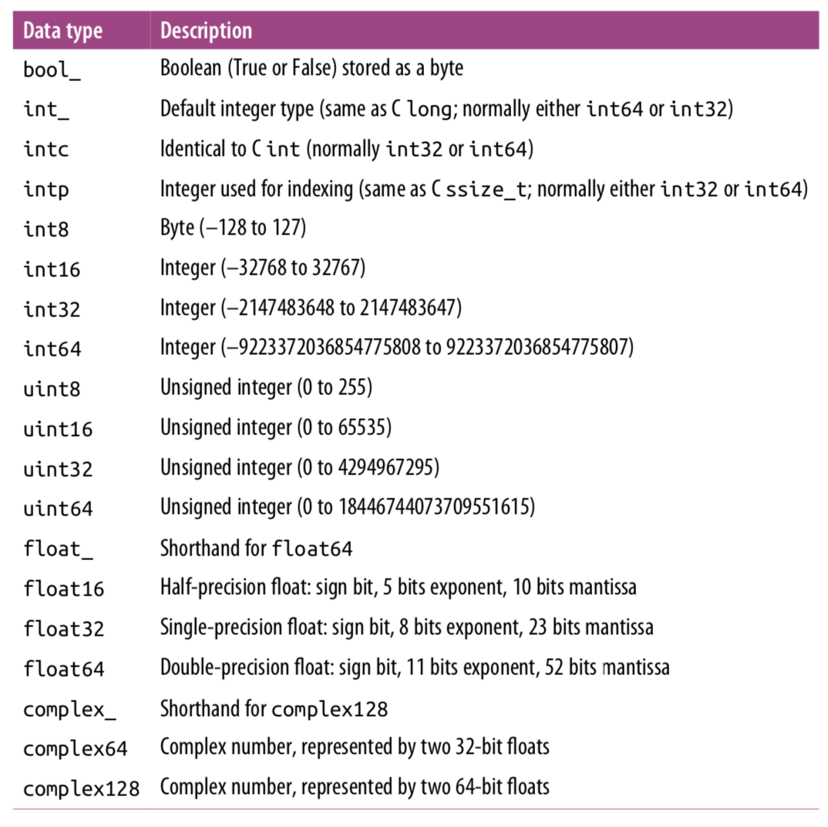
NumPy Standard Data Types

Slide 6
The Basics of NumPy Arrays
Attributes of arrays
Indexing of arrays
Slicing of arrays
Reshaping of arrays
Joining and splitting of arrays

Slide 7
NumPy Array Attributes
np.random.seed(0)
x1 = np.random.randint(10, size=6)
x2 = np.random.randint(10, size=(3, 4))
x3 = np.random.randint(10, size=(3, 4, 5))
print("x3 ndim: ", x3.ndim)
print("x3 shape: ", x3.shape)
print("x3 size: ", x3.size)

Slide 8
Array Indexing: Accessing Single Elements
In a one-dimensional array, you can access the ith value (counting from zero) by specifying the desired index in square brackets, just as with Python lists
To index from the end of the array, you can use negative indices
In [10]: x1
Out[10]: array([5, 0, 3, 3, 7, 9])
In [11]: x1[0]
Out[11]: 5
In [12]: x1[3]
Out[12]: 3
In [13]: x1[-1]
Out[13]: 9
In [14]: x2
Out[14]:
array([[3, 5, 2, 4],
[7, 6, 8, 8],
[1, 6, 7, 7]])
In [15]: x2[0, 0]
Out[15]: 3
In [16]: x2[2, -3]
Out[16]: 6

Slide 9
Array Slicing: Accessing Subarrays
In [17]: x = np.arange(10)
In [18]: x
Out[18]: array([0, 1, 2, 3, 4, 5, 6, 7, 8, 9])
In [19]: x[:5]
Out[19]: array([0, 1, 2, 3, 4])
In [20]: x[5:]
Out[20]: array([5, 6, 7, 8, 9])
In [21]: x[::2]
Out[21]: array([0, 2, 4, 6, 8])
In [22]: x[::-1]
Out[22]: array([9, 8, 7, 6, 5, 4, 3, 2, 1, 0])
In [29]: x2
Out[29]:
array([[3, 5, 2, 4],
[7, 6, 8, 8],
[1, 6, 7, 7]])
In [30]: x2[:2, :3]
Out[30]:
array([[3, 5, 2],
[7, 6, 8]])
In [31]: x2[::,::2]
Out[31]:
array([[3, 2],
[7, 8],
[1, 7]])

Slide 10
Accessing Array Rows and Columns
In [32]: x2
Out[32]:
array([[3, 5, 2, 4],
[7, 6, 8, 8],
[1, 6, 7, 7]])
In [33]: x2[:, 0]
Out[33]: array([3, 7, 1])
In [34]: x2[0, :]
Out[34]: array([3, 5, 2, 4])
In [35]: x2[0]
Out[35]: array([3, 5, 2, 4])

Slide 11
Subarrays as No-Copy View
One important—and extremely useful—thing to know about array slices is that they return views rather than copies of the array data
To copy the data within an array or a subarray use copy()

Slide 12
Reshaping of Arrays
Another useful type of operation is reshaping of arrays
The most flexible way of doing this is with the reshape() method
In [36]: grid = np.arange(1, 10).reshape((3,3))
In [37]: grid
Out[37]:
array([[1, 2, 3],
[4, 5, 6],
[7, 8, 9]])

Slide 13
Array Concatenation and Splitting
In [41]: x = np.array([1, 2, 3])
...: y = np.array([3, 2, 1])
...: np.concatenate([x, y])
Out[41]: array([1, 2, 3, 3, 2, 1])

Slide 14
Splitting of Arrays
In [46]: x = [1, 2, 3, 4, 5, 6, 7, 8, 9]
In [47]: x1, x2, x3 = np.split(x, [3, 5])
In [48]: print(x1, x2, x3)
[1 2 3] [4 5] [6 7 8 9]

Slide 15
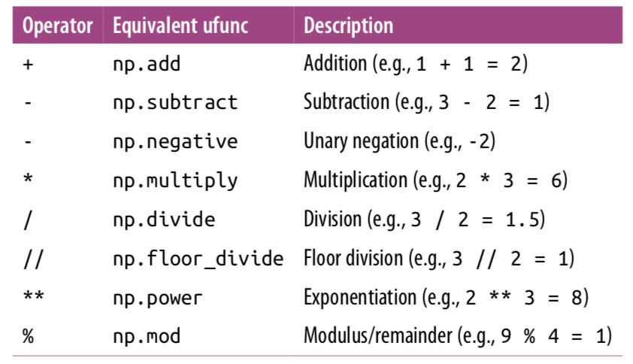
Arithmetic Operators Implemented in NumPy

Slide 16
Aggregates: reduce, min, max
We can use the reduce method to reduce an array with a particular operation
In [19]: x = np.arange(1, 6)
...: np.add.reduce(x)
Out[19]: 15

Slide 17
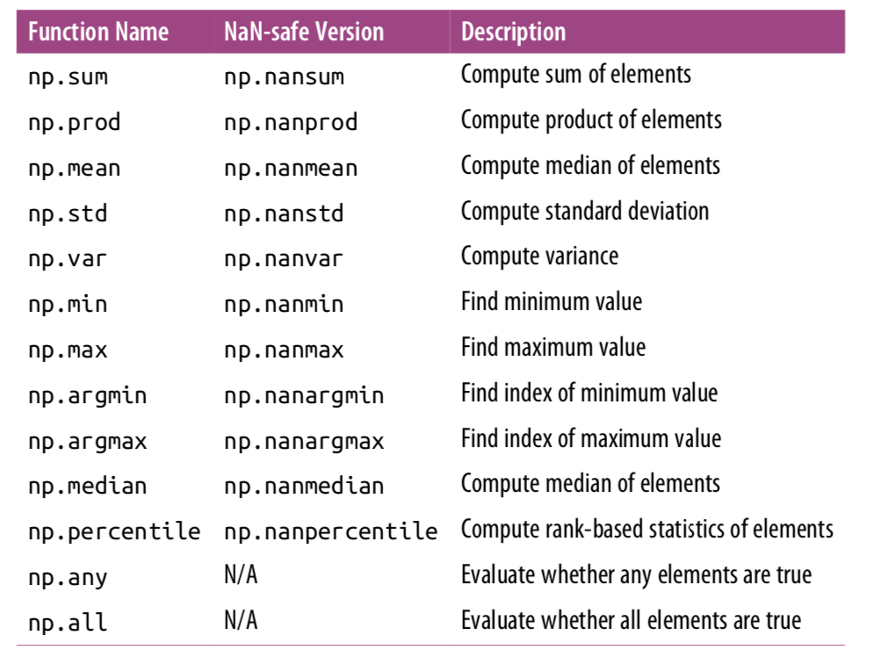
Aggregation Functions

Slide 18
Conditional Selections
In [50]: x = np.arange(1, 11)
In [51]: x
Out[51]: array([ 1, 2, 3, 4, 5, 6, 7, 8, 9, 10])
In [52]: x[x>4]
Out[52]: array([ 5, 6, 7, 8, 9, 10])

Slide 19
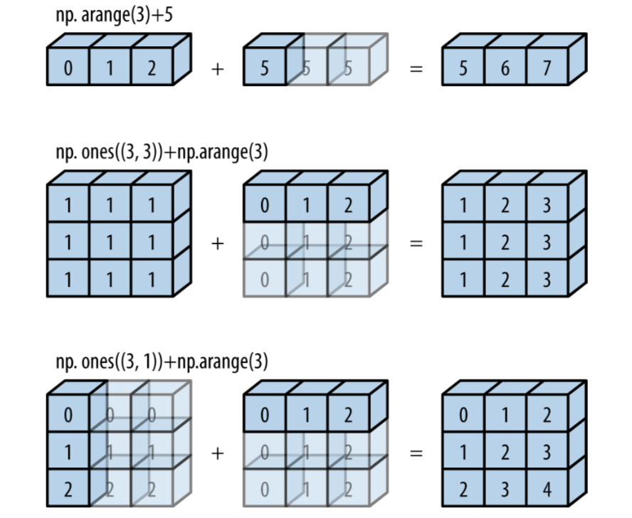
Computation of Arrays: Broadcasting
Broadcasting is simply a set of rules for applying binary ufuncs (addition, subtraction, multiplication, etc.) on arrays of different sizes
In [64]: import numpy as np
In [65]: a = np.array([1, 2, 3])
In [66]: b = np.array([4, 5, 6])
In [67]: a + b
Out[67]: array([5, 7, 9])

Slide 20
Rules of Broadcasting
Rule 1: If the two arrays differ in their number of dimensions, the shape of the one with fewer dimensions is padded with ones on its leading (left) side
Rule 2: If the shape of the two arrays does not match in any dimension, the array with shape equal to 1 in that dimension is stretched to match the other shape
Rule 3: If in any dimension the sizes disagree and neither is equal to 1, an error is raised

Slide 21
Importing Data with genfromtxt
np.genfromtxt(filename, delimiter=',’, skip_header=1, usecols=range(1, 7))
parameters | Description
delimiter | Splitting the lines into columns
autostrip | Strip whitespaces
skip_header | Skip header
skip_footer | Skip footer
usecols | Select which columns to import
converters | Convert data, {col: function}
filling_values
missing_values

Slide 22
Other Methods
np.cumsum
np.cumprod

