Slide 1

CI7104: Internet of Things
Sensors
Pramote Kuacharoen

Slide 2
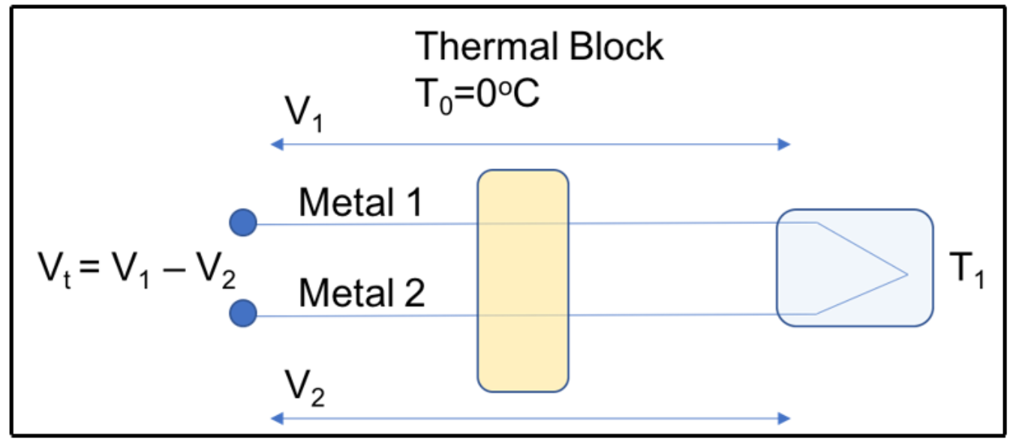
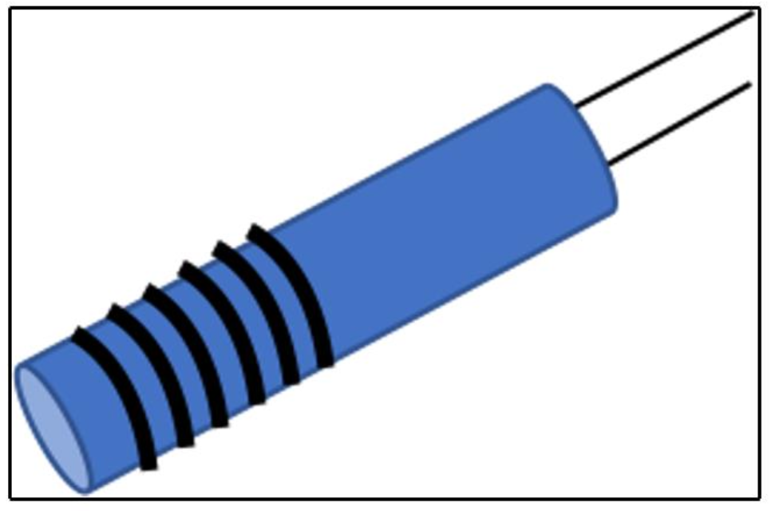
Thermocouples and Temperature Sensing
Thermocouples
Resistance temperature detectors
Thermistors

Slide 3
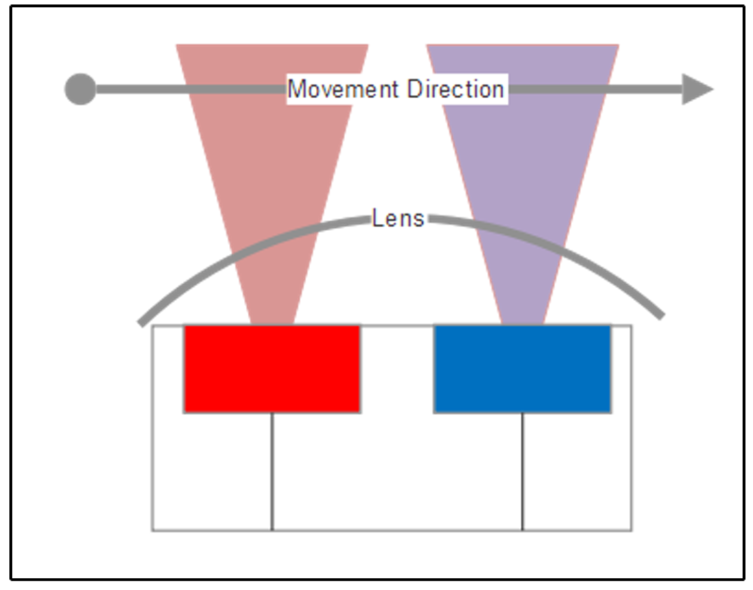
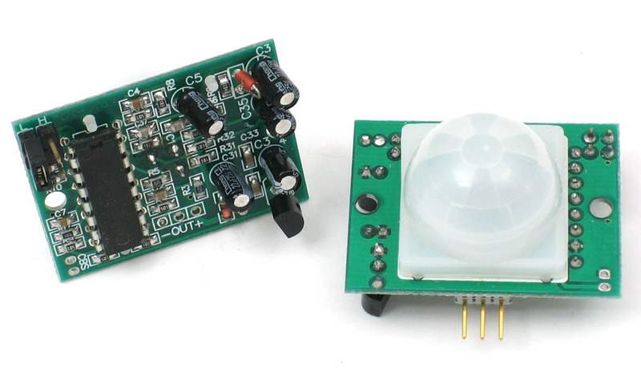
Photoelectric Sensors
PIR sensors (Pyroelectric Infrared, Passive Infrared)
LiDAR and active sensing systems
Light Detection and Ranging
measures the distance to a target by measuring a laser pulse reflection on the target
used pervasively in agriculture, automated and self-driving vehicles, robotics, surveillance, and environmental studies.
capable of analyzing anything that crosses its path
used to analyze gases, atmospheres, cloud formations and compositions, particulates, the speed of moving objects, and so on.

Slide 4
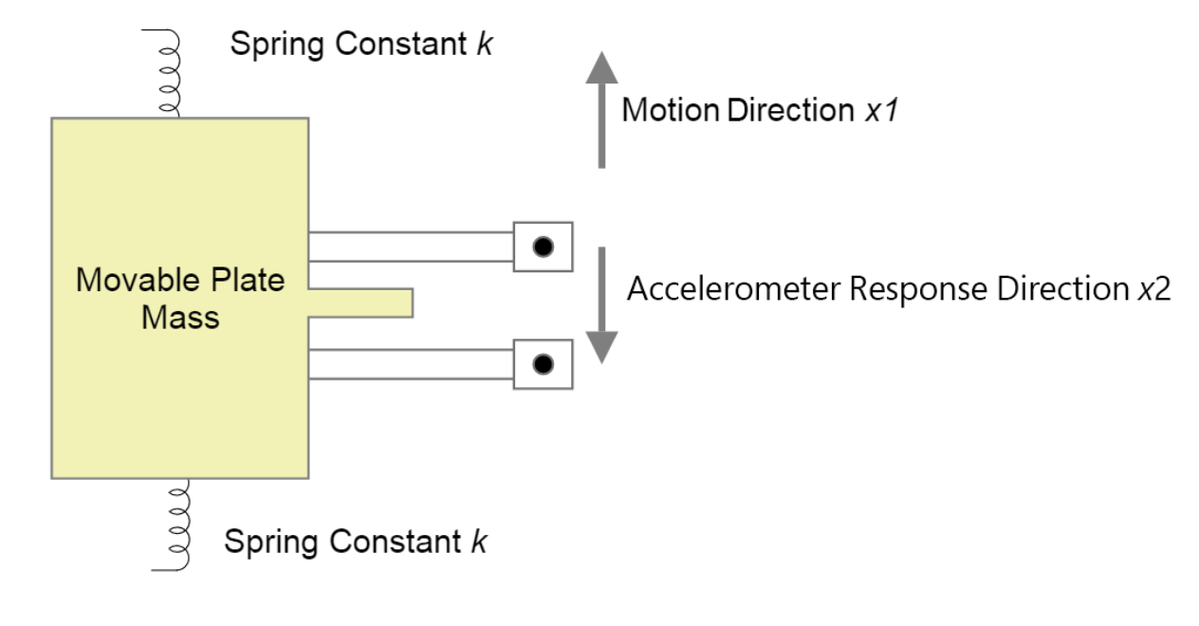
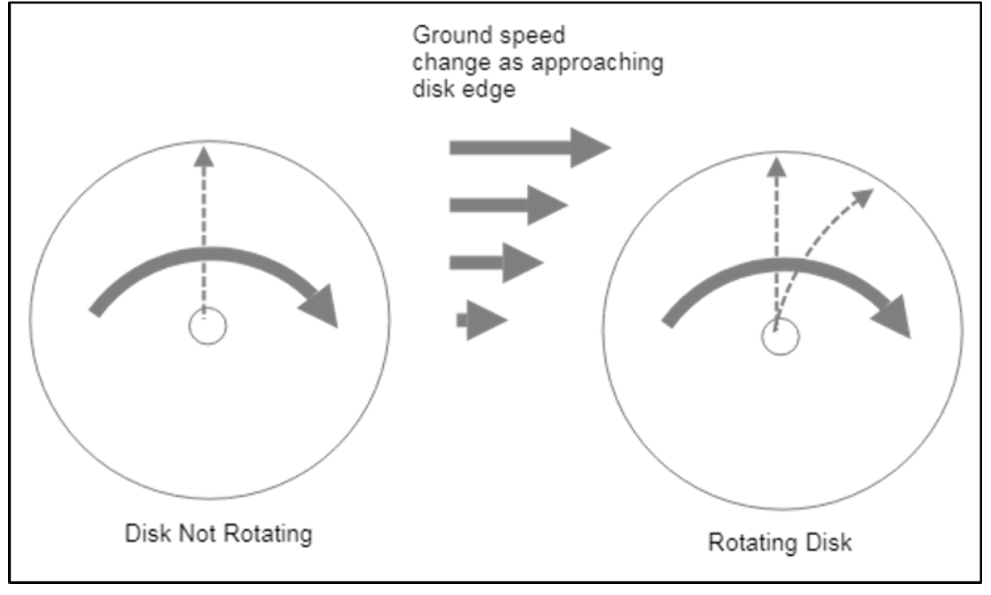
MEMS sensors
Microelectromechanical systems (MEMS)
Accelerometers
respond to changes in linear motion
Gyroscopes
detect rotational motion

Slide 5
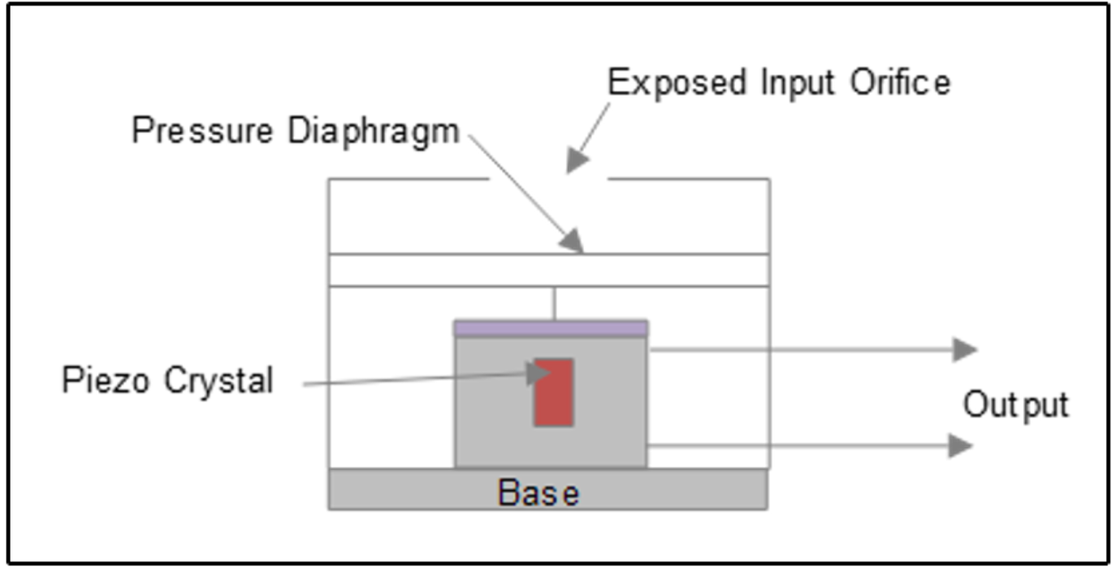
MEMS sensors
Microphones
MEMS devices can also be used for sound and vibration detection
sound and vibration measurements are common in the industrial IoT and predictive maintenance applications
Pressure sensors
Pressure and strain gauges are used in a variety of IoT deployments, from smart cities monitoring infrastructure to industrial manufacturing. These are typically
used to measure fluid and gas pressures.

Slide 6
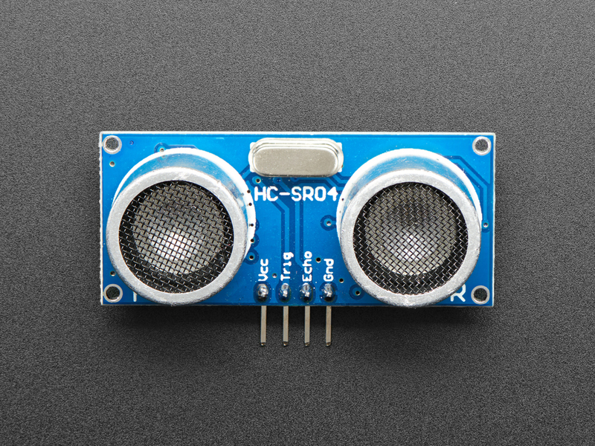
Ultrasonic Sonar Distance Sensors
Distance sensors are suitable for the detection, differentiation and measurement of objects by means of ultrasound.

