Slide 1
Distributed Learning of Pedestrian Behaviour
Student James Giller
Supervisor Dr Ken Brown

Slide 2

This is a wireless sensor node
It can communicate wirelessly.
It has limited resources
Memory
Battery Power
Processing Ability
It can connect to a network
Its sensors can gather data about the environment.

Slide 3
Energy requirements
To maximise battery life, a node must sleep most of the time.
Zzz…
It can communicate when awake
Zzz…
Only if a neighbour is available.

Slide 4


This is a wireless sensor network
Data flow
The closest nodes communicate with the data sink.
It gathers data about the environment..
Data sink
..and forwards it to a high memory machine.
Nodes pass messages over short distances.

Slide 5
This is a wireless sensor network
Need more machines as the network grows larger.
The closest nodes work too hard
What if the connection fails?
Data sink
This can be expensive
Scalability problems

Slide 6



Using mobile data sinks
Mobile data sinks visit different parts of the network.
Scalable
Flexible
Robust

Slide 7
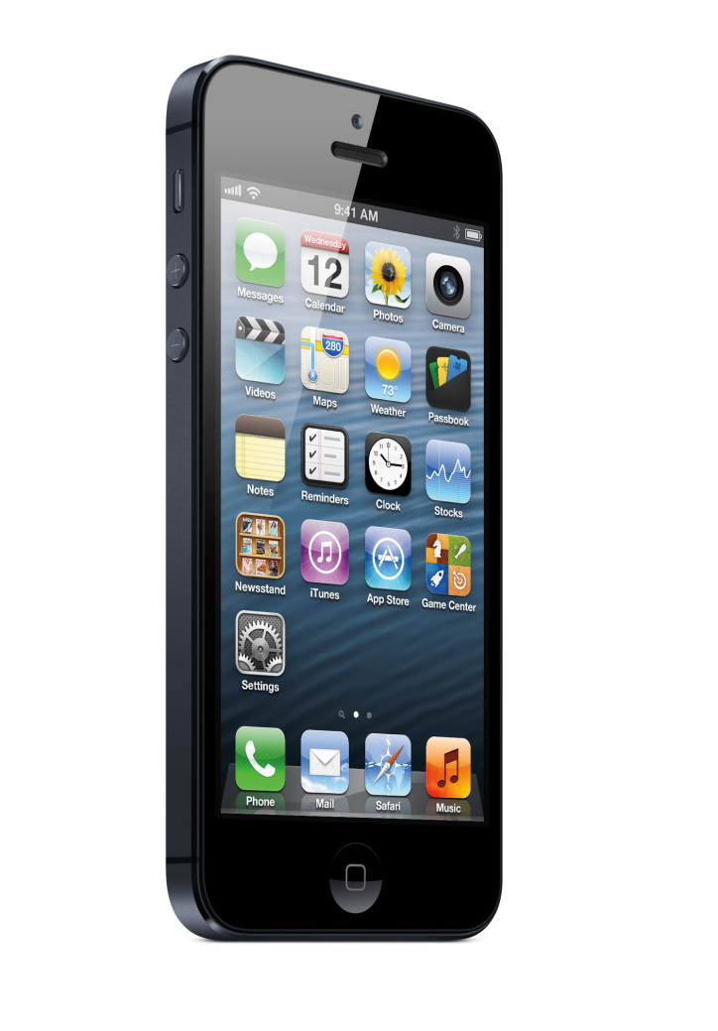
The idea
Exploit mobile consumer devices for data collection

Slide 8

The problem
Remember that a node must sleep to conserve battery.
How can the node know when to wake up?
Zzz…
Contact area

Slide 9

The solution
Time: 15:35
Zzz…
Learn patterns in pedestrian’s movements.
Contact area

Slide 10
How it works
A node periodically broadcasts beacon messages.
13:33 | 13:34 | 13:35
X | X | ✓
The pedestrian’s device can acknowledge a contact.
Contacts are recorded in a table.
Contact area

Slide 11
The learning table
The node decides on an action to perform based on utility values
State | HDC | LDC | SLEEP
… | … | … | …
12:00 | +87.309 | +106.597 | -24.789
12:05 | -61.943 | -43.392 | -24.802
12:10 | -60.066 | -43.318 | -24.802
12:15 | -61.035 | -42.725 | -24.802
12:20 | -60.066 | -40.69 | -24.802
… | … | … | …
The node makes decisions at these times.
Broadcast beacons at high frequency.
Broadcast beacons at low frequency.
Do not broadcast any beacons.
High Activity
Low Activity
No Activity

Slide 12
Rewards & Utility
Probe at Low Duty Cycle: Current Action
If there is a positive outcome to performing the action, e.g. a contact is made, the action and state it was performed in are rewarded.
Time: 12:00: Current State
Rewards accumulate over time in utility table
State | HDC | LDC | SLEEP
… | … | … | …
12:00 | +87.309 | +106.597 | -24.789
12:05 | -61.943 | -43.392 | -24.802
12:10 | -60.066 | -43.318 | -24.802
12:15 | -61.035 | -42.725 | -24.802
12:20 | -60.066 | -40.69 | -24.802
… | … | … | …

