Slide 1

MASTER1 INTELLIGENCE ARTIFICIELLE ET INTERNET DES OBJETS
Internet of Things - IoT
Korota Arsène COULIBALY ENSAM de Casablanca, Maroc
Année universitaire 2024-2025

Slide 2
Programme
Introduction to IoT
MQTT Protocol
IoT platform
Embedded system and end devices programmation

Slide 3
Objectifs du programme
Objectif principal :
Être capable de concevoir un système IoT
Objectifs pédagogiques:
Décrire un système IoT;
Décrire les systèmes embarqués;
Comprendre les contraintes des systèmes embaqués vis-à-vis de l’IoT;
Choisir et mettre en place une plateforme IoT;
Décrire et choisir le protocole de communication sans fil adapté pour son application IoT

Slide 4

Introduction to Internet of Things
Le problème de la collecte des récipients en verre en milieu urbain : un spectacle pas si inhabituel …
La solution : assurer la collecte des récipients en verre AVANT que la poubelle ne soit pleine.
Les moyens : équiper la poubelle
d’un capteur de niveau de remplissage qui alerte automatiquement le centre de collecte de ce qu’elle est presque pleine, et que donc, il faut la vider.
-> Internet des Objets

Slide 5
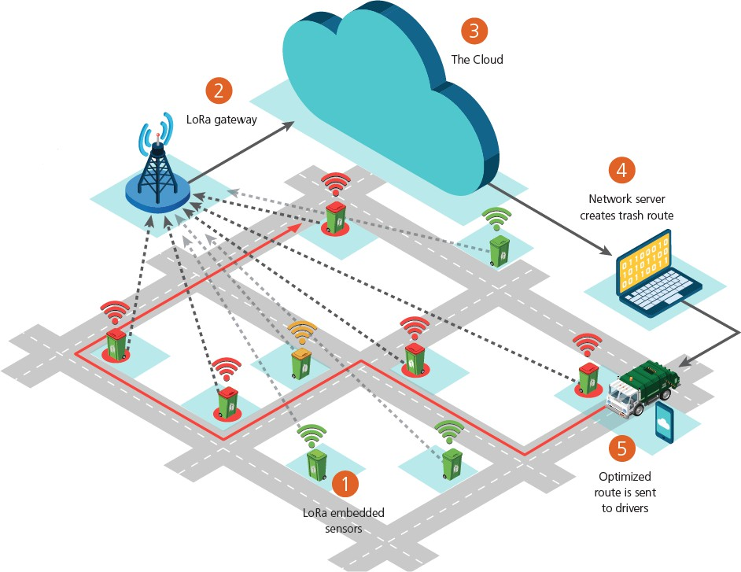
Introduction to Internet of Things
Les principales caractéristiques de l’IoT
Une couverture radio le plus large possible
Une interopérabilité avec les réseaux câblés, sans fil et cellulaires existants
Une transmission radio essentiellement unidirectionnelle (de l’objet vers la passerelle)
Une technologie radio faible consommation
Une transmission de données de faible volume, à bas débit et discontinue

Slide 6
Introduction to Internet of Things
Optimisation de la collecte des récipients en verre
Tous les jours, avant que ne débute la collecte, les poubelles (1) transmettent leur taux de remplissage (de 0 à 100%) à une passerelle (2).
Les informations collectées sont ensuite transmises à un serveur et mises à disposition sur le « cloud » (3).
L’opérateur chargé de la collecte des poubelles récupère les informations (4) et optimise sa tournée (5) de façon à ne collecter que les poubelles jugées suffisamment pleines.

Slide 7
Introduction to Internet of Things
L’IoT est un système dans lequel des objets appelés Nœuds (Node) ou End Devices collectent des données et les injectent directement sur le réseau internet ou via une passerelle (gateway). Ces objets sont capables de s’échanger des données.

Slide 8
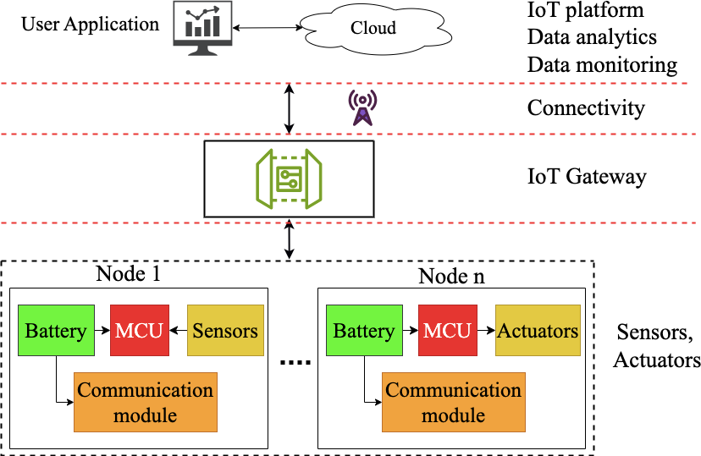
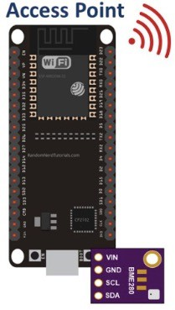

Introduction to Internet of Things

Slide 9
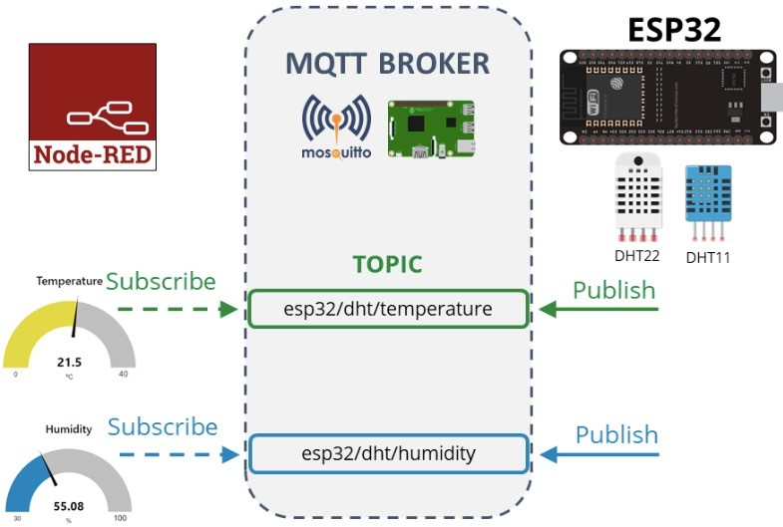
Introduction to Internet of Things

Slide 10
MQTT - Publisher - Broker - Subscriber
MQTT = Message Queuing Telemetry Transport
End device (ESP32 node)
MQTT
IoT Platform

Slide 11
MQTT - Publisher - Broker - Subscriber
BROKER

Slide 12
MQTT - Publisher - Broker – Subscriber
T° sensor
H° sensor
BROKER

Slide 13





MQTT - Publisher - Broker - Subscriber
Publisher
Publisher
T° sensor
H° sensor
BROKER
TOPIC Temperature
TOPIC Humidity
Subscriber
Subscriber
Heating system
Drying system

Slide 14
MQTT - Publisher - Broker - Subscriber
House
Room
I’m looking for the temperature in the bedroom of the house:
TOPIC → House/Room/T°sensor
H°
sensor
Noise sensor
I’m looking for the temperature in the living-room of the house:
TOPIC → House/Living-room/T°sensor
T°
sensor
Living-room
I’m looking for all the sensors in the house:
TOPIC → House/# or #
Noise sensor
I’m looking for all temperatures in the house:
TOPIC → House/+/T°sensor
H°
sensor
T°
sensor

Slide 15







MQTT - Publisher - Broker - Subscriber
MQTT characteristics
Publisher and subscriber don't know each other.
Infinite number of topics.
Topics are created by the publishers.
…
Authentication procedure to publish or subscribe to the broker.

Slide 16

MQTT – Demonstration with a public broker
Our demonstration
Publisher
Subscriber

Slide 17





MQTT – Demonstration with a public broker
Our demonstration
A famous one:
or
We could set up our own
We can use a public broker
Another example:
Client controlled by a Command Line Interface (CLI)
Publisher
Subscriber
MQTT
client
Client using Node-RED
Client with a standalone user interface
E.g.:

Slide 18



MQTT – Demonstration with a public broker
Our demonstration
or
Publisher
Subscriber
Client configuration:
Server we want to connect to
The Login and password for the connection
The topic we want to target (for publisher). The topic we want to read (for subscriber)
The message to send to the specified topic (for publisher)

Slide 19
MQTT – Demonstration with a public broker
Our demonstration
First part of the demonstration
Publisher
Subscriber
Second part of the demonstration
Publisher
Subscriber

Slide 20
IoT Platform architectures
IoT platform

Slide 21
IoT Platform architectures
IoT Platform solutions … There are plenty of them !
Our solutions:
IoT platform
Most of them are free & open-source
Can work both with uplink and downlink streams

Slide 22

IoT Platform architectures
HTTP
MQTT
Data collection and transfer
Example:
Data storage
HTTP and MQTT connections, Graphical UI, etc.
Data visualization
IoT platform
Web Server and UI

Slide 23



IoT Platform architectures
Our solution :
To connect our IoT Platform to our End device
To store data
HTTP
MQTT
Data collection and transfer
Data storage
Data visualization
IoT platform
To create dashboards and customize our User Interface
Web Server and UI

Slide 24

IoT Platform architectures
Our solution :
To connect our IoT Platform to our End device
MQTT broker
To store data
MING Stack
Mosquitto InfluxdB NodeRED Grafana
IoT platform
To create dashboards and customize our User Interface

Slide 25



IoT Platform architectures
Another solution:
To connect our IoT Platform to our End device
ELK Stack
Elasticsearch Logstash Kibana
To store data
IoT platform
To create dashboards and customize our User Interface

Slide 26
IoT Platform architectures
Another way:
Use an IoT platform without creating one.
IoT platform
A professional service !
Not free
Good choice for a big project

Slide 27




Our IoT platform solution
Our solution :
LDR value
Potentiometer value
LEDs state
End-device
Gateway 1
IoT platform

Slide 28

Our IoT platform solution
Our solution :
NodeRED acts as a subscriber to get uplinks, and as a publisher to send downlinks.
End
device
MQTT (uplink)
MQTT (downlink)

Slide 29
Our IoT platform solution
Our solution :
NodeRED acts as a subscriber to get uplinks, and as a publisher to send downlinks.
Influxdb is a software installed separately.
End
device
MQTT (uplink)
Data to save
MQTT (downlink)

Slide 30
Our IoT platform solution
Our solution :
NodeRED acts as a subscriber to get uplinks, and as a publisher to send downlinks.
Influxdb is a software installed separately.
Grafana requests the data it needs for the creation of graphs, etc.
End
device
MQTT (uplink)
Data to save
Data to display
MQTT (downlink)

Slide 31
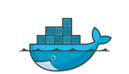
Our IoT platform solution
Our solution :
End
device
MQTT (uplink)
Data to save
Data to display
MQTT (downlink)
How to install these services ?
With Docker !
Where can we set up this IoT platform ?
Anywhere !
In our case: Raspberry pi

Slide 32
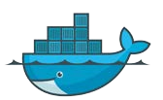
Our IoT platform solution
Our solution :
End
device
MQTT (uplink)
Data to save
Data to display
MQTT (downlink)
Public Server
Organization example:
Public Server
Public Server
Container talk to each other thanks to an IP address on a specific port.

Slide 33

Our IoT platform solution
Our solution:
Everything is on the same public server
NodeRED UI
Influxdb UI
Grafana UI
Port 3000
End
device
Port 1880
Port 8086
MQTT communication
Access Influxdb
Access Influxdb
Port 1883
Port 8086
Port 8086

Slide 34




Our IoT platform specifications
Let’s build our IoT Platform !
Our requirements:
1 dashboard with Temperature, LDR value, potentiometter value, LEDs state
Steps to achieve our goal:
Step 1 Build an MQTT subscriber on Node-RED to get the uplink data.
Extract the exact value we want: the temperature LDR value, potar value, LEDs state. Send the extracted values to Influxdb.
Check our data are available on Influxdb.
Step 2
Tell Grafana how it can access the database. Create a request to get the values we need.
Step 3

Slide 35
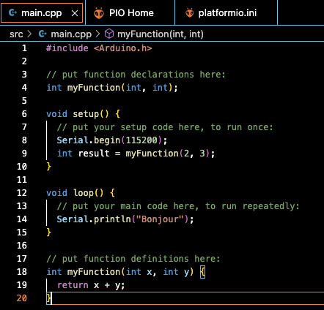
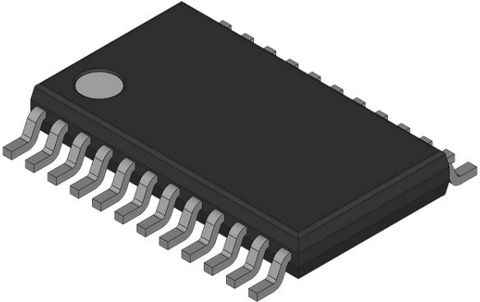
Embedded systems
Embeddded system = Hardware part + Software part
electronic
User application

Slide 36
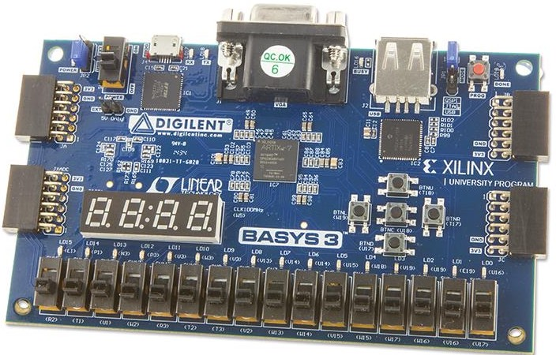
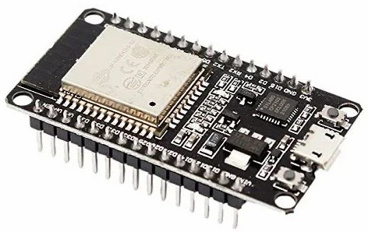
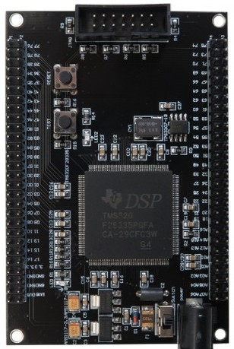
Embedded systems – Hardware architecture
The embedded hardware is where the software (user application) will be embedded. It may be a microcontroller board or a CPU based board.
MCU based board
Microcontroller
DSP based board
FPGA based board

Slide 37
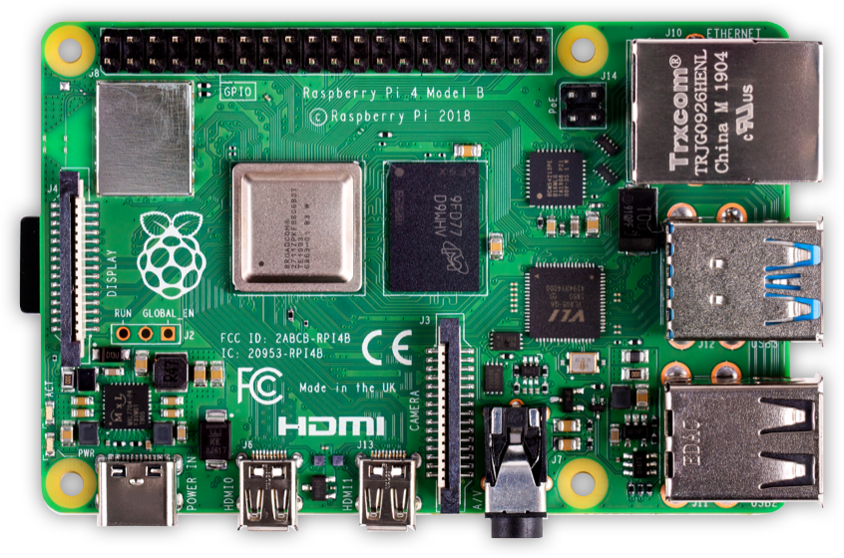

Raspberry pi
Operating System
Raspberry pi OS
Ubuntu
Windows 10 Arm
Single board computer
Single board computer

Slide 38
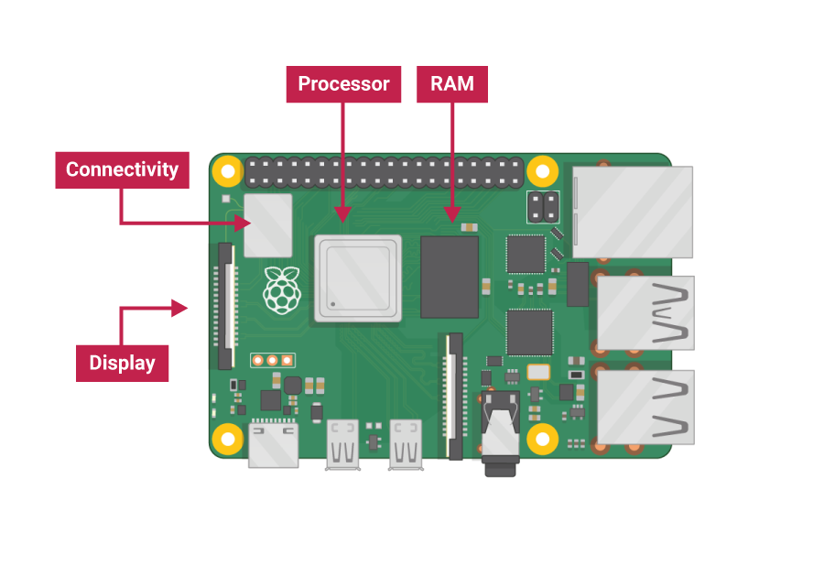
Raspberry pi

Slide 39
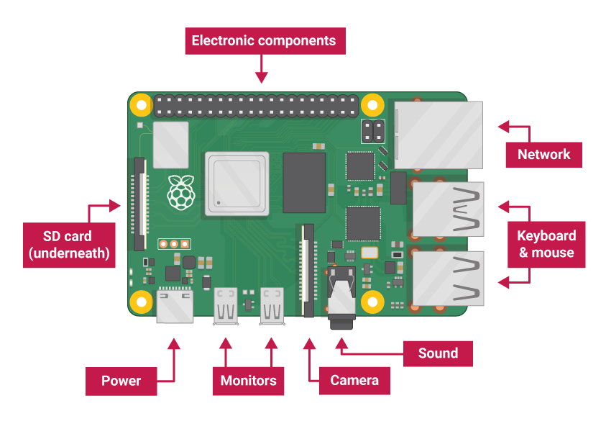
Raspberry pi

Slide 40
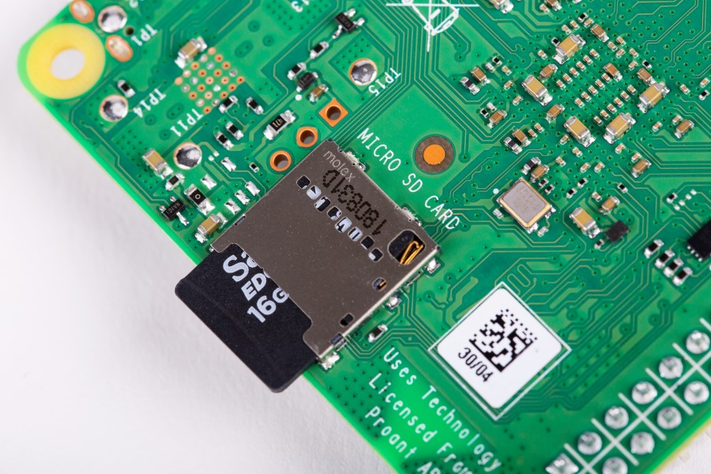
Raspberry pi

Slide 41
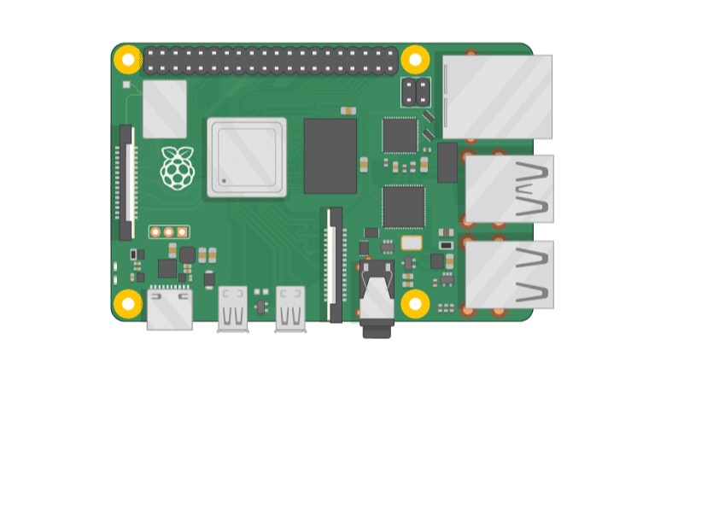
Raspberry pi

Slide 42
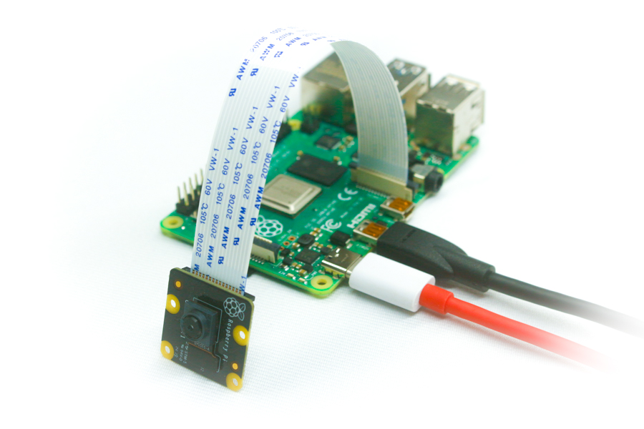
Raspberry pi

Slide 43
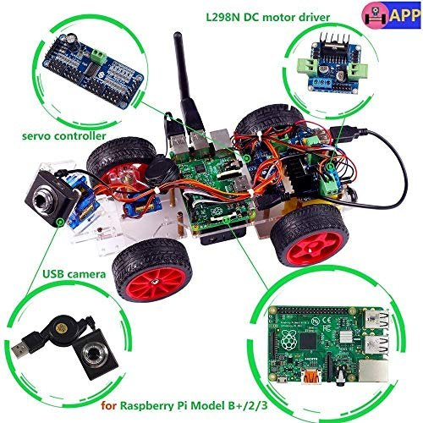
Raspberry pi

Slide 44
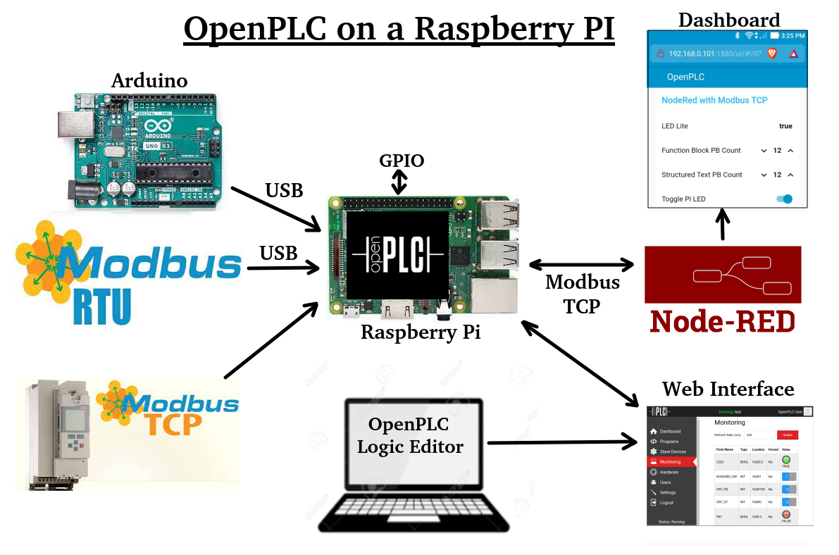
Raspberry pi

Slide 45

Embedded systems – Hardware architecture
ESP boards: ESP32 & ESP8266
ESP32 and ESP8266 are series of MCU chips developed by Espressif.
Why ESP32 ?
Low cost : 150Dh
Low energy consumption
WiFi & Bluetooth
Two cores : Xtensa 32 bits
I/O interfaces : ADC DAC, SPI, I2C, UART, PWM
Supports Arduino programming language and MicroPython

Slide 46

Embedded system – Hardware architecture
ESP boards: ESP32 & ESP8266

Slide 47
Embedded system – Hardware architecture
ESP boards: ESP32 & ESP8266
How to program ESP boards ?
Espressif IDF (IoT Development Framework)
Arduino C/C++ with Arduino ESP core:
MicroPython
In this course we’ll used Arduino with PlatformIO

Slide 48
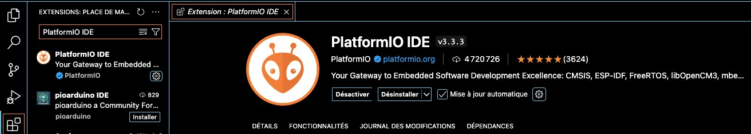
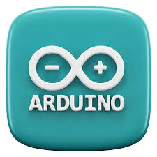
Embedded system – Hardware architecture
ESP boards: ESP32 & ESP8266
Configuration of development environment
Download and install
Install PlatformIO extension in VS Code

Slide 49
Embedded system – Hardware architecture
ESP boards: ESP32 & ESP8266
Configuration of development environment
1. Download and install Arduino sw
2. Install esp32 and esp8266 Arduino core
3. Add esp32 and esp8266 boards url in Arduino sw
ESP32 url : http://arduino.esp8266.com/stable/package_esp8266com_index.json
ESP8266 url: https://raw.githubusercontent.com/espressif/arduino-esp32/gh-pages/package_esp32_index.json
Copy two url and colle in :
File -> Preferences -> Additional boards manager urls

