Slide 1

MASTER1 INTELLIGENCE ARTIFICIELLE ET INTERNET DES OBJETS
Internet of Things - IoT
Korota Arsène COULIBALY ENSAM de Casablanca, Maroc
Année universitaire 2024-2025

Slide 2

A serial link connection
Serial link
Entity 1
Entity 2

Slide 3
a serial link connection
Serial link settings
Serial link settings
Serial link
TX RX
RX TX
Entity 1
Entity 2

Slide 4














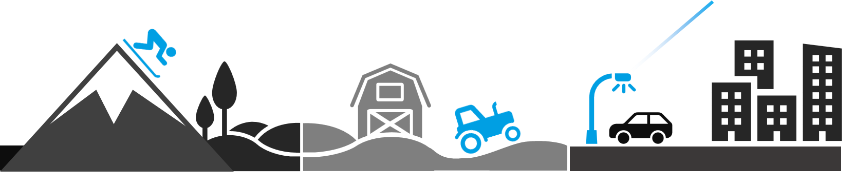


LoRa and LoRaWAN® for the Internet of Things

Slide 5

LoRa and LoRaWAN® for the Internet of Things

Slide 6

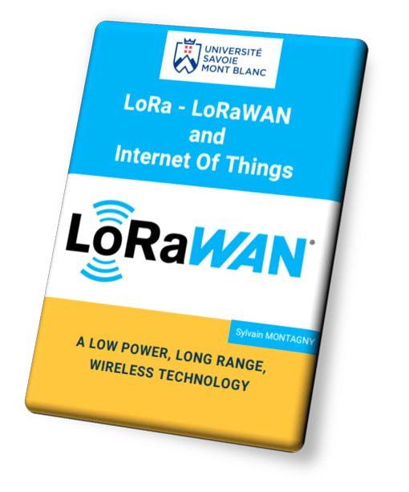
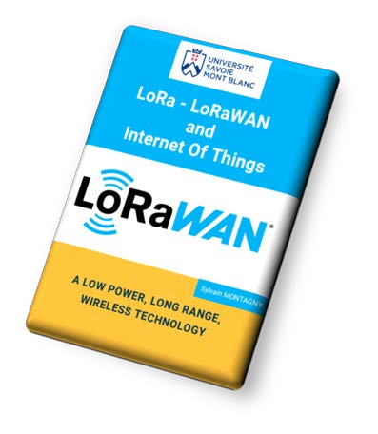

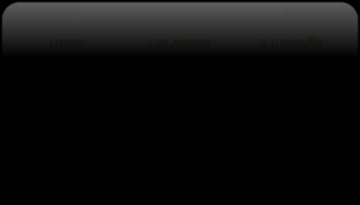


www.univ-smb.fr/lorawan/en/

Slide 7









www.univ-smb.fr/lorawan/en/

Slide 8

Device A
Device B

Slide 9


Device A
Gateway 1
Bandwidth, channels, Spreading Factor, RSSI, SNR, Sensitivity, etc

Slide 10
Low Power
Application Server
Network Server
Network Server
Application Server
Gateway
Data Rate
Class A
End-device
Device A
Gateway 1

Slide 11


User Application
Network Server
Application Server
Device A
Gateway 1
Database

Slide 12
User Application
Network Server
Application Server
Device A
Gateway 1
Database
Complete IoT solution with LoRaWAN

Slide 13
Embedded systems &
Internet of Things
Characteristics of embedded systems
The protocols used in IoT
How can thousands of devices can transmit at the same frequency

Slide 14
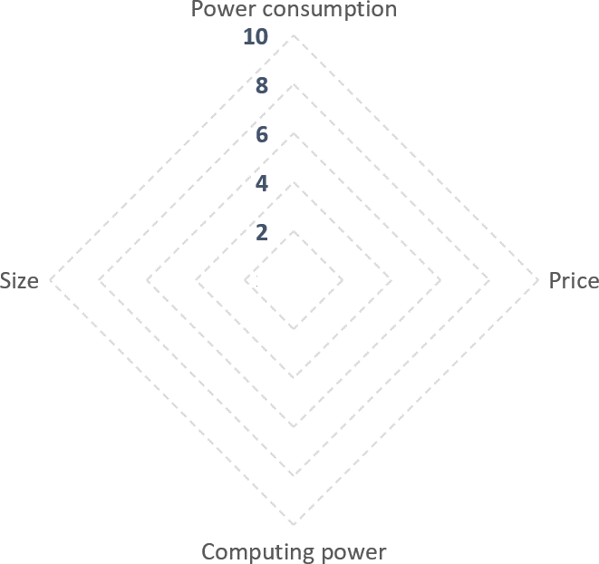


Embedded systems and IoT

Slide 15
Protocols used in IoT
Bit rate (bps)
5G
WiFi
4G
3G
Bluetooth
2G
Zigbee
LoRa,
SigFox
NFC
Range

Slide 16


The free frequency bands
Free bands in Europe:
No need for authorization
Free of charge
Frequencies | Examples of protocols
13.56 Mhz | NFC
433 MHz | LoRa
868 MHz | Sigfox, LoRa
2.4 Ghz | WiFi BLE Zigbee
5 Ghz | WiFi
LoRa end-device
Network Server
868 MHz
868 MHz

Slide 17
Frequency Division Multiplexing
Frequency channels
8 devices !
867 MHz
869 MHz
868 Mhz band
8 channels Uplinks
Downlinks
1 channel
1 channel Downlinks
Frequency in Mhz
867.1
867.3
867.5
867.7
…

Slide 18
Spread Spectrum
Colors
868 Mhz band
1 channel
Spreading Factor
DEV 4
DEV 3
DEV 10
6 SF
DEV 2
DEV 7
DEV 9
DEV 1
DEV 6
DEV 8
Frequency in Mhz
867.1
867.3 867.5 867.7 …
x 8 channels = 48 devices
6 devices

Slide 19

Time Division Multiplexing
LoRa message DURATION
50ms – 2s
868 Mhz band
LoRaWAN
Time Division Multiplexing
1 sec
1 channel
DEV 4
DEV 3 |  |  | DEV 10
DEV 2 | DEV 7 |  | DEV 9
DEV 1 | DEV 6 |  | DEV 8
99 sec
≈ 1 sec
Frequency in Mhz
867.1
867.3
867.5
867.7
…
1% of the time
100 sec
x 48 devices
= 4800 devices

Slide 20


LET’S RECAP
LoRa is a "long distance" and "low speed" protocol
It transmits on channels in the 868 MHz band
LoRa uses Spreading Factors :
SF5, SF6, SF7, SF8, SF9, SF10, SF11 and SF12
If two LoRa devices are using different SF :
  They can transmit at the same time on the same channel

Slide 21
LET’S RECAP : Exercise
What does IoT mean?
What’s the most used frequency for LoRaWAN in Europe
Can two LoRa devices send data on the same channel at the same time?
Explain briefly the techniques used by LoRa to enable many devices to send data at the same time on the same channel

Slide 22
Radio Transmission and propagation
Units and definitions: Decibel, dBm, RSSI, Sensitivity and SNR
Examples and studies of technical documentation

Slide 23
Units and definitions : Decibel - 1
dB: Ratio between two powers
An attenuation A gain
→ represented by a negative number (-).
→ represented by a positive number (+).
PT
PR
dB ?
Power ratio in dB | Power ratio
10 dB | Multiplication by 10
3 dB | Multiplication by 2
0 dB | Equality
-3 dB | Division by 2
-10 dB | Division by 10
PR = 10 PT PR = 2 PT PR = PT
PR = PT/2
PR = PT/10
𝑃_{𝘙}
𝐺 = 10log( )
𝑑𝐵
𝑃
𝑇
Interest ?
dB

Slide 24


Units and definitions : Decibel - 2
Transmitter
Receiver
Air
PT : 90 dB attenuation
P_{T} : Transmit power
P_{R} : Received power
P_{R} is 1 billion times smaller than P_{T}
Power ratio in dB | Power ratio
+ 10 dB | Multiplication by 10
+3 dB | Multiplication by 2
0 dB | Equality
-3 dB | Division by 2
-10 dB | Division by 10
𝑃_{𝑇} = 10 ⁹ × 𝑃_{𝘙}
= 10 × 10 × 10… × 𝑃_{𝘙}
𝟗 𝑡𝑖𝑚𝑒𝑠
𝐺_{𝑑𝐵} = 10 + 10 + 10 … = 90dB

Slide 25


The decibel for power : dBm
dBm : Ratio (in decibel) between a power and the power of 1mW
x10 → 10 mW x2 → 2 mW 1 mW
0,5 mW
0,1 mW
The walkie-talkie has a transmission power of 2W. What is the transmission power in dBm?
𝑃_{𝑇} = 1𝑚W
^{𝑃}𝑇(𝑑𝐵𝑚) ⁼
Power in dBm | Power ratio
10 dBm | Multiplication by 10
3 dBm | Multiplication by 2
0 dBm | Equality
-3 dBm | Division by 2
-10 dBm | Division by 10
× 1𝟏𝟏 × 1𝟏𝟏 × 1𝟏𝟏
× 𝟐𝟐
= 𝟐𝟐W
𝟏𝟏
+ 1𝟏𝟏
+ 1𝟏𝟏
+ 1𝟏𝟏
+ 𝟑𝟑
= 𝟑𝟑𝟑𝟑𝑑𝐵𝑚

Slide 26

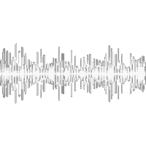
Definitions: RSSI, Sensitivity, SNR
We want:
Transmitter
Receiver
P_{R} : Received power
^{P}R ≈ ^{P}T
P_{N} : Noise power
P_{B}
≈ 0
P_{T} : Transmitted power
Noise
RSSI (Received Signal Strength Indication): power P_{R} of the received signal
RSSI > Sensitivity RSSI < Sensitivity
Sensitivity: minimum RSSI to receive a signal
SNR (Signal over Noise Ratio): Ratio of P_{R} and P_{N}
P_{R}/P_{N}

Slide 27
Definitions: RSSI, Sensitivity, SNR
A transmitter delivers a power of 13 dBm using an antenna with a gain of 2 dB gain. The air loss is 60 dB. The receiving antenna has a gain of 2 dB and is connected to a receiver with a sensitivity of -80 dBm.
Will the signal be received?
Noise measured on the receiver is -50dB. Calculate SNR

Slide 28
Example - 1
A transmitter uses 13dBm with a 2dBi gain antenna. The air loss is 60dB. Then a 2dBi gain antenna is connected to a receiver with a -80dBm sensitivity.
Will the signal be received? YES
The noise on the receiver is measured at -50dBm. What is the SNR?
SNR = 7 dB
Transmitter
Receiver
Air
2)
𝑆𝑁𝘙_{𝑑𝐵} = 𝑃_{𝘙} − 𝑃_{𝑁}
= 𝘙𝑆𝑆𝐼 − (−𝟓𝟓𝟏𝟏)
= 𝟕𝟕𝑑𝐵
Radio Antenna
Antenna Radio
1)
+2dBi
-60dB
13dBm
-43dBm = PR = RSSI
+2dBi
-80dBm Sensitivity

Slide 29

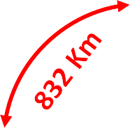


Definitions: Link Budget
Transmitter
Receiver
LINK BUDGET
= 0dBm –(-110dBm)
= 110dBm
=-20dBm – (-120dBm)
Air
Radio Antenna
Antenna Radio
PT = 0 dBm |  | -100 dBm Sensitivity
LINK BUDGET
PT = - 20 dBm
-120 dBm Sensitivity
Link Budget: P_{T} - Sensitivity
  In LTE (4G): 130 dB
BIG LINK BUDGET
LONG DISTANCE
In LoRa: 157 dB

Slide 30
Example - 2
A transmitter uses 13dBm with a 2dBi gain antenna. The air loss is 60 dB. Then a 2dBi gain antenna is connected to a receiver with a -80dBm sensitivity.
3) What is the link budget ?
Transmitter
Receiver
3)
𝐿𝑖𝑛𝑘 𝐵𝑢𝑑𝑔𝑒𝑡 = 1𝟑𝟑 𝑑𝐵𝑚 −
= 𝟗𝟗𝟑𝟑 𝑑𝐵𝑚
−𝟖𝟖𝟏𝟏 𝑑𝐵𝑚
Air
Radio Antenna
Antenna Radio
13dBm
-80dBm Sensitivity

Slide 31
Reception on Gateway
"gateways":
{
"time": "2020-04-29T12:09:45.563621044Z",
"channel": 0,
"rssi": -13,
"snr": 9.8
}

Slide 32
Example of LoRa transceiver documentation
Study of the characteristics of the SX1272
Study of the characteristics of the SX1276
Spreading Factor and SNR (page 25)

Slide 33
LET’S RECAP
The decibel helps to represent ratio (dB) or power (dBm).
RSSI is the power received.
If the RSSI is above the receiver sensitivity, the transmission is successful.
The Link budget evaluate the potential of the transmission.
The SNR is the ratio between the signal and the noise.
With a high SF, the reception capabilities are improved (sensitivity and SNR)
What about the bitrate ?

Slide 34
LoRa modulation Physical Layer
The LoRa frame
LoRa bitrate: Spreading Factor, Coding Rate, Bandwidth, Time-On-Air and Duty-Cycle
The simulation of a LoRa transmission
The consumption and the autonomy of a LoRa device

Slide 35
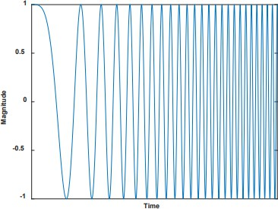
The Chirp (symbol) - 1
Chirp Spread Spectrum Modulation
0 to 125 kHz
or
0 to 500 kHz
BANDWIDTH (BW)

Slide 36
The Chirp (symbol) - 2
Frequency
A symbol
A symbol
+ 62,5kHz
868 162 500 Hz
125kHz
868 100 000 Hz
- 62,5kHz
868 037 500 Hz
Time
A symbol duration

Slide 37
The Chirp (symbol) - 3
Example with 2 bits
00
01
10
11
4 symbols
Symbol 0
Bits "00"
Symbol 1
Bits "01"
Symbol 2
Bits "10"
Symbol 3
Bits "11"
868 162 500 Hz
868 100 000 Hz
868 037 500 Hz
Time
X-bits representation → SFX (5 to 12)

Slide 38
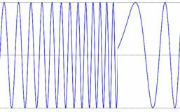
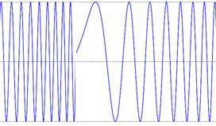
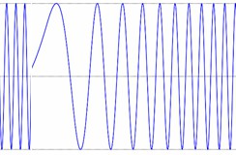
The LoRa frame - 1
10 bits = 1024 conbinations
0 1 0 1 1 1 0 0 0 1 1 0 0 1 0 0 0 1 1 0 1 0 0 1 1 0 0 1 0 0 0 1 1 0
SF10
Sending 1 Chirp
Sending 1 Chirp
Sending 1 Chirp
Transmission
Transmission
Transmission

Slide 39

The LoRa frame - 2
1024 frequency possibilities
Frequency
125kHz
Time
1 symbol

Slide 40
The LoRa frame - 1
10 bits = 1024 conbinations
0 1 0 1 1 1 0 0 0 1 1 0 0 1 0 0 0 1 1 0 1 0 0 1 1 0 0 1 0 0 0 1 1 0
SF10
Sending 1 Chirp
Sending 1 Chirp
Sending 1 Chirp
duration
Transmission
Transmission
Transmission

Slide 41
Symbol duration
Frequency
Time symbol in SF 12
^{𝑇}𝑆𝑦𝑚𝑏𝑜𝑙._{𝑆𝐹1𝟐𝟐} ^{= 2× 𝑇}𝑆𝑦𝑚𝑏𝑜𝑙._{𝑆𝐹11}
Time symbol in SF 11
SF7
High frequency
SF8
SF9
_{𝟐} ^{S. F}
^{𝑇𝑆𝑦𝑚𝑏𝑜𝑙 =} 𝐵𝑎𝑛𝑑w𝑖𝑑𝑡ℎ
SF10
Center frequency
SF11
SF12
𝐵𝑎𝑛dw𝑖𝑑𝑡ℎ
𝐵𝑖𝑡𝑟𝑎𝑡𝑒 = 𝑆𝐹 ×
_{𝟐} 𝑆. 𝐹
Low frequency
Time

Slide 42
LoRa bitrate
𝐵𝑎𝑛𝑑w𝑖𝑑𝑡ℎ
Case 1: For SF7, 125 kHz
Bit Rate = 𝑆𝐹
_{𝟐} 𝑆. 𝐹
𝐵𝑎𝑛dw𝑖𝑑𝑡ℎ
Case 2: For SF12, 125 kHz
Bit Rate = 𝑆𝐹
_{𝟐} 𝑆. 𝐹
𝑆𝐹
𝐵𝘙

Slide 43
Bit rate
Case 1: For SF7, 125 kHz
Bit Rate =
Case 2: For SF12, 125 kHz
Bit Rate =
𝐵𝘙 = 𝑓(𝑆𝐹, 𝐵W, … ? )

Slide 44
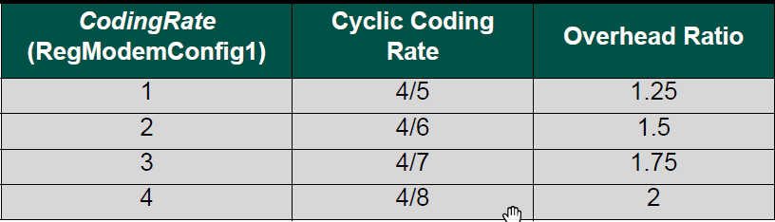
Coding Rate
𝐵𝑖𝑡 𝘙𝑎𝑡𝑒 = 𝑓(𝑆𝐹 + 𝐵W + CodingRate
)
4
5
4 8
Overhead Ratio
Additional bits Detect and correct errors
Case 1: For SF7, 125 kHz and CR4/5 > Bit Rate =
Case 2: For SF12, 125 kHz and CR4/5 > Bit Rate =
𝟔. 8 3 6
5469 bps
1,25
366
293 bps
1,25

Slide 45
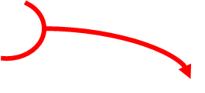
LoRa Frame
Data
1-byte
Preamble
Header
Payload
CRC
LoRa frame
Previously, Bit Rate was:
Real Bit Rate is:
^{𝑆𝐼𝑍𝐸}𝑝𝑎𝑦𝑙𝑜𝑎𝑑
𝐵𝑖𝑡 𝘙𝑎𝑡𝑒 =
^{𝑆𝐼𝑍𝐸}𝑝𝑎𝑦𝑙𝑜𝑎𝑑
𝐵𝑖𝑡 𝘙𝑎𝑡𝑒 =
^{𝑇𝐼𝑀𝐸}𝑝𝑎𝑦𝑙𝑜𝑎𝑑
^{𝑇𝐼𝑀𝐸}𝑓𝑟𝑎𝑚𝑒
TIME ON AIR

Slide 46

LoRa Frame
Real Bit Rate is:
^{𝑆𝐼𝑍𝐸}𝑝𝑎𝑦𝑙𝑜𝑎𝑑
𝐵𝑖𝑡 𝘙𝑎𝑡𝑒 =
^{𝑇𝐼𝑀𝐸}𝑓𝑟𝑎𝑚𝑒
TIME ON AIR
Speed capacity
Previously, Bit Rate was:
^{𝑆𝐼𝑍𝐸}𝑝𝑎𝑦𝑙𝑜𝑎𝑑
𝐵𝑖𝑡 𝘙𝑎𝑡𝑒 =
^{𝑇𝐼𝑀𝐸}𝑝𝑎𝑦𝑙𝑜𝑎𝑑
100 km/h
5km/h 100km/h
70km/h
𝐽𝑜𝑢𝑟𝑛𝑒𝑦 𝑑𝑖𝑠𝑡𝑎𝑛𝑐𝑒
Average speed =
𝐽𝑜𝑢𝑟𝑛𝑒𝑦 𝑡𝑖𝑚𝑒

Slide 47
LoRa Frame
Real Bit Rate is:
^{𝑆𝐼𝑍𝐸}𝑝𝑎𝑦𝑙𝑜𝑎𝑑
𝐵𝑖𝑡 𝘙𝑎𝑡𝑒 =
Previously, Bit Rate was:
^{𝑆𝐼𝑍𝐸}𝑝𝑎𝑦𝑙𝑜𝑎𝑑
𝐵𝑖𝑡 𝘙𝑎𝑡𝑒 =
^{𝑇𝐼𝑀𝐸}𝑝𝑎𝑦𝑙𝑜𝑎𝑑
^{𝑇𝐼𝑀𝐸}𝑓𝑟𝑎𝑚𝑒
TIME ON AIR
𝟖𝟖
_{𝟐𝟐𝟓𝟓, 𝟖𝟖𝟓𝟓. 1𝟏𝟏−𝟑𝟑} = 𝟑𝟑𝟏𝟏𝟗𝟗, 𝟑𝟑 𝐛𝐛𝐛𝐛𝐛𝐛
Case 1: For SF7, 125 kHz and CR4/5 >
Bit Rate =
𝟖𝟖
𝟖𝟖𝟐𝟐𝟕𝟕, 𝟑𝟑𝟗𝟗. 1𝟏𝟏^{−𝟑𝟑 = 𝟗𝟗, 𝟔𝟔 𝐛𝐛𝐛𝐛𝐛𝐛}
Case 2: For SF12, 125 kHz and CR4/5 > Bit Rate =

Slide 48
LoRaWAN Frame
Data
1-byte
Preamble
Header
Payload
CRC
LoRa frame

Slide 49
LoRaWAN Frame
Data
1-byte
Preamble
Header
Payload
CRC
LoRa frame
Preamble
Header
LoRaWAN Header
Payload
CRC
LoRaWAN frame
Time On Air ?

Slide 50
LoRaWAN Frame
Preamble
Header
LoRaWAN Header
Payload
CRC
LoRaWAN frame
Time On Air
46,3 ms (SF7)
1155,1 ms (SF12)
𝟖𝟖
_{𝟓𝟓𝟔𝟔, 𝟑𝟑. 1𝟏𝟏−𝟑𝟑} = 1𝟕𝟕𝟐𝟐, 𝟕𝟕 𝐛𝐛𝐛𝐛𝐛𝐛
Case 1: For SF7, 125 kHz and CR4/5 >
Bit Rate =
𝟖𝟖
11𝟓𝟓𝟓𝟓, 1. 1𝟏𝟏^{−𝟑𝟑 = 𝟔𝟔, 𝟗𝟗 𝐛𝐛𝐛𝐛𝐛𝐛}
Case 2: For SF12, 125 kHz and CR4/5 > Bit Rate =

Slide 51
Duty-cycle in LoRaWAN (EU868)
LoRa transmission
8 channels Spreading Factor
Limit the transmission time
1% of the time
1𝟕𝟕𝟐𝟐, 𝟕𝟕
Case 1: For SF7, 125 kHz and CR4/5 >
Bit Rate =
= 1, 𝟕𝟕𝟑𝟑 𝐛𝐛𝐛𝐛𝐛𝐛
1𝟏𝟏𝟏𝟏
𝟔𝟔, 𝟗𝟗
= 𝟏𝟏, 𝟏𝟏𝟕𝟕 𝐛𝐛𝐛𝐛𝐛𝐛
1𝟏𝟏𝟏𝟏
Case 2: For SF12, 125 kHz and CR4/5 > Bit Rate =

Slide 52
Energy consumption
Time On Air
(Spreading Factor, Data, BW, Coding Rate)
Collisions
(Confirmations, retransmissions)
Duty-Cycle Transmit power Low power mode

Slide 53
The LoRaWAN protocol
LoRaWAN ecosystem
  Specification
  LoRa vs LoRaWAN
LoRaWAN infrastructure
  Device
  Gateway
  LoRaWAN Server
LoRaWAN Security
Device classes
Activation methods: ABP or OTAA
How to …
  … prevent replay attack?
  … change the communication parameters?
  … change Network operator?
Optimization of the communication: ADR

Slide 54


LoRa vs LoRaWAN

Slide 55






LoRa vs LoRaWAN
→ Type of modulation (Chirp)
Device A
Gateways
Network Server
Application Server
Device B
→ Secured and standardized protocol

Slide 56


LoRaWAN protocol versions
2015
2020
1.0.0 1.0.1 1.0.2 1.0.3 1.0.4
In this course
2015
2017
1.0
1.1
1.2
1.01
1.0 1.1
Specification
LoRaWAN
Regional Parameters
Network Server
Application Server
Device
Gateways

Slide 57

LoRaWAN network infrastructure
LoRaWAN frame
= User Payload + Security information
User Application
Network Server
Application Server
HTTP
or
MQTT
Gateway 1
Cloud Services
Device A
IoT platform
LoRa modulation
Gateway 2
Internet
Web protocols

Slide 58
LoRaWAN network infrastructure
Network Server
Application Server
Gateway 1
Device A
Gateway 2
Internet

Slide 59
LoRaWAN Network Server and Application Server
CONFIDENTIALITY
Nobody can understand what the end-device says
SECURITY
INTEGRITY
Nobody can change the transmitted frame
AUTHENCITY
Only allowed end-device can send on the Network Server

Slide 60
LoRaWAN Network Server and Application Server
INTEGRITY AUTHENCITY
CONFIDENTIALITY
25°C
Device 1
AppSKey_1
Network Server
Application Server
!j%u#
NwkSKey_1
Gateway 1
DevAddr_1
NwkSKey_1
App?2S?5?K°eCy_1
DevAddr_1
Device 2
AppSKey_2
ms?# 2
NwkSKey_2
100°C
WHAT YOU NEED:
NwkSKey
AppSKey
DevAddr

Slide 61
LoRaWAN end-device Classes
Packet transmission time
= TIME ON AIR
Network Server
Application Server
Gateway 1
1% Time duration
= DUTY CYCLE
Device A
Gateway 2
UPLINK
Downlink ?
DOWNLINK
End-device classes
A or B or C

