Slide 1



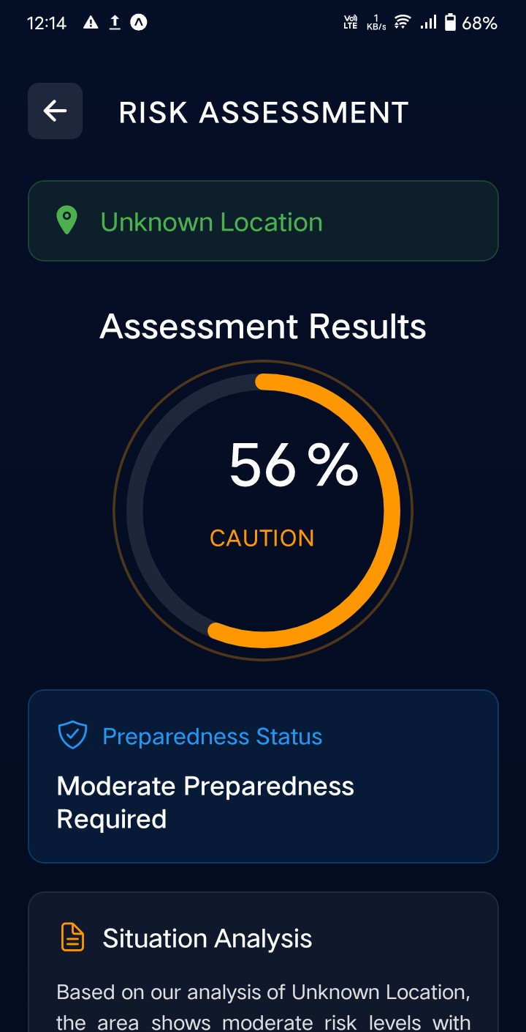

D E M O
ASSESSMENT RESULTS
INPUT

