Slide 1


Concurrent GARTH (Genetic AlgoRiTHms) using C++11
A Concurrent Framework for Genetic Algorithms
J. Caleb Wherry
Virginia Tech
Department of Engineering Science & Mechanics

Slide 2

Outline
Introduction & Motivations
Genetic Algorithms
Application Area
Concurrent Methods
Results & Conclusions

Slide 3
Intro & Motivations

Slide 4
Genetic Algorithms

Slide 5
Application Area

Slide 6
Concurrent Methods

Slide 7
Results & Conclusions
Cross- Compiler / Cross-Platform Results
 | Windows 7 | Mac OS 10.8 | Linux - Ubuntu 12.04 LTE
GNU GCC 4.8 |  | ✓ | ✓
Clang 3.4 | ✓ | ✓
MinGW 4.8 | ✓
MSVC 18.0 | ✓
Intel 14.0 | ✓

Slide 8
Results & Conclusions
Mini-Benchmark Performance Results

Slide 9
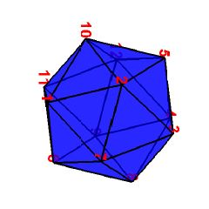
Questions
Questions &| Comments?
N = 12

