Slide 1


Concurrent GARTH (Genetic AlgoRiTHms) using C++11
A Concurrent Framework for Genetic Algorithms
J. Caleb Wherry
Virginia Tech
Department of Engineering Science & Mechanics

Slide 2


Outline
Introduction & Motivations
Application Area
Genetic Algorithms & Framework
Concurrent Methods & Implementation (Timing)
Results
Future Work

Slide 3
Intro & Motivations
Problem Statement:
Create a cross-platform Genetic Algorithm framework using native C++11 features
Goals:
Integrate concurrent principles wherever possible
Apply framework to real world problem
Test cross-compiler / cross-platform C++11 standard support
Specifically new native thread support
Performance benchmark of framework against sequential GAs
Software Engineering Notes:
Open Source (MIT License)
http://github.com/calebwherry/Concurrent-GARTH
Cmake build system
Cross-compiler/cross-platform development
Python wrapper for cross-platform testing
Library Unit Tests (Google Test)
Travis-CI (Continuous Integration)

Slide 4
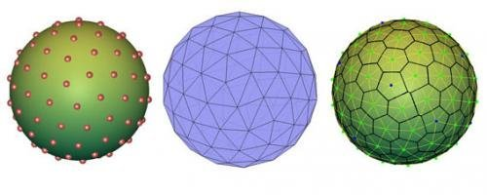
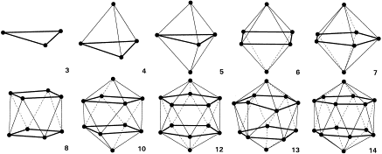
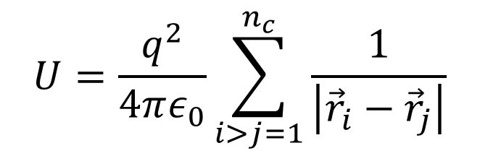
Application Area
Thomson Problem
Minimize Electrostatic Energy Between All Charged Particles
GA nomenclature: Fitness Function
$$U=\frac{q^{2}}{4πε_{0}}\sum_{i>j=1}^{n_{c}}{\frac{1}{\left|{\vec{r}}_{i}−{\vec{r}}_{j}\right|}}$$

Slide 5
Genetic Algorithms
Based on principles from Darwin’s Origin of Species
Natural Selection
Very powerful for non-linear optimization problems
Selection & Mutation drive exploration of search space
Larger population = better searching of space
Create Initial (Random) Population
Selection
Select based on fitness function
Crossover (Mating)
Pick organisms to mate
No
Mutation
Mutate certain %
Converged?
Check convergence (hard!)
Yes
Done!

Slide 6

Genetic Algorithm Framework
std::unique_ptr<Zoo> (“Galapagos”)
std::unique_ptr<ZooKeeper>(“Darwin”)
Habitat N
Trainer 1
Trainer 2
…
Trainer N
Habitat 1
Habitat 2
…
Trainer 1
Trainer 1
Trainer 2
Trainer 2
…
…
Trainer N
Trainer N
*Habitat = CPU, Trainer = Core/Thread, Cow = Organism

Slide 7
Results
Cross-Compiler / Cross-Platform Results
 | Windows 7 | Mac OS 10.8 | Linux - Ubuntu 12.04 LTE
GNU GCC 4.8 | - | ✓ | ✓
Clang 3.4 | ✓ | ✓ | -
MinGW 4.8 | ✓ | - | -
MSVC 18.0 | ✓ | - | -
Intel 14.0 | ✓ | - | -

Slide 8
Results
Mini-Benchmark Performance Results
Intel® Core™ i5-2500K CPU @ 3.30GHz (4 core)
Results averaged over 5 runs
No speedup, wat?!
Not using ThreadPool?
Overhead of OOP?
Bad Design?
Simple organism fitness?
Number Particles | T = 1 | T = 2 | T = 3 | T = 4
N=4 | 0.76831 | 0.78415 | 0.80762 | 0.80893
N=6 | 1.12857 | 1.13520 | 1.13676 | 1.13939
N=8 | 2.20581 | 2.21002 | 2.20900 | 2.20811
N=12 | 3.39890 | 3.39945 | 3.39669 | 3.39931
N=20 | 10.10100 | 10.10144 | 10.10119 | 10.10109

Slide 9
Future Work
Deeper scalability testing on hardware with many cores
Xeon Phi (57+ cores)
Fully Implement ThreadPool and Barrier
Reason why mini-performance results are not good.
Not native to C++11, might be in C++14 or C++17?
Scalability testing using HPC Systems
MPI (not done for this project since not natively supported)
Memory Testing
Does OOP design effect anything? Probably
Does overhead of std::shared_ptr<T>, etc effect anything?
Parallelize other parts of GA
Mutation, selection, sorting, etc.

Slide 10
References
[1] M. Herlihy and N. Shavit. The Art of Multiprocessor Programming. Morgan Kaufmann Publishers, 2012.
[2] M. K ̈ppen and E. Dimitriadou. Concurrent Application of Genetic Algorithm in Pattern Recognition, pages 868–877. IOS Press, Amsterdam, The Netherlands, The Netherlands, 2003.
[3] T. Pang. Introduction to Computational Physics. Cambridge University Press, Cambridge, 2006.
[4] A. Williams. C++ Concurrency In Action: Practical Multithreading. Manning Publications, 2012.
[5] http://tracer.lcc.uma.es/problems/thomson/img/electr.gif
[6] https://www.maths.unsw.edu.au/sites/default/files/imagecache/default_content/me100im1.jpg

Slide 11
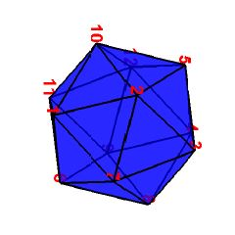
Questions
Questions &| Comments?
N = 12, ~10,000 generations

