Slide 1

GlucoTwin
A diabetes digital twin that predicts glucose spikes 30 minutes to 2 hours before they happen
Digital Twin Challenge 2026 · Team hackers_ · IIT (ISM) Dhanbad · Team leader: Korra Santhosh
Notes:
Introduce the team: hackers_ from IIT (ISM) Dhanbad, presented by team leader Korra Santhosh. GlucoTwin is a proof-of-concept digital twin for people with diabetes: it fuses the patient record with continuous glucose and wearable data, and warns 30 minutes to 2 hours before glucose goes above 180 mg/dL.

Slide 2

Diabetes care in India is still reactive
101 M
Repeated high glucose (> 180 mg/dL) drives eye, kidney, nerve and heart damage.
A continuous glucose monitor alarms only after glucose is already high.
Doctors see past readings, not where this patient is heading next.
Indians living with diabetes
136 M
Our question, asked every 15 minutes for every patient:
Will glucose go above 180 mg/dL in the next 30 minutes, 1 hour or 2 hours?
more with prediabetes (ICMR-INDIAB, 2023)
Notes:
India has about 101 million people with diabetes and 136 million with prediabetes (ICMR-INDIAB, Lancet Diabetes & Endocrinology 2023). Hyperglycaemia causes long-term complications, yet monitoring is reactive. We want a forward-looking view.

Slide 3




Our digital twin fuses two data streams and looks ahead
Static stream: EHR
Dynamic stream
The twin
Doctor dashboard
Age, BMI, diabetes type and duration, complications, medicines, HbA1c and other labs
CGM glucose, insulin, meals, heart rate, steps — every 5 to 15 minutes
111 fused features → three models (30 min, 1 h, 2 h), each with accuracy and safety alert modes
Live timeline, risk cards, patient record and a replay of what really happened
Notes:
The twin has two inputs, exactly as the challenge asks: a static clinical record and a dynamic sensor stream. They are fused into one feature vector; three models give the risk for three horizons; the doctor sees it on a dashboard.

Slide 4
Built only on open, anonymised data: 187 people, Type 1 and Type 2
Dataset | People | Diabetes | What it adds
ShanghaiT2DM | 100 | Type 2 | Real clinical record (labs, drugs, history)
ShanghaiT1DM | 12 | Type 1 | Real clinical record
HUPA-UCM (Spain) | 24 | Type 1 | Fitbit heart rate, steps, calories
AZT1D (USA) | 25 | Type 1 | Insulin-pump data, carbohydrates
T1D-UOM (UK) | 17 | Type 1 | Insulin, meals, heart rate, steps
BrisT1D (UK) | 9 | Type 1 | Insulin, meals, smartwatch
OhioT1DM (USA) | 12 | Type 1 | External test only — never trained on
187
people for training & testing
≈ 530 k
prediction moments per horizon
Open data
CC BY 4.0 research datasets*
* BrisT1D is published under CC BY 4.0; we used its Kaggle competition copy, whose rules we have not separately verified.
Notes:
Every training dataset is openly available and anonymised, as the challenge rules require. The 100 Type 2 patients from Shanghai are the closest open match to the Indian population and come with a real clinical summary. OhioT1DM is under a data-use agreement, so we only use it locally as an unseen external test.

Slide 5






We found and fixed six data problems before any modelling
Duplicated readings
Hidden future leak
Mixed units
BrisT1D stored each reading up to 72 times; stitched into one timeline (0 conflicts in 11.4 M values)
HUPA-UCM gaps were filled by straight lines toward the NEXT reading; removed
mmol/L vs mg/dL, carbs in grams vs 10-g portions, basal U/h vs units
Missing ≠ zero
Different sensor speeds
Leak-proof by test
"Not recorded" kept separate from "none"; long-acting insulin spread over 24 h
5-min and 15-min CGMs put on one common 15-minute grid
100+ automated tests: changing future data never changes a past feature
Notes:
Most of the real work was data engineering. Each of these problems would silently inflate or corrupt accuracy; we caught them with sanity checks and lock them down with tests.

Slide 6
111 fused features feed three horizon-specific models (123 in the v9 2-hour model)
Stream features · 80
EHR features · 31
Glucose level, change, slope, acceleration, 30-min projection
Rolling mean, spread, min, max (30 min – 4 h)
Insulin on board, carbs on board, last meal
Heart rate, steps, energy
Personal memory: spikes at this time on the last 7 days
Age, sex, BMI, smoking, alcohol
Diabetes type and duration, complications
HbA1c, glycated albumin, fasting and post-meal glucose, C-peptide
Lipids, creatinine, eGFR
Drug classes: insulin, metformin, SGLT2, DPP-4, GLP-1 …
HistGradientBoosting × 3
One model per horizon: 30 min, 1 h, 2 h
Accuracy mode and safety mode thresholds
Each person weighted equally
2-hour model v9: +12 history and trend features
Runs live in under a second
Notes:
Stream features describe the last minutes to days of glucose, insulin, meals and activity, and the person's own history at this time of day. EHR features come from the clinical record. Gradient-boosted trees handle missing values natively, which matters because not every dataset has every signal.

Slide 7
Every number is measured on people the model never saw
1
Person-grouped 7-fold CV
A person is never in training and testing at once
2
Nested thresholds
Alert thresholds chosen inside the training folds only
3
Leave-one-dataset-out
Train on 4 datasets, test on a 5th
4
External test: OhioT1DM
New hospital, devices and patients
5
Bias & fit audit
Sex, age, BMI, diabetes type, time of day, calibration, train-vs-test gap
Notes:
The most common mistake in glucose prediction is testing on the same people you trained on. We never do that: all numbers come from people held out of training, with thresholds tuned without seeing them, plus a fully external dataset.

Slide 8
Early warning that works: 94.7% at 30 minutes, 84.9% at 2 hours
Next 30 min
Next 1 hour
Next 2 hours
94.7%
91.1%
84.9%
accuracy on unseen people
accuracy on unseen people
accuracy on unseen people
ROC-AUC 0.983
Spikes caught 86.4% (safety mode 92.3%)
OhioT1DM external: 94.5%
ROC-AUC 0.956
Spikes caught 77.8% (safety mode 85.3%)
OhioT1DM external: 90.6%
ROC-AUC 0.913
Spikes caught 68.9% (safety mode 76.7%)
OhioT1DM external: 83.7%
Notes:
These are the headline results on 187 held-out people. The 95% confidence intervals are about ±0.4 to ±0.9 points. On the external Ohio dataset, never used in training, performance is essentially the same, which shows the model generalises.

Slide 9
GlucoTwin beats the "already high" rule, and the margin grows with the horizon
Accuracy on people the model never saw (%)
Why a baseline matters
If glucose is already above 180, a spike "in the next 30 minutes" is almost certain. That rule alone is right most of the time.
The twin adds the hard part: spotting rises from normal glucose. Its ranking quality (AUC 0.91 at 2 h) is far above the rule's.
100
95
94.7
94.5
93.7
91.1
90.6
90
89.7
84.9
85
83.7
82.5
80
75
30 min
1 hour
2 hours
Simple rule (glucose > 180 now)
GlucoTwin (cross-validation)
GlucoTwin on OhioT1DM (external)
Notes:
We always compare with the simplest possible rule. Short horizons are easy for both; the further ahead we look, the more the model adds. Ohio, the external test, tracks the cross-validation closely.

Slide 10
Strongest for Type 2 diabetes, and fair across patient groups
Accuracy by diabetes type (%)
Group (Type 2 & Type 1, Shanghai) | 2-h accuracy | Calibration gap
Women | 90.0% | 0.2 pts
Men | 89.5% | -0.8 pts
Age < 40 | 92.5% | 0.2 pts
Age 40–60 | 89.4% | -0.7 pts
Age 60+ | 89.4% | -0.2 pts
BMI < 23 | 89.4% | -0.3 pts
BMI 23–27.5 | 89.1% | -0.6 pts
BMI 27.5+ | 94.8% | 0.9 pts
100
96.4
95
94.3
93.8
90.4
89.8
90
85
83.6
80
75
30 min
1 hour
2 hours
Type 1 (87 people)
Type 2 (100 people)
Notes:
Type 2 patients, the main group in India, get the most accurate predictions. Accuracy is similar for women and men and across age and BMI groups, and predicted risk matches the observed rate within about one point in every group.

Slide 11


What we learned by testing every idea
Helped
Did not help (measured, not guessed)
More diverse patients: 21 → 187 people from 4 countries
Personal memory: "spikes at this time in the last 7 days"
Cleaning the data (removing a future leak, fixing units)
Shorter horizons for urgent alerts; safety-mode thresholds
Type 2 data: the most accurate group (89.8% at 2 h)
Bigger / deeper models: they only memorise training patients*
Even perfect knowledge of future meals: +0.2 points*
Per-patient recalibration on day 1–3: no gain*
EHR on top of CGM: +0.2 points in a patient's first day (not significant), ~0 after
Extra wearable features (steps, calories): +0.0 points*
* measured in the earlier 87-person study (v6); the other results are from the 187-person v7 evaluation
Notes:
We ran an experiment for every idea instead of assuming. Algorithm and tuning changes moved accuracy by about a tenth of a point, so the remaining gains have to come from new information that is known at prediction time.

Slide 12
Where the remaining error comes from
49.9%
13.9%
36.8%
of 2-hour errors happen where the actual peak was 162–198 mg/dL, i.e. within ±10 % of 180
mean difference between CGM and fingerstick readings (MARD): the reference itself is noisy
of serious spike episodes get no warning 30–120 min ahead
Accuracy 90.2% on clear outcomes vs 66.8% near 180 (530,807 moments, 187 people)
4,010 pairs from 98 Shanghai patients; median 11.0%; CGM reads 7.0% low
3,495 of 9,503 episodes (peak ≥ 250 or ≥ 3 consecutive 15-min bins > 180)
Calibration on held-out people is good (ECE 0.15 / 0.34 / 0.38 % at 30 min / 1 h / 2 h). "Near 180" uses the actual outcome, so it splits the error rather than selecting cases in advance. Fingerstick meters have their own error.
Notes:
Every number here is re-derived from the held-out predictions by an automated verifier. About half of the remaining 2-hour errors sit right at the 180 line, where even the sensor and a fingerstick disagree by over 10 percent. The rest are mostly spikes that start later from normal glucose, often after a meal eaten after the prediction. That is why the next gains need new information, such as meal announcements, rather than a new algorithm.

Slide 13
New information, tested once on 37 people locked away in advance
Prediction (2 h)
Alerts (serious spikes)
Accuracy 85.24% → 85.33% (change within noise)
Ranking (AUC) 0.9154 → 0.9167: +0.0013, significant
OhioT1DM external 83.72% → 83.98%
Type 2 90.41% → 90.37%
Warned 30–120 min ahead: 1,526 → 1,569 of 2,515 episodes
False alerts per patient-day 1.46 → 1.33
All alerts per day 8.6 → 3.7: warns only while glucose is still in range
Tested: longer personal history, recorded meals and tablets, multi-window trends (all known at prediction time). Every choice was made on 150 development people; the 37 test people were scored once. Served: v9 2-hour model + early-warning policy; 30 min / 1 h unchanged. No open Indian Type 2 CGM dataset was available.
Notes:
We tested new information instead of new algorithms, with a test set locked away before any experiment. The new features improve ranking slightly but not accuracy in a measurable way. The bigger practical gain is the alert policy: warning only while glucose is still in range halves the number of alerts and warns of slightly more serious spikes, without more false alerts.

Slide 14
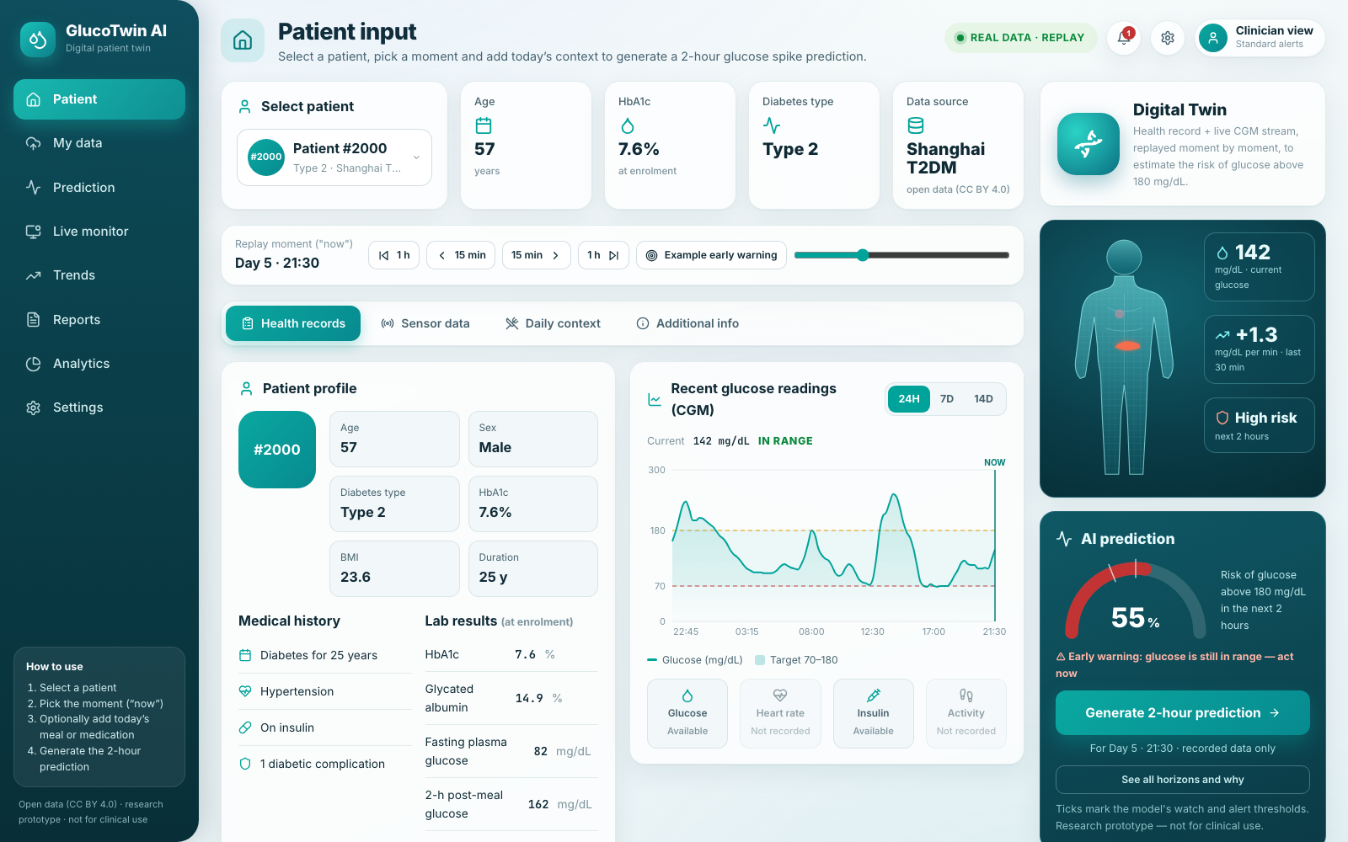
What the doctor sees
Patient input
EHR, labs, CGM chart, data completeness
Digital twin & AI prediction
Live probability from FastAPI, early warning
Daily context (what-if)
Meal, insulin or tablets taken now
Monitor · Trends · Reports · My data
Replay, time in range, printable report, upload your own CGM file
Notes:
The dashboard is a React app talking to the FastAPI backend. Every number on it comes from the API: the probability, the thresholds, the data completeness. Demo patients are real open-data recordings replayed moment by moment, and none of them was in the training data.

Slide 15
Demo workflow: from patient to prediction in five steps
1
Select a patient
30 open-data demo patients (Type 1 and Type 2) or your own uploaded CGM file
2
Pick the moment
Replay slider sets "now"; the model only sees data up to that moment
3
Review the record
EHR and labs, CGM history, sensor completeness
4
Add daily context
Optional what-if: meal carbs, rapid insulin, oral tablets
5
Generate & compare
Probabilities for 30 min, 1 h, 2 h; then the replay shows what really happened
Notes:
This is exactly what we will do live. If the API is unavailable, we show the recorded screenshots and the verified numbers instead, and say so.

Slide 16
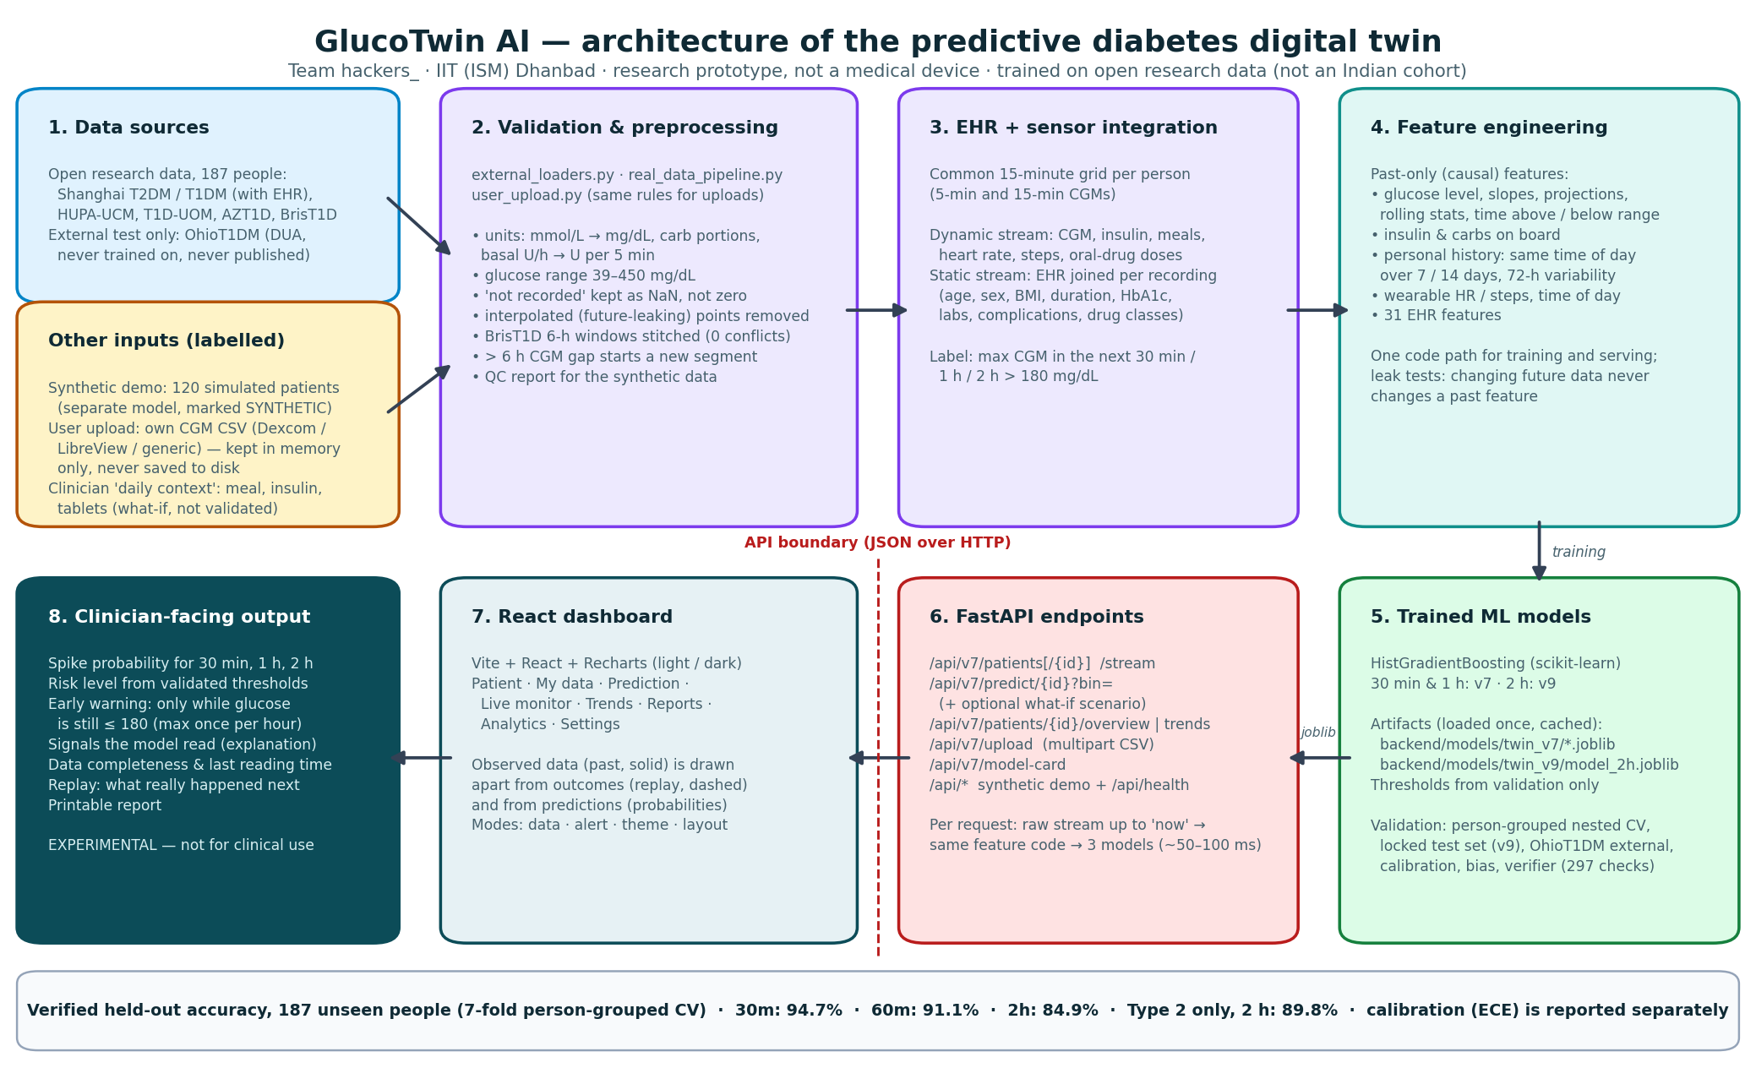
Architecture
Notes:
Data sources, harmonisation, feature fusion, three models with validation, and serving through FastAPI to a React dashboard. Stack: Python, scikit-learn, FastAPI, React.

Slide 17
Limitations and clinical safety
Not clinically validated
Not an Indian cohort
A research prototype trained on open research data; not a medical device and not for treatment decisions.
The Type 2 data is from Shanghai, China. Validation with Indian Type 2 patients is future work.
Missed serious spikes
Errors near the 180 line
36.8% of 9,503 serious episodes got no warning 30–120 min ahead (all 187 people, event level).
49.9% of 2-hour errors have a peak within ±10% of 180 mg/dL; CGM and fingerstick differ by MARD 13.9%.
False alarms
What-if and uploads
Even with the in-range early-warning rule, about 1.3 false alerts per patient-day on the locked test set.
Daily-context scenarios and individual uploads are not separately validated.
Notes:
We are explicit about what the system cannot do. Accuracy, recall and calibration are different measures; none of them means clinical benefit, which has not been tested.

Slide 18




From prototype to Indian clinics
Clinical validation
Health-record integration
Prospective study with Indian Type 2 patients and clinicians before any real use
Connect to ABHA-linked records (ABDM) for labs and prescriptions
Affordable sensing
Privacy by design
Low-cost CGMs and phone alerts for patients and care teams
DPDP-Act consent, encrypted processing, clinician-in-the-loop alerts
Notes:
The prototype is not a medical device. The path to impact is clinical validation in India, integration with the national digital health stack, affordable sensors, and privacy-first deployment.

Slide 19
See the spike before it happens
94.7% at 30 min · 91.1% at 1 h · 84.9% at 2 h — on 187 unseen people, confirmed on an external dataset
hackers_ · IIT (ISM) Dhanbad · Code (MIT): github.com/KorraSanthosh/happiness_ · Thank you
Notes:
Thank the jury. Summarise: two-stream fusion, honest validation, working dashboard, and a clear path to clinical use in India.

