Slide 1
A Data Exploration
Earthquake dataset
Sep 13th - Oct 13th 2022
Korrin

Slide 2
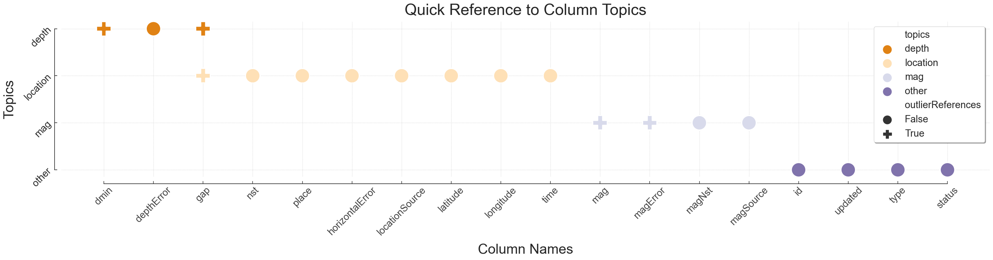
Understanding the Data
Starting Off
This data set is totally new to me and has 18 columns, many of which are reference data I have never seen before. The most recognisable column for me relating to earthquakes is the magnitude.
I have done some research in the past into natural disasters and that has included earthquakes, particularly tsunamis that result from underwater earthquakes but apart from that everything else in this data set is completely new.
I spent a fair amount of time going through the documentation for this data and trying to wrap my head around the content and the purpose of each column. I found it helpful to create a CSV file that lists the columns, a keyword description of the column's topic and whether the documentation says this column's figure will essentially help you identify outliers and other inaccurate readings.
Column Definitions
Next Up
I decided to start analysing the data by topic, I went through and made note of questions I had that could start off my analysis. Following that, I had plenty of data cleaning I could do using the references from the documentation.
Result
This process was really helpful and I concluded that the data in the columns fall under one of 4 topics…
Depth Data
Location Data
Magnitude Data
Other

Slide 3

Data Cleaning
Round one
Remove unwanted types
Step 1 : Group by type to see if there are multiple types of entries.
Step 2 : Search by type and save the entries to a new variable that is equal to ‘earthquake’.
Step 3 : Run a check to see if there are any other ‘types’ listed.
The current dataset now contains 10,145 earthquake-related entries.

Slide 4
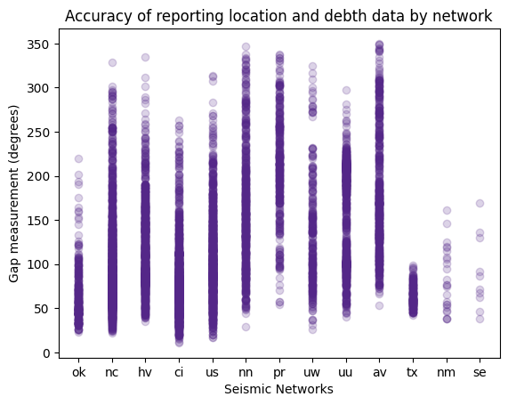
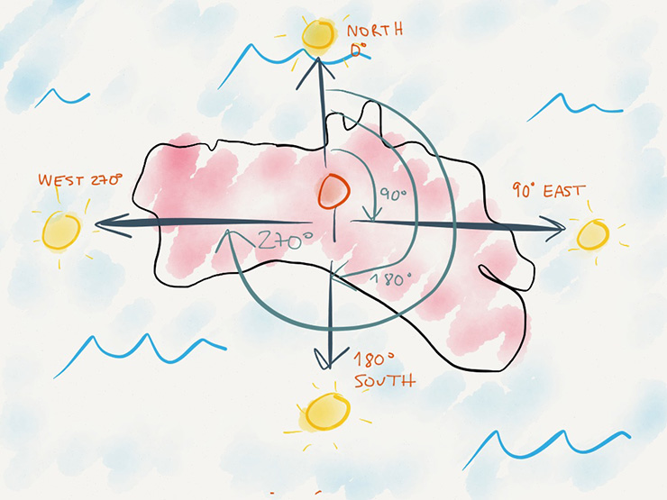
Analysing Data Accuracy
Aim
I wanted to see if there were any networks that were consistently providing inaccurate readings. This would be seen if their data points were clustering in the higher gap number ranges.
Gap & Location Source
Result
- Most of the networks have reported a full range of highly accurate to highly inaccurate readings. This was surprising so I wanted to see this more clearly by changing the graph. I was expecting more clustering like the tx network.
Gap Column Description
The largest azimuthal gap between azimuthally adjacent stations (in degrees). In general, the smaller this number, the more reliable is the calculated horizontal position of the earthquake. Earthquake locations in which the azimuthal gap exceeds 180 degrees typically have large location and depth uncertainties.
Azimuthal Gap
credit: Rafael Pons

Slide 5
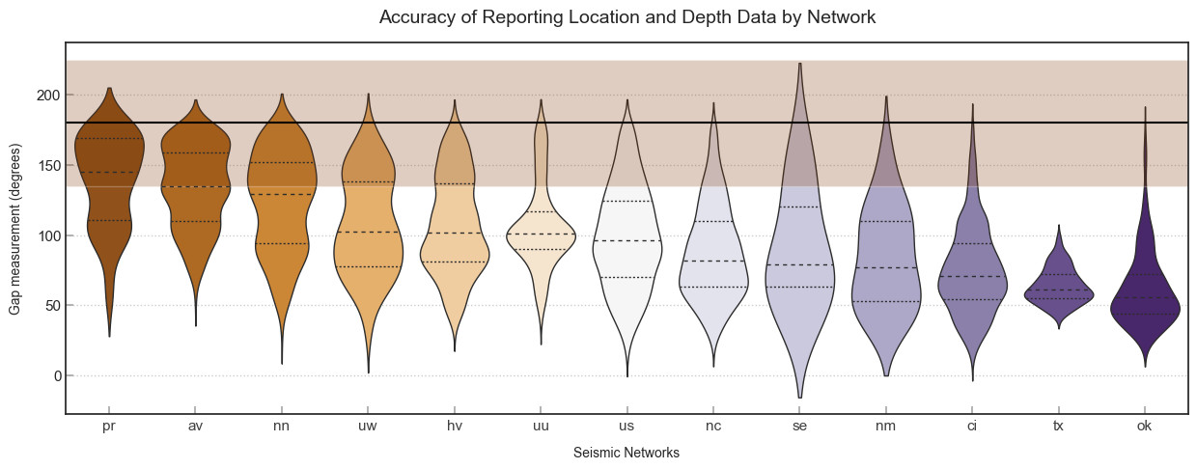
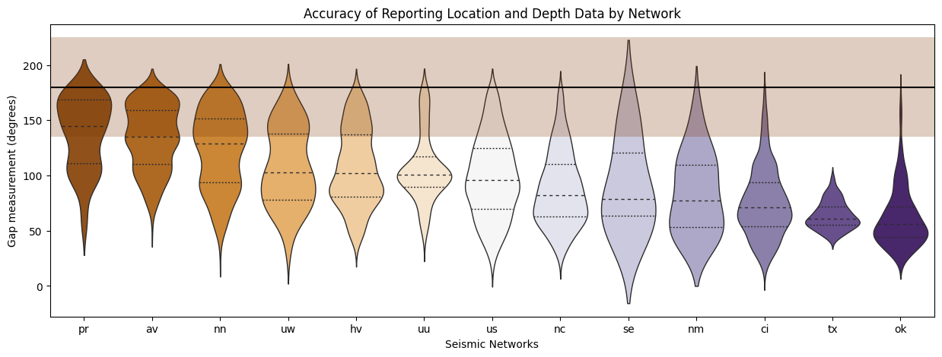
Analysing Data Accuracy
Aim
To get a better picture of the volume of gap measurements per seismic network to further help me see any patterns.
Gap & Location Source
Result
The networks are arranged by the median values in descending order. There is a line representing 180 degrees with a coloured rectangle showing 25% above and 25% below the 180-degree mark representing the highly inaccurate location and depth data readings.
With this, we can easily see that there are networks that were reporting inaccurate data consistently during this period. These include ‘pr’, ‘av’, and ‘nn’. This may suggest that we need to provide more stations nearer to the locations of these earthquakes to get more accurate readings.
180 degree
25%

Slide 6



Data Cleaning
Round two
Removing Mag related outliers
Step 1 : typical mag values are between [-1, 10] so lets remove the outliers. The min value in the dataset is -1.17 and the maximum is 7.6
Step 2 : Search for any empty cells in the mag column. The result is 0
Step 3 : Using the magError column: typical values are between [0,100] so lets remove anything outside of that range.
Step 4 : let’s also remove any values that == ‘unknown’ meaning the data was not provided.
Step 5 : let’s check the magError column for any empty cells. There are none.
Step 6 : let’s describe the magError column and see what we are left with. The range of magError values remaining are between 0 and 5.52 out of 100. The higher the value the more inaccurate the mag reading could be so im confident the remaining mag values are pretty accurate.
The current dataset now contains 6,838 entries.

Slide 7
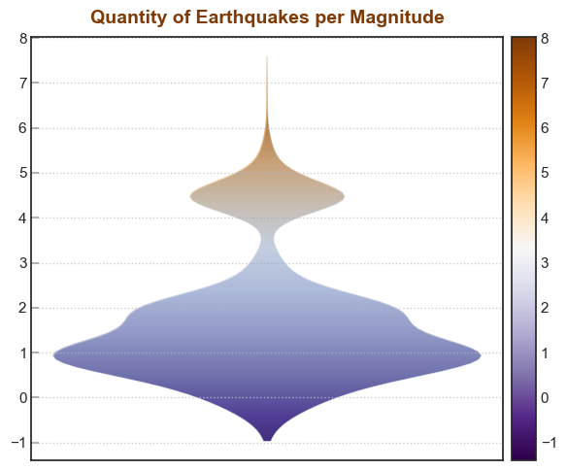
Magnitude Analysis
Next Steps
To continue to analyse the accuracy of the reported location and depth data by using the columns ‘dmin’ and ‘depth error’ which affect the depth accuracy and the horizontal error column which affects the location accuracy.
But I wanted to check out the magnitude whilst I had time so this is what's next…..
6,838 Entries
Aim
To see the density in earthquake reports per magnitude during this time period.
Result
The majority of entries had a magnitude between 0.5 and 2.5.
A surprising cluster of 4.5 mag earthquakes was reported as well.
It’s unclear if many of these reported earthquakes were ‘after shocks’ which normally happen after the first earthquake.

Slide 8
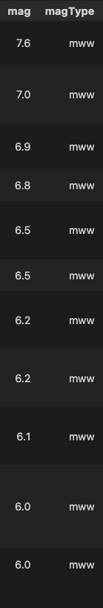
Magnitude Analysis
Aim
Result
Let's investigate the strongest reported earthquakes 6 mag and up. Below is the point on the graph showing
There are 11 reported earthquakes from 6 and up. The strongest is a 7.6.
Next Steps
To look at the locations of these earthquakes and see if there were any significant disasters as a result of them.
Then I would like to have a look at the response times.
Id also like to have a look at the dataset as a whole and see if it’s possible to separate the aftershocks from the original earthquakes and make some charts based on those findings.
Magnetude Description
Mag 6 = ‘Moderate Earthquake’ that can have property damage.
Mag 7 = ‘Strong Earthquake’ damage in the billions and loss of life.
Mag 8 = ‘Great Earthquake’ severe economic impact and large loss of life.

Slide 9
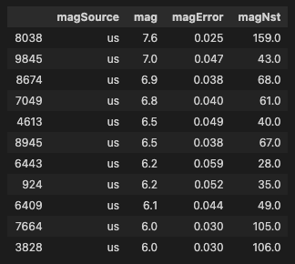
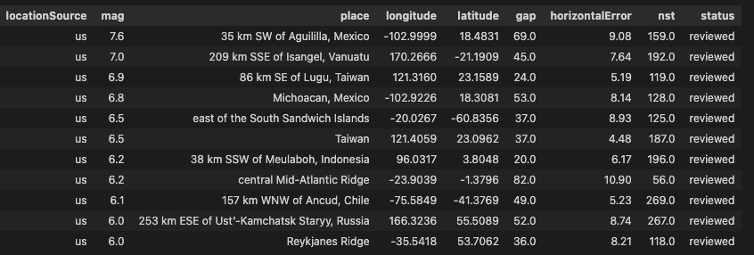
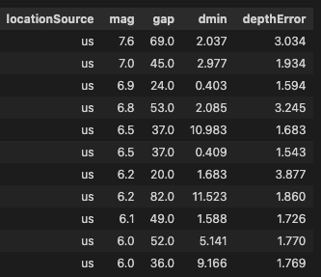
Strongest Earthquakes
Aim
Review the other data given for the strongest earthquakes in this dataset.
Review
Magnitude Review
Location Review
All the top magnitudes were reported by the same network.
The magError figures are very low so I am confident they are reliable magnitudes.
The location data was provided by the same network for all of these entries.
The locations reside all around the globe for each of these earthquakes so I am interested in how they can all be reported by the same network which I would have thought to be small clusters around the world.
They have all been reviewed by a human which is not surprising considering their magnitude but this does not tell us the extent of the review.
The horizontal error and nst are to be looked at.
Depth Review
The depthError figures are very low as well. The gap data is a range of medium to low measurements so the depth data should be pretty reliable. I have not analysed the dmin column yet.
Mag related Columns
Location related Columns
Depth related Columns

Slide 10
After Shocks?
Aim
Could some of these readings in the dataset actually be after shocks? Perhaps I should compare locations of the remaining entries and see if there are any over laps.
…
Result
To be continued…

