Slide 1
Data Detectives: Electricity Analytics & Default Risk Platform
AI-Driven Utility Intelligence for Non‑Technical Loss Reduction
Leader: Usha Sri Yelleti | Members: Magatapalli Aruna, Gudivada Satyaveni, Korukonda Praveen

Slide 2
Executive Summary & Problem Statement
Objective
Key Problems
Opportunity
Reduce non‑technical losses, accelerate recoveries, prioritize field actions
Unmetered consumption spikes and tampering
Electricity theft across mixed zones
Delayed collections and manual follow‑up
Opaque risk signals hinder targeted enforcement
Combine meter telemetry, billing, payment history, and field audits into one AI‑first workflow

Slide 3


System Architecture & RBAC
Multi‑tier operational ecosystem with role‑based access controls
1
2
Billing / Collections Officers — case management, automated dunning
Field Staff — inspection routing, tamper verification, evidence upload
Administrators — model governance, user provisioning, audit review
Data Layer
Analytics Layer
AMI telemetry, billing ledger, payments, CRM
Feature store, XGBoost models, XAI explanations
3
4
Operational Layer
Governance
Case queue, mobile inspection app, evidence repository
RBAC, audit logs, dispute workflow

Slide 4



Collections Officer Desk — Decisioning & KPIs
Live KPIs
Zone Risk Filtering
Automated Action Engine
Open cases, recovery rate, MTTR (days), predicted default probability distribution
Spatial filters, high‑risk clusters, hot‑zone alerts
Auto‑notices, priority scheduling, legal escalation triggers

Slide 5
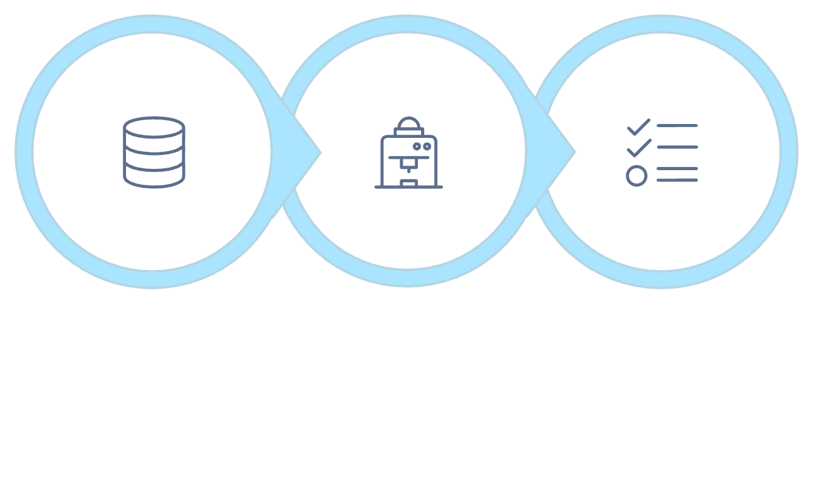
AI Diagnostics & Explainability (XAI)
Transparent risk scoring with per‑customer explanations
SHAP weight breakdowns: top 5 contributory features per account
6‑month consumption sparkline and anomaly markers
Structured payment history timeline: missed payments, amount trends
Ingest Data
Score & Explain
Prioritize Cases
Model: XGBoost ensemble with calibrated probabilities and reliability banding
Caption: From raw signals to prioritized actions — explainable scores enable defensible decisions.

Slide 6




Field Staff Operations — From Analytics to Action
Hardware Integrity Checks
Inspection Queue
Seal status, tamper indicators, meter health diagnostics
Proximity routing, priority tags, scheduled windows
Field Closure
Evidence Capture
On‑site resolution codes, provisional billing adjustment, dispute flag
Photo/video upload, geo‑stamp, tamper report auto‑attach

Slide 7
Admin Oversight & ML Analytics
Model performance & monitoring
Tracked metrics: Accuracy, Precision, Recall, ROC‑AUC, PSI
Drift detection: feature distribution alerts, population stability
Batch inference simulations for policy scenarios
0.91
0.78
0.72
ROC‑AUC
Precision
Recall
Strong discrimination on held‑out folds
High precision on top decile alerts
Recovering prioritized incidents before escalation

Slide 8


Centralized Audit Trail
Real‑time logging of all user interventions and automated decisions
Event Captured
Timestamps + officer IDs for every action
Immutable event stream for compliance & dispute resolution
Dispute outcome tracking, evidence linkage, adjudication notes
Immutable Log
Evidence & Officer
Dispute Record
Audit data feeds compliance reporting and model feedback loops
Caption: Ensures transparency, traceability, and governance across operations.

Slide 9
Business Impact & Conclusion
Faster Recoveries
Automated prioritization reduces case handling time and increases collections velocity
Reduced Fraud
Targeted inspections and XAI‑backed enforcement lower non‑technical loss exposure
Operational Scale
Role‑based workflows and batch inference support large utility portfolios
Next Steps
Pilot: 3 high‑risk zones, 90‑day window
Governance: deploy audit & model retraining cadence
Scale: integrate full AMI fleet and mobile inspection app

