Slide 1

CCGC 5506 EMERGING TECHNOLOGY· MIDTERM PROJECT 4 · GROUP H
Marrowick SecureVault
Governance, security and compliance guardrails for a multi tenant health analytics data lake on AWS
Qawiyy A. Rabiu
Saheedat O. Abbas
N10038749
N10038753
Humber Polytechnic · October 23, 2026
Notes:
Speaker: Qawiyy (0:00 to 0:20).
Good afternoon. We are Group H. I am Qawiyy, the cloud security engineer who built and deployed the platform, and this is Saheedat, our security test and compliance analyst, who tested every control. Our project is Marrowick SecureVault: the guardrails around a health analytics data lake.

Slide 2


Meet Group H
Qawiyy A. Rabiu
Saheedat O. Abbas
N10038749 · Cloud Security Engineer (Build and Deployment)
N10038753 · Security Test and Compliance Analyst
Built the KMS key, S3 zones, bucket policies and CloudTrail
Developed and deployed the PII gate: Lambda, Step Functions, SNS
Built the Glue catalog and Athena access views
Drafted the IAM policy set; set up the GitHub repository
Ran the encryption enforcement test (SSE-S3 upload denied)
Ran all six gate tests; analysed 14 of 14 detection against the answer key
Ran access tests T0 to T5b and audit queries Q1 to Q3
Mapped controls to PIPEDA; tested the runbook scenarios; signed off
Presents: problem, architecture, encryption, IAM, lessons
Presents: PII gate demo, access, audit, compliance, close
Notes:
Speaker: Qawiyy (0:20 to 0:35).
We split the work by role. I built and deployed every component. Saheedat tested every control, analysed the results against the brief and mapped them to compliance principles. We each present the parts we owned.

Slide 3
Agenda
01
Problem statement and objectives
05
Access separation and audit trail
Why Marrowick needs guardrails
Who can see what, and proof of who did
02
Architecture
06
IAM, compliance and incident response
How data moves through the platform
Honest scope, PIPEDA mapping, runbook
03
Encryption that is enforced
07
Lessons learned and Q&A
Customer managed key and bucket policies
What we would do next
04
The PII gate (live demo)
A bad batch is caught and quarantined
Notes:
Speaker: Qawiyy (0:35 to 0:45).
Here is our plan. We start with the problem, then the architecture, then each control with its evidence, including a live run of the PII gate. We finish with governance, lessons and your questions.

Slide 4




Problem statement
Marrowick Health Analytics ingests de-identified encounter and billing data from independent clinic partners into one shared analytics platform.
To pass a partner security review, it must prove with evidence, not just policy, that the data is protected.
Identifiers in free text
Cross clinic exposure
Intake clerks paste names, health card numbers, SINs and emails into notes_field.
One clinic's analysts must never see another clinic's patients.
3
615
14
clinic partners
synthetic encounters
seeded PII rows
Weak encryption
No proof of access
Default encryption can be overridden by a single upload setting.
A reviewer will ask who accessed which data, and when.
Our workstream: build the guardrails around the lake, then prove they hold.
Notes:
Speaker: Qawiyy (0:45 to 1:25).
Marrowick is a fictional health analytics vendor. Three clinics send 615 encounter records. Fourteen of those rows have personal information pasted into a free text notes field, which is exactly what happens in real intake. The platform faces four risks: identifiers in free text, one clinic seeing another clinic's data, encryption that can be weakened, and no proof of who accessed what. Our job was not the analytics. It was the guardrails, and proving they hold.

Slide 5




Objectives and success criteria
Encryption at rest
Automated PII gate
Access separation
Audit trail
Every tenant bucket uses SSE KMS with our customer managed key, and the bucket policy enforces it.
Any batch containing PII or PHI is quarantined, the team is alerted, and it never reaches curated.
Clinic analysts see only their clinic; corporate analysts see all clinics but no PII columns.
CloudTrail records every access and change, and we can query it with Athena.
PASS IF
PASS IF
PASS IF
PASS IF
An upload asking for weaker encryption is denied.
All 14 seeded rows caught, zero clean rows flagged.
Every restricted query returns 0 rows or is refused.
At least two audit questions answered with evidence.
Plus, a governance package: least privilege IAM policies, a PIPEDA compliance mapping and an incident response runbook.
Notes:
Speaker: Qawiyy (1:25 to 1:50).
We set four objectives, each with a pass condition we could test: enforced encryption, an automated PII gate, separation between clinics and between roles, and an audit trail. Around those we built a governance package.

Slide 6
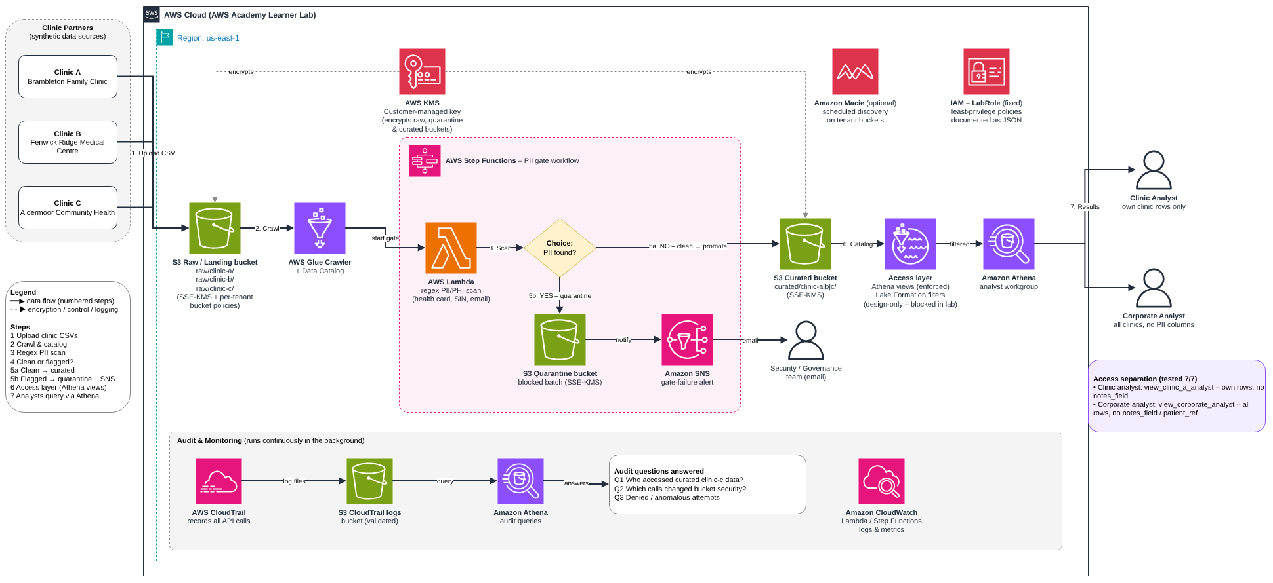
How the platform works
Source: architecture/Marrowick_Architecture.drawio · Region us-east-1 · All services serverless and pay per use
Notes:
Speaker: Qawiyy (1:50 to 2:40).
Each clinic uploads a CSV into its own folder in the raw bucket. A Step Functions workflow runs a Lambda that scans the batch. A clean batch is copied to the curated zone; a batch with PII is copied to quarantine and the security team gets an SNS email. A Glue crawler catalogs only the curated zone, and analysts query it through role scoped Athena views. CloudTrail runs underneath everything and we query its logs with Athena. One customer managed KMS key encrypts all three zones.

Slide 7
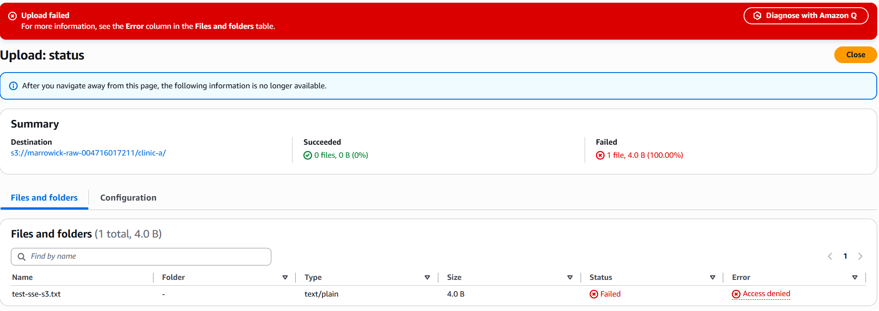


Encryption that is enforced, not just enabled
Customer managed key
SSE KMS with Bucket Key on all three zones. Key policy separates duties: voclabs administers, LabRole only uses. Rotation every 365 days.
Bucket policies deny
Any non-HTTPS request, any upload not encrypted with KMS, and any upload naming a different key.
Evidence: evidence/week1/20, upload refused by the bucket policy
Why this matters
Default encryption only applies when the uploader does not ask for something else. A deny in the bucket policy overrides any IAM allow, so a weaker request is refused for every caller.
Tested
Upload of test-sse-s3.txt with an SSE-S3 override: Access denied.
Notes:
Speaker: Qawiyy (2:40 to 3:20).
Every tenant bucket uses our customer managed key. The key policy separates duties: a human operator administers the key while the pipeline role can only use it, and rotation is automatic every year. But default encryption can be overridden on upload, so each bucket policy denies non HTTPS traffic, non KMS uploads and any other key. Here is the proof: an upload that asked for weaker SSE-S3 encryption was refused. Saheedat ran this test. Over to Saheedat.

Slide 8
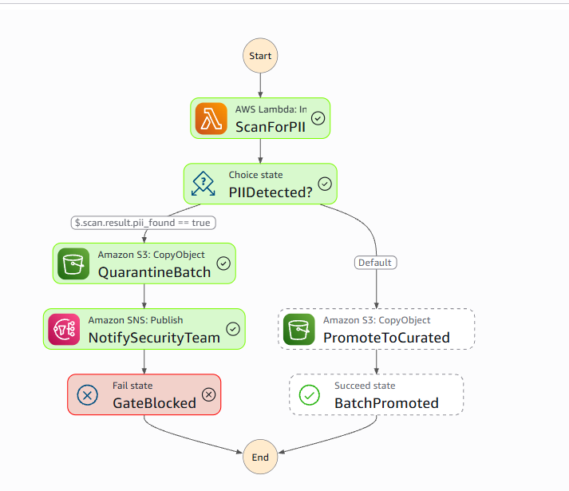
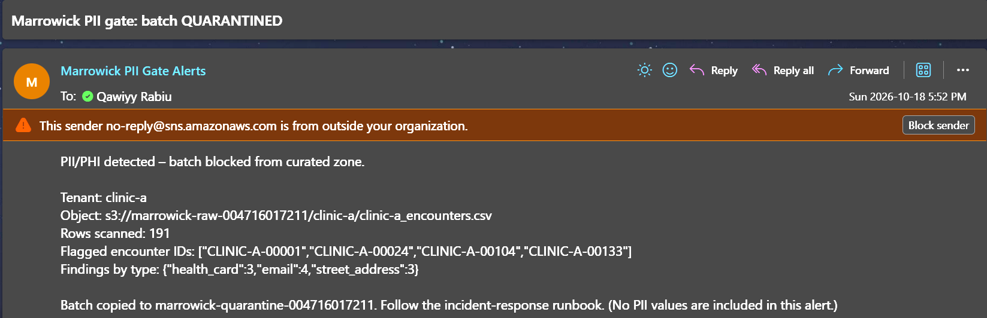
Live: the PII gate blocks a bad batch
LIVE DEMO
1
Scan
Lambda checks free text for health card, SIN, email and street address patterns
2
Decide
PII found? One bad row blocks the whole batch
3
Quarantine and alert
Batch copied to quarantine; SNS emails the team with IDs only, no PII values
4
Blocked
The run fails on purpose with PIIDetected; PromoteToCurated never runs
Execution test1-clinic-a-raw: Failed at GateBlocked
The real alert: flagged encounter IDs and finding types, no PII values
Notes:
Speaker: Saheedat (3:20 to 4:30).
[Switch to the AWS console and start the execution on the Clinic B raw file.]
This is the hard gate. The Lambda checks every free text field for health card numbers, SIN formatted numbers, emails and street addresses. It found PII, so the Choice state sends the batch to quarantine, notifies the security team, and the run ends in a deliberate failure called PIIDetected. PromoteToCurated never ran.
[Switch to the inbox.] Here is the alert. It lists the flagged encounter IDs and the finding types, but never the PII values, so the alert itself cannot leak data.
If the live run fails, play clip 4 from the demo video and keep talking.

Slide 9
PII gate results: 14 of 14 caught, zero false alarms
14 / 14
seeded PII rows caught, checked against the instructor answer key
1.00
1.00
0
Clinic | Rows | Flagged | Seeded | Findings | Gate result
clinic-a | 191 | 4 | 4 | health card 3, email 4, address 3 | Blocked, then promoted after redaction
clinic-b | 243 | 6 | 6 | health card 5, email 2, address 2, SIN 1 | Blocked, then promoted after redaction
clinic-c | 181 | 4 | 4 | email 2, health card 2 | Blocked, then promoted after redaction
precision
recall
false positives
3 raw batches blocked, 3 steward redacted batches promoted. Rerun offline on Oct 21 with python3 tests/test_pii_scan.py.
Notes:
Speaker: Saheedat (4:30 to 4:55).
I checked every detection against the instructor answer key. All fourteen seeded rows were flagged and no clean row was flagged, so precision and recall are both 1.00. Health card numbers and emails were the most common leaks. After a data steward redacted only the flagged notes and resubmitted a version 2 file, the same gate promoted all three batches.

Slide 10
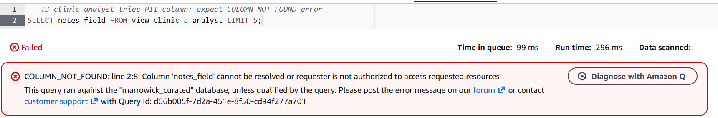
Each analyst sees only what their role allows
Test | Role | Restricted query we attempted | Result | Status
T0 | Baseline (admin) | Count all curated rows | 615 rows, 3 clinics | Pass
T1 | Clinic analyst | Count rows by clinic | Only clinic-a, 191 rows | Pass
T2 | Clinic analyst | Rows where clinic = clinic-b | 0 rows returned | Pass
T3 | Clinic analyst | SELECT notes_field | Refused: COLUMN_NOT_FOUND | Pass
T4 | Corporate analyst | Count rows by clinic | 191 / 243 / 181 | Pass
T5a | Corporate analyst | SELECT notes_field | Refused: COLUMN_NOT_FOUND | Pass
T5b | Corporate analyst | SELECT patient_ref | Refused: COLUMN_NOT_FOUND | Pass
7 of 7 passed
A refused query is the pass: the restricted data never came back.
Real result of T3 (evidence/week2/43). Enforced with Athena views because Lake Formation is blocked in the Learner Lab.
Notes:
Speaker: Saheedat (4:55 to 5:40).
Lake Formation is blocked in the Learner Lab, so we enforced the same rules with role scoped Athena views and tested them by actually attempting the forbidden queries. The clinic analyst sees only Clinic A, 191 rows. Asking for Clinic B returns nothing. Asking for the notes field, the one that leaked PII, is refused with COLUMN_NOT_FOUND. The corporate analyst sees all three clinics but neither notes nor patient references, so they cannot link one patient across clinics. Seven of seven passed.

Slide 11
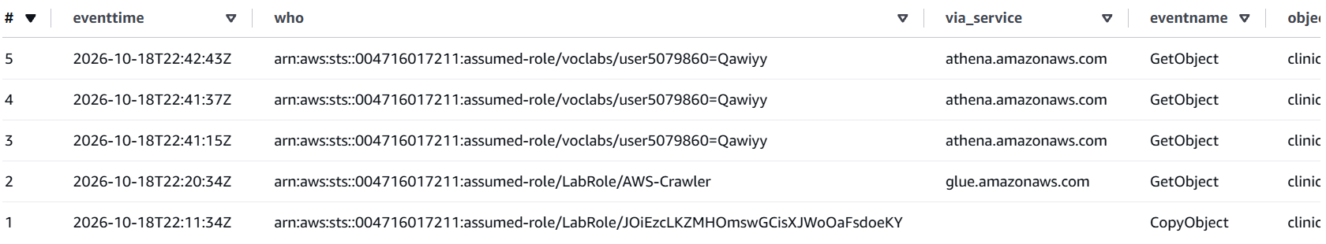
Every access leaves an auditable trail
Q1
Q2
Q3 · ANOMALY
Who accessed curated clinic-c data?
Who changed bucket security?
Any probing of security services?
The pipeline copy, the Glue crawler, then 3 analyst queries, each with identity and time.
4 bucket policy changes and 1 encryption change, with who made each and when.
A burst of denied Lake Formation calls within 5 minutes, flagged for review.
Q1 result from CloudTrail via Athena (evidence/week2/51). Data events scoped to the three tenant buckets; log file validation on; times in UTC.
Notes:
Speaker: Saheedat (5:40 to 6:20).
We query CloudTrail with Athena. Question one: who accessed Clinic C's curated data? You can see the pipeline copying it in, the Glue crawler reading it, then three analyst queries, each with identity, time and service. Question two lists every bucket security change with who made it and when. Question three found an anomaly: a burst of denied Lake Formation calls, a principal repeatedly probing a security service it is not allowed to use. Times are in UTC.

Slide 12
What the lab blocked, and what we did instead
Blocked in the Learner Lab | What we did instead | Status
Creating IAM roles | Wrote one least privilege policy per role as JSON; every service ran as LabRole | Design only
Lake Formation (GetDataLakeSettings denied) | Athena views plus the full data cells filter design | Tested 7 of 7; views are weaker
Tagged principals | Per tenant isolation statements in the bucket policies | Deployed, not testable
Enforced regardless of IAM
KMS key policy
Bucket policies (a deny beats any allow)
The PII gate logic itself
Designed as JSON (iam/roles)
Why views are weaker: anyone who can read the base table or the S3 objects can bypass a view. In production, analysts get Lake Formation filters plus an explicit deny on direct S3 access.
Clinic A analyst
Corporate analyst
PII scan Lambda
PII gate Step Functions
Curated Glue crawler
Notes:
Speaker: Qawiyy (6:20 to 6:50).
Three things the lab blocked. IAM role creation, so everything ran as LabRole; we wrote a least privilege policy for each role and marked it design only. Lake Formation, so we used views, which are weaker; our production design pairs Lake Formation filters with an explicit deny on direct S3 access. And tagged principals, so the per tenant bucket policy rules are deployed but untested. What stayed enforced regardless: the key policy, the bucket policies and the gate itself.

Slide 13
Controls mapped to PIPEDA principles
PIPEDA principle | Control we implemented | Strength
4.7 Safeguards | SSE KMS with rotation; policies deny non-TLS, non KMS and wrong key uploads; SNS alert on gate failure | Strong
4.4 Limiting collection | Regex PII gate blocks identifiers from analytics; answer key removed before ingestion | Strong
4.5 Limiting use and disclosure | Clinic analysts see only their rows; corporate analysts see no PII columns | Strong
4.1 Accountability | CloudTrail records who did every action; log file validation detects tampering | Partial
4.6 Accuracy | Original kept, steward fix saved as a new _v2 object; 615 in, 615 catalogued | Partial
Breach safeguards (s.10.1) | Runbook covers RROSH assessment, OPC report, notification, 24-month record | Partial
Not covered
4.2 Identifying purposes
4.3 Consent (held by the clinics)
4.9 Individual access
Retention and deletion rules
PII the regex cannot see
PHIPA (Ontario health law)
A learning exercise on synthetic data, not a compliance certification. Full table: docs/compliance-mapping.md
Notes:
Speaker: Saheedat (6:50 to 7:10).
I mapped each control to a PIPEDA principle. Safeguards, limiting collection and limiting use are strong because we tested them. Accountability and accuracy are partial. Just as important is what we do not cover: consent, individual access, retention rules and Ontario's PHIPA. This is a learning exercise, not a certification.

Slide 14
If a control fails: the incident response runbook
IR-1
IR-2
IR-3
IR-4
PII reached curated
Gate did not alert
Access control failed
Security setting changed
Gate missed a new format
SNS failed or workflow skipped
Analyst saw another tenant or a PII column
Bucket or key policy altered
1
2
3
4
5
6
Detect and triage
Contain
Investigate
Eradicate and recover
Notify
Review
0 to 30 min
30 to 60 min
Same day
1 to 3 days
As soon as feasible
Within 1 week
Log it, set severity, find tenant and objects
Move to quarantine, cut access, pause the gate
Audit Q1, Q2, Q3: who saw it, who changed it
Add the pattern, retest to 100% recall, redeploy
RROSH test, OPC report, clinic, 24 month record
Blameless write up, regression test
Full runbook with SQL for each phase: docs/incident-response-runbook.md
Notes:
Speaker: Saheedat (7:10 to 7:25).
If a control ever failed, the runbook covers four scenarios. For example, if PII reached curated, we contain it by moving the file to quarantine and cutting access, investigate with audit query one to see who read it, fix the pattern and retest, and then assess whether PIPEDA breach reporting applies.

Slide 15





Lessons learned and future work
LESSONS LEARNED
FUTURE WORK
1
Enable CloudTrail first
It only records from the moment it is on.
Lake Formation filters and per role IAM in a full account
2
Verify every console default
Amazon Macie discovery, reconciled with the regex gate
Rotation was off; the bucket form picked DSSE KMS and versioning.
CloudWatch alarms on gate failures and AccessDenied spikes
3
Check that a test fails for the right reason
Our first SSE-S3 upload succeeded because the override was never applied.
Partial masking of health card numbers for corporate analysts
4
Conventions are not controls
S3 lifecycle rules for retention and deletion
Files once landed in curated by mistake. Zones need policy and the gate.
Notes:
Speaker: Qawiyy (7:25 to 7:45).
Four lessons. Turn CloudTrail on first, because it only records from that moment. Verify every console default. Make sure a test fails for the right reason; our first encryption test passed by accident. And conventions are not controls. Next we would deploy Lake Formation and per role IAM in a full account, add Macie, alarms, masking and retention rules.

Slide 16
Guardrails built, and proven to hold
Enforced
14 / 14
7 / 7
3
encryption with a customer managed key
PII rows blocked, with masked alerts
access separation tests passed
audit questions answered from CloudTrail
Thank you. Questions?
Qawiyy A. Rabiu (N10038749) · Saheedat O. Abbas (N10038753) · Group H
Notes:
Speaker: Saheedat (7:45 to 8:00).
In short: data encrypted with enforcement, PII blocked end to end with alerts, tenant and column separation tested, and every access auditable, with an honest account of what the lab did not allow. Everything is in our GitHub repository. Thank you, we are happy to take questions.

