Slide 1

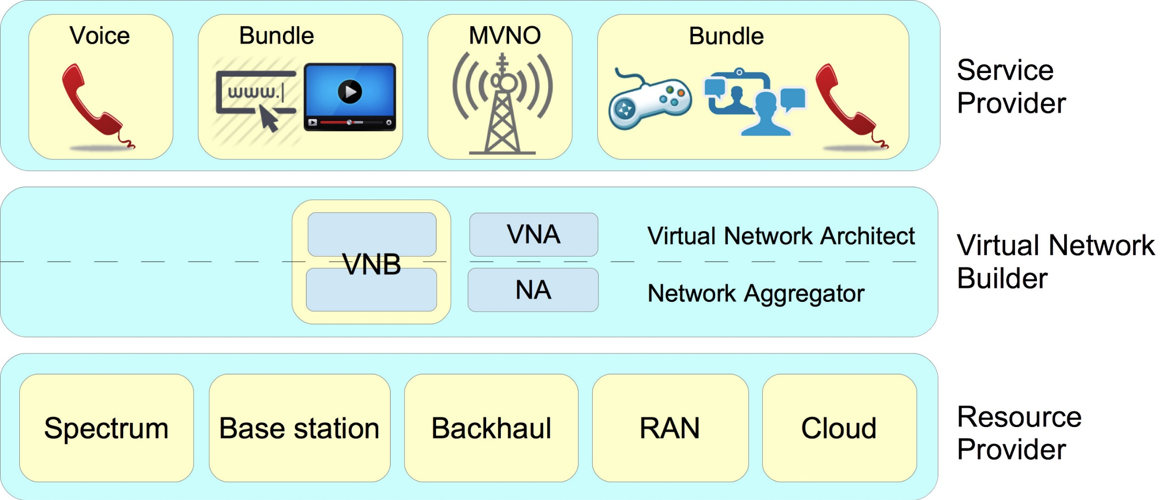
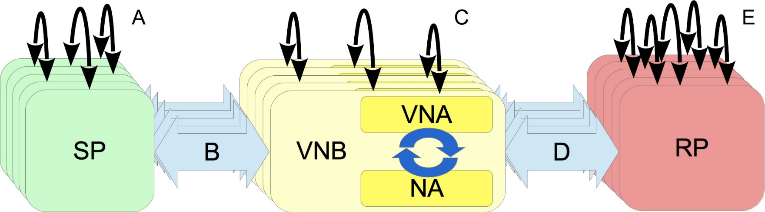
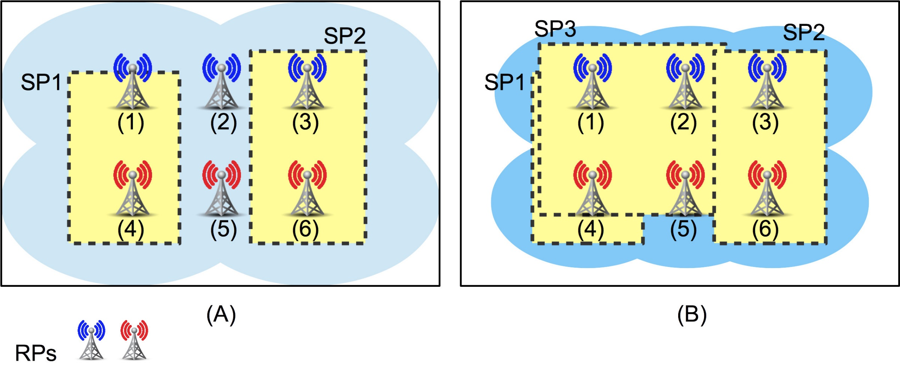
Sponsored by: NSF and CNPq (Brazil)
#XX
June 1 - 3
Virtualization and Programmability in Mobile Wireless Networks: Architecture and Resource Management
2016
26th Wireless Personal
Communications Symposium & Summer School
Kleber Cardoso, Mohammad Abdel-Rahman, Kory Teague, Allen MacKenzie, and Luiz DaSilva
I. Motivation
Virtualization and programmability are two fundamental concepts in the cloud computing paradigm and in the idea of providing everything as a service, a.k.a. XaaS or *aaS. In the networking context, software-defined networking (SDN) has been the main initiative in this direction. While SDN has established a rather solid basis in wired networks, a similar solution for mobile wireless networks (MWNs) is still lacking. Software-defined wireless networking (SDWN) is evolving, however, virtualization and programmability applied in an end-to-end context have aspects that demand a broader view, which cannot be encapsulated on a single SDWN.
We present our view for next-generation MWNs through a high-level end-to-end architecture. Our view is grounded in the Network without Borders (NwoB) paradigm [1], which introduces the service-oriented concept as a natural motivation for virtualization and programmability in the MWNs.
II. Architecture for Networks without Borders
Roles
Service Provider (SP): Can be a traditional mobile virtual network operator (MVNO) that offers data, voice, and messaging services, a specialized MVNO that offers data services for specific applications (e.g., support for IoT devices), or any of the present over-the-top services.
Virtual Network Builder (VNB): Consists of a Virtual Network Architect and Network Aggregator. It composes and aggregates the virtual resources from the resource providers (RPs) to build virtual networks for the SPs.
Resource Provider (RP): The owner of a set of resources that can be offered as virtual resources in a set of pools, according to contracts established with VNBs or NAs, for example. In general, an RP will define how to slice and share its resources as virtual ones.
Interactions
Interaction A: May occur because an SP can bundle services from other SPs to offer to the users, or because an SP (e.g., a content provider) prefers to outsource the virtual network operation to an SP with this expertise (e.g., an MVNO).
Interaction B: One of the most frequent and important interactions in NwoB; because it involves the demand for and the offer of virtual networks.
Interaction C: VNBs tend to compete with each other for offering virtual networks to the SPs, but they may also cooperate under certain scenarios. For example, when a VNB cannot cover the geographical area requested by an SP.
Interaction D: Is a frequent and critical interaction in NowB; because it involves the mapping of the virtual networks in the substrate. From a VNB to an RP, this interaction arises to request resources, to update a previous request, or to release resources.
Fig. 2. Interactions between some typical entities.
Fig. 1. Roles that an entity can play in the NwoB paradigm.
III. Resource Allocation
The VNB is in a better position to slice the resources than the RPs. The way a resource is sliced and configured can affect properties such as capacity and coverage. Based on the demands from the SPs, a VNB can make its choices about slicing and configuration of the resources in order to minimize the cost.
Figure 3 illustrates two scenarios. In scenario A, the VNB chooses to allocate all capacity of one BS of each RP for a single SP, i.e., BSs 1, 3, 4, and 6. In scenario B, the VNB chooses to share some BSs (1, 2, 4, and 5) and increase the minimum transmission rate.
Fig. 3. Scenarios with the same set of RPs and different sets of SPs.
References
[1] L. Doyle, J. Kibilda, T. Forde, and L. DaSilva, “Spectrum Without Bounds, Networks Without Borders,” Proceedings of the IEEE, vol. 102, no. 3, pp. 351–365, March 2014.

