Slide 1

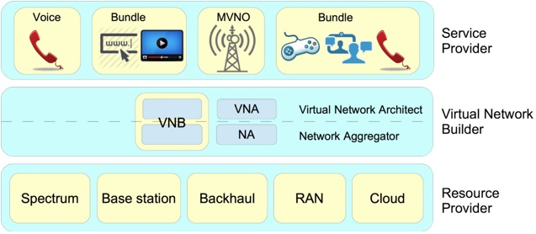
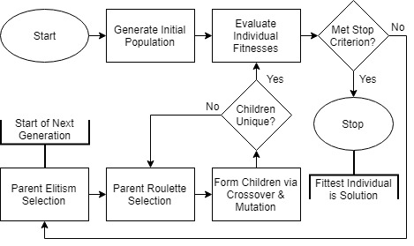
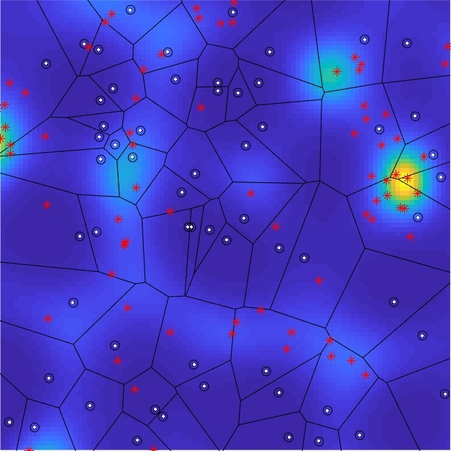
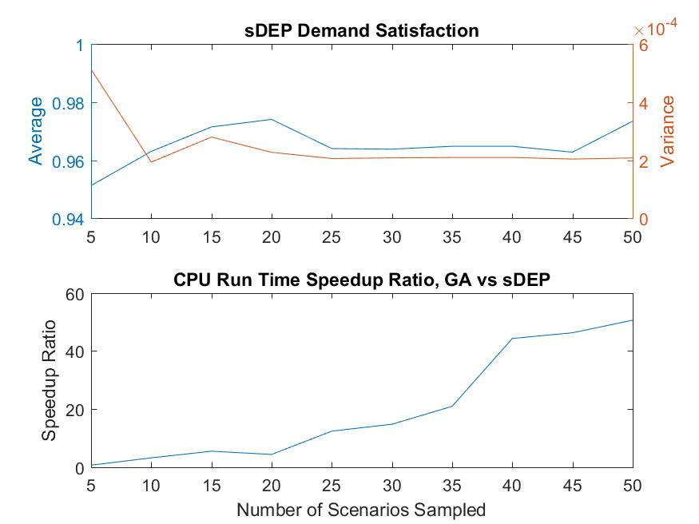
Sponsored by: National Science Foundation
#XX
April 27th
Joint Base Station Selection and Adaptive Slicing in Virtualized Wireless Networks
2018
Wireless @ Virginia Tech
Research Symposium
Kory Teague, Mohammad Abdel-Rahman, Allen MacKenzie
{koryat, mo7ammad, mackenab}@vt.edu
Motivation
Resource sharing has been a common practice for Mobile Network Operators (MNOs) to decrease the capital and operational expenditures of deploying and maintaining their cellular networks. Roaming agreements and passive infrastructure sharing, such as the sharing of physical sites, tower masts, and power, saved expenditures leading to motivation in more active resource sharing, such as the reuse of backhaul and the sharing of radio access networks. This has led to wireless virtualization, a promising approach for efficient sharing of radio resources in next-generation mobile networks.
Our work focuses on the problem of resource allocation for virtualized wireless network (VWN) construction. We use a framework based on the Network without Borders (NwoB) paradigm, which introduces a service-oriented concept as a natural motivation for virtualization in mobile wireless networks (MWNs).
III. VWN Construction
Consider a geographic area in which a VWN is to be constructed. A set of base stations (BSs) are available to be rented from the local RPs, each with their own cost, capacity, and coverage range. A SP has a known continuous demand density field to satisfy, which at any given time is realizable to a set of demand points (DPs).
The VNB aims to find and select the base stations with minimal cost that, when allocated to the SP demand points, generates maximal demand satisfaction. This is modeled as a two-stage stochastic optimization model, with homogenous demand points in stochastic locations. This is not possible to solve directly, so we present two approaches to solve the model that could be run within the VNB.
Sampled Deterministic Equivalent Program (sDEP) Approach: We convert the stochastic optimization model into a deterministic equivalent program (DEP), which replaces the stochastic variables with deterministic ones. These are composed of a set containing all scenario realizations of the stochastic variables. We use a sampling approach to trim the set to a solvable, finite form for a linear solver. This requires tuning: sample too few scenarios and the sDEP is inaccurate, but sample too many and the sDEP is intractable.
Genetic Algorithm (GA) Approach: A major restriction of the sDEP approach is its intractability. The GA approach attempts to find a tractable approximate solution to the base station selection stage.
II. VWN Architecture
Service Provider (SP): Can be a traditional mobile virtual network operator (MVNO) that offers data, voice, and messaging services, a specialized MVNO that offers data services for specific applications (e.g. support for IoT devices), or any other over-the-top services.
Virtual Network Builder (VNB): It composes and aggregates the virtual resources from the resource providers (RPs) to build virtual networks for the SPs.
Resource Provider (RP): The owner of a set of resources that can be offered as virtual resources, according to contracts established with VNBs or NAs, for example. In general, an RP will define how to slice and share its resources as virtual ones.
Fig. 1. Roles in the Networks without Borders paradigm
Fig. 3. Genetic Algorithm Flowchart
IV. Results
GA has a speedup ratio of up to 50 compared to the sDEP
sDEP runtime grows exponentially with number of scenarios; did not complete within time limit with 50 scenarios
(Not shown) GA incurs appx. 20% (2 BSs) additional cost compared to sDEP (9 or 10 BSs vs 12)
Due to increased selection, GA has improved demand satisfaction (>99.99%) compared to sDEP (96-97%, 99.0% with 10 BSs)
At 10-20 scenarios, sDEP variance drops to a “tight” solution, implying convergence towards stochastic optimization model
GA is more tractable; may incur less comparative cost with larger data sets (e.g., more BSs and resources).
Fig. 4. sDEP Demand Satisfaction and Algorithm Speedup Ratio
Fig. 2. Example area containing SP demand points (red) and field (background; SSLT) and available RP resources (points white, Voronoi tessellation black; PPP)

