Slide 1

DSI5 Capstone Project Restaurant Analytical Solution WANG WEISHI
Recommendation
Natural language processing (NLP)
Classification
Deep Learning
Notes:
Audience

Slide 2







Agenda
Background
Project Objective
Project Part I: Restaurant Recommendation System & Validation
Project Part II: NLP Based Customer-Restaurant Ranking Classification & Validation
Project Part III: Restaurant Average Rating Prediction & Validation
Project Part IV: Restaurant Closure Event Prediction
Conclusion

Slide 3
Background
Customer
Which restaurant to choose?
Recommender
Restaurant Owner
Is my restaurant good?
Causes (Positive & Negative)
Investor
Which restaurant to invest?
Supports
Notes:
Example and cases,

Slide 4
Data Set
Business
Restaurant
Categorical
Check-in
Restaurant
Review
Customer
Customer
Numerical
Popularity
Time
Text
Rating
Customer
User Profile

Slide 5
Project Objective
Objective
To develop a restaurant analytical solution for customer, restaurant owner and investor
Project Requirements
Implement restaurant recommendation system
Develop restaurant rating prediction algorithm
Deploy restaurant closure prediction solution
Evaluate models
Create visualization through information dashboard (Python) <= To finish before M&G

Slide 6
Project Part I: Restaurant Recommendation System & Validation
Customers
Customer similarity Computation
Most frequently visited restaurants
Sort by restaurant ratings
Restaurants
Generate similar restaurants
Predict generated restaurants’ ratings
Recommend restaurant to a particular customer

Slide 7
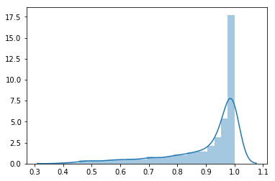
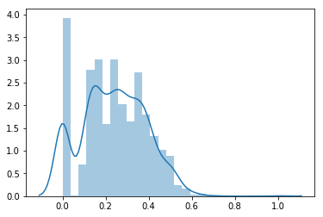
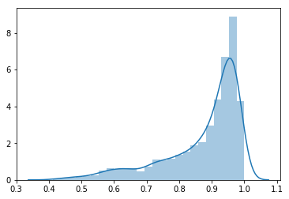
Project Part I: Visualization
Restaurant Similarity Distribution
X: Cosine Similarity
Y: Frequency
Before Feature Engineering
Added features
After Feature Engineering

Slide 8
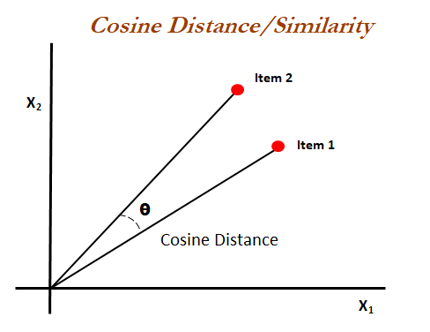
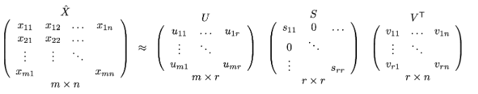
Project Part I: Technologies
Mathematics:
Cosine Similarity
Singular Value Decomposition
Model
Deep learning

Slide 9
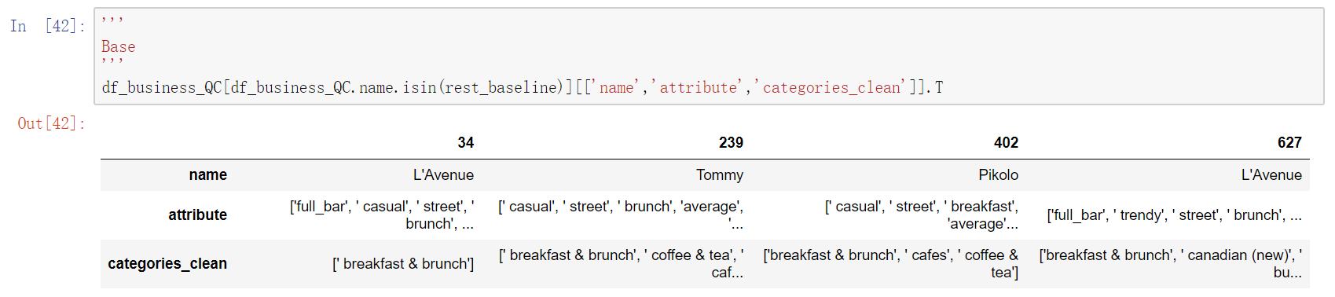
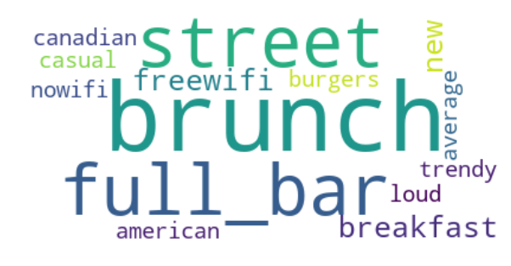
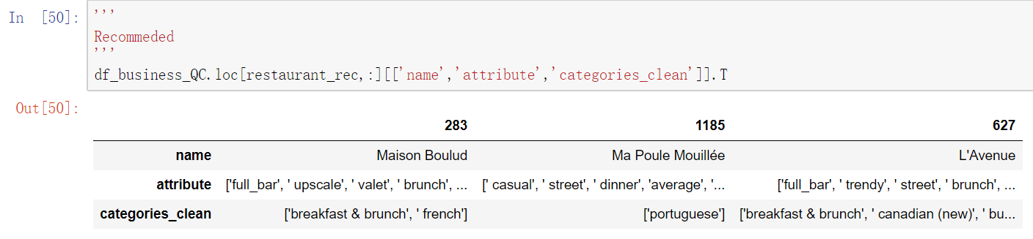
Project Part I: Validation
Recommendation Summary:
Base Restaurants ID: [34,239,402,627]
Recommended Top 3 Restaurants ID: [283,1185,627]
Notes:
Split and spread

Slide 10
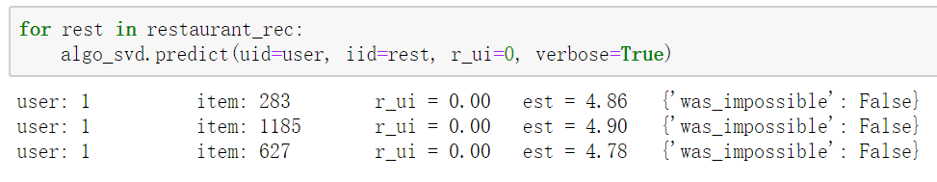
Project Part I: Validation
Recommendation Summary:
Recommended Top 3 Restaurants [283,1185,627] Rating:

Slide 11
Project Part II: NLP Based Restaurant Rating Classification & Validation
Data
Ranking (stars: 1-5)
Review (Text)
Feature Engineering
Review Length
Review Length Transformation (logp1)
Tokenizing
Classification
Multiple Classes
Binary Classes

Slide 12
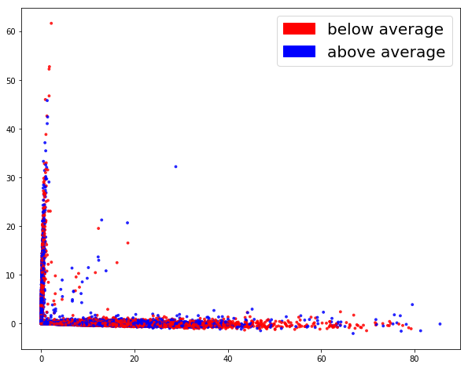
Project Part II: Visualization
Tokenizing
CountVectorizer
SVD (n_components=2)

Slide 13
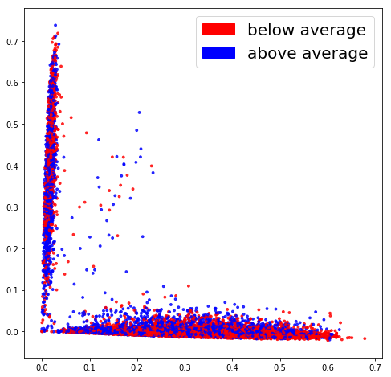
Project Part II: Visualization
Tokenizing
TFIDF
SVD (n_components=2)

Slide 14
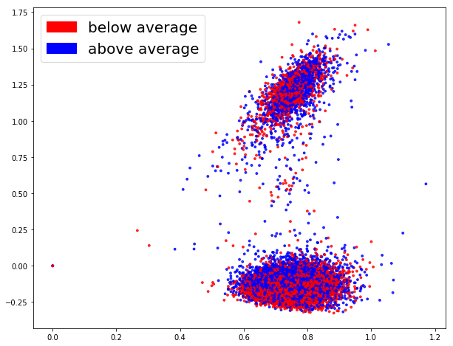
Project Part II: Visualization
Tokenizing
Word2vec
GoogleNews-vectors-negative300.bin
SVD (n_components=2)

Slide 15
Project Part II: Validation
Count Vectorizer
Accuracy
Precision
TFIDF
Accuracy
0.934
Word2vec
Accuracy
0.893
Recall
F1
0.921
Precision
Recall
F1
Precision
Recall
F1
Deep Learning
Accuracy
0.855
500 epoch

Slide 16

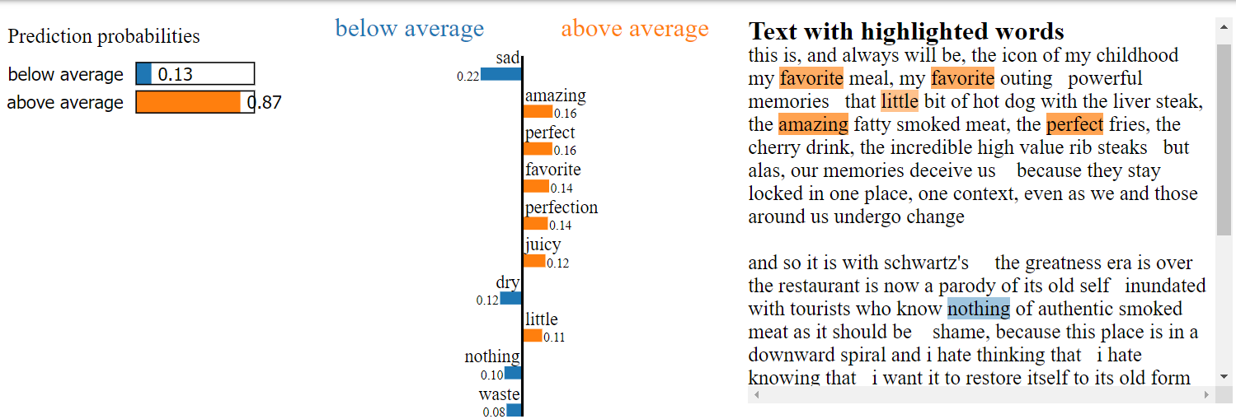
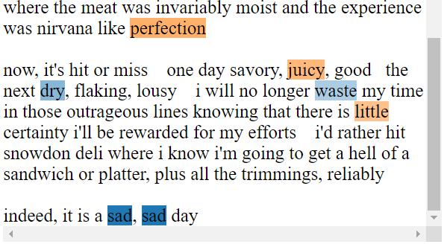
Project Part II: Review Text Validation
TFIDF

Slide 17
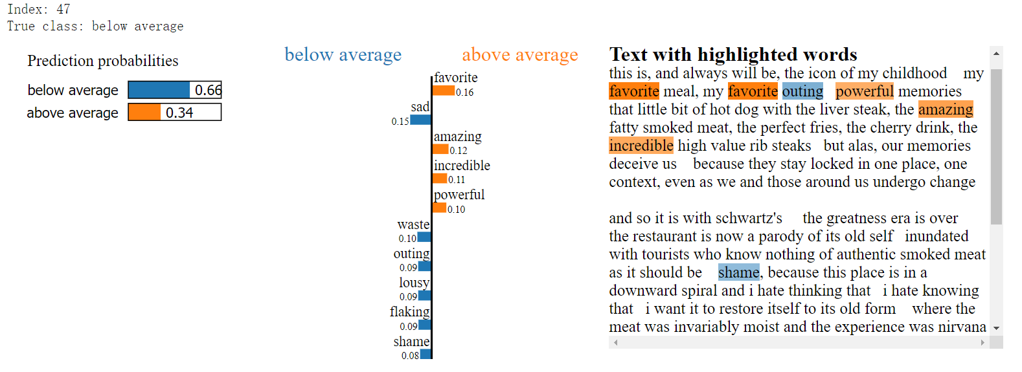
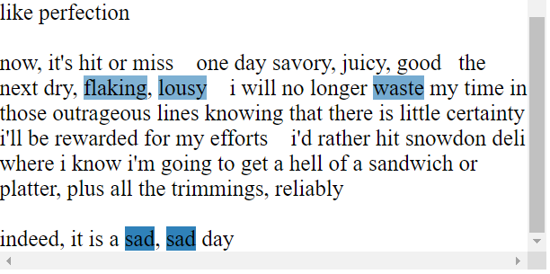
Project Part II: Review Text Validation
Word2Vec
Notes:
Merge 1 & 2

Slide 18
Project Part III: Restaurant Average Rating Prediction & Validation
Features
Location
Numerical
Model
Logistic Regression
Tokenizing
User Review
Categorical_rest
Cleaning
Categorical_rest
Categorical
User Review
TFIDF
CountVectorizer

Slide 19
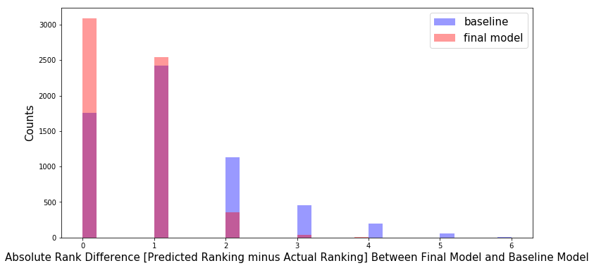
Project Part III: Visualization & Validation

Slide 20
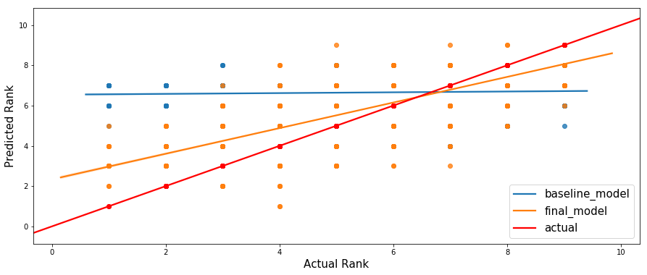
Project Part III: Visualization & Validation

Slide 21
Project Part IV: Restaurant Closure Event Prediction
My Restaurant Closure Definition (Assumption)
Short Term Prediction: df_2018_o_c=df[df.review_year_max>=2016]
Features
Location
Numerical
Model
Logistic Regression
Tokenizing
User Review
Categorical_rest
Cleaning
Categorical_rest
Categorical
Feature Transformation
User Review
TFIDF
CountVectorizer
Age of restaurant
Support Vector Machine
Random Forest
Naive Bayes
GaussianNB
SMOTE
PCA
Restaurant Density

Slide 22
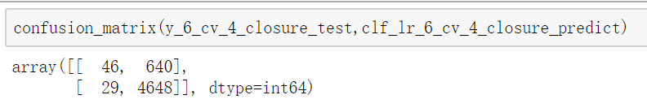
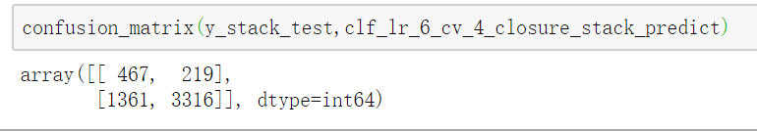




Project Part III: Restaurant Closure Event Validation
Baseline Model:
$$TNR=\frac{46}{46+640}∗100\%=6.7\%$$
$$TPR=\frac{4648}{4648+29}∗100\%=99.38\%$$
Final Model: Baseline + PCA + SMOTE + (LogisticRegression + GaussianNB)<Stacking
$$TNR=\frac{467}{467+219}∗100\%=68.08\%$$
$$TPR=\frac{3316}{3316+1361}∗100\%=70.90\%$$

Slide 23
Conclusion
Successfully developed restaurant analytical solution for different users:
Python based analytical solution
Restaurant Recommendation System
Customer-Restaurant Ranking Model
Restaurant Average Rating Prediction Model
Restaurant Closure Event Prediction Model

Slide 24

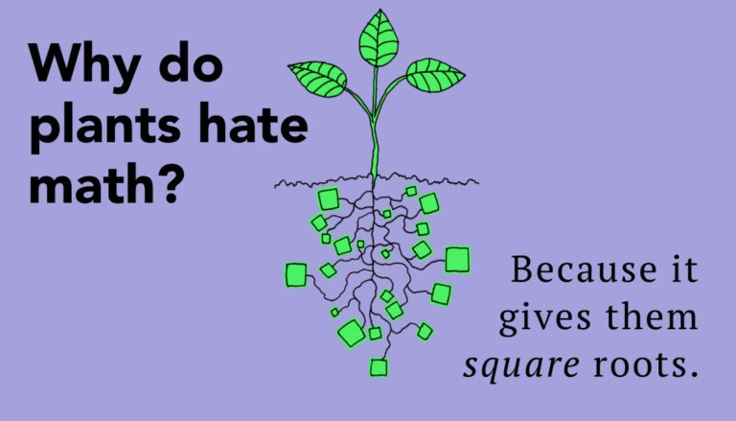
Thank You

Slide 25
Appendix

Slide 26
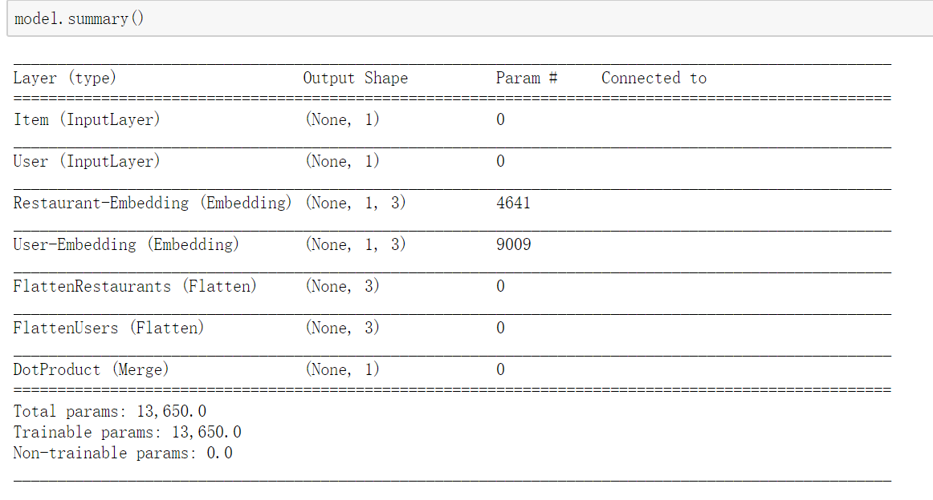
Appendix Project I: Deep Learning
Back

Slide 27
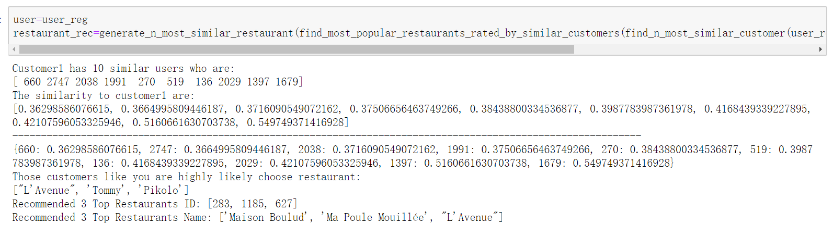
Appendix Project I: Recommendation Summary
Back
Notes:
vidusl

Slide 28
Appendix Project I: Recommendation Summary
Back

Slide 29
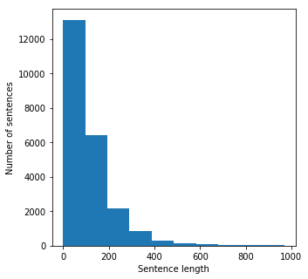
Appendix Project II: Review Length
Back

Slide 30
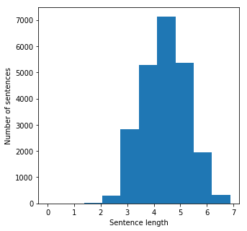
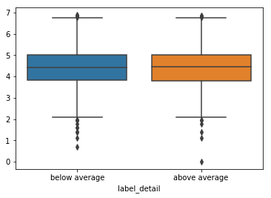
Appendix Project II: Review Length Logp1
Back

Slide 31
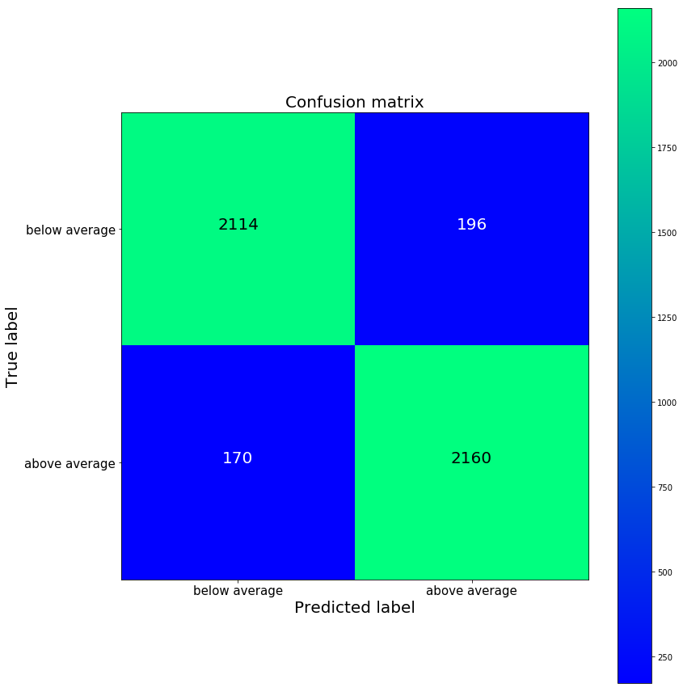
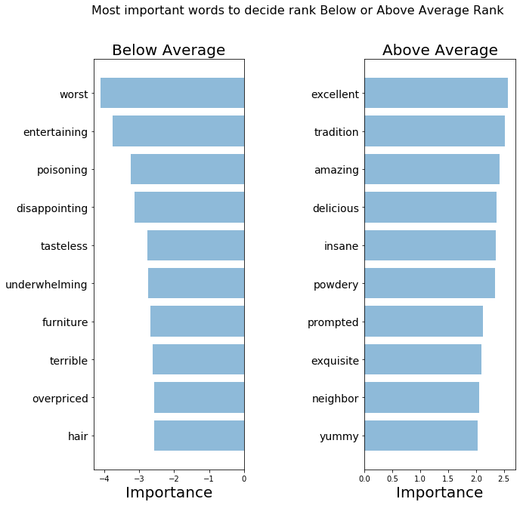
Appendix Project II: Validation CV
Back

Slide 32
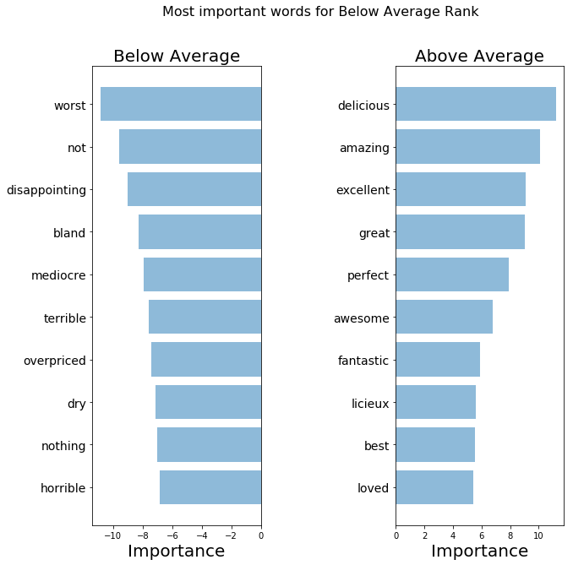

Appendix Project II: Validation TFIDF
Back

Slide 33
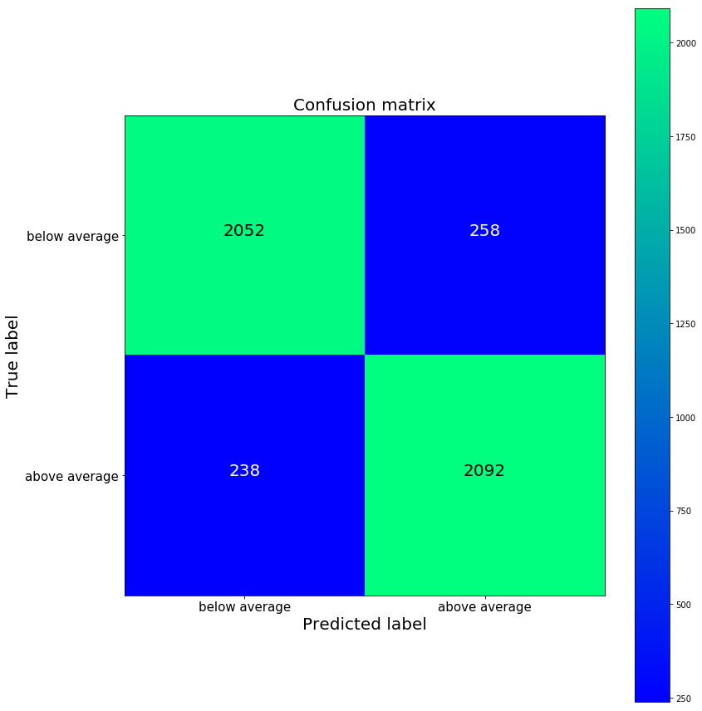
Appendix Project II: Validation word2vec
Back

Slide 34
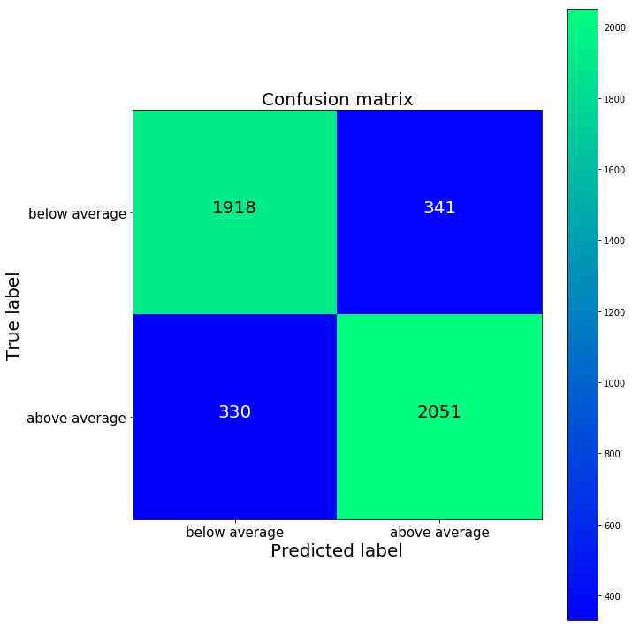
Appendix Project II: Validation Deep Learning
Back

Slide 35
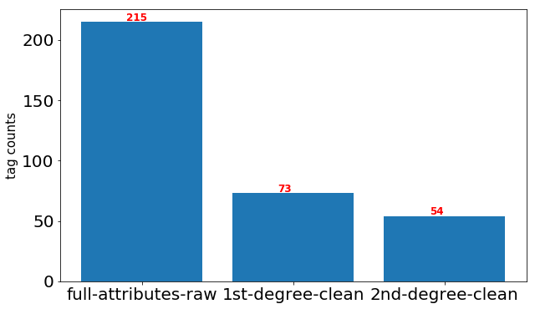
Appendix Project III: Categorical Clean
Back

Slide 36
Appendix Project IV: Categorical Clean
Back

Slide 37
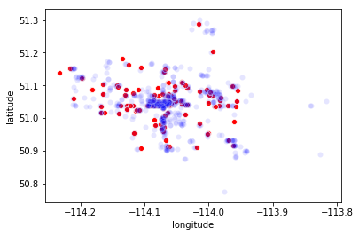
Appendix Project IV: Restaurant Density
Blue: Opening
Red: Closed
Back

Slide 38
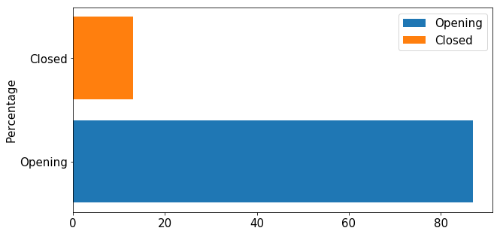
Appendix Project IV: SMOTE
Back

