Slide 1
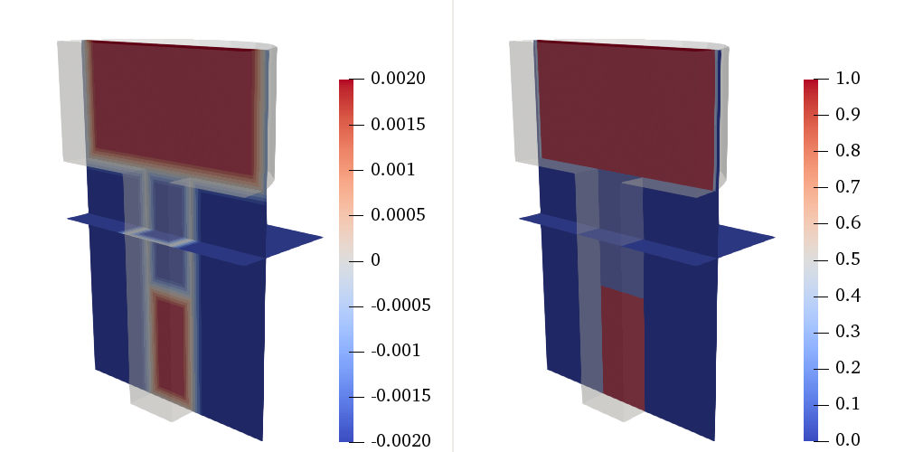
Distance [m]
1 - α

