Slide 1
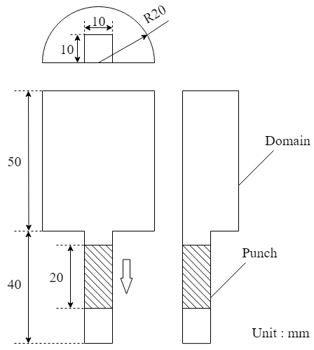
Figure 1. Schematic diagram

Slide 2
Table 1. Physical properties
Gas phase
Viscosity | 1.8×10⁻⁵ Pa・s
Density | 1 kg/m³
Solid phase
Density | 1500 kg/m³
Spring constant | 50 N/m
Coefficient of restitution | 0.9
Coefficient of friction | 0.3
Table 2. Calculation conditions
Particle diameter | 250 μm
Number of particles | 500,000
Grid size | 0.5 mm
Calculation time | 0.24 s

Slide 3
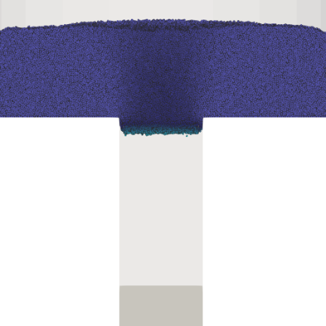
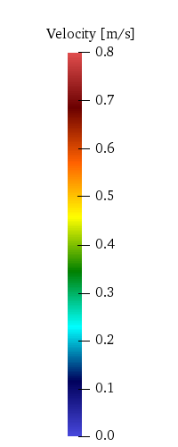
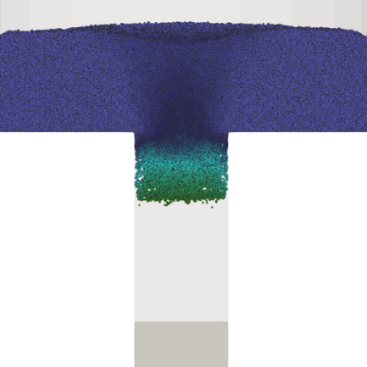
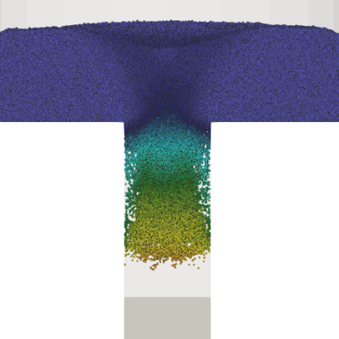
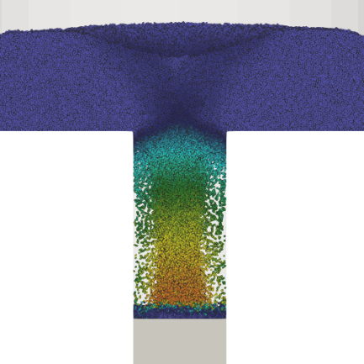
0.020 s
0.040 s
0.060 s
0.080 s
Figure 2. Powder velocity

Slide 4
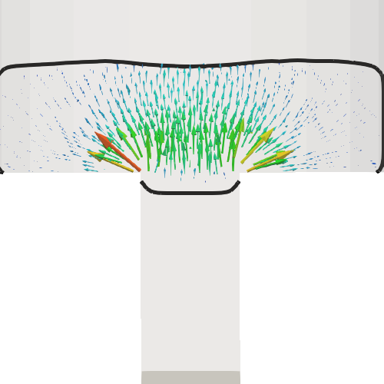
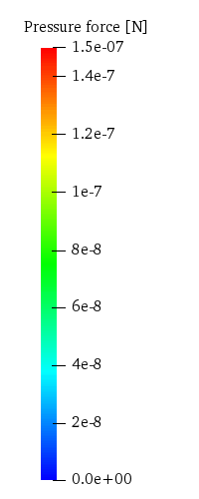
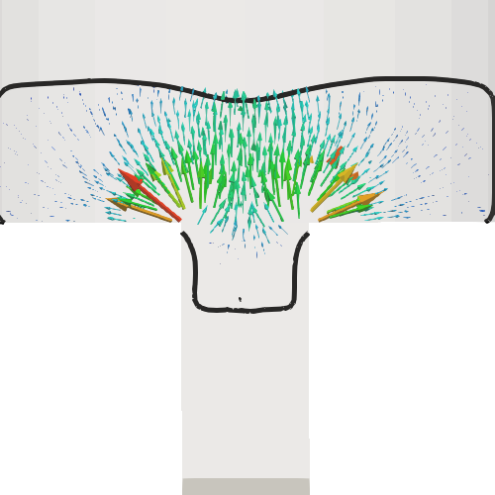
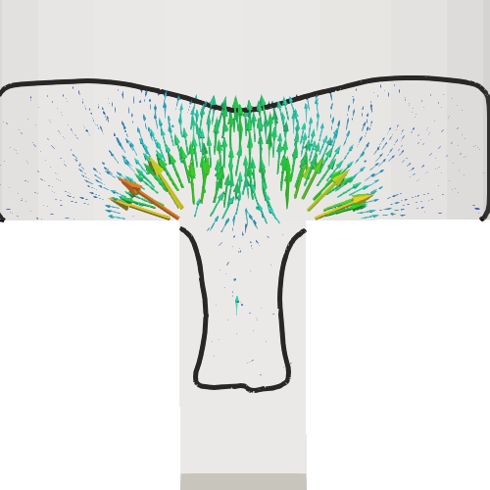
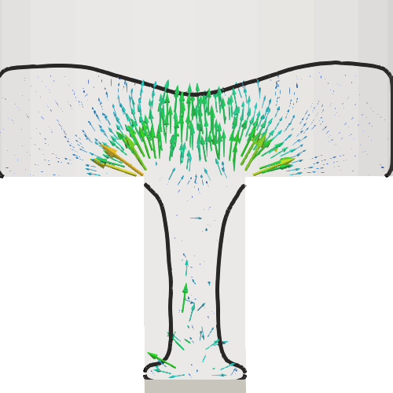
0.020 s
0.040 s
0.060 s
0.080 s
Figure 3. Pressure force

Slide 5
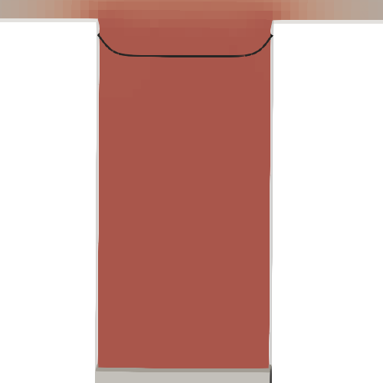
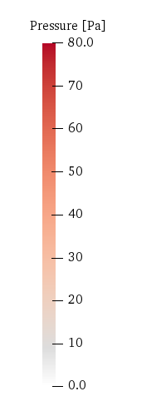
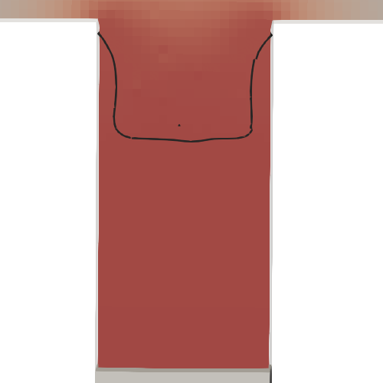
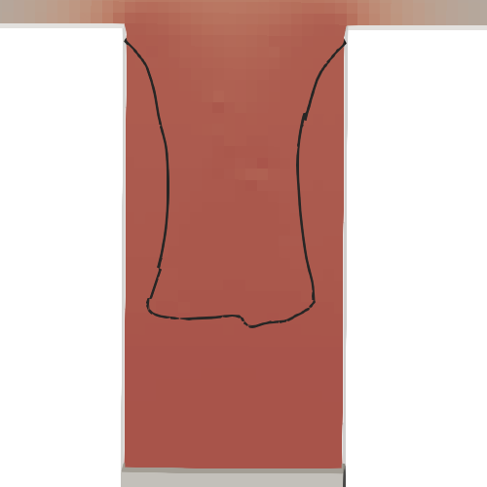

0.020 s
0.040 s
0.060 s
0.080 s
Figure 3. Pressure distribution

Slide 6
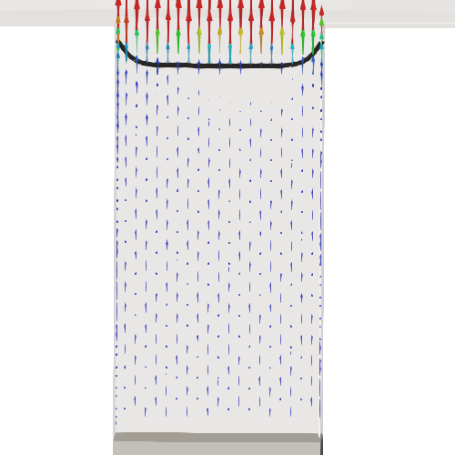
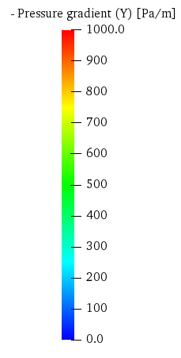
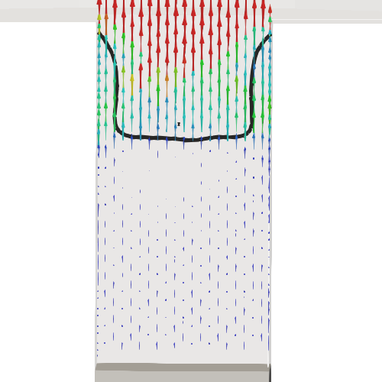
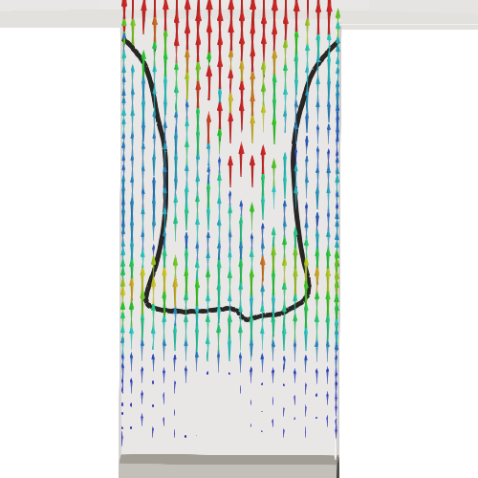
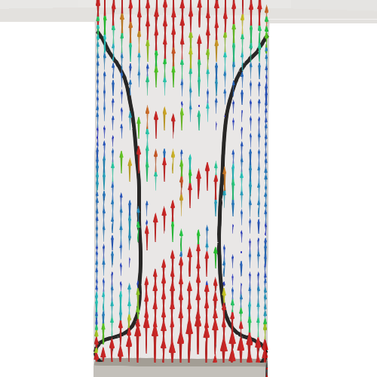
0.020 s
0.040 s
0.060 s
0.080 s
Figure 3-2. Pressure gradient

Slide 7
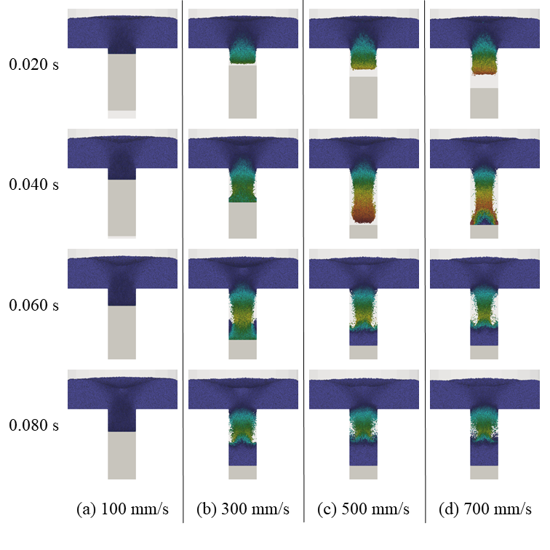
Figure 4. Powder velocity

Slide 8
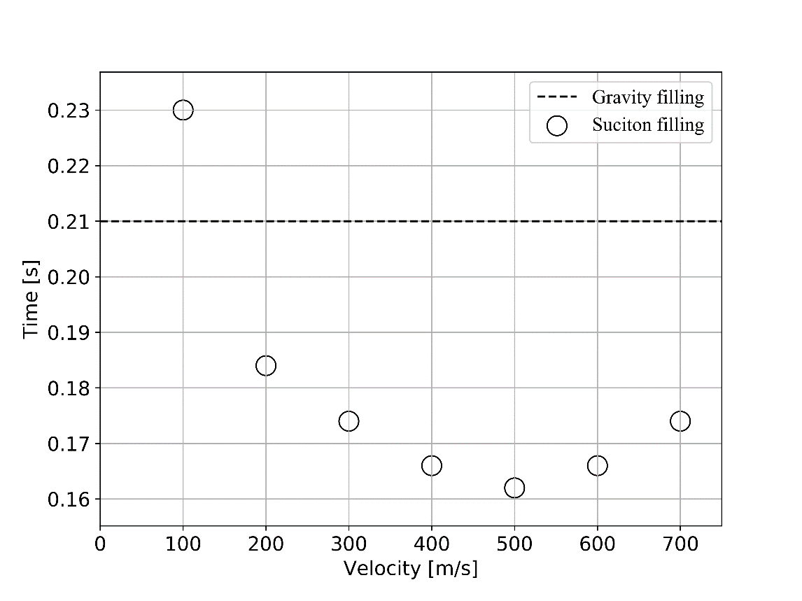
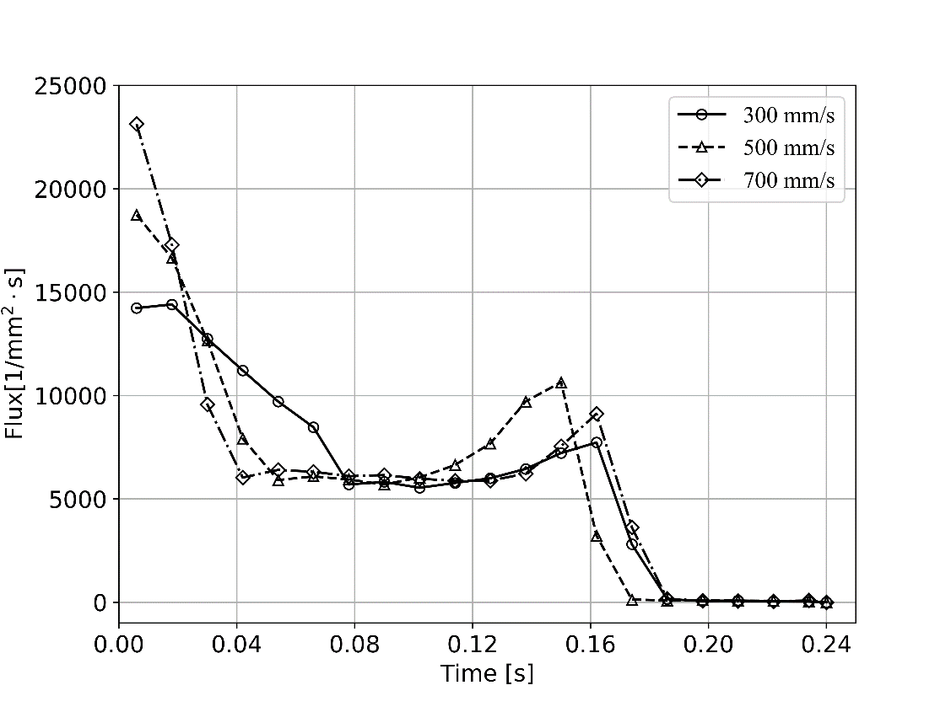
Figure 5. Filling time
Figure 6. Flux of powder flow

Slide 9
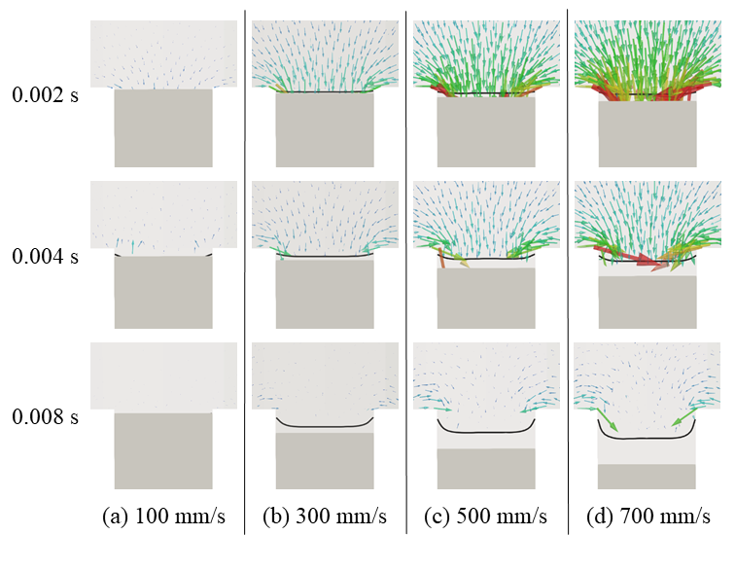
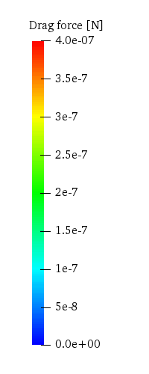
Figure 7. Drag force

Slide 10
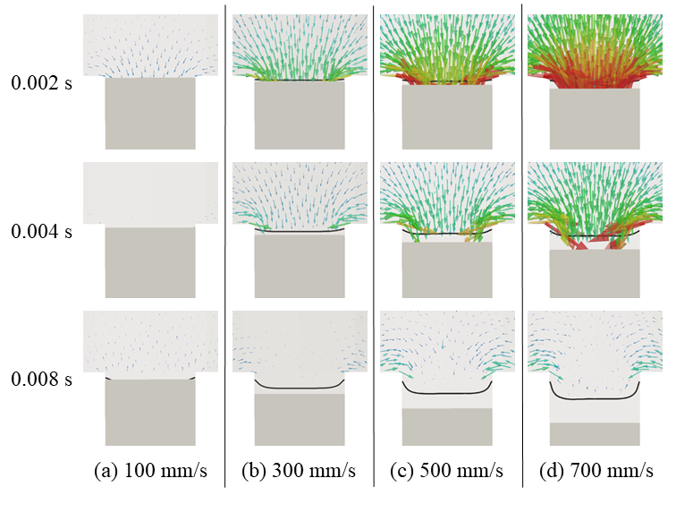
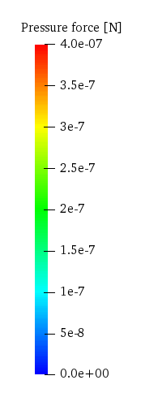
Figure 8. Pressure force

Slide 11
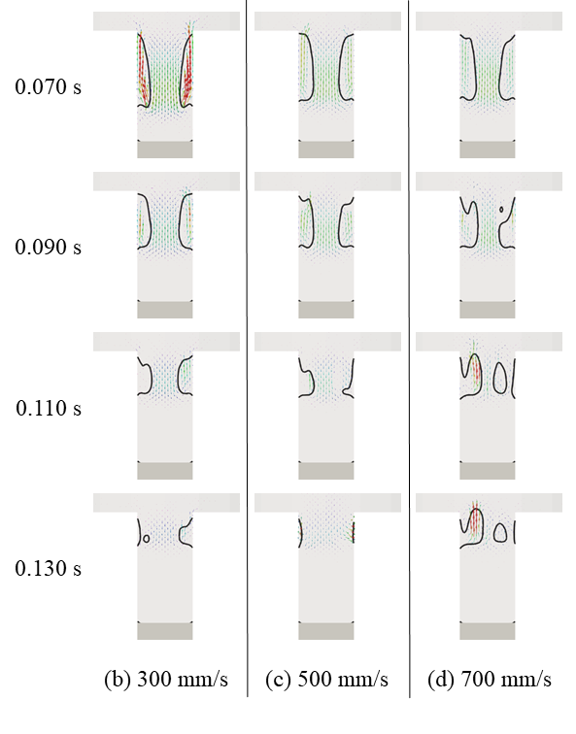
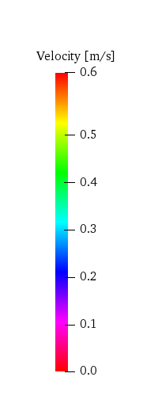
Figure 9. Air velocity

