Slide 1
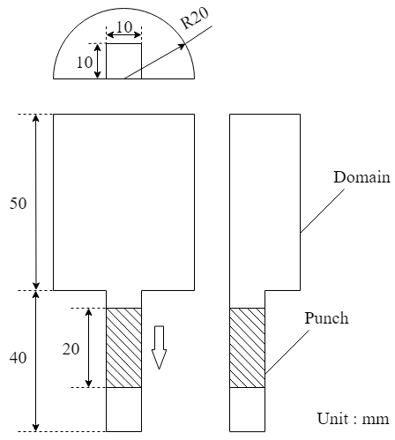
Figure 1. Schematic diagram

Slide 2
Table 1. Physical properties
Gas phase
Viscosity | 1.8×10⁻⁵ Pa・s
Density | 1 kg/m³
Solid phase
Density | 1500 kg/m³
Spring constant | 50 N/m
Coefficient of restitution | 0.9
Coefficient of friction | 0.3
Table 2. Calculation conditions
Particle diameter | 250 μm
Number of particles | 500,000
Grid size | 0.5 mm
Calculation time | 0.24 s

Slide 3
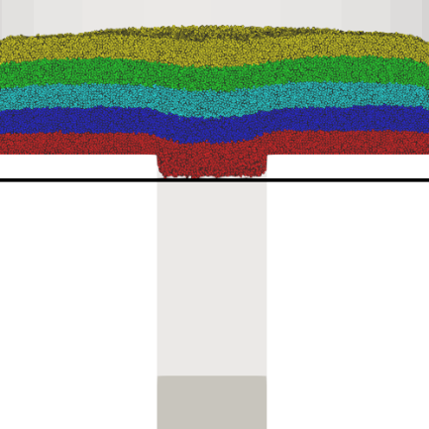
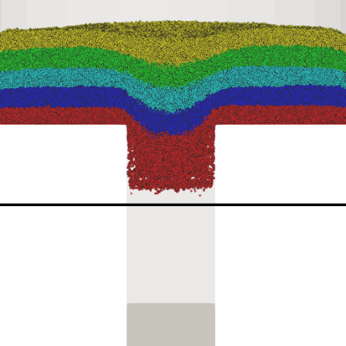
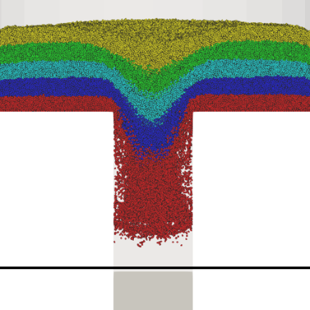
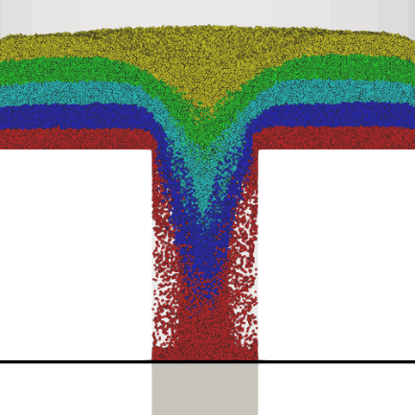
0.020 s
0.040 s
0.060 s
0.080 s
Figure 2. Particle distribution

Slide 4
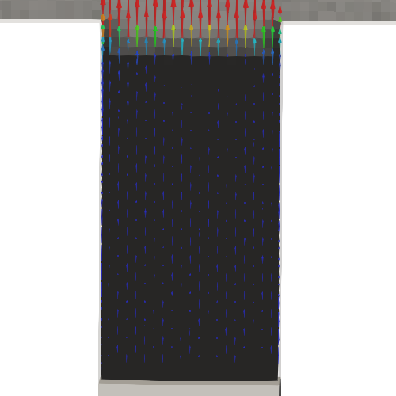
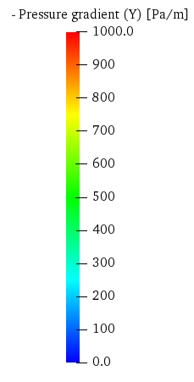
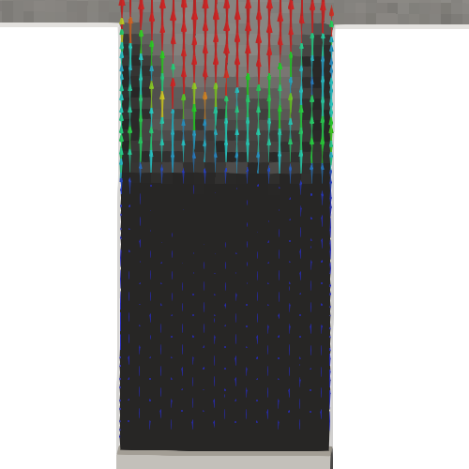
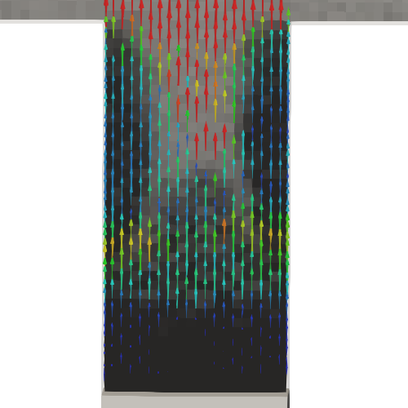
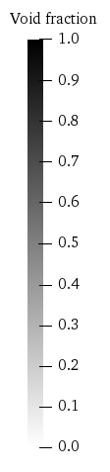
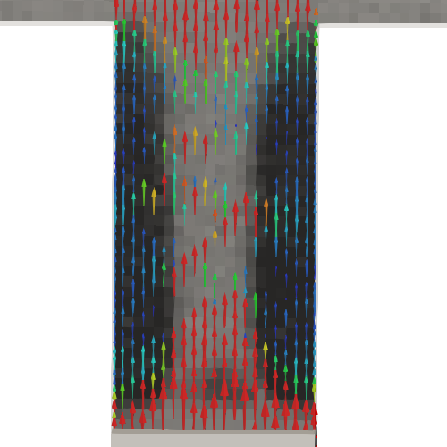
0.010 s
0.020 s
0.030 s
0.040 s
Figure 3. Pressure gradient

Slide 5
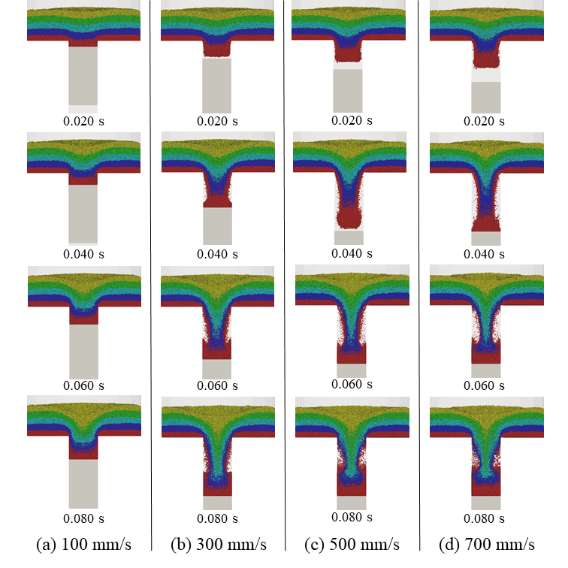
Figure 4. Particle distribution

Slide 6
Figure 5. Flux of powder flow

Slide 7
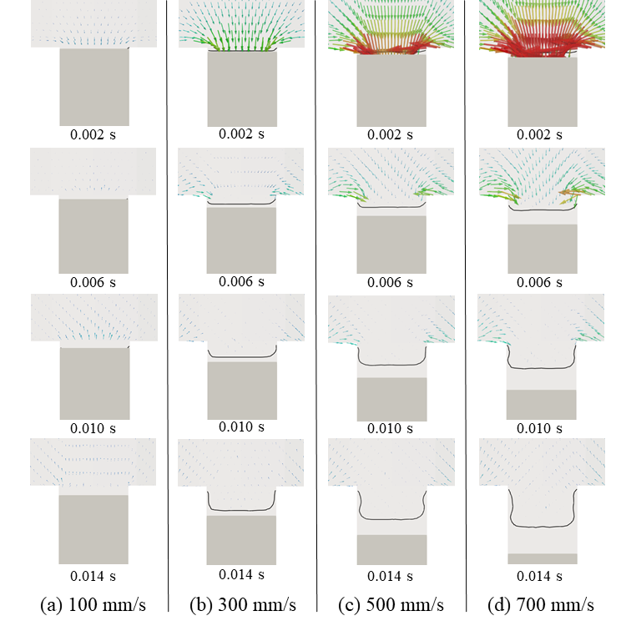
Figure 6. Pressure gradient

Slide 8
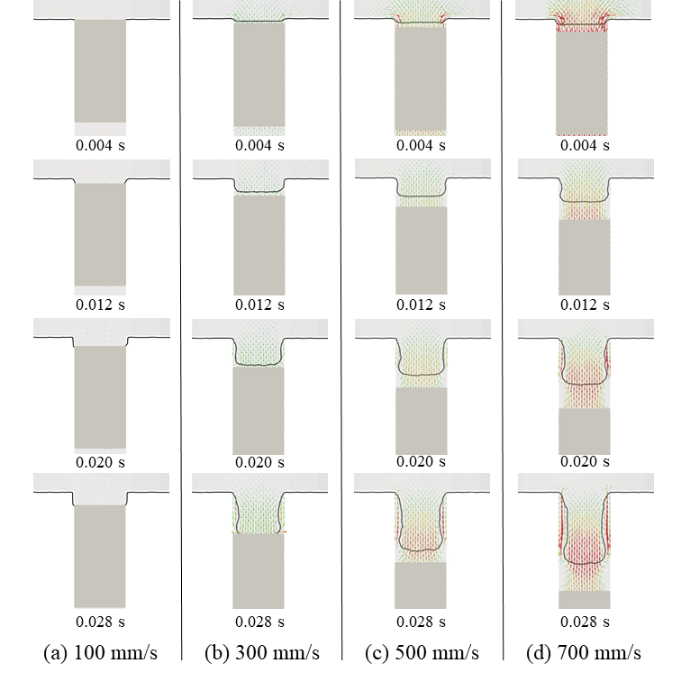
Figure 7. Air velocity

Slide 9
Figure 8. Bubble escape time and max volume

