Slide 1
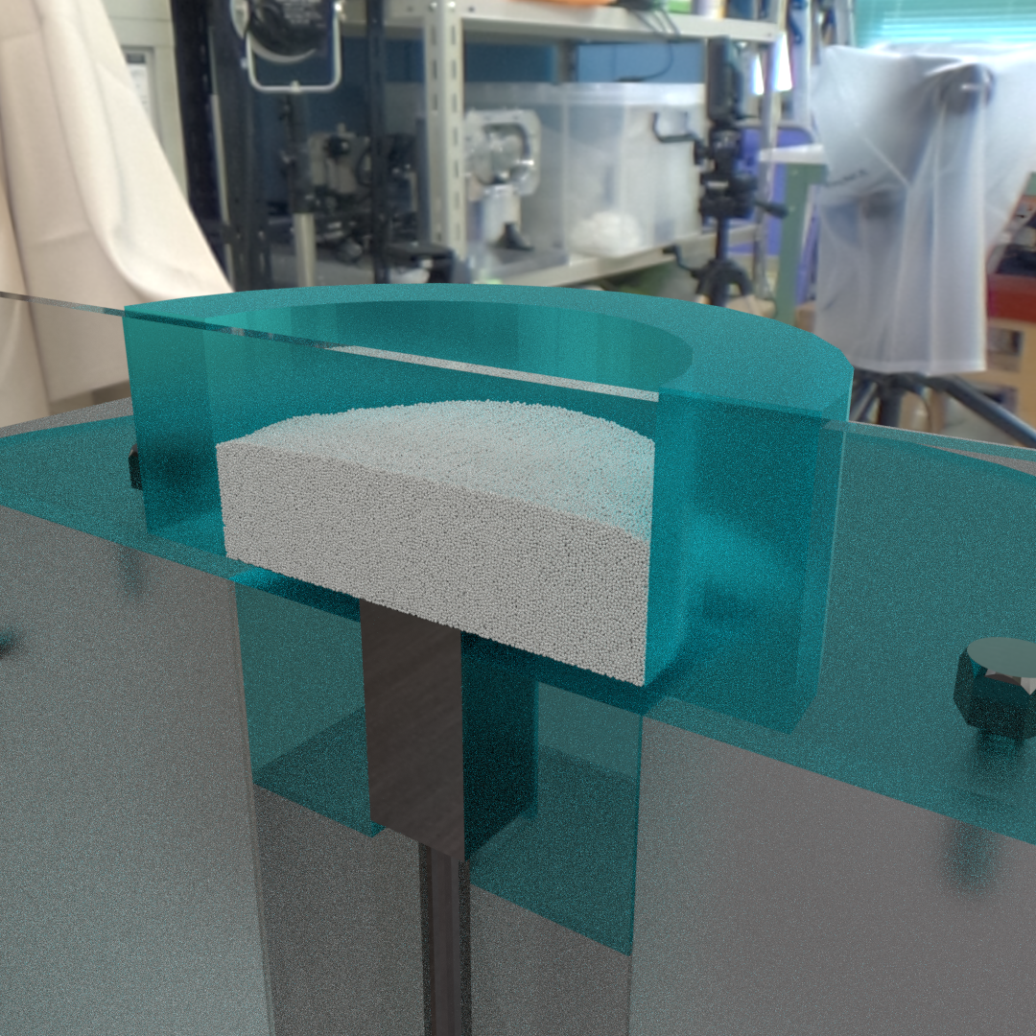
Φ 40 mm
20 mm
10 mm
10 mm

