Slide 1
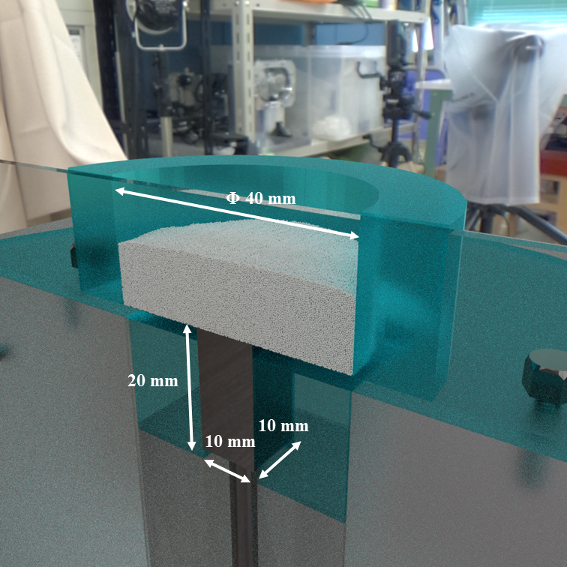
Figure 1. Schematic diagram

Slide 2
Table 1. Physical properties
Gas phase
Viscosity | 1.8×10⁻⁵ Pa・s
Density | 1 kg/m³
Solid phase
Density | 1500 kg/m³
Spring constant | 50 N/m
Coefficient of restitution | 0.9
Coefficient of friction | 0.3
Table 2. Calculation conditions
Particle diameter | 250 μm
Number of particles | 500,000
Grid size | 0.5 mm
Calculation time | 0.24 s

Slide 3
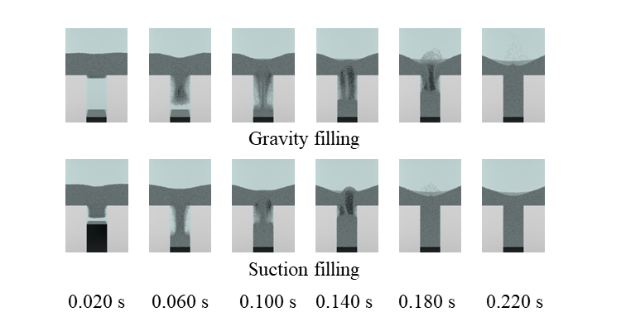
Figure 2. Powder distribution
In case suction filling, the punch speed was 500 mm/s.
Figure 3. Flux of powder into die region

Slide 4
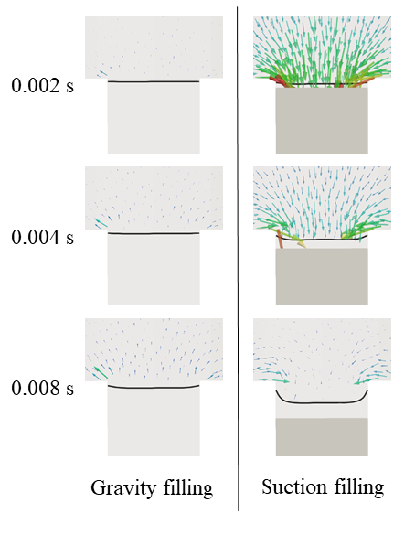
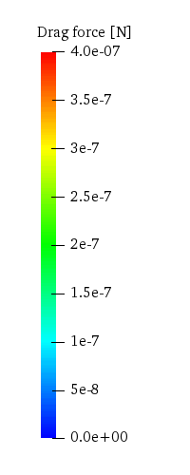
Figure 4. Drag force

Slide 5
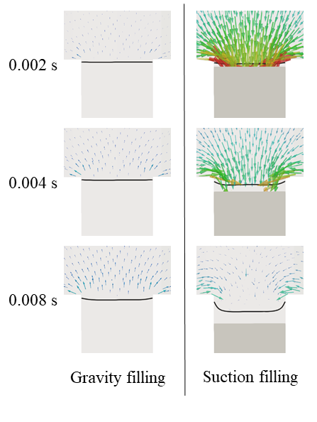
Figure 5. Pressure force

Slide 6
Figure 6. Number of suctioned particles

Slide 7
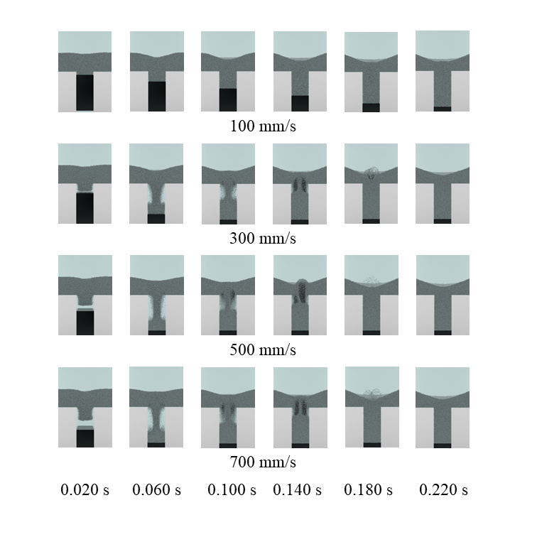
Figure 7. Powder distribution

Slide 8
Figure 8. Filling time
Figure 9. Flux of powder into die region

Slide 9
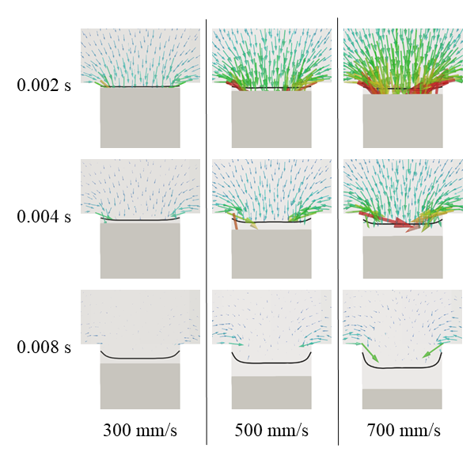
Figure 4. Drag force

Slide 10
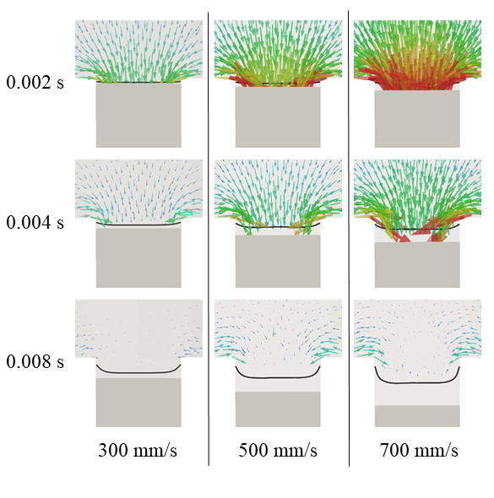
Figure 5. Pressure force

Slide 11
Figure 10. Number of suctioned particles by drag force
Figure 11. Number of suctioned particles by pressure gradient

Slide 12
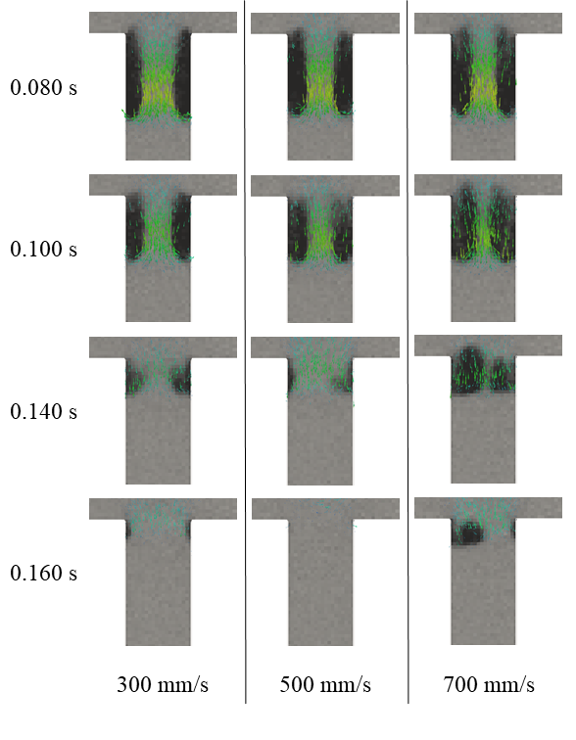
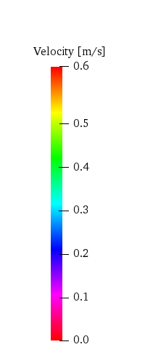
Figure 12. Bubble movement

