Slide 1
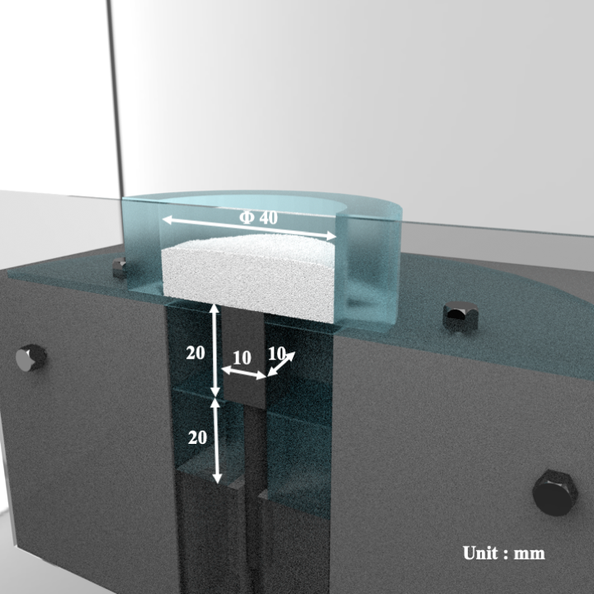
Figure 1. Schematic diagram

Slide 2
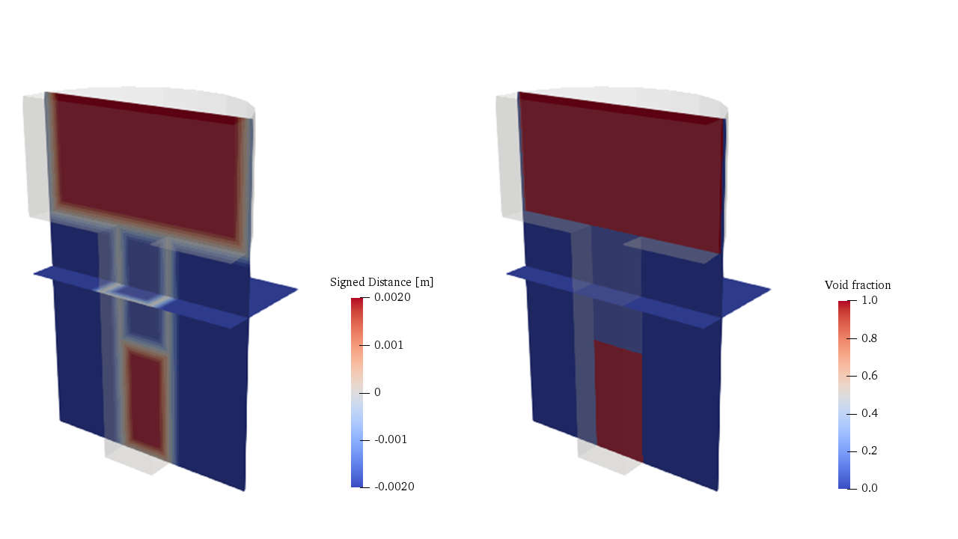
Figure 2. SDF and IBM

Slide 3
Table 1. Physical properties
Gas phase
Viscosity | 1.8×10⁻⁵ Pa・s
Density | 1 kg/m³
Solid phase
Density | 1500 kg/m³
Spring constant | 50 N/m
Coefficient of restitution | 0.9
Coefficient of friction | 0.3
Table 2. Calculation conditions
Particle diameter | 250 μm
Number of particles | 500,000
Grid size | 0.5 mm
Calculation time | 0.24 s

Slide 4
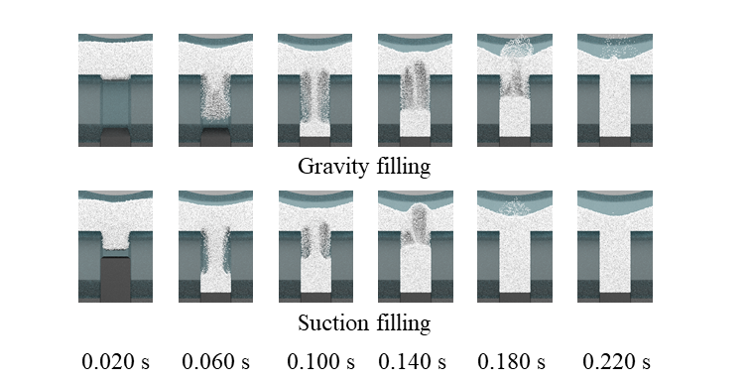
Figure 3. Powder distribution
In case suction filling, the punch speed was 500 mm/s.
Figure 4. Number of particles in die region

Slide 5
Figure 5. Flux of powder into die region

Slide 6
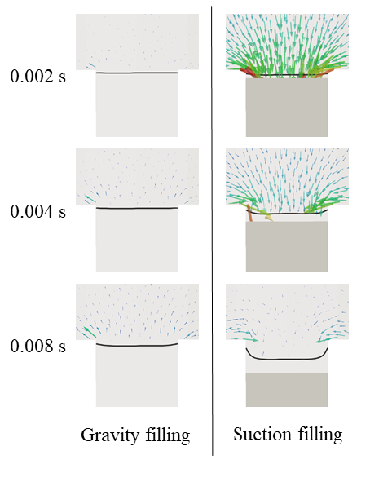
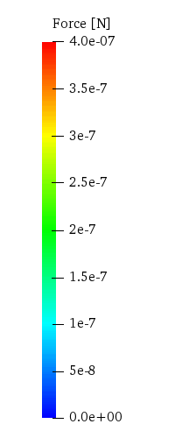
Figure 6. Drag force

Slide 7
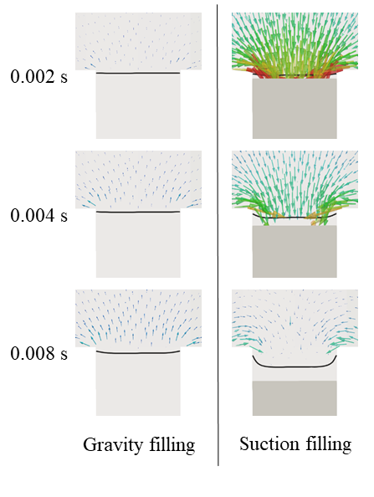
Figure 7. Pressure force

Slide 8
Figure 8. Number of suctioned particles

Slide 9
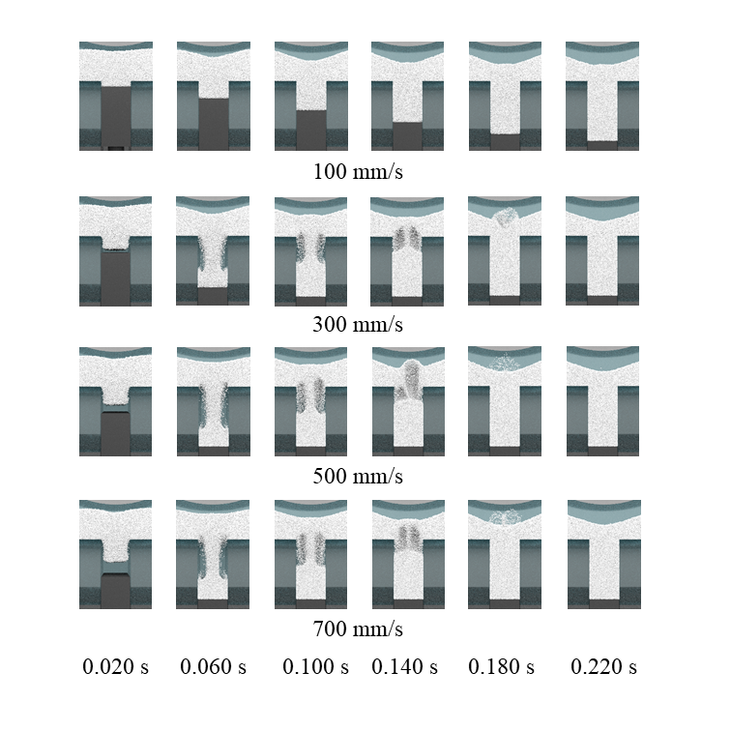
Figure 9. Powder distribution

Slide 10
Figure 10. Number of particles in die region

Slide 11
Figure 11. Filling time
Figure 12. Flux of powder into die region

Slide 12
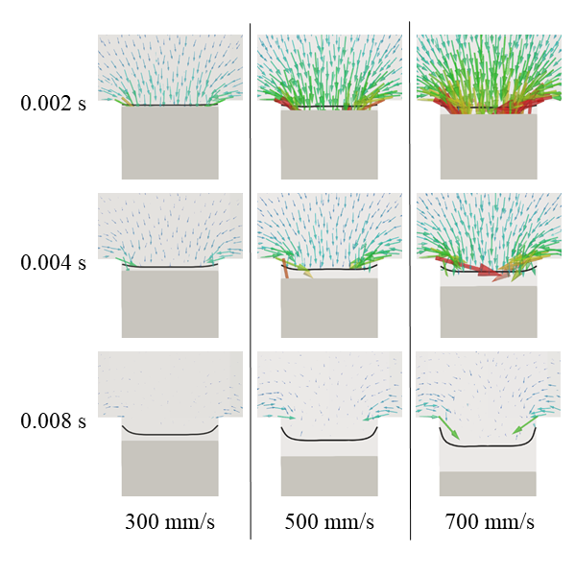
Figure 13. Drag force

Slide 13
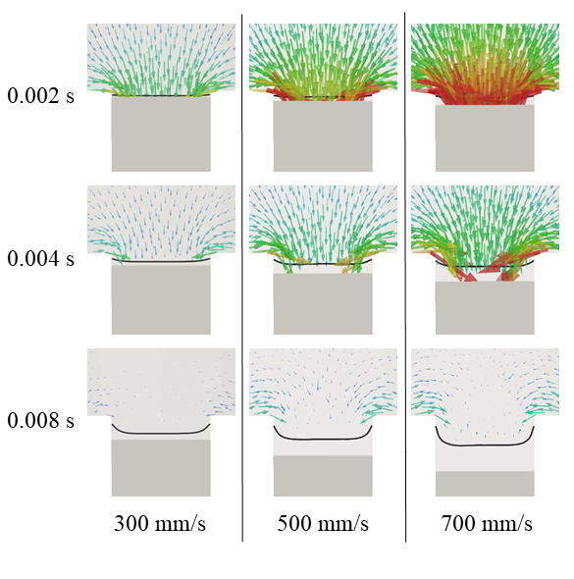
Figure 14. Pressure force

Slide 14
Figure 15. Number of suctioned particles by drag force
Figure 16. Number of suctioned particles by pressure gradient

Slide 15
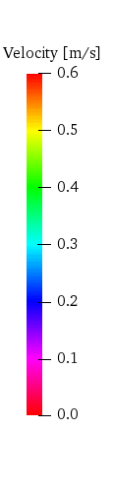
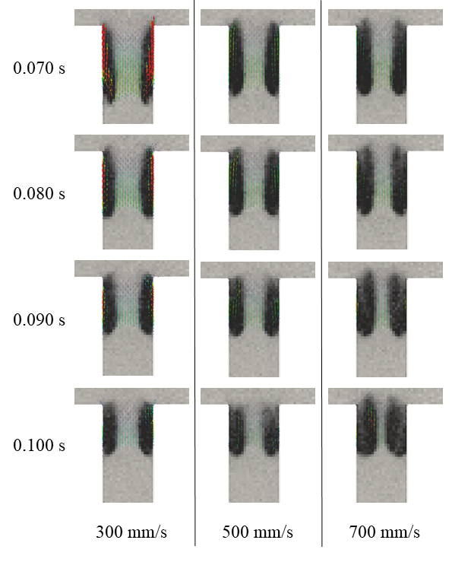
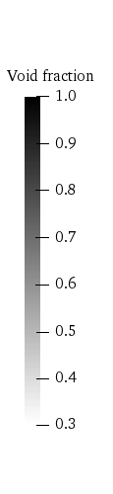
Figure 17. Air velocity

