Slide 1
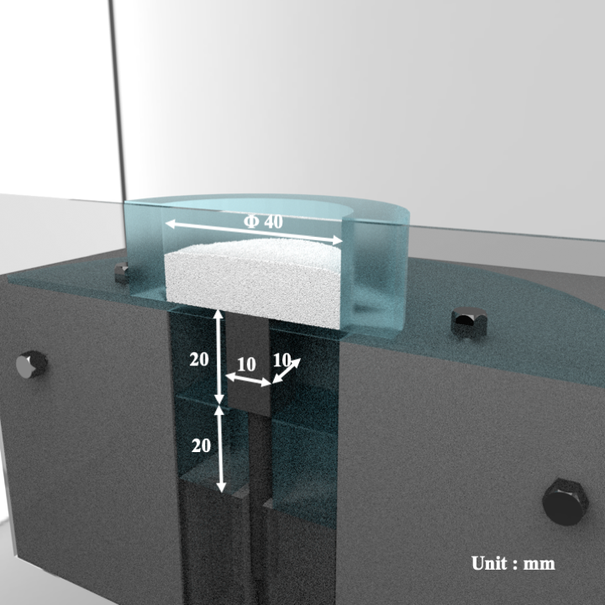
Figure 1. Schematic diagram

Slide 2
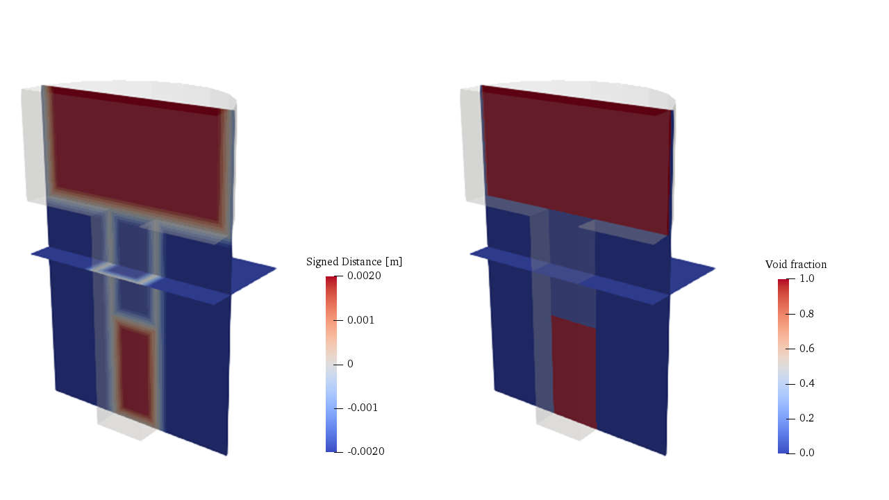
Figure 2. SDF and IBM

Slide 3
Table 1. Physical properties
Gas phase
Viscosity | 1.8×10⁻⁵ Pa・s
Density | 1 kg/m³
Solid phase
Density | 1500 kg/m³
Spring constant | 50 N/m
Coefficient of restitution | 0.9
Coefficient of friction | 0.3
Table 2. Calculation conditions
Particle diameter | 250 μm
Number of particles | 500,000
Grid size | 0.5 mm
Calculation time | 0.24 s

Slide 4
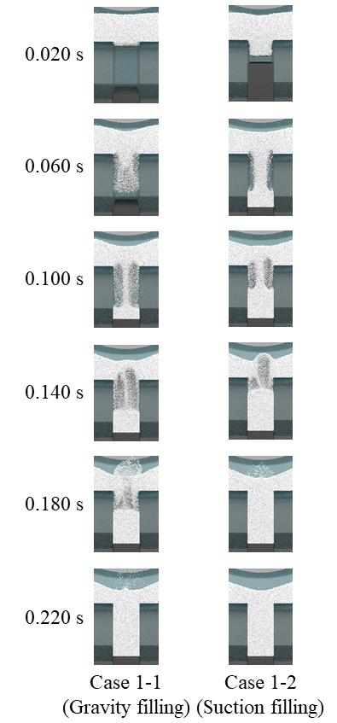
図3. Case1における粒子配置のスナップショット（Case 1-2における下杵の降下速度：500 mm/s）

Slide 5
図4. 金型領域における粒子数の時間変化
図5. 金型領域に対する流入フラックスの時間変化

Slide 6
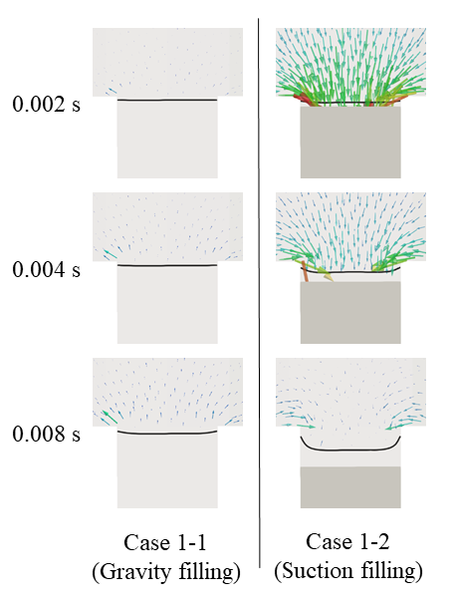
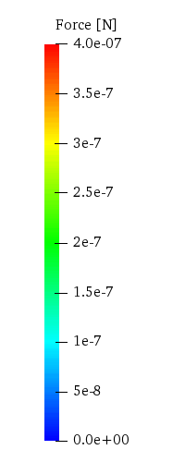
図6. 充填の初期において粉末粒子に作用する流体抗力（図中の黒い実線は空隙率0.9の境界線を表す）

Slide 7
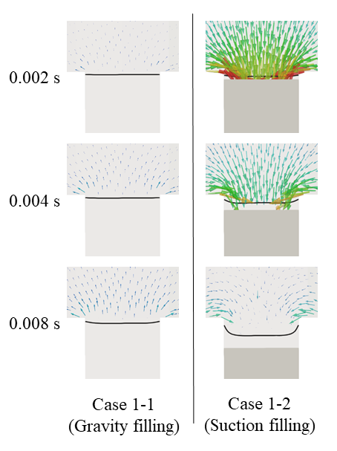
Figure 7. Pressure force

Slide 8
Figure 8. Number of suctioned particles

Slide 9
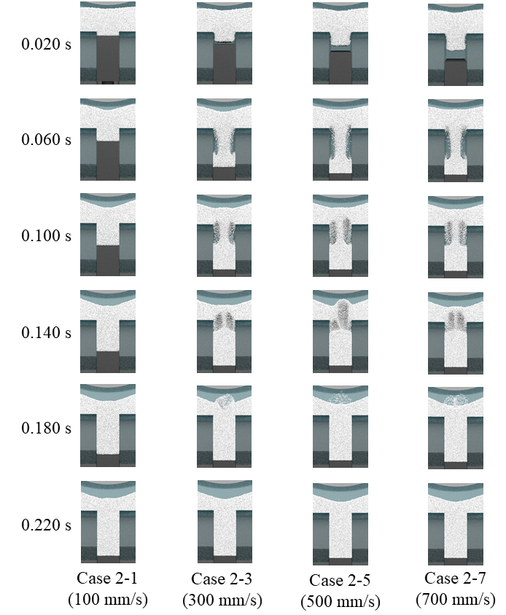

Slide 10
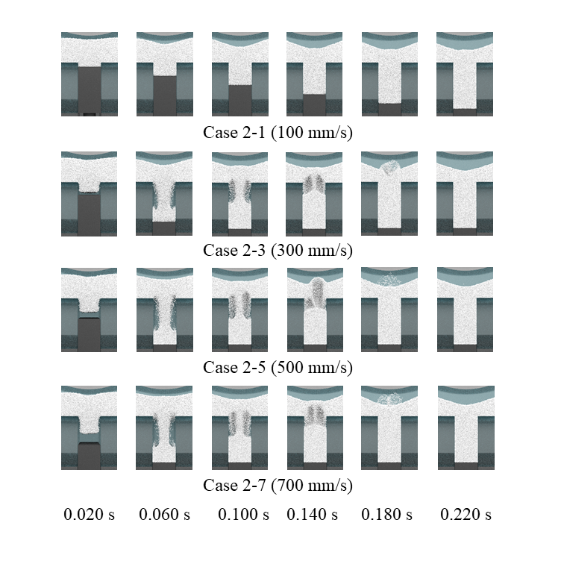
Figure 9. Powder distribution

Slide 11
Figure 10. Number of particles in die region

Slide 12
Figure 11. Filling time
Figure 12. Flux of powder into die region

Slide 13
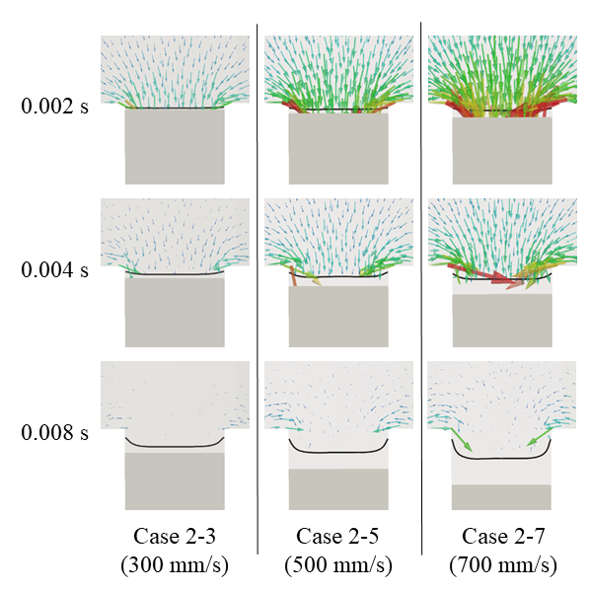
Figure 13. Drag force

Slide 14
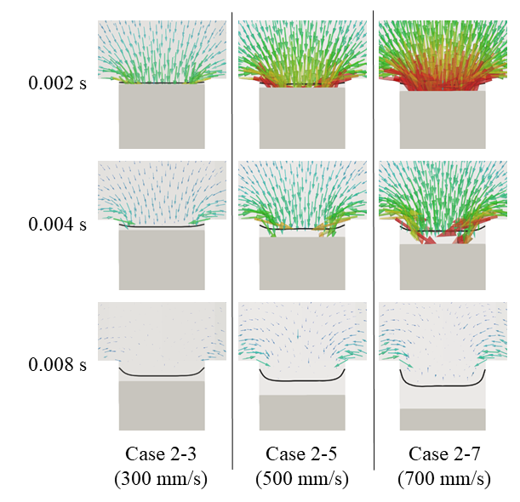
Figure 14. Pressure force

Slide 15
Figure 15. Number of suctioned particles by drag force
Figure 16. Number of suctioned particles by pressure gradient

Slide 16
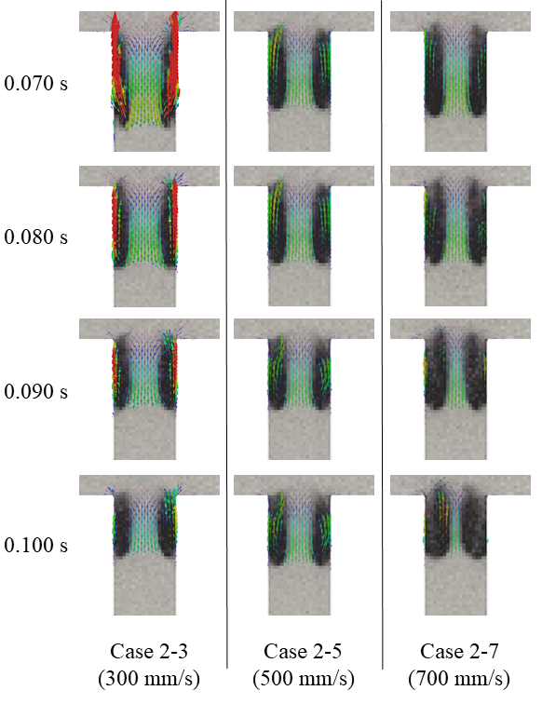
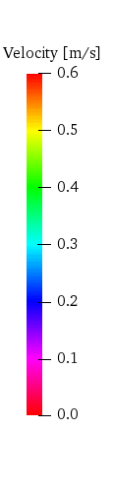
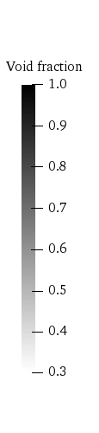
Figure 17. Air velocity

