Slide 1
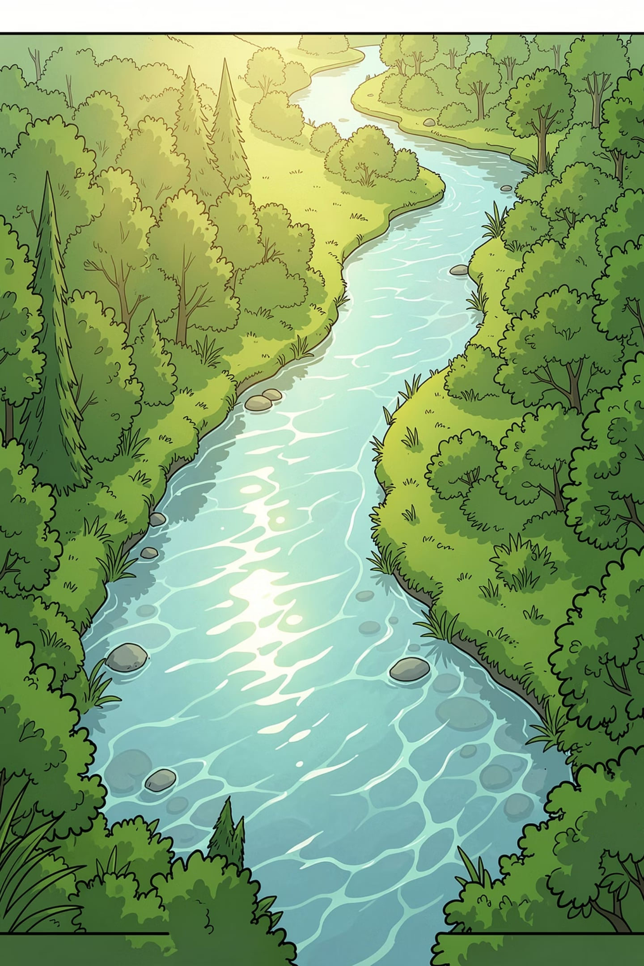
Water Pollution Analysis using Power BI
A Data Science Project for Environmental Monitoring
This project analyzes water pollution data from multiple states, cities, and water sources to identify pollution patterns, unsafe water bodies, and major contaminants — using interactive Power BI dashboards to support environmental decision-making.

Slide 2



Project Objectives & Scope
Why It Matters
Why Power BI
Expected Outcomes
Water pollution threatens public health, ecosystems, and agriculture. Timely, data-driven insights are essential for effective intervention.
Power BI enables interactive dashboards, real-time filtering, and intuitive visuals — ideal for exploring complex environmental datasets.
Identify high-risk regions, dominant pollutants, vulnerable water sources, and temporal trends to guide policy and remediation efforts.

Slide 3





Dataset Description & Data Preprocessing
Dataset Fields
Data Cleaning Steps
State & City
Year & Water Source
Pollutant Type & Pollution Level
pH Level, Dissolved Oxygen, Temperature
Safe Limit Status
Removed duplicate records
Handled missing and null values
Standardized state and city names
Corrected inconsistent text values
Converted data types where required
Removed unnecessary columns
Checked for outliers
Created a clean dataset for Power BI visualization
Raw Dataset
Data Cleaning
Transformation
Power BI Visualization
Insights

Slide 4
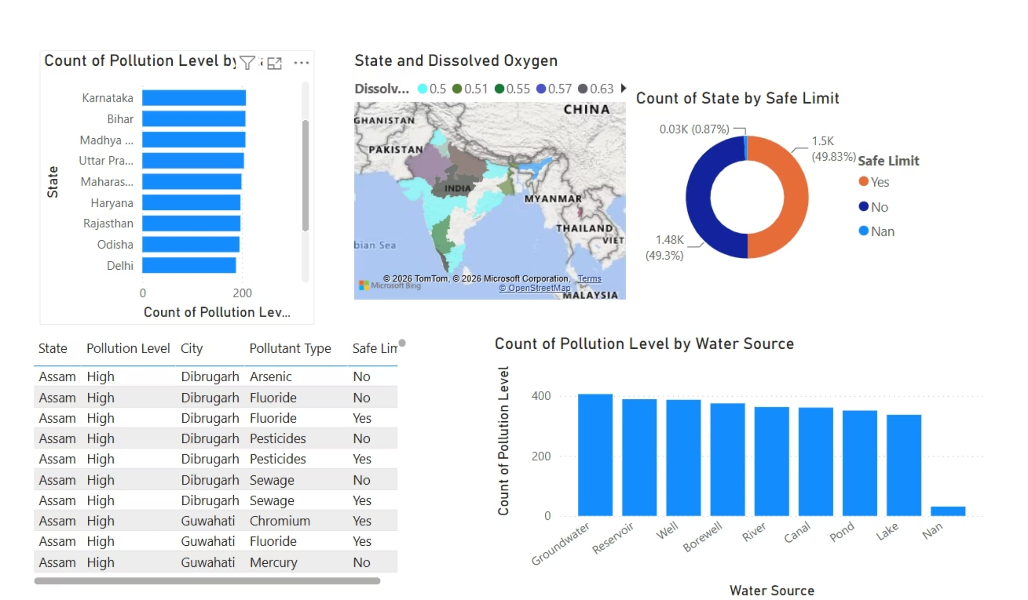
QUESTION 1
Which States Have the Highest Water Pollution?
Key Insights
States with the highest concentration of unsafe water bodies
Geographic clustering of pollution hotspots
Correlation between industrial activity and pollution levels
States exceeding safe limits across multiple parameters

Slide 5
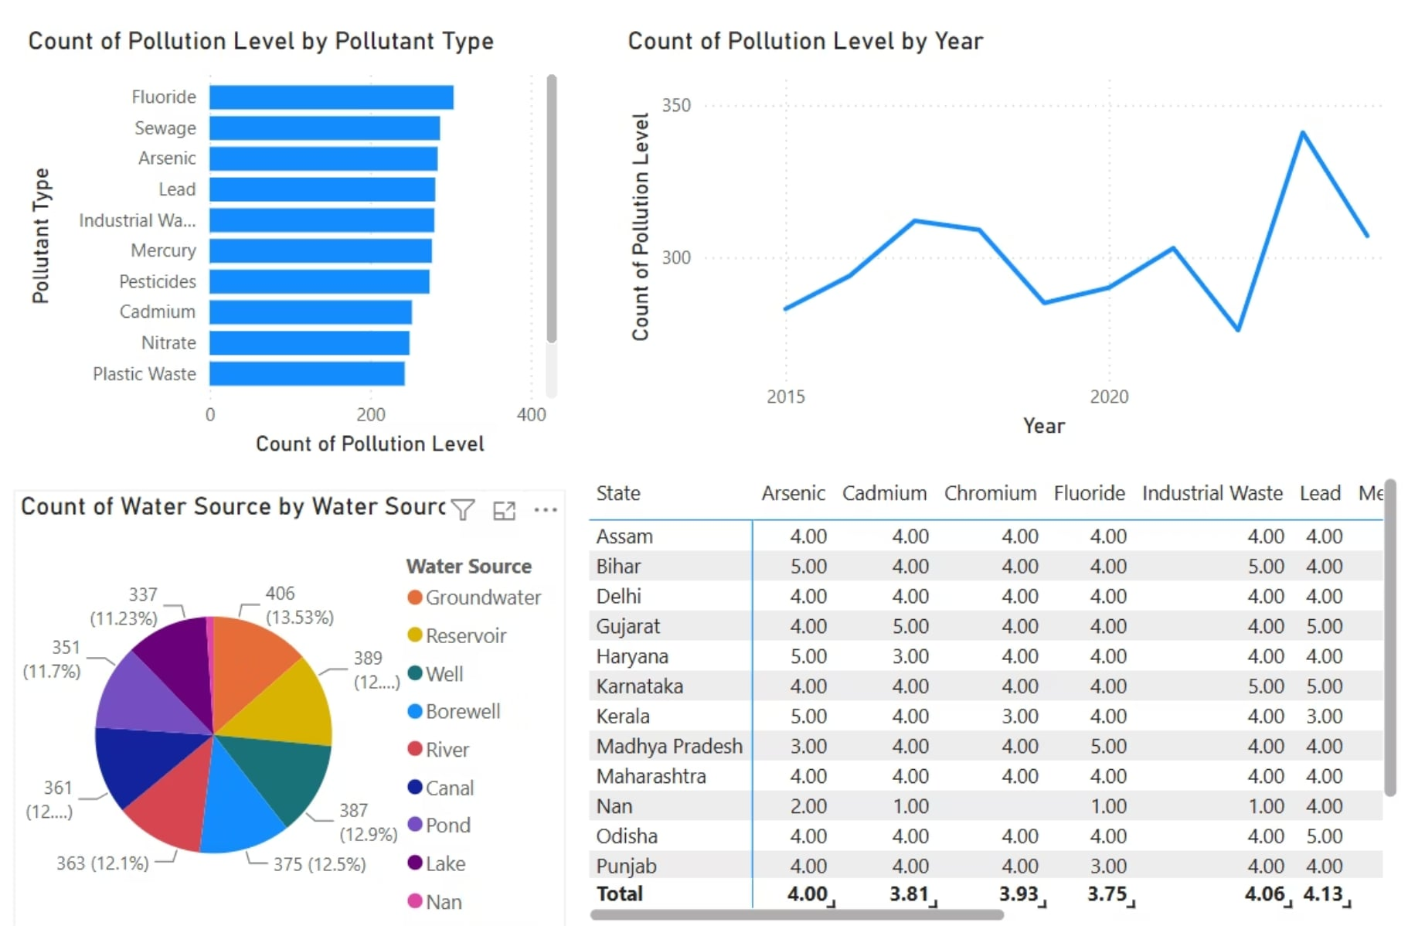
QUESTION 2
Which Pollutant Contributes the Most to Water Pollution?
Key Insights
Most frequently detected pollutants across all water sources
Pollutants most often exceeding safe thresholds
Dominant pollutant types by state or region
Seasonal or annual variation in pollutant prevalence

Slide 6
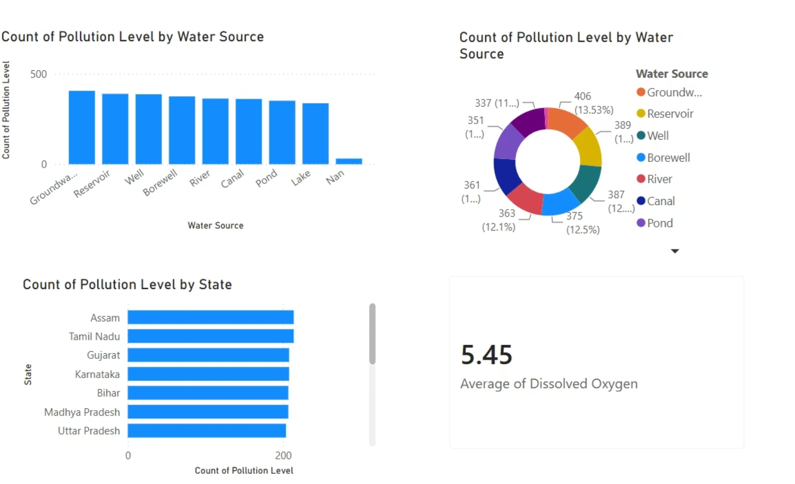
QUESTION 3
Which Water Source is Most Polluted?
Key Insights
Pollution levels across rivers, lakes, groundwater, and reservoirs
Water sources most vulnerable to contamination
Safe limit violation rates by source type
Implications for drinking water and irrigation

Slide 7
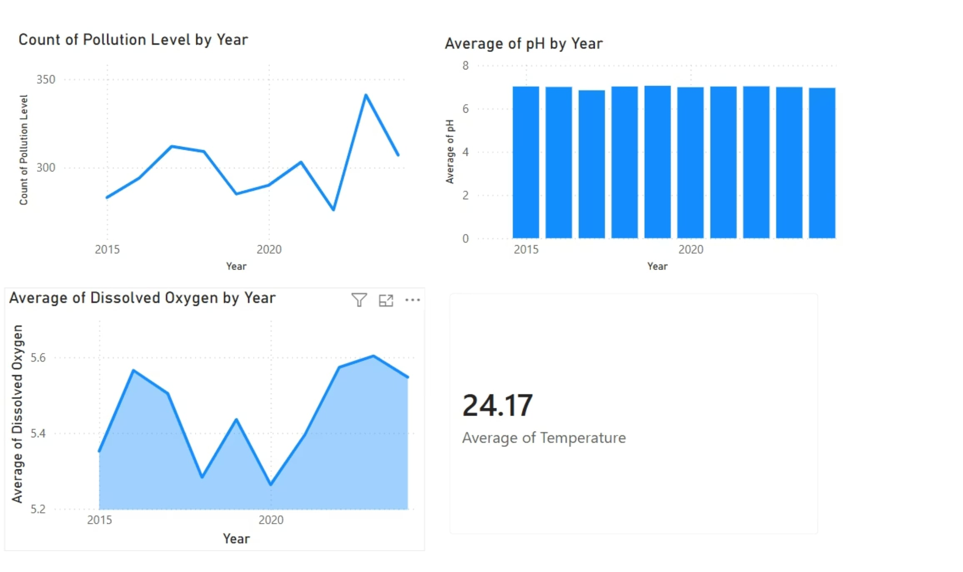
QUESTION 4
How Has Water Pollution Changed Over Time?
Key Insights
Year-over-year trends in overall pollution levels
Improvement or deterioration patterns by state
Impact of policy interventions or industrial growth
Forecasting potential future risk zones

Slide 8
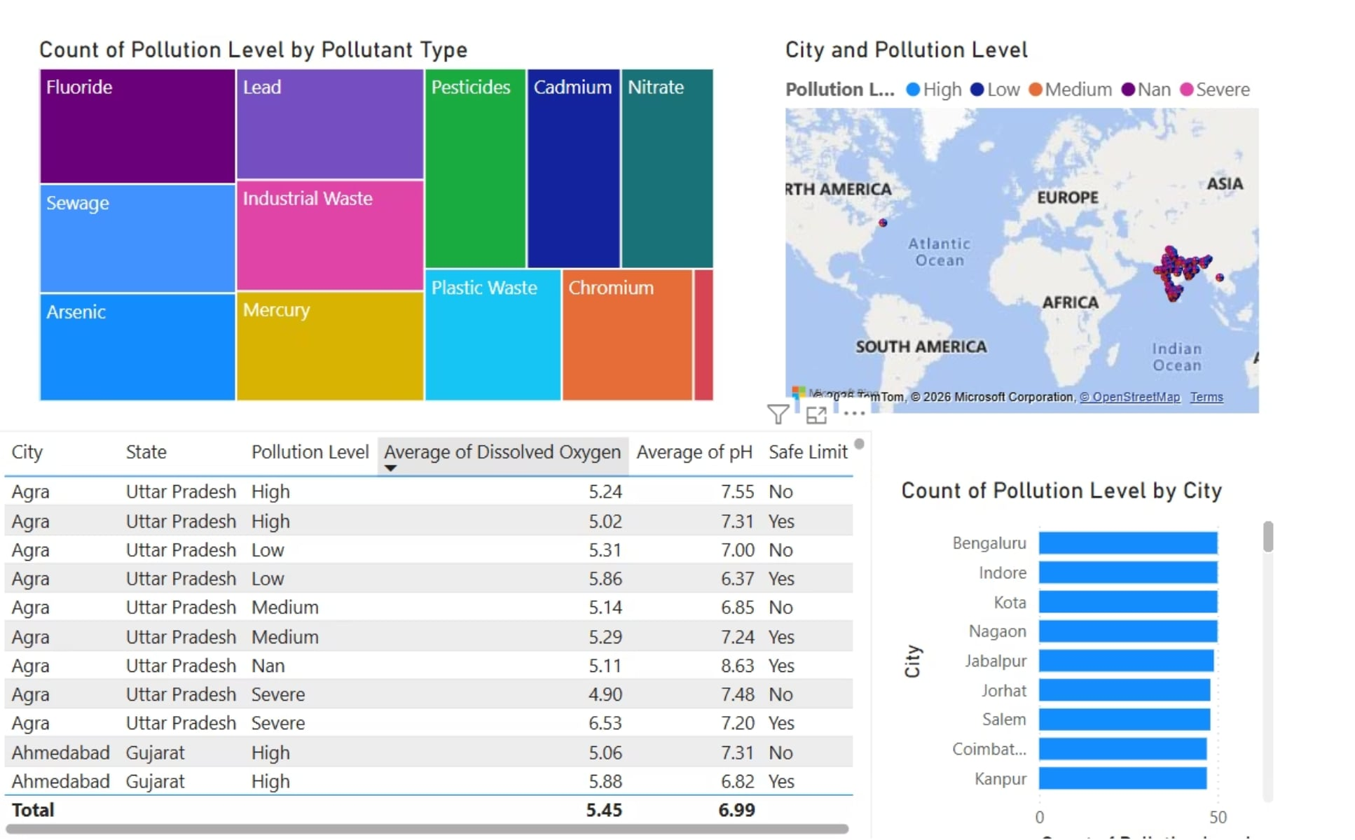
QUESTION 5
Which Cities Require Immediate Attention?
Key Insights
Cities with the highest frequency of unsafe readings
Urban areas with multiple failing water parameters
Priority ranking for remediation and resource allocation
Cities showing worsening trends requiring urgent action

Slide 9

Conclusion & Key Takeaways
This project demonstrates how Power BI can transform raw environmental data into actionable insights — enabling stakeholders to identify pollution hotspots, track trends, and prioritize intervention efforts across states and cities.
Data-Driven Monitoring
Policy Impact
Findings can guide targeted environmental regulations and resource allocation.
Interactive dashboards make complex pollution data accessible and actionable.
Scalable Framework
The methodology can be extended to additional regions and real-time data feeds.

