Slide 1
BAND Project 2
Copy of BAND Project2.xlsx

Slide 2
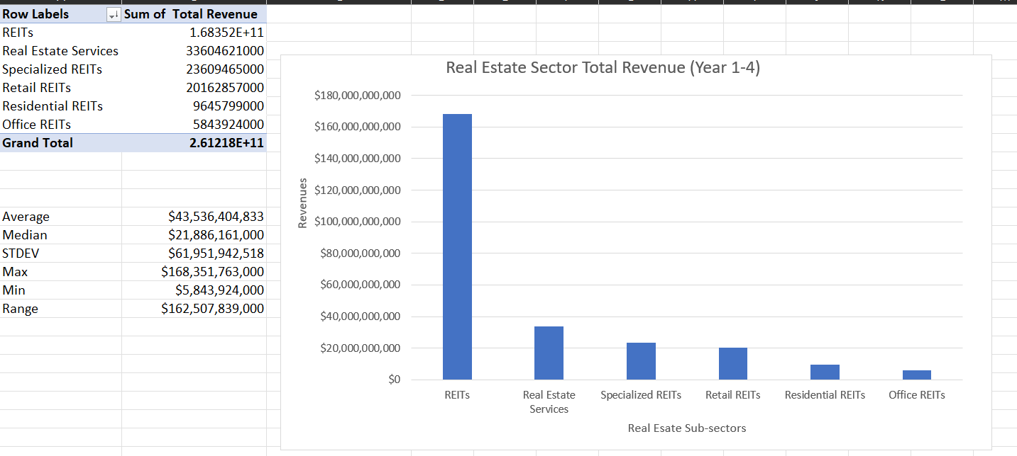
Real Estate Sector and Sub-sectors
Histogram
The histogram for the real estate subsection shows how the REITs makes significantly higher revenues than any of the other sub-sectors.
Looking at the range which is large predict a greater possibility of loss.
The mean is greater than the median which is a positive skewed.
The STDEV is lower than the mean and shows a positive outcome.
<visualization or summary statistics used for finding>

