Slide 1
Predicting Student Educational Performance with Machine Learning
Author: Kostantinos Morfesis

Slide 2
Problem Statement
Question: What causes students to academically under perform?
Why care?
  Helps beat poverty
  Decreased reliance on public assistance
  Linked to Healthier behaviors (69% vs. 45% report exercising vigorously once a week)
  Job security
Answer: Determine what causes students to fail
  With what accuracy can we predict final grades?
  How can we utilize this information?

Slide 3
Solving the Problem: Data Sources
Portugal Questionnaire: 649 students grades for three periods of the school year with 33 different attributes
Programme for International Student Assessment (PISA) test results
Percent of government expenditure on education (OECD)
Average class size by country (OECD)

Slide 4
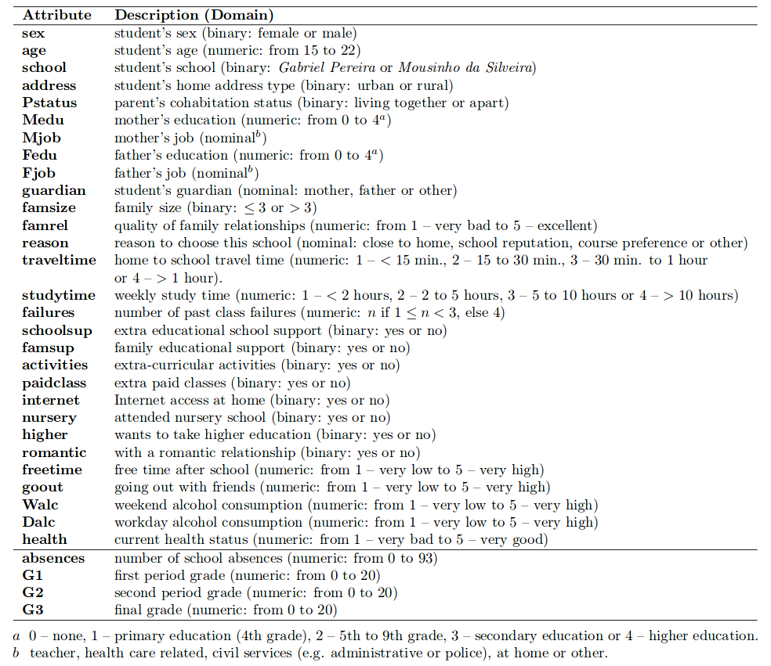
Questionnaire Features
Grades

Slide 5
Data Cleaning
Questionnaire
Inter-Country data
Check/remove for Null values (missing GDP data & classroom sizes)
Remove G3=0 values (students leaving school)
Inner join data frames on same countries
Merging (concatenate) Portuguese and math data sets
Average grades over reading and mathematics
Grouping absences into groups: x<2, 2<=x<4, 4<=x<7, x>=7
Choose correct years and grade level (secondary school)

Slide 6
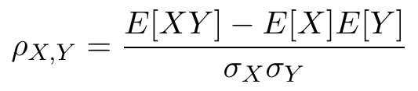
Exploratory Analysis
Split into: Numerical feature analysis and categorical feature analysis
Pearson Correlation coefficient for linear correlation

Slide 7
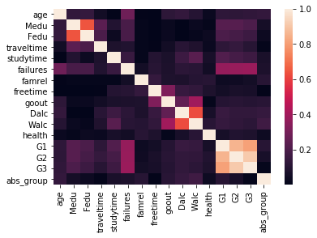
Data Correlations
Correlation heat map – see highest correlations for G3
Other high correlations
Highest correlation region G3

Slide 8
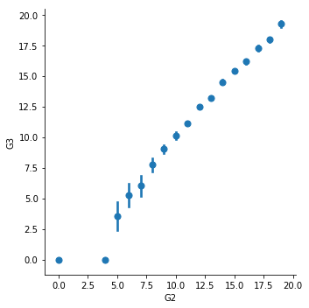
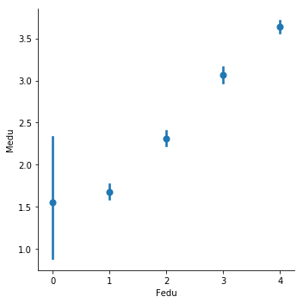
Numerical Correlations
Highest correlation for G3
Highest correlation for feature variables (collinearity)

Slide 9
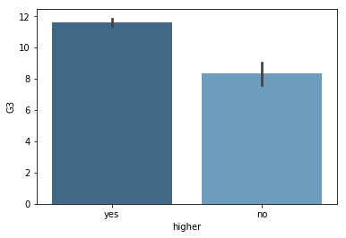
Categorical Correlations
Highest categorical correlation with G3- Plan on higher education

Slide 10
Machine Learning Analysis: Preprocessing
Classification Schemes: With and without G1 & G2
Binary: Pass (G3>=10), fail (G3<10)
5-level classification: A:(16-20), B:(14-15), C:(12-13), D(10-11), F:(0-9)
Regression analysis

Slide 11
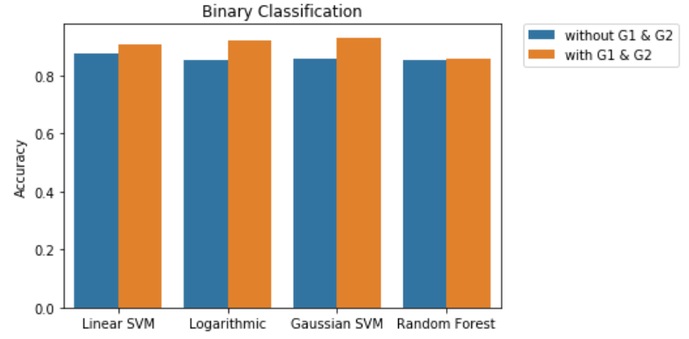
Binary Classification
Accuracy based on percent correct
Similar accuracies
Analysis based on all features

Slide 12
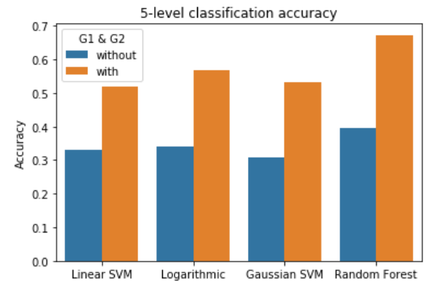
5-Level Classification
Accuracy based on percent correct
Performed with all features
Low accuracy of SVM due to irrelevant features
  Random forest: Max_features = sqrt(N)
Random Forest highest accuracy

Slide 13
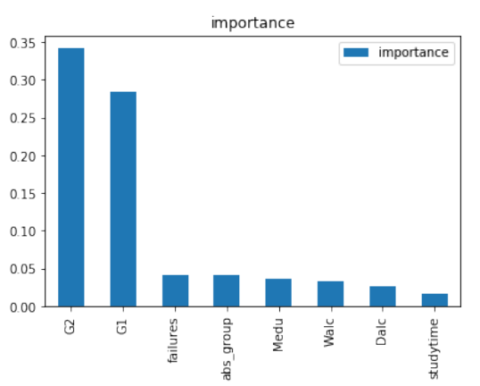
Random Forest Feature Importance
Feature importance for Random Forest
Previous failures, absences, and mothers education with highest importance
Non-grade based features

Slide 14
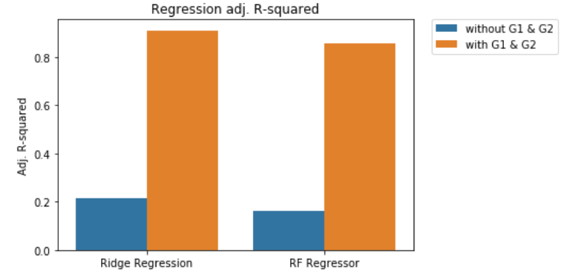
Regression Analysis
Ridge regression performed best
Optimal number of features: w/o G1 & G2 = 6
                w/ G1 and G2 = 4

Slide 15
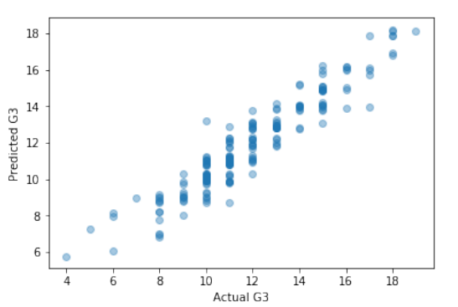
Regression Predictions
Adj. R-squared = 0.910

Slide 16
Conclusions
Important variables:
  Previous failures
  Absences
  Study time
  Frequency of going out with friends
  Father and mother education levels
Implementation by schools (councelling, school promotions, etc.)
Future analysis: only 21% of variance was determined without G1 and G2. Add more features

