Slide 2
Lab 1 Outline
  Presentation
    Introduction
    Digital Design Today
    Lab Hardware and Software
    Lab Work
    Team Work
New Handouts
  CS2204 Lab & Engineering Fundamentals
Accompanying PowerPoint presentation
  Installing Xilinx WebPACK 12.4
Read also next slide
CS 2204 Spring 2012
Lab 1
Page <number>

Slide 3
While waiting for the lab to start :
  Use your userid and password to login to the LABS domain
    User id : labs\yourPeopleSoftuserid
    Password : yourPeopleSoftpassword
  If you still cannot log in, go to 337RH after this lab
  If you login, check if you have the S drive listed on “My Computer”
  If you do not see, go to 337RH after this lab
  Create a CS2204 folder on the S drive
  Take a look at the course web site :
    http://cis.poly.edu/cs2204
  Download the Lab 1 presentation and other lab files to your CS2204 folder
CS 2204 Spring 2012
Lab 1
Page <number>

Slide 4
Introduction
  CS2204 is on digital circuits
    Theory, design and analysis of digital circuits
  Three goals mentioned in the Syllabus are targeted
    Intellectual
      Learn how to learn fast and be a critical thinker
    Technical
      System-oriented problem solvers working on digital circuits as a team
    Non-technical
      Interacting with and managing people in a global environment
CS 2204 Spring 2012
Lab 1
Page <number>

Slide 5
Why CS2204 Lab ?
  Reinforce and study concepts presented in class in detail
    Classroom discussions are abstract
      Using concepts in real life is easier to see in the lab
      Studying technology dependent topics is easier in the lab
  Introduce current
    Digital design techniques
    Digital design tools
    Engineering environment fundamentals
      Engineering environment is emulated
        Teaming up to design digital circuits piece by piece under the guidance of a project manager and senior engineers
CS 2204 Spring 2012
Lab 1
Page <number>

Slide 6
Lab Goals
  A semester-long term project
    The Polytechnic Playing Machine, Ppm
      Digital design is emphasized extensively to master it
        Digital design techniques
        Digital design tools
        Engineering environment fundamentals
    Like doing the homework
      Lab experiments help students understand and answer exam questions better
        Students solve exam problems faster
CS 2204 Spring 2012
Lab 1
Page <number>

Slide 7
Why A Project ?
  Students learn how to design complex digital circuits
    One can master design by practicing, not by reading
  It is harder to design than analyze
    Analysis means a digital circuit is given, the purpose is asked
  Design means creating a circuit, given a purpose
    All the knowledge acquired needs to be utilized
      To select components among alternatives
      To satisfy trade-offs among conflicting design goals
CS 2204 Spring 2012
Lab 1
Page <number>

Slide 8
The term project targets a game chip
  The Polytechnic Playing Machine, Ppm
    Students will design a game chip that can beat a human player
    Student will learn about design tips
      Use pencil and paper to design circuits
      Take a break every 50 minutes
    Students will master design
CS 2204 Spring 2012
Lab 1
Page <number>

Slide 9
Digital Design Today
  Digital design environment is fast-paced and dynamic
    Stressful for even experienced engineers
  The environment has technical and non-technical practices
    College students need to learn them now to be ready for this environment
  There are many similarities to software engineering and analog hardware engineering environments
CS 2204 Spring 2012
Lab 1
Page <number>

Slide 10
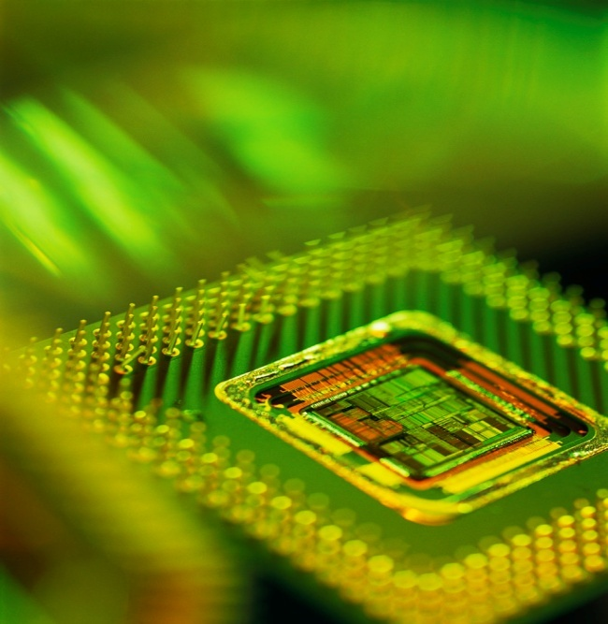
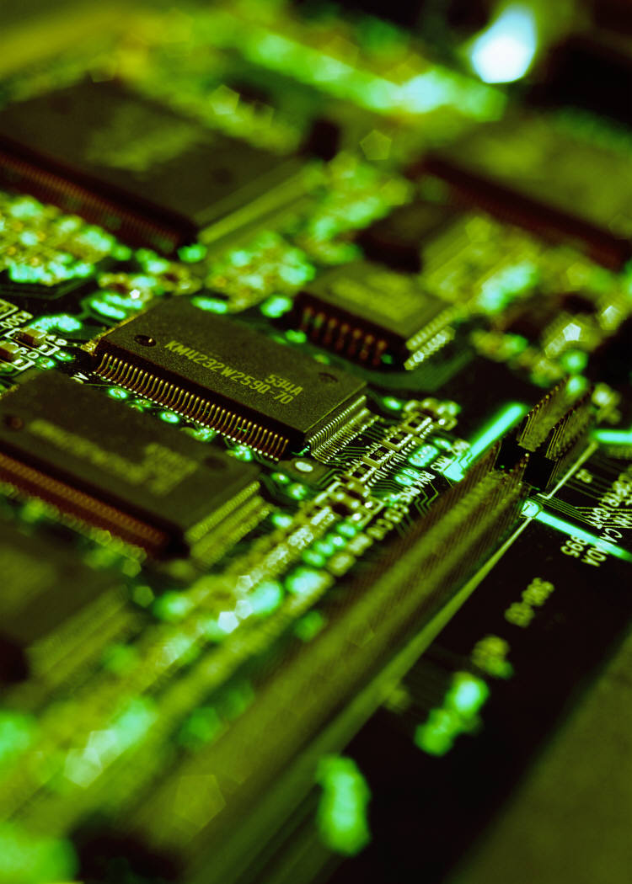
Digital Products Today
  Chips
  Printed circuit boards (PCBs)
  Intellectual property (IP)
    The IP is a circuit which eventually becomes a chip or a PCB
Chip
PCB
A chip must be on
a PCB to be used
CS 2204 Spring 2012
Lab 1
Page <number>

Slide 11
Digital Products Today
  CS2204 is about digital circuits
    Gates and flip-flops (FFs) form digital circuits
      Combinational circuits have only gates
      Sequential circuits have both gates and flip-flops
        Most real-life circuits are sequential circuits
Q
J
Q
D
K
AND gate
OR gate
C
Q
Q
C
D Flip-flop
J-K Flip-flop
NOT gate
CS 2204 Spring 2012
Lab 1
Page <number>

Slide 12


Digital Products Today
  Gates and flip-flops form digital circuits
    Gates and flip-flops (digital circuits) are on chips
    Chips are on printed circuit boards (PCBs)
Chip
PCB
A chip must be on
a PCB to be used
CS 2204 Spring 2012
Lab 1
Page <number>

Slide 13
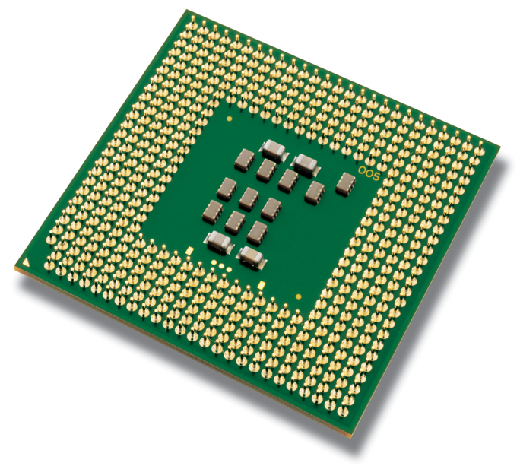

Why CS 2204 Lab ?
  Students have a better understanding of digital product development
    For a chip
    For a PCB
    For an IP
Chip
PCB
Intel® Pentium® 4 Processor
http://www.intel.com
CS 2204 Spring 2012
Lab 1
Page <number>

Slide 14
Why CS 2204 Lab ?
  Learn how to satisfy product goals set when the product development starts
    Design chips and PCBs by first specifying
      Design goals : speed, cost, size, power consumption (allowable heat), weight, reliability, upgradability, etc.
      ❒ Each digital product has its own combination of :
      ► Speed, cost, size, weight, power consumption, etc.
      Operation of the product
        Input/output relationship of the product
      Technology to use
        Electrical properties of the product
CS 2204 Spring 2012
Lab 1
Page <number>

Slide 15
Why CS2204 Lab ?
  Satisfying the design goals is a difficult task
    The higher the speed, the higher the cost
    The higher the speed, the higher the power consumption
      Heat generation is high
        We have to use more expensive cooling techniques
         Today : heat sinks, fans and liquids are used to cool
      If a chip is developed
        Decisions made on the chip will then affect the PCB it will be on
CS 2204 Spring 2012
Lab 1
Page <number>

Slide 16
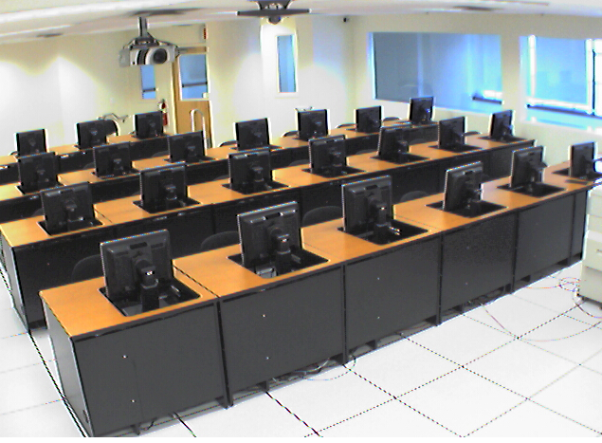
Lab Hardware & Software
  The CS2204 lab is 227RH
CS 2204 Spring 2012
Lab 1
Page <number>

Slide 17

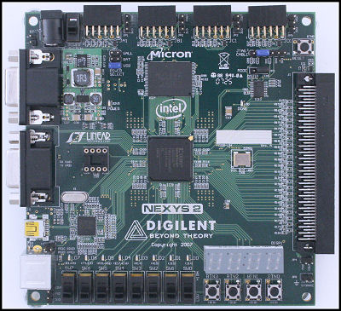


Lab Tools
  Hardware : The Digilent NEXYS-2 FPGA board
    A Xilinx Spartan-3E Field Programmable Gate Array (FPGA) chip
      Hardware programmable chip
        Emulates the circuit designed
  Software : The Xilinx ISE 12.4 CAD software
    For digital circuit develop (design & test) on Xilinx FPGAs
CS 2204 Spring 2012
Lab 1
Page <number>

Slide 18
Digilent NEXYS-2FPGA Board
Xilinx
Spartan-3E
FPGA
chip
On/off
light
USB cable
must be
connected
to this port
LED lights
7-segment
displays
Slide switches
Push buttons
CS 2204 Spring 2012
Lab 1
Page <number>

Slide 19
The Lab Hardware
  Students should not touch the FPGA board except switches, push buttons and lights
    Especially, the FPGA chip area needs to be avoided
      The FPGA chip is sensitive to static electricity
  Please be gentle with push buttons and switches
  More discussions on the hardware topic every week
CS 2204 Spring 2012
Lab 1
Page <number>

Slide 20

The Lab Software
  The Xilinx software is ISE 12.4
    It’s full version is installed in 227RH
      It requires a license from Xilinx !
      Its icon on the desktop is named Xilinx ISE Design Suite 12.4
        Students must login to the LABS domain in 227RH
    Students will install the smaller version of ISE 12.4 : WebPACK 12.4 on their laptops
      Its license is free from Xilinx
        Students must use the distributed handout Installing Xilinx WebPACK 12.4 to followthe steps to install WebPACK
      WebPACK is sufficient to develop the term project !
  More discussion on the software next week !
CS 2204 Spring 2012
Lab 1
Page <number>

Slide 21
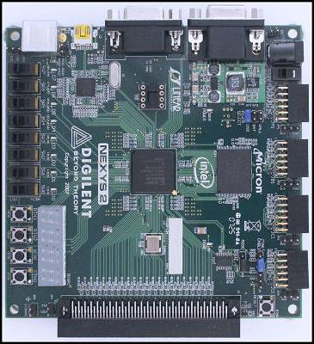
CS2204 Term Project
  Game playing digital circuit schematic design
    Ppm
  Human vs. machine play against each other
  Luck and thinking determine the winner
    A random digit is played on one of the four display digits
CS 2204 Spring 2012
Lab 1
Page <number>

Slide 22
CS2204 Term Project
  Luck and thinking determine the winner
    A player receives a random digit and plays it either
      Directly (overwrite) on or
      With an addition to
    One of the four display digits to earn points
      If the result is the same as the nearby digits, more points are earned
        Hence thinking is needed to play a random digit well
RD = 5
Displays = 7272
How would you play RD ?
The play that earns the most points : 7772
Since there are adjacent identical digits, plays again
There is also a code that can result in more points
More on these next week
CS 2204 Spring 2012
Lab 1
Page <number>

Slide 23
CS2204 Term Project
  The game chip will be developed by developing a schematic (circuit diagram)
    Schematics are kept in schematic files
      The schematic file extension is “sch”
    Hardware description language-based design (HDL-based design) will not be done
    VHDL is a HDL and will discussed in the last week
      VHDL ≡ VHSIC HDL
        VHSIC ≡ Very High Speed Integrated Circuit
a
b
y(a, b, c) = a.b + a.c
a
c
CS 2204 Spring 2012
Lab 1
Page <number>

Slide 24
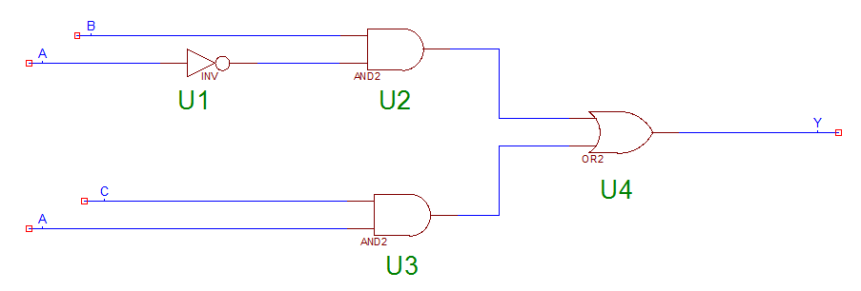
CS2204 Term Project
  Schematic design will start in week 4
    The Xilinx standalone 2-to-1 Multiplexer (MUX) schematic
a
b
y(a, b, c) = a.b + a.c
a
c
CS 2204 Spring 2012
Lab 1
Page <number>

Slide 25
Xilinx Projects
  A Xilinx project, such as ppm, is contained in a project folder, for example, termproject
    There are a number of folders in the project folder
      The termproject folder contains seven folders
    There are a number of files
      The termproject folder has 73 files
      One of the files is the schematic file : ppm.sch
        Microsoft gives its type as “SQL Server Replication Snapshot Schema Script” which is wrong
  To copy a project means copying the project folder
    If you want to copy the term project, you will copy the termproject folder by using Xilinx, not by using Microsoft
      The termproject folder size is about 35.7MBytes
CS 2204 Spring 2012
Lab 1
Page <number>

Slide 26
Project Development
  Students will develop the term project both in the lab and out of the lab
  When students are out of the lab, they will use their laptops
    Students need to be organized on their laptops
      In order not to waste time later in the semester
        Projects are built on earlier projects
    Students are suggested that they create the CS2204 folder on their laptop
      We will call each project “experiment”
        Each experiment will be in a separate folder in CS2204
        The Experiment 1 project will be in the exp1 folder
CS 2204 Spring 2012
Lab 1
Page <number>

Slide 27
Project Development
  Students will use the PCs when they are in the lab in order to work with their partners and share the FPGA boards
    Students will keep their Xilinx project files in the LABS domain with the drive name “S” when they work in the lab
    When students log into the LABS domain in 227RH, the PC will provide them with space on the S drive
  That is, to use the Xilinx software in the lab, students need to have
    A LABS domain account
      Most students have the account
        If you do not have it, go to room 337RH to get it
    The S drive access right
      You may have the LABS domain account, but not S drive access right
        If you do not have it, go to room 337RH to get it
CS 2204 Spring 2012
Lab 1
Page <number>

Slide 28
Project Storage
  Students will use the PCs when they are in the lab in order to work with their partners and share the FPGA boards
    Students will keep their Xilinx project files in the LABS domain with the drive name “S” when they work in the lab
      Students need to be organized on the S drive
  For continuous efficient work this semester their laptops and the S drive must be synchronized !
    They have make sure that the S drive is up to date before arriving to the lab
    Their laptop is up to date after leaving the lab
      Make sure that at the end of each lab session the laptop content is identical to the S drive content
      That is, save your lab work on your laptop before leaving the lab
    The S drive is a networked drive !
      If the network is down, the S drive may not accesible !
CS 2204 Spring 2012
Lab 1
Page <number>

Slide 29
Caution !
  Students have to use caution
    Make sure that
      The PCs in
        227RH
      Their laptops
    Do not get infected
  When using PCs and your laptop, make sure that they are free from
    Viruses, worms, malware, spyware, trojans, etc.
  Use protection/detection software all the time !
CS 2204 Spring 2012
Lab 1
Page <number>

Slide 30
Lab Related Resources
  Components that will be used for projects, i.e. schematic components, and the board are described by
    Xilinx web pages
    Digilent we pages
    The Wakerly text book and its web site
    Digital logic books
    Texas Instruments on line manual
    Motorola chip manual on reserve in the library
  Printing some of the pages, especially those that are needed for exams, from these web sites and keeping them handy will be helpful
CS 2204 Spring 2012
Lab 1
Page <number>

Slide 31
Lab Work
  The goal is to complete the development of the term project by the deadline : April 27, 2012
    During the lab session of Section D
  Tentative schedule :
    First eight weeks
      Lab hardware and software are introduced
      Digital Technology and manufacturing practices are discussed
      Top level view (input/output relationship) and initial design steps of the term project are discussed
        By third week 3- or 4-student teams are formed
    Last five weeks teams complete the development of the term project
CS 2204 Spring 2012
Lab 1
Page <number>

Slide 32
CS2204 Term Project
  The project is in six phases
    Each phase is called “experiment”
      Experiment 1 through Experiment 6
        Experiment 6 completes the Term Project
        Experiment 6 will be collected at the end of the semester
        Deadline : April 27, 2012
    Teams that do not fall behind can complete the term project with a sophisticated machine player by the deadline
      A student who falls behind (such as missing a lab) can try to make up by working with his/her teammates
        The student asks the teammates how to make up
    Experiments follow lectures and complement them
      Students need to bring their lecture notes and handouts to the lab
CS 2204 Spring 2012
Lab 1
Page <number>

Slide 33
CS2204 Project Phases
  All six project phases will be collected and graded
    The collection deadline is the last lab of project phase
      The TAs will grade the first five project phases
        These five project works are considerably simple though gets more complicated as the semester progresses
        These five project phases will not affect the term grade
        They will indicate your progress in the semester
        No late project submissions !
      The professor will grade Experiment 6 work
    All six project phases will be graded based on the Term Project Check List handout
CS 2204 Spring 2012
Lab 1
Page <number>

Slide 34
Lab Work
  Lecture requirements apply
    Attending the lab is required
      Arriving on time
      Leaving the lab with teammates will ensure the team does not fall behind
    Cooperating with teammates
      Without distracting others
    Lab participation improves learning
      Participate in all the lab work
CS 2204 Spring 2012
Lab 1
Page <number>

Slide 35
Lab Grade
  Students receive a lab grade
    5% of the term grade
      Lab work
        Lab attendance, arrival, departure
        Concentration on lab work
        How well he/she cooperates with the teammates
      Experiment 6 project work grade based on the Term Project Check List handout
    The calculation of the lab grade will be explained next week
CS 2204 Spring 2012
Lab 1
Page <number>

Slide 36
Lab Grade
  Students receive a lab grade
    Arriving late would delay the team work
      Also, teammates cannot synchronize well
      If this happens frequently, the team member would fall behind the teammates
        Exam grades would go down as well
    Labs affect the term grade more
      Labs are on all exams
      Labs reinforce lecture topics
CS 2204 Spring 2012
Lab 1
Page <number>

Slide 37
Lab Sessions
  Each lab session starts with the professor and two TAs
    Students synchronize with their teammates
    The professor takes attendance
    Students’ questions are answered
  The professor gives a presentation covering
    New material
    Important points of students’ work
  Then, students work on their assigned project until the end of the lab session
    Students are strongly advised to stay in the lab to
      Help their partners
      Start their next lab work
      Do the current homework assignment
      Study the course material
    Before leaving the lab, students need to log off, turn off the monitor and FPGA board
CS 2204 Spring 2012
Lab 1
Page <number>

Slide 38
Students’ Work
  Students work on their circuits
    Do the design on paper and then on Xilinx software
    Test their design on the Digilent board
    The professor and TAs answer questions on
      The Digilent board
      The Xilinx software
      How to play the Ppm game
      General design issues
    Students develop the term project by themselves
      3- or 4-student teams work on the term project !
      Students use pencil and paper to design circuits first then move the design to their computers
      As you design the term project, take a break every 50 minutes
CS 2204 Spring 2012
Lab 1
Page <number>

Slide 39
Lab Work
  Be careful with food and drinks in the lab
    No spills on the Digilent board !
    Students can go out to have food and drinks provided that it is short and teammates accept it
      Students should make sure
        They do not fall behind
        They are on schedule to complete the project
      The project due date will not be postponed for a team
CS 2204 Spring 2012
Lab 1
Page <number>

Slide 40
Lab Work
  The 227RH lab will be open with a TA present when a lab session is not scheduled
    Before leaving the lab, students need to log off, turn off the monitor and FPGA board
    The lab supervisor is Mr. Keni Yip and his office is 225RH
CS 2204 Spring 2012
Lab 1
Page <number>

Slide 41
Developing the term project
  A student who has fallen behind
    Lectures
    Labs
    Homework assignments
  cannot develop the term project !
  When it is week 11, 12, 13, you may realize you cannot design the machine player !
    It is too late !
CS 2204 Spring 2012
Lab 1
Page <number>

Slide 42
Team Work
  Team–based design is a necessity today
    Digital products are too complex to be designed by a single engineer
    Members of a team work on the design simultaneously to arrive at an acceptable solution faster
    Team work is not simple
      The success depends on the quality of cooperation
      Team members, human beings, must cooperate
        They have their own goals, ambitions, background and schedule
    College students need to learn about and practice team work
      CS2204 helps students understand team work
CS 2204 Spring 2012
Lab 1
Page <number>

Slide 43
Team Work for CS2204
  3- or 4-student teams are formed by the 3rd week
    The students must be from the same lab section
    Exchange contact info with your partners
      Telephone numbers
      Email addresses
      Semester schedule
CS 2204 Spring 2012
Lab 1
Page <number>

Slide 44
Team Work for CS2204
  Teams can start working together on the homework today
    Each team submits the homework
      One per team
      All partners need to have a copy of the graded homework to use it during exams
      Homework 1 is due on February 9, 2012
CS 2204 Spring 2012
Lab 1
Page <number>

Slide 45
Team Work for CS2204
  Each team works on the term project experiments together
    Each team submits the term project
      One per team
      All partners need to have printouts of the schematics (circuit diagrams) to use during exams
    Experiment 6 ≡ term project
      By Friday, April 27, 2012
CS 2204 Spring 2012
Lab 1
Page <number>

Slide 46
Team Work for CS2204
  Having partners is advantageous since they think on a problem together, solving it in acceptable way faster
    Team members help each other
    Learn from each other
    A student busy in a week can get help from the partners, catching up quickly
      Assuming the student has not fallen behind much
CS 2204 Spring 2012
Lab 1
Page <number>

Slide 47
Team Work for CS2204
  The success depends on the amount of cooperation among the partners
    Submitting the homework and projects requires coordination
      Meetings during the week are needed
      Partners need to carry each other’s contact information and schedule
CS 2204 Spring 2012
Lab 1
Page <number>

Slide 48
Team Work for CS2204
  What would you do if your partner did not show up to the lectures and labs and does not do much work ?
    Try to reach out to your partner “now”
      Next time your partner can reach out to you
    Do not hesitate to talk to your professor and TAs
      Also, for any course talk to your professor for this kind of situations
    If your partner starts showing up to lectures and labs
      Ask if everything is alright
      As a team, help the partner make up
CS 2204 Spring 2012
Lab 1
Page <number>

Slide 49
Team Work for CS2204
  Even if one has 3/4 partners, still has to work as if there is no partner
    To be able to answer exam questions
    The term project and homework assignments are not complex
      A student can do the homework and the project without any partner, provided that the student has NOT fallen behind
CS 2204 Spring 2012
Lab 1
Page <number>

Slide 50
Developing the term project
  A student who has fallen behind
    Lectures
    Labs
    Homework assignments
  cannot develop the term project !
  When it is week 11, 12, 13, you may realize you cannot design the machine player !
    It is too late !
CS 2204 Spring 2012
Lab 1
Page <number>

Slide 51
Logging into the LABS domain :
  Use your userid and password to login to the LABS domain
    User id : labs\yourPeopleSoftuserid
    Password : yourPeopleSoftpassword
  If you still cannot log in, go to 337RH after this lab
  If you login, check if you have the S drive listed on “My Computer”
  If you do not see, go to 337RH after this lab
  Create a CS2204 folder on the S drive
  Take a look at the course web site :
    http://cis.poly.edu/cs2204
  Download the Lab 1 presentation and other lab files to your CS2204 folder
CS 2204 Spring 2012
Lab 1
Page <number>

Slide 52
Assignment by next lab
  Install Xilinx WebPACK 12.4 on your laptop by using the Installing Xilinx WebPACK 12.4 PowerPoint presentation at the course web site
    It must be 12.4, not 13.2
  Form your team with no more than 4 people on the team with students from your lab session
CS 2204 Spring 2012
Lab 1
Page <number>

Slide 53
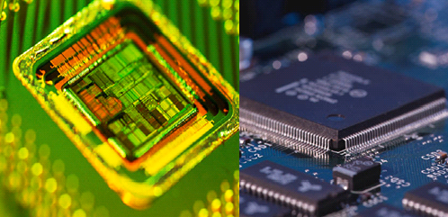
QUESTIONS ?
Organize your S drive and laptop
Create a CS2204 folder on both
Think about forming teams before leaving the lab
Check the course web site all the time : http://cis.poly.edu/cs2204
Digital
Logic and
State Machine Design
CS 2204 Spring 2012
Lab 1
Page <number>

