Slide 1

XAMES
THE ERRORs: Костадин Костадинов, Калин Дойчев, Александър Маринов, Мартин Пенев, Невена Павловска

Slide 2
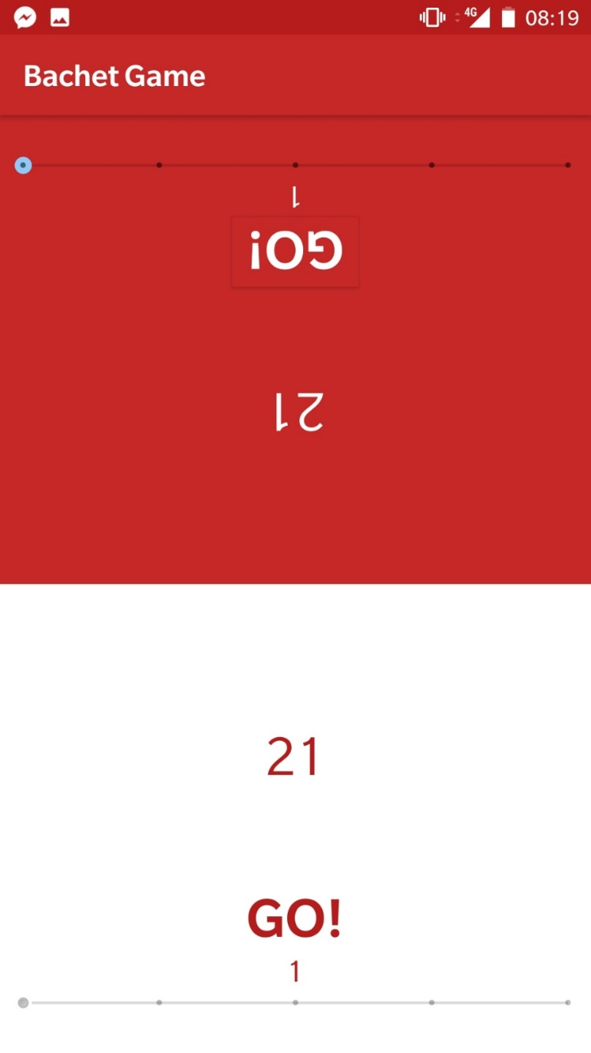
Bachet Game
Option – single / multi player
Turn - take from one to five objects from the common group
Goal - make your opponent take the last object

Slide 3
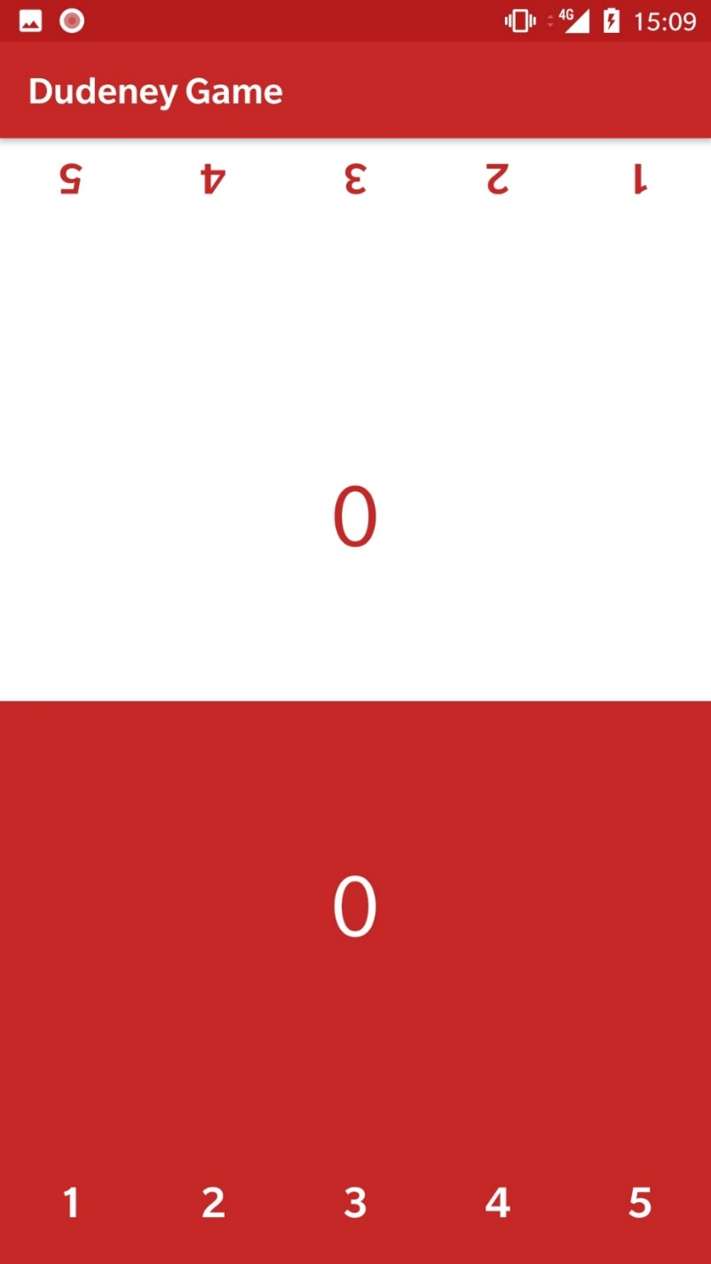
Dudeney Game
Multi player
Turn - complete the common group with objects
Goal - succeed in decreasing the amount of objects in the group to a given number or to create a situation, where the opponent always exceeds the given value

Slide 4
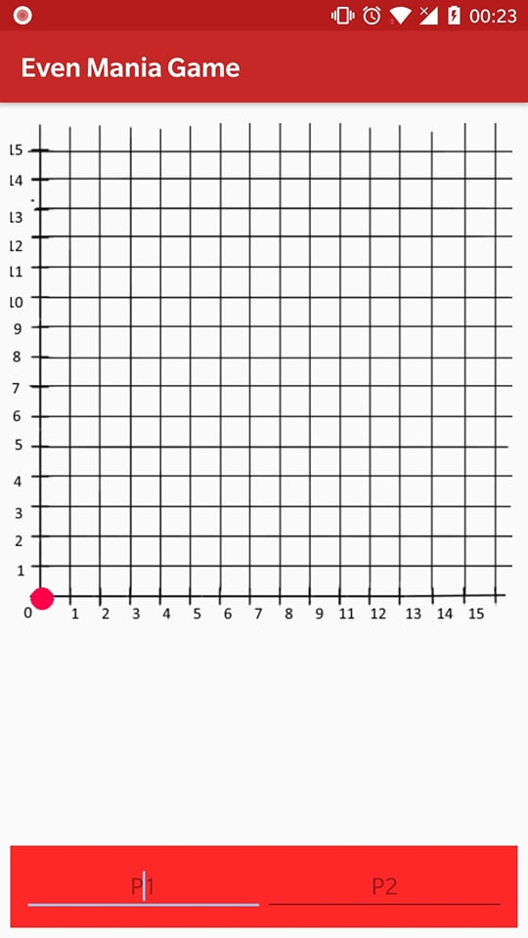
Even Mania
Multi player
Turn - control one circular object in a coordinate system
Player 1 -> X axis
Player 2 -> Y axis
Goal -the object, the players are moving, passes the diagonal line

Slide 5

Xames and Hack 30xTUES
Topic: Digital Past VS. Product: Xames

Slide 6
What We Used:
Written on Java / Android Studio
Used libraries: Butter Knife
A lot of Coffee
No sleep
An old book

