Slide 1
Presentation 2 HTML Containers and Lists
PETKO BOZHINOV
ELSYS, WD18/19

Slide 2
HTML Tables
<table>
Content of the table
</table>

Slide 3
HTML Tables
Consisted of rows and columns
<tr>, <th>, <td>

Slide 4
Tables Basic Attributes
colspan
rowspan
id

Slide 5
HTML Tables Basic Properties
<!DOCTYPE HTML>
<html>
<head>
<style>
…
</style>
</head>
<body>
…
</body>
</html>

Slide 6
HTML Tables Basic Properties
border: 1px solid red;
border-collapse: collapse|separate;
padding: 5px;
border-spacing: 5px;

Slide 7
Sample Usage
<!DOCTYPE HTML>
<html>
<head>
<style>
table {
border: 2px solid black;
}
</style>
</head>
<body>
<table>
<tr>
<td>Haha</td>
</tr>
</table>
</body>
</html>

Slide 8
DIV Tag
Block-level element
Used as a container for other elements
Element could be used to style content pieces

Slide 9
Span Tag
Inline element
Often used as a text holder
Could be used to stylize parts of the text

Slide 10
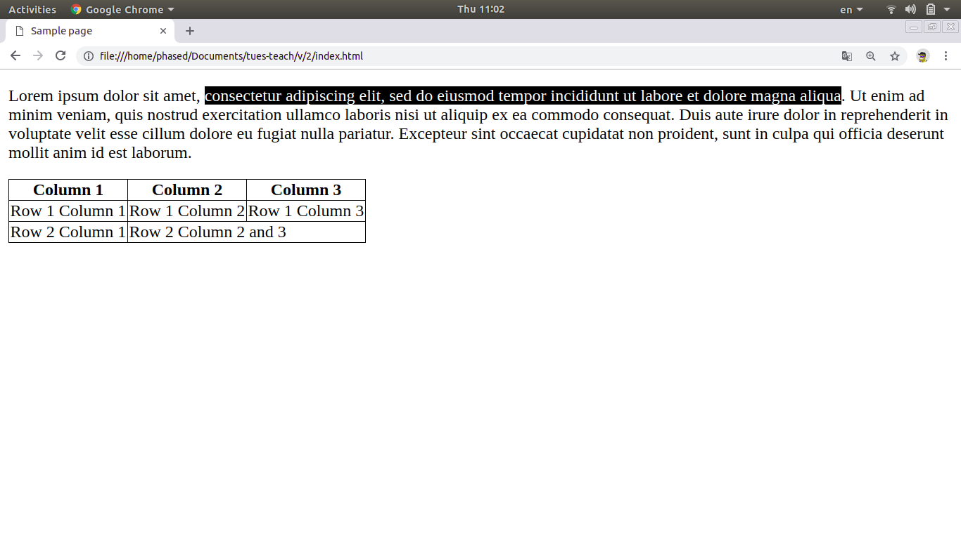

Slide 11
Any questions?

