Slide 1
GitHub

Slide 2
Git Bash
First, you need to install Git Bash on your computer.
https://www.educative.io/answers/how-to-install-git-bash-in-windows
In this link, you will find all the instructions for installing Git Bash.

Slide 3
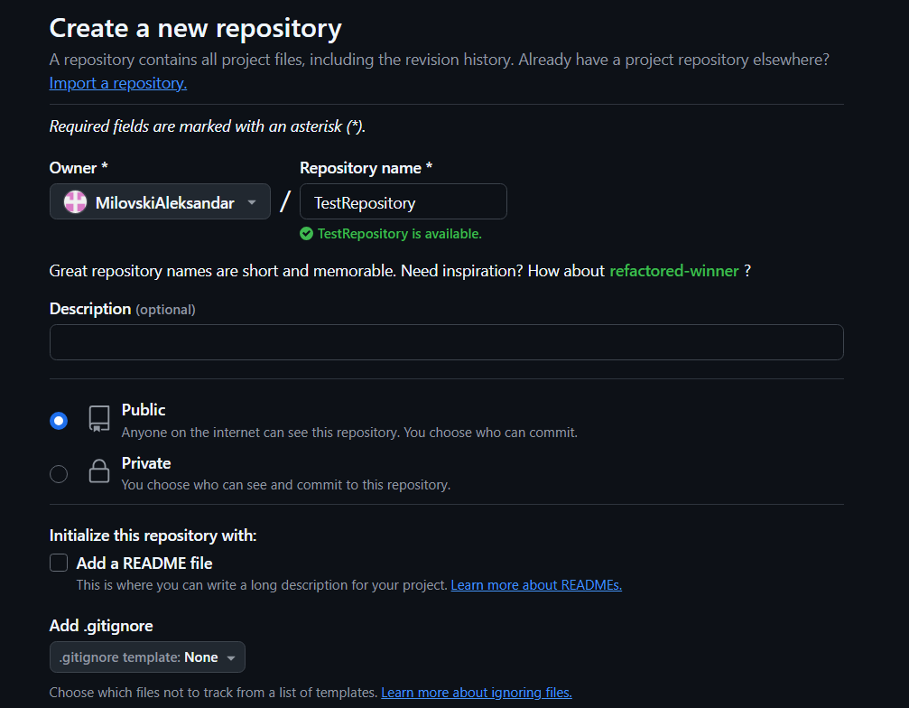
STEP 1
Create a GitHub account(if you don't already have one)
Log in and click on "New" to create a new repository
Name the repository “Homeworks”
Set the repository to Public
Add a README file

Slide 4
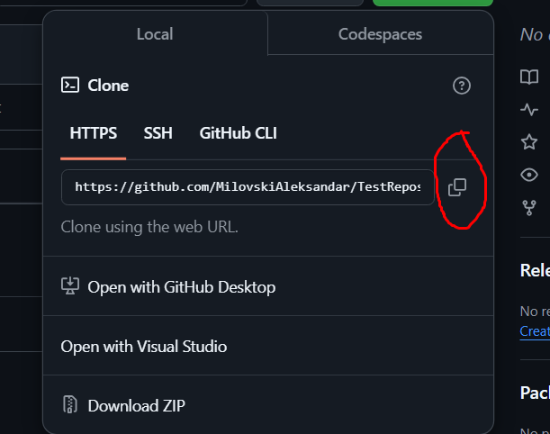
STEP 2
1. Copy the URL from your GitHub repository

Slide 5
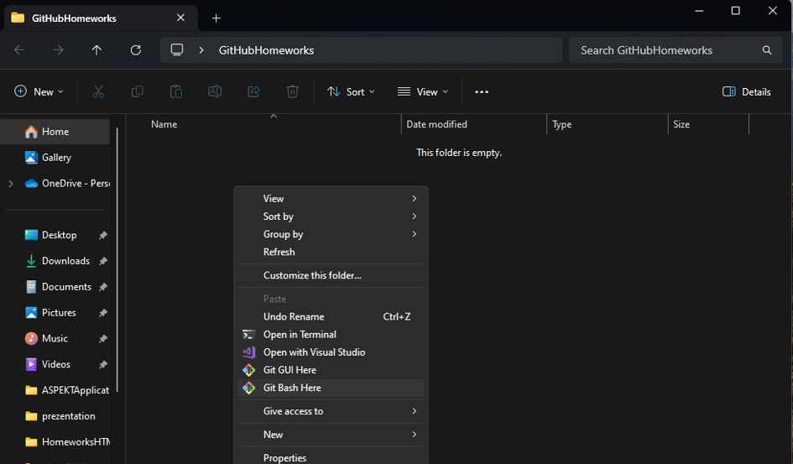
STEP 3
Create an empty folder on your computer
Go inside that folder
Right-click inside the folder and select "Git Bash Here" to open Git Bash in the current directory.

Slide 6
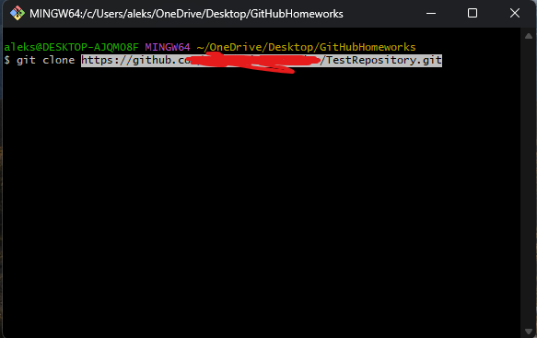
STEP 4
Go to the empty folder you created
Right-click and select “Git Bash Here” (as in STEP 3)
The Git Bash console should open
In the Git Bash console that opens, type git clone and paste the URL you copied from your GitHub repository (from STEP 2)

Slide 7
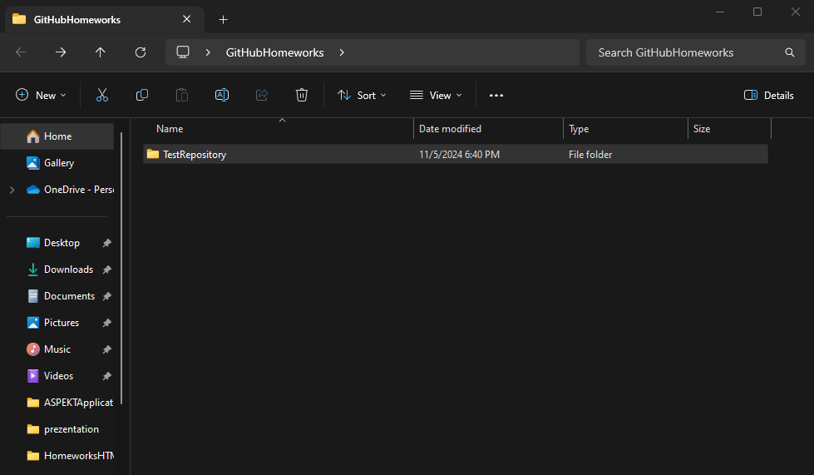
STEP 5
After completing STEP 4, a new folder should appear inside your empty folder
This new folder is linked to your GitHub repository, meaning it's now a local copy of the repository you created on GitHub

Slide 8
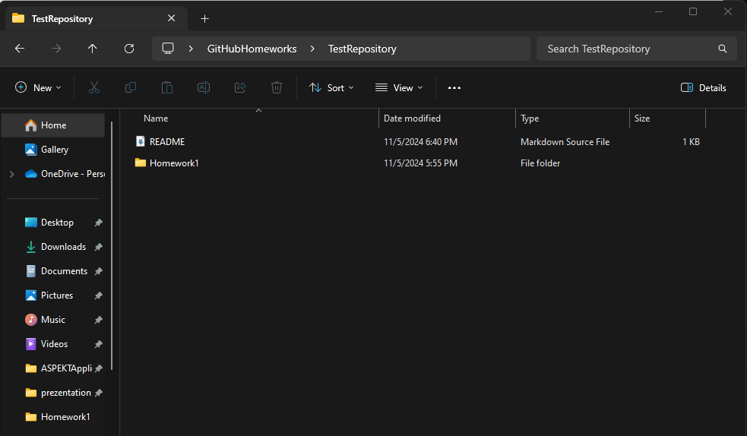
STEP 6
Go inside the new folder created in STEP 5.
Place your homework folder inside this GitHub-linked folder.

Slide 9
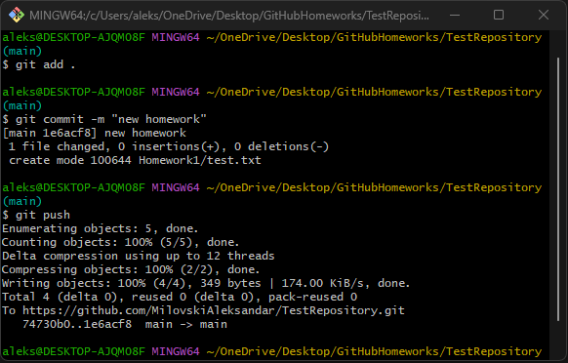
STEP 7
Open Git Bash in the folder from STEP 6
Run the following commands in Git Bash to add, commit, and push your new folder to your GitHub repository
git add .
git commit –m “test”
git push

Slide 10
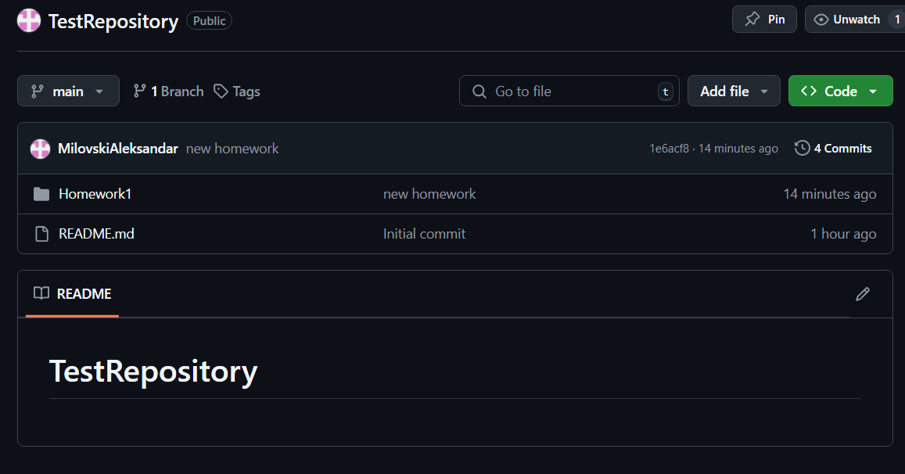
STEP 8
After completing all the steps, refresh your GitHub repository page to see the updates☺
If you need to add a new homework folder in the future, simply repeat STEP 6 and STEP 7

