Slide 1
Explore USA’s
Traffic Accidents
Kanaris Konstantinos

Slide 2


Some Key Facts
Road traffic accidents:
cause ~1.3 (mi) deaths each year.
cost most countries 3% of their GDP.
up to 5% for low, middle-income countries.
Global Priority

Slide 3
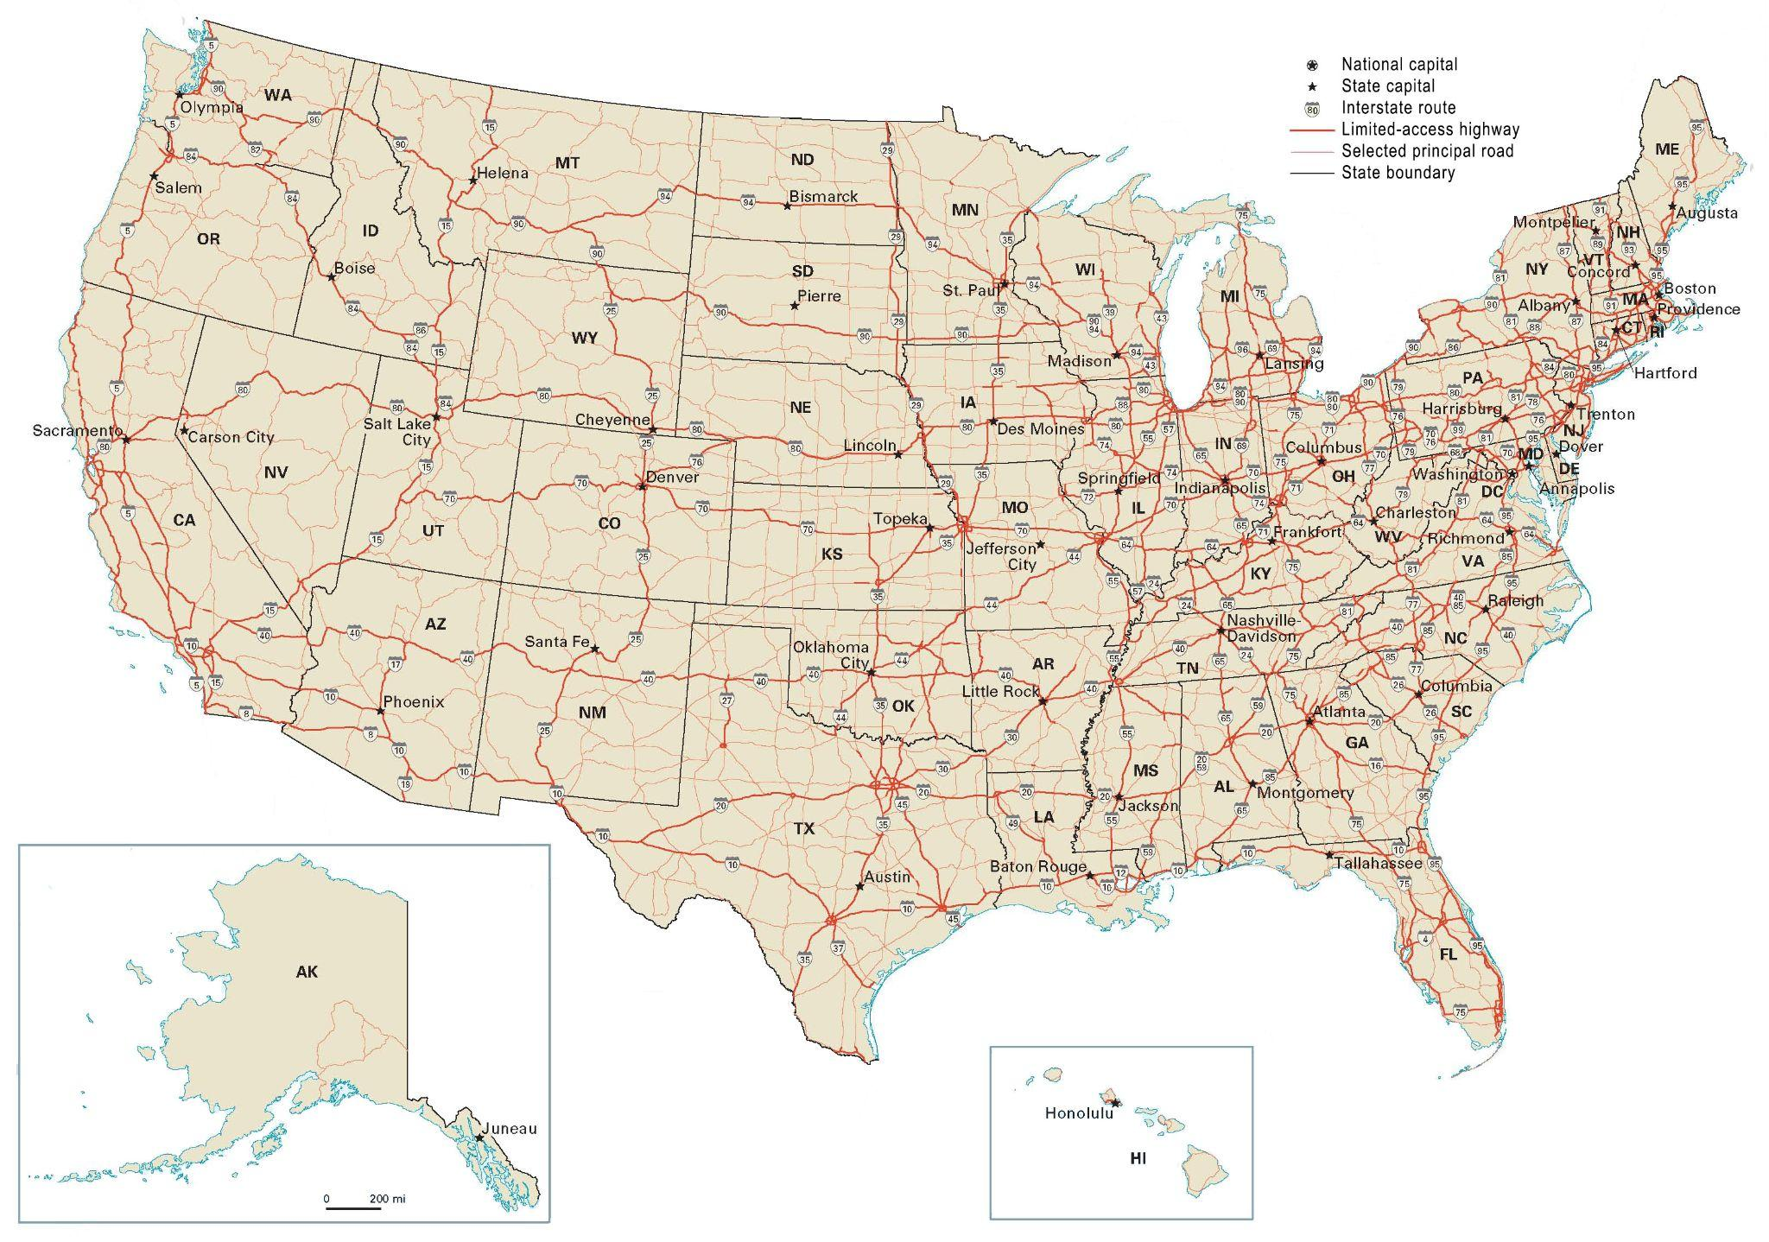

Our Focus
Map Source
USA:
One of the busiest countries.
~284Μ vehicles in operation.
over 12Μ involved in crashes in 2019.

Slide 4
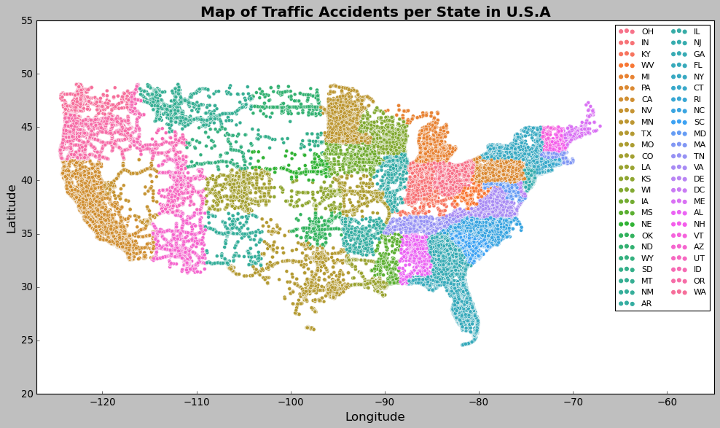
About Data
Our data:
cover 49 states of USA.
include ~1.5M recorded accidents.
collected through years 2016-2020.
Important feature:
Severity level, (1-4).

Slide 5
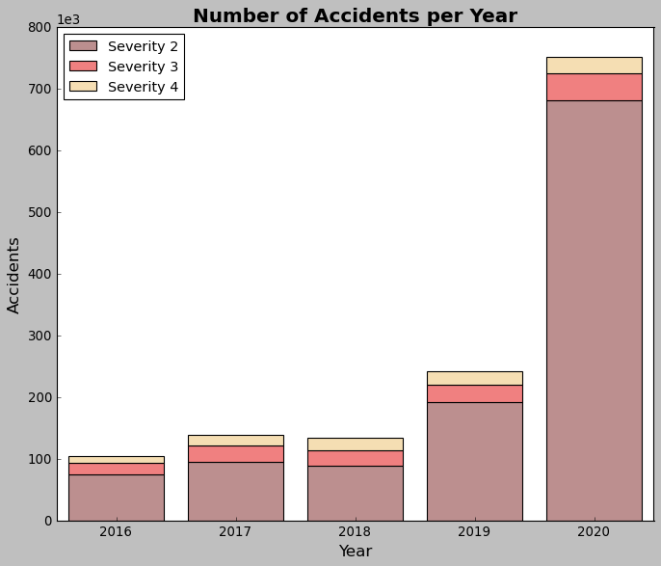

Insights
Years 2016-2020:
Increasing trend.
Year 2020:
Big increase.
~750k incidents.
~26k fatal accidents (~3.4%).

Slide 6
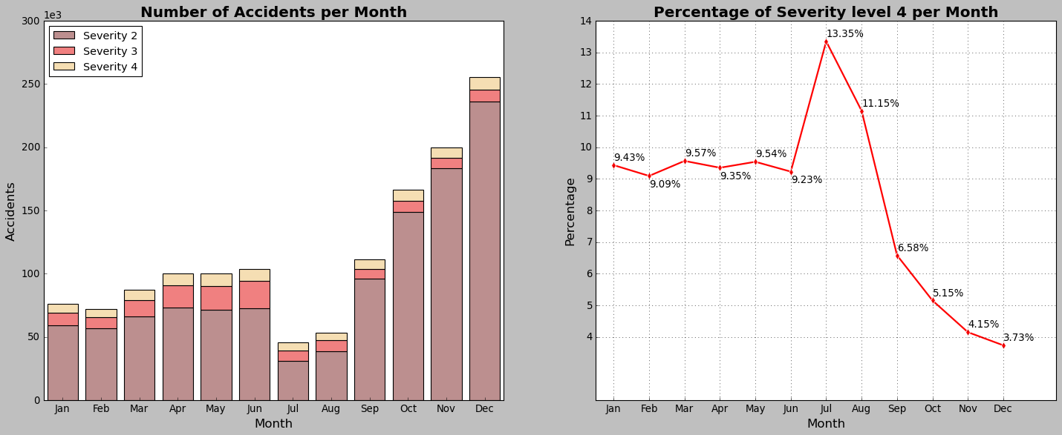
Insights

Slide 7
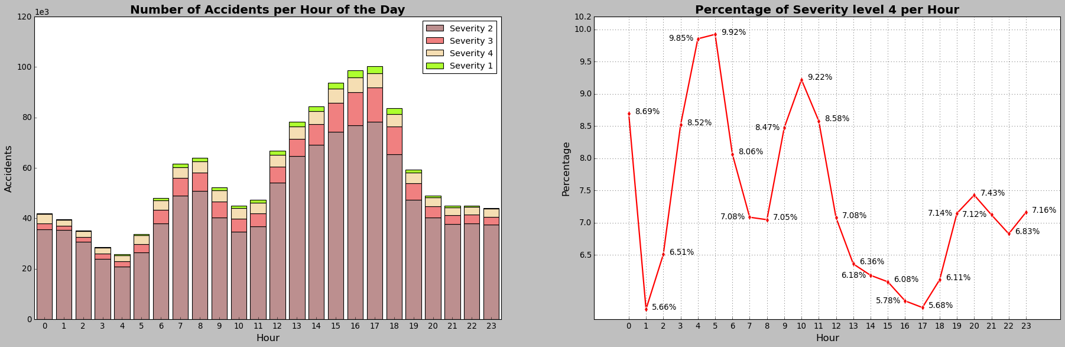
Insights
Rush hours:
7:00-8:00 AM, going to work.
People are in hurry.
4:00-5:00 PM, returning home.
People are less focused.

Slide 8
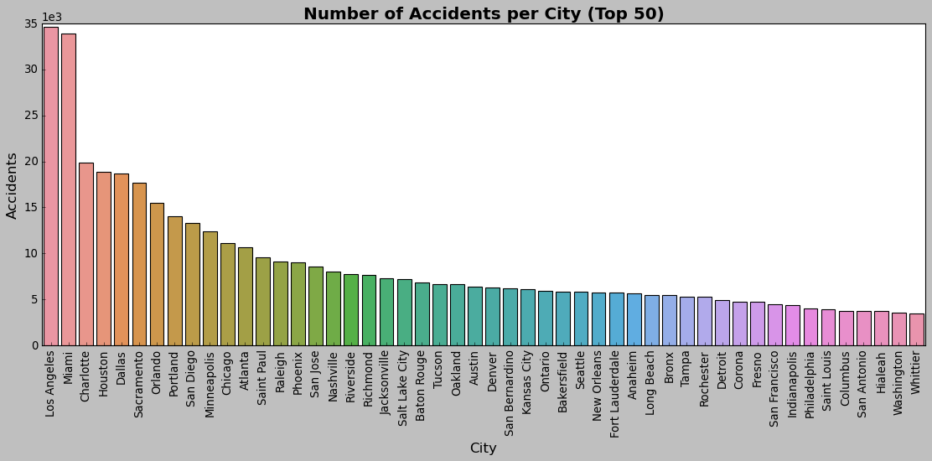
Insights
Most dangerous cities:
Los Angeles, state of California (CA).
Miami, state of Florida (FL).

Slide 9




Further Research
We can explore other interesting features like:
Wind
Humidity
Snow
Precipitation

Slide 10



Counteract Policies
Two different types of policy initiatives:
Firstly, policies that aim to reduce the overall traffic accidents, and thereby reduce the overall potential for fatal accidents to occur. This can be done by:
Implementing increased traffic safety controls during rush hours.
2. Secondly, targeted policies aimed at reducing fatal traffic accidents, such as:
Targeted safety messaging in regions and cities with the highest proportion of fatal accident rates.

Slide 11

The End
For a more detailed analysis, refer to my Github.

