Slide 1
and M-ary Quadrature Amplitude Modulation (M-QAM)
M-ary Pulse Amplitude modulation (M-PAM)

Slide 2
M-PAM
M-ary PAM is a one-dimensional signaling scheme described mathematically by

Slide 3
Where the
is the basis function and
and
E_{o} is the energy of the signal with lowest amplitude

Slide 4
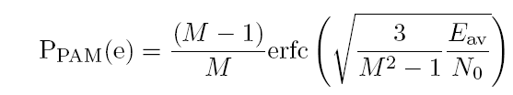
The average symbol energy:
The probability of symbol error on AWGN channel:

Slide 5
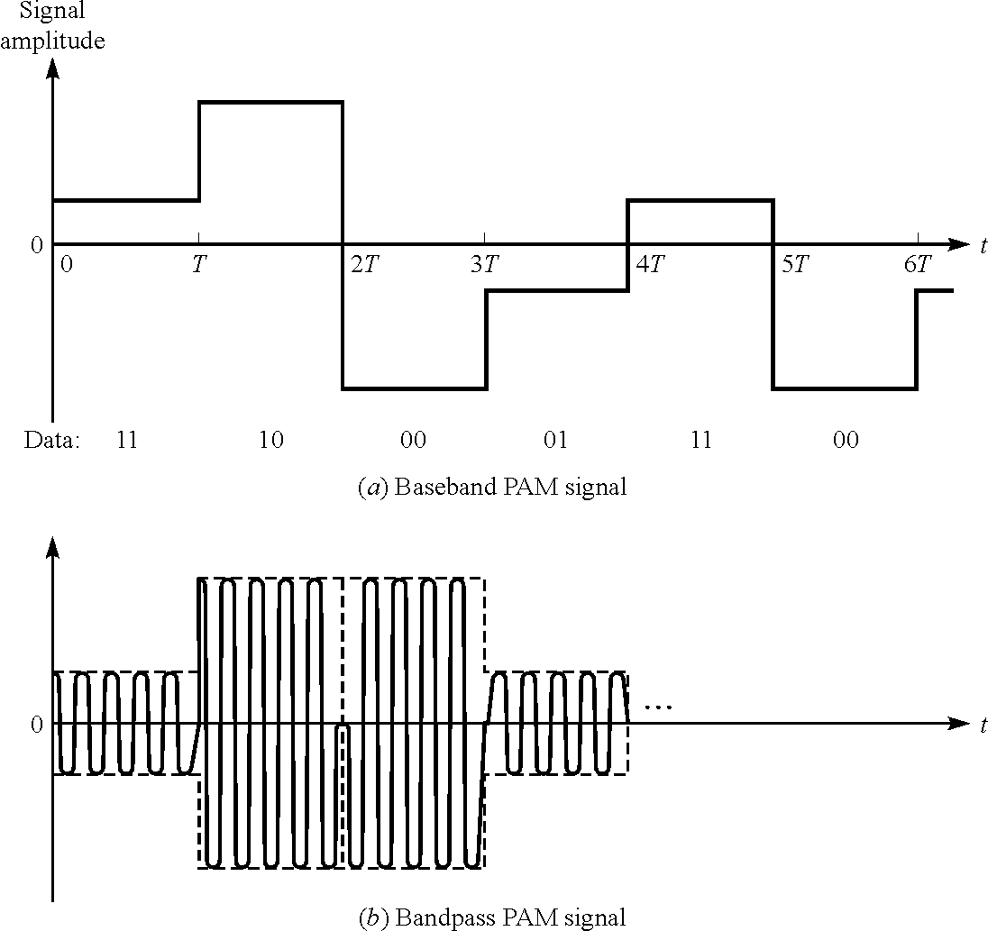
4-PAM

Slide 6
Example: 4-PAM

Slide 7

Example: 4-PAM
M=4
a₁=-3, a₂=-1, a₃=+1, a₄=+3
“00”
“01”
“11”
“10”
0

Slide 8
comments

Slide 9
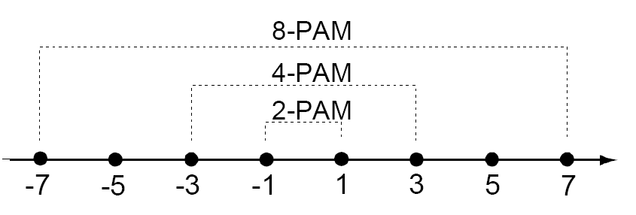
The signal space representation of binary PAM, 4-PAM and 8-PAM constellations for E_{o}=1

Slide 10
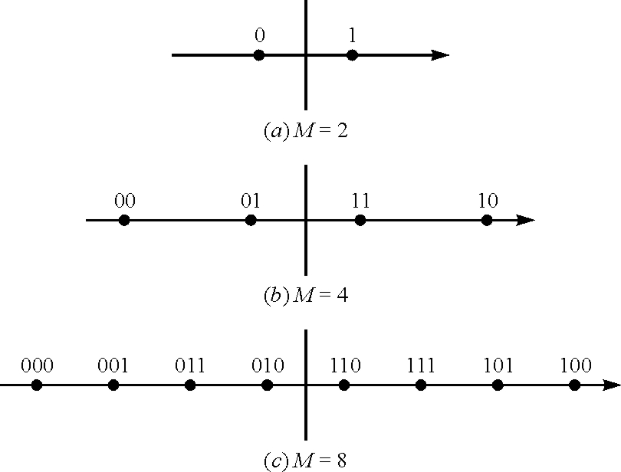
The signal space representation of binary PAM, 4-PAM and 8-PAM constellations.

Slide 11
Comments

Slide 12
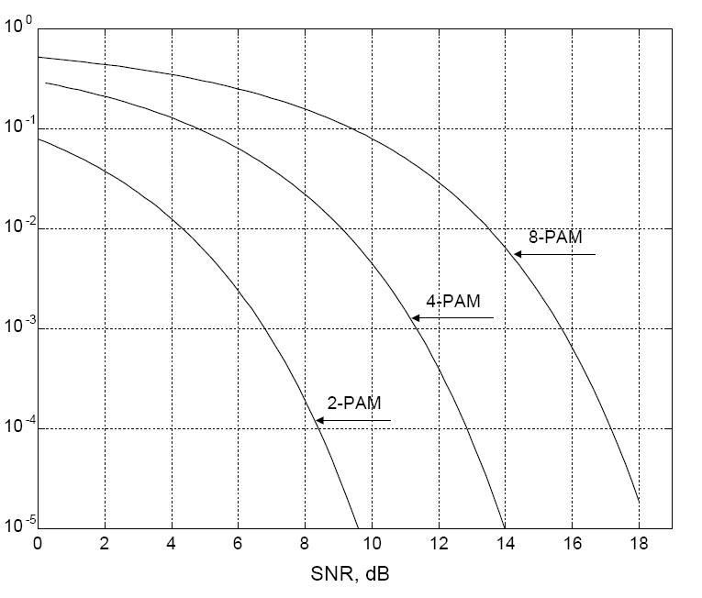
Symbol error probability for 2, 4 and 8-PAM as a function of SNR per bit.

Slide 13
M-ary Quadrature Amplitude Modulation M-QAM
Quadrature amplitude modulation (QAM) is a popular scheme for high-rate, high bandwidth efficiency systems.
QAM is a combination of both amplitude and phase modulation. Mathematically, M-ary QAM is described by
The combined amplitude and phase modulation results in the simultaneous transmission of log₂ M₁ M₂ bits/symbol

Slide 14
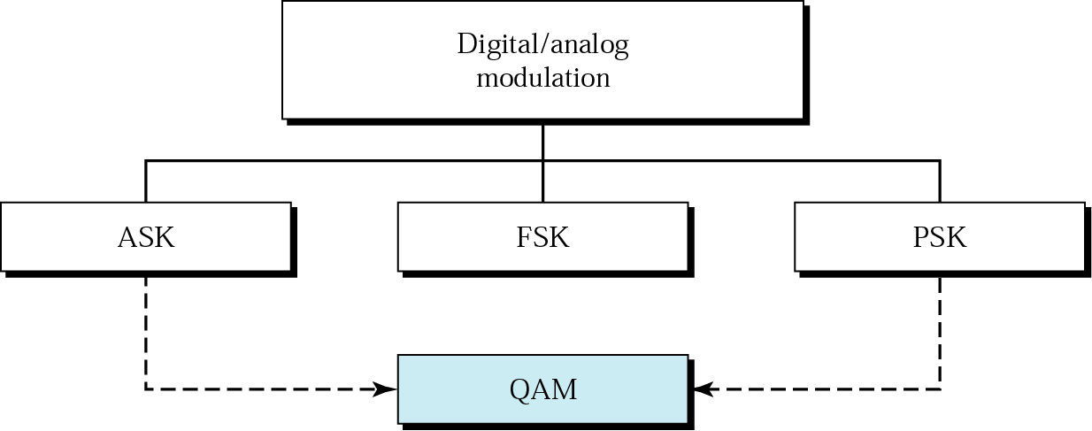
Digital Modulation Techniques

Slide 15
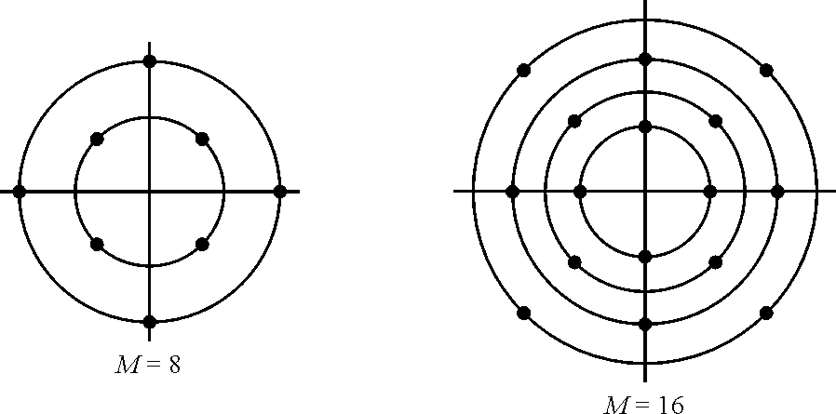
Examples of combined PAM-PSK signal space diagrams.

Slide 16
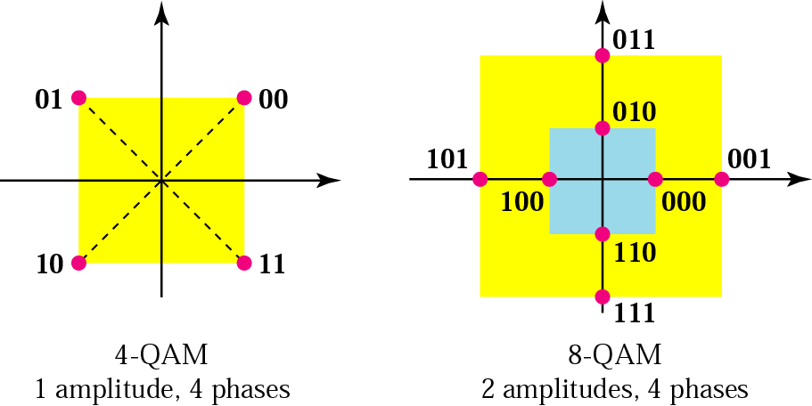

Slide 17
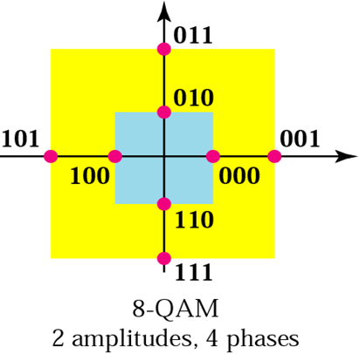
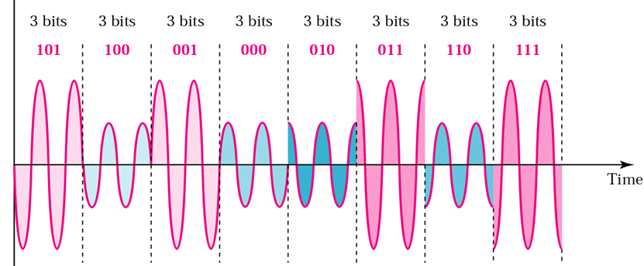
8-QAM signal (2 amplitudes and 4 phases)

Slide 18
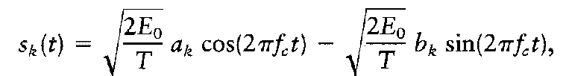
The transmitted M-QAM signal is defined by:
The signal can be expressed using the two basis functions as
The signal consists of two phase-quadrature carriers with each one being modulated by a set of discrete amplitudes, hence the name quadrature amplitude modulation.
The signal-space representation of QAM signals is shown in Figure for various values of M which are powers of 2, that is, M = 2^{k}, k = 2; 3; …..

Slide 19
For even values of k, the constellations are square (4-QAM, 16-QAM, 64-QAM,..)
for odd values of k the constellations have a cross shape and are thus called cross constellations. (32-QAM, 128 QAM, ..)
For square constellations, QAM corresponds to the independent amplitude modulation (M-PAM) of an in-phase carrier (i.e., the cosine carrier) and a quadrature carrier (i.e., the sine carrier).

Slide 20
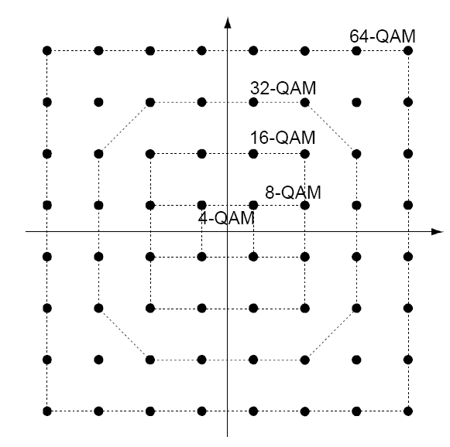
Signal-space representation of various QAM constellations.

Slide 21
32-Cross QAM (in red)

Slide 22
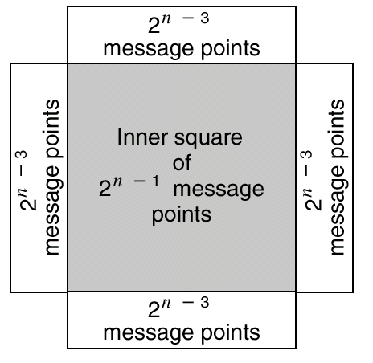
Illustrating how a square QAM constellation can be expanded to form a QAM cross-constellation.
4
4
4
Square 16-QAM
4
Square 16-QAM expanded to 32-cross QAM (n=5)

Slide 23
M-QAM square constellation
With an even number of bits per symbol, we may write
M-ary QAM square constellation can be viewed as the Cartesian product of a one-dimensional L-ary PAM constellation with itself.

Slide 24
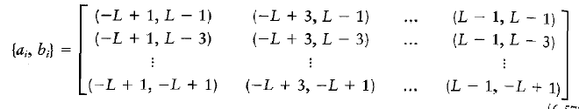
In the case of a QAM square constellation, the pairs of coordinates form a square matirx, as shown by

Slide 25
Example: square 16-QAM
M=16, L=4
Thus the square constellation is the Cartesian product of the 4-PAM constellation with itself.
a_{k} and b_{k} take values from the set {-1,+1, -3, +3}
The matrix of the product

Slide 26
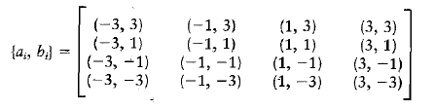

Slide 27
Comments

Slide 28
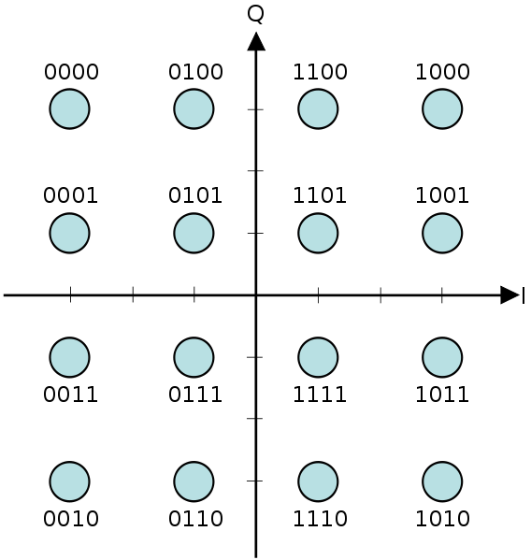
“00”
“01”
“11”
“10”
0
4-PAM
Gray coded 16-QAM

Slide 29
Gray Coded 16-QAM with E_{o}=1
“0000” “0001” “0011” “0010”
3
“1000” “1001” “1011” “1010”
1
-3
-1
1
3
-1
“1100” “1101” “1111” “1110”
-3
“0100” “0101” “0111” “0110”

Slide 30

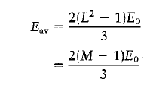
Performance of square QAM in Additive Gaussian Noise
The probability of symbol error of M-QAM with square constellation is given by
Where E_{av} is the average symbol energy given by

Slide 31
Example: Calculate the average symbol energy for square 16-QAM

Slide 32
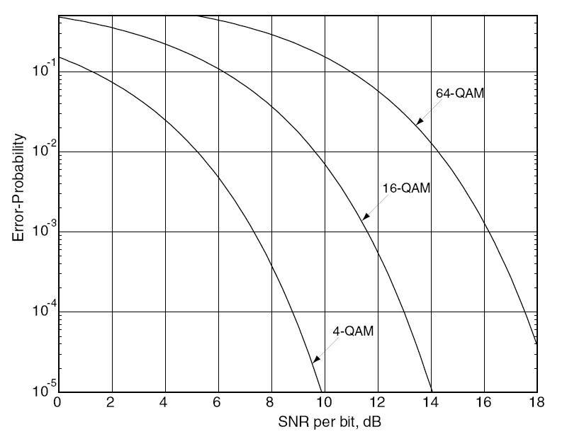
Symbol error probability as a function of SNR per bit (Eb/No)for 4, 16, and 64-QAM.

Slide 33

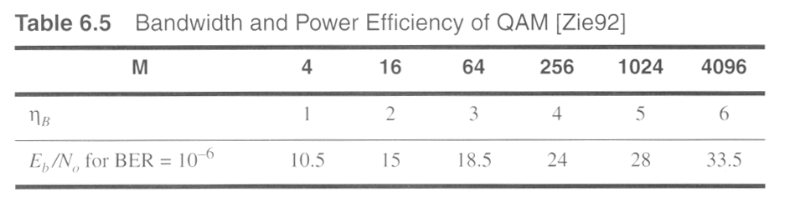
ρ

Slide 34
Comparison between M-PAM and M-QAM
Prob. Of Symbol Error M-PAM
Prob. Of Symbol Error M-QAM

Slide 35
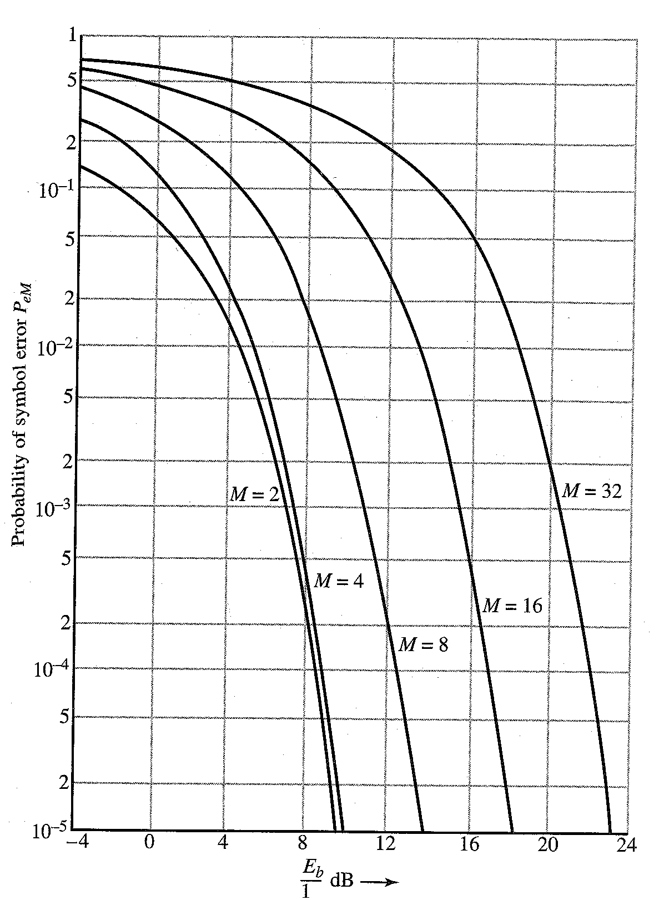
Comparison between M-QAM and M-PSK
Prob. Of Symbol Error M-PSK
Prob. Of Symbol Error M-QAM
E_{b}/N_{o} dB
E_{b}/N_{o} dB

Slide 36
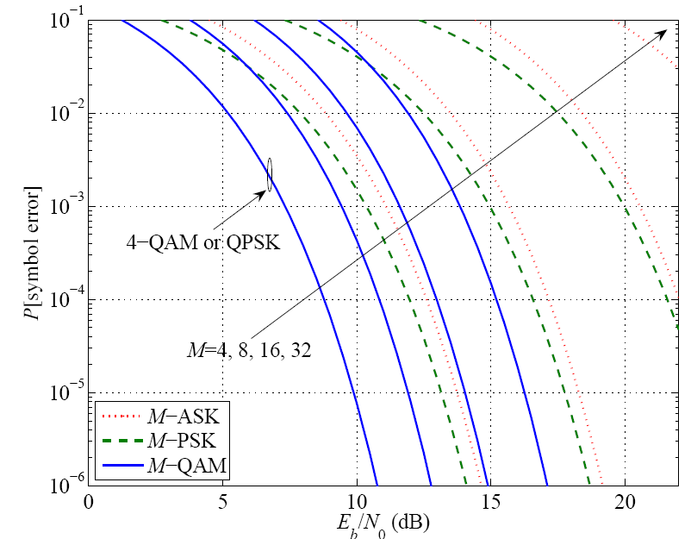
Performance comparison of M-PAM, M-PSK and M-QAM

Slide 37
Comments

Slide 38
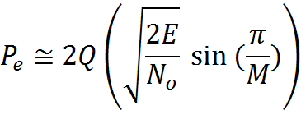
Performance Comparison of M-PSK and M-QAM
For M-PSK: approximate Pe
For M-QAM: approximate Pe
Comparing the arguments of Q(.) for the two modulations we calculate the advantage in signal-to-noise ratio of M-QAM over MPSK (to achieve same error performance) as

Slide 39
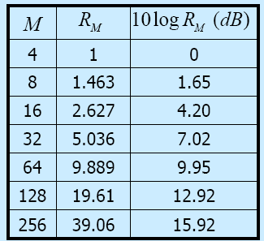
SNR Advantage of M-QAM over M-PSK for different M

Slide 40
