Slide 1
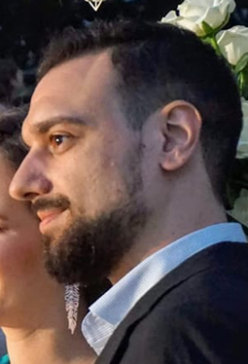
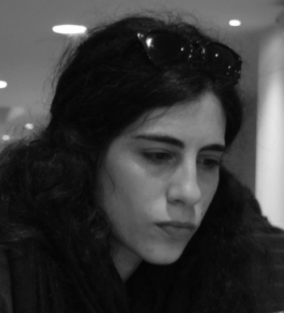
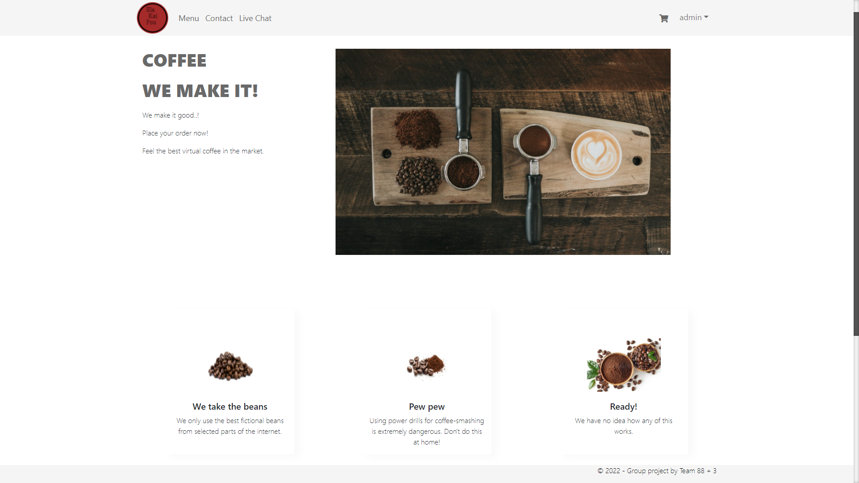
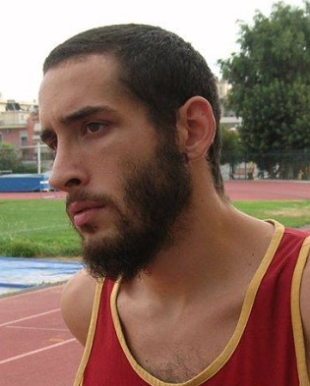


Group Project - “Ela Kai Pou” Coffee Shop - Presentation
Team Members (By first to last added to the team):
By Team “88 + 3”
A project that simulates a Coffee shop’s website in which:
One can register and log in as a customer, go through the menu which includes a variety of coffees. They can also pick, fully customize and add their favorite products to their personal cart and finally place their order by paying online via PayPal or paying at the store.
The Owner of the Coffee Shop can customize (CRUD operations) the products they sell.
There is an internal real time communication between customers (whether they have registered as users or not) and admins.
Efstathios Kravaritis
(Team Coordinator)
Eleni Stoumpou
Konstantinos Chountas
Petros Ouzounis
Alexandros Besbalta

Slide 2














Technologies We Used
C#
.NET FRAMEWORK 4.8
ASP.NET MVC 5
Entity Framework 6
Singleton Design Pattern
Repository Design Pattern
Unit of Work Design Pattern
Autofac Dependency Injection
ASP.NET SignalR
HTML
CSS
Bootstrap 5
PayPal .NET SDK
AJAX
JavaScript
JQuery
SQL

Slide 3
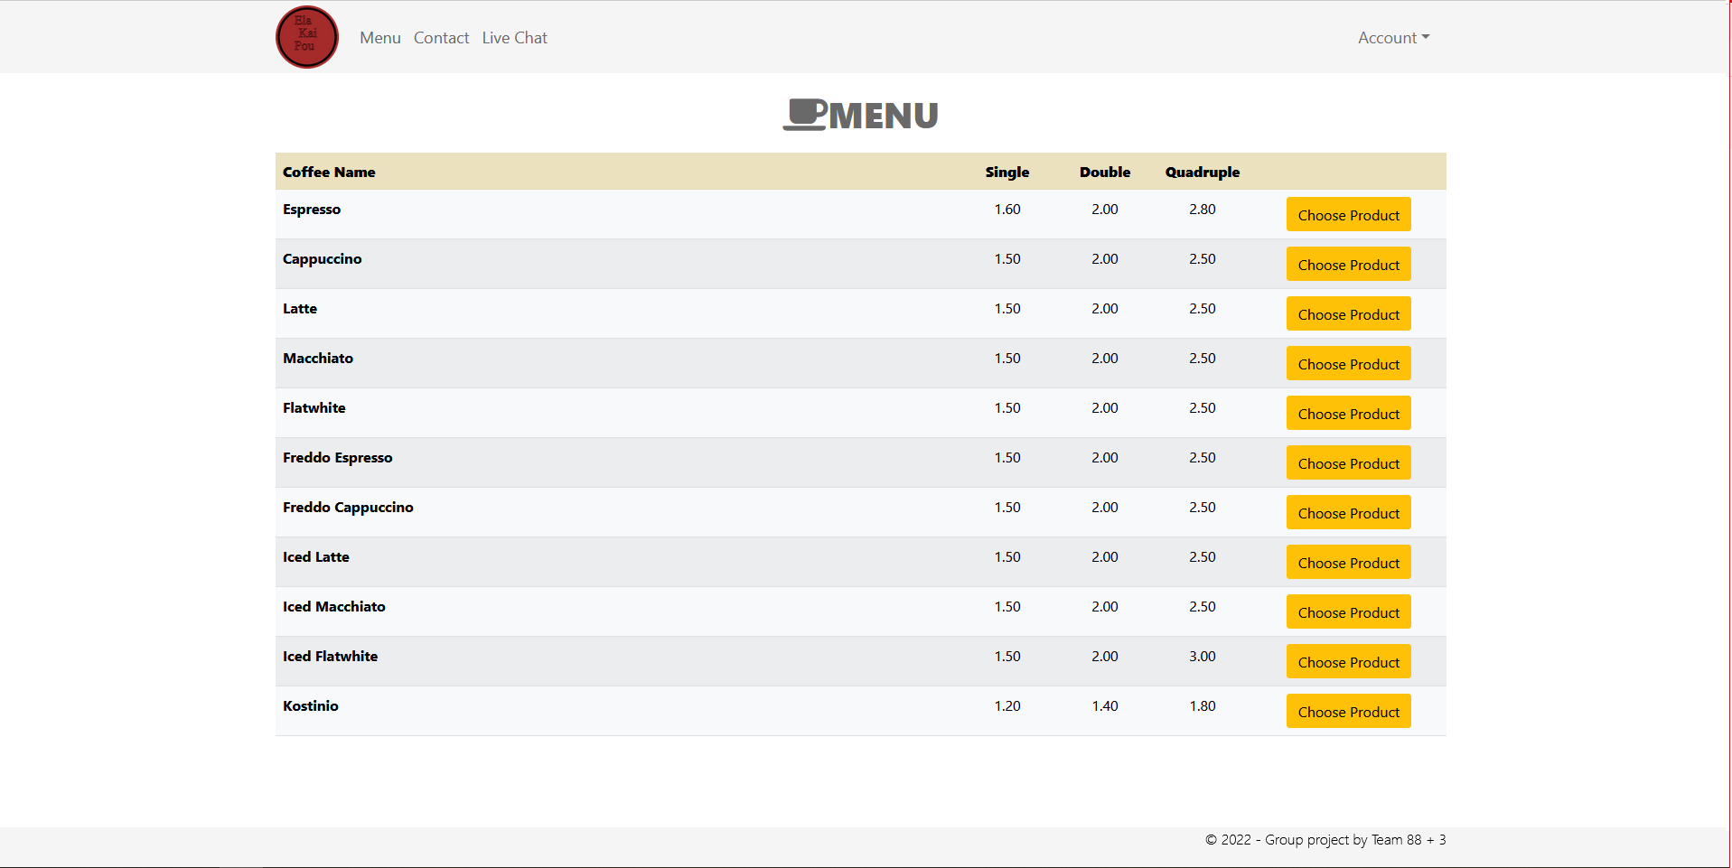
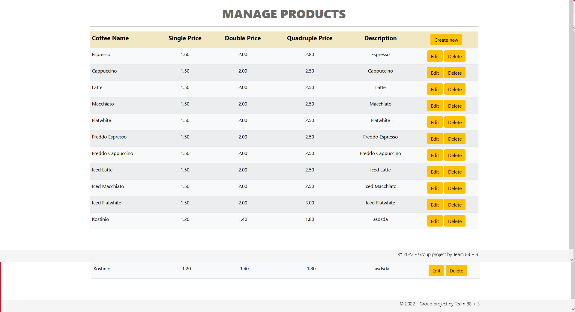
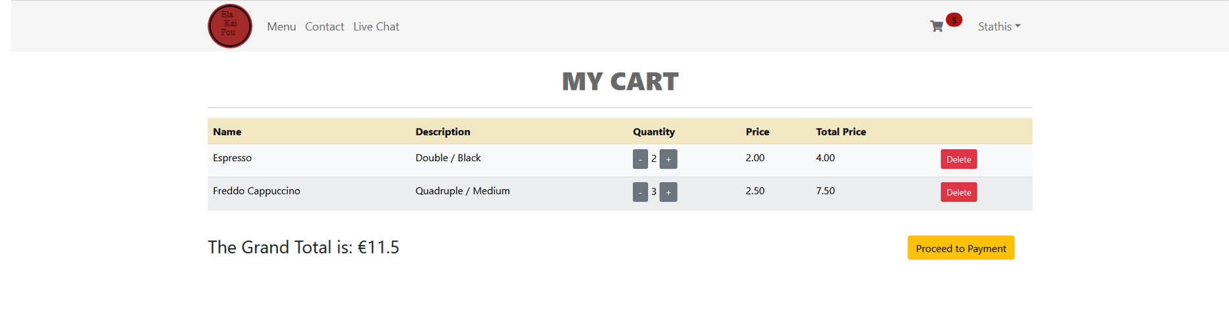
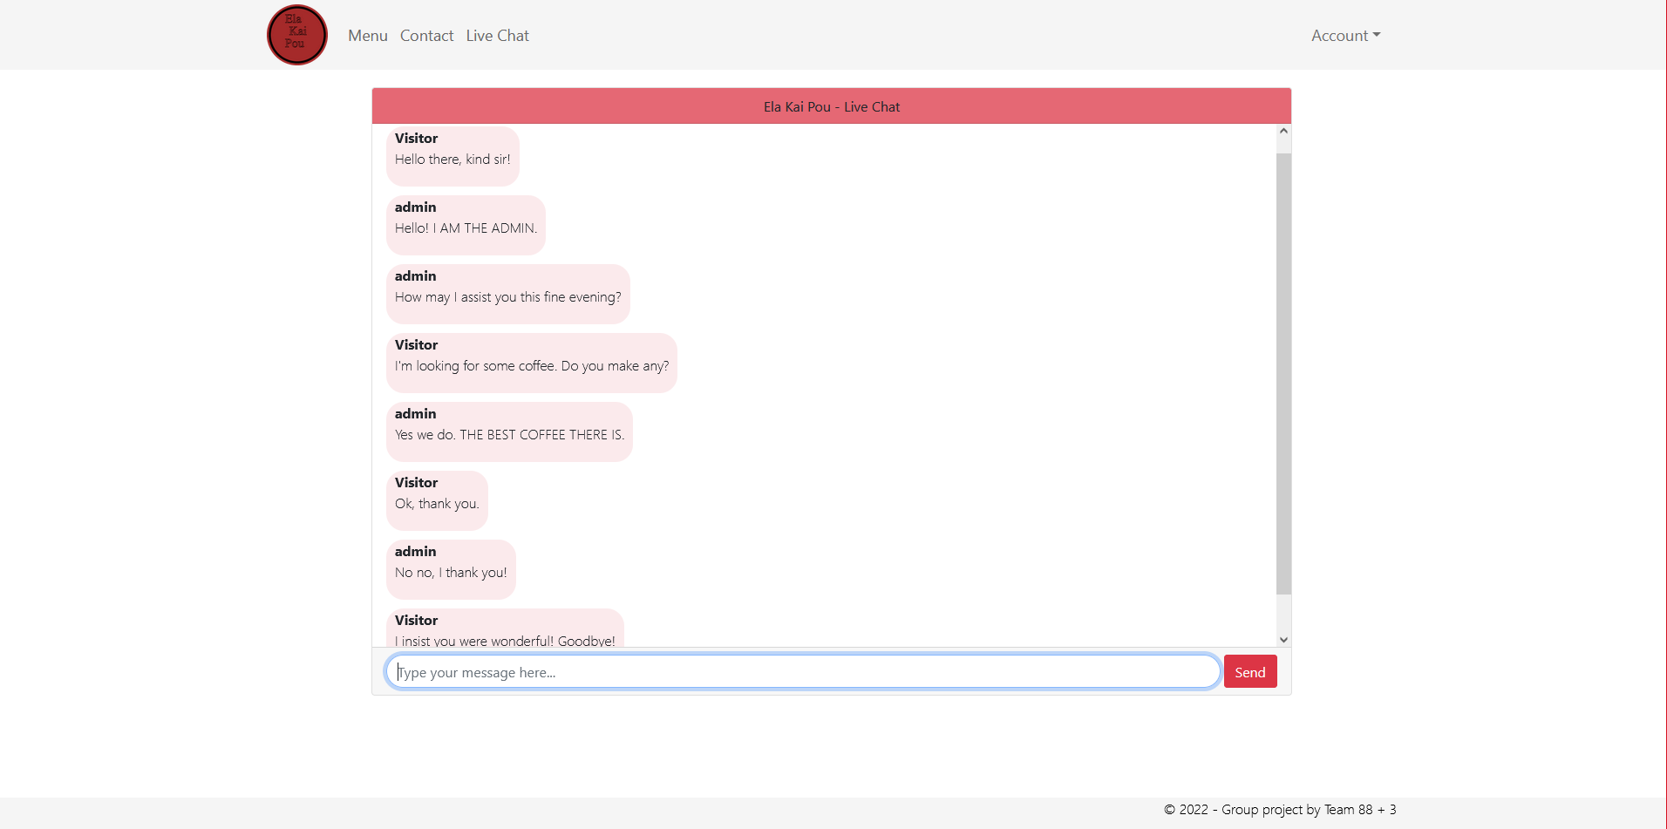
Future Improvements
Adding Async Tasks to improve the program’s runtime speed.
Implementing JS Frameworks to maximize Front-End’s potential.
Implementation of a wider menu with a variety of categories and products.
Unit testing’s addition to the application.
Statistic analysis on various categories’ addition as a service to the Admin.

