Slide 1
Gis interactive map for cross section of vtk files
Tsakirmpaloglou Konstantinos

Slide 2
Python GIS
Scope
Build an interactive map for slicing vtk files
Make a base map using the draw class from folium
Specify the line of the slice
Import the vtk
Generate the sliced plane of the vtk
Present it as a pop-up in the center of the line
Write the documentation

Slide 3
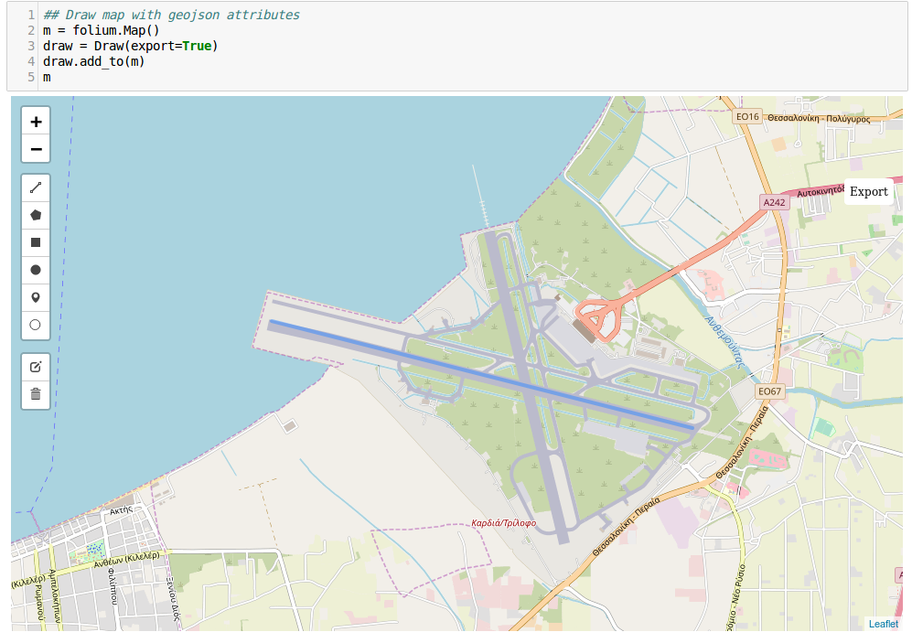
Python GIS

Slide 4
Python GIS
The export button will save a geoJson file
We will use GeoPandas to read and interact
with the coordinates

Slide 5
Python GIS
Read the vtk file
Cut the vtk using a plane specified from the coordinates
Generate an image (slice) from the vtk

Slide 6
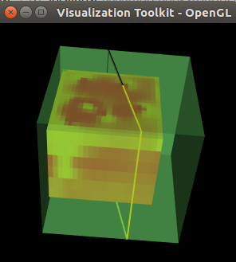
Python GIS

Slide 7
Python GIS
Future Work
Optimize the cut process
Multiple slices
Extend the code for adding more informations to map
More user friendly with more interactions and less “line changes”

Slide 8
Thank you!

