Slide 1

IMPUTATIONS
... AND BINARY CLASSIFICATION
Jakub Kosterna
Dawid Przybyliński
Hanna Zdulska

Slide 2

38
27
188
56
4
6 AWESOME
BINARY CLASSIFICATION
DATASETS
55

Slide 3
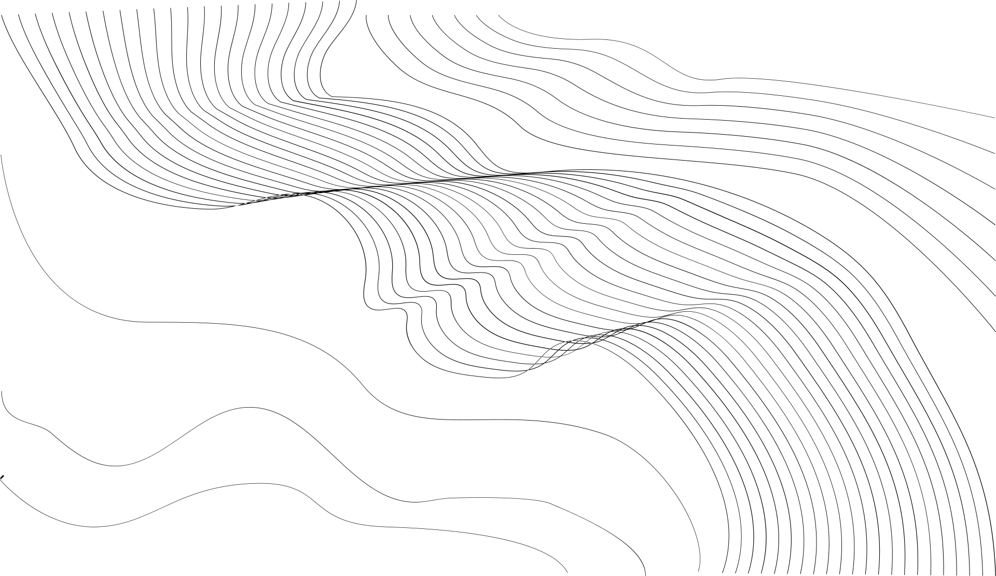


5
epic
CLASS-
-ification
models
CLASSIFICATION TREE
K-NEAREST NEIGHBOURS
The epic structural mapping of binary decisions algorithm taken from rpart package
A classic model attributing a given observation to a target ... corresponding to its closest friends in space!
Damn...
so much class!
NAIVE BAYES
RANGER
SVM
Naive but not stupid!
Another legendary algorithm, which uses the classic Bayesian formula in the field of probability theory and works great especially with independent feautures.
a fast and powerful model implementing random foreset for high dimensional data
everyone well known as support vector machine - another strong player, which uses a technique called the kernel trick to transform the data and then based on these transformations finds an optimal boundary between the possible outputs.

Slide 4


6 NOTEWORTHY
IMPUTATION
METHODS
Remove rows
Random replace
Simple method of removing rows containing any missing data.
Also a simple solution replacing NA values with random numbers or factors from their columns.
Mode / median replace
mice imputation
Another basic imputation putting in place empty median cells from their columns for numerical values and dominant for categorical ones.
Creates multiple imputations for multivariate missing data, based on Fully Conditional Specification, where each incomplete variable is imputed by a separate model.
missForest imputation
VIM's knn
The intelligent imputation based on random forest
Legendary k-nearest neighbors imputation algorithm taken from the great VIM package

Slide 5


BUT WHICH WILL TURN OUT TO BE THE BEST AND WILL WIN THIS AMAZING RACE?

Slide 6
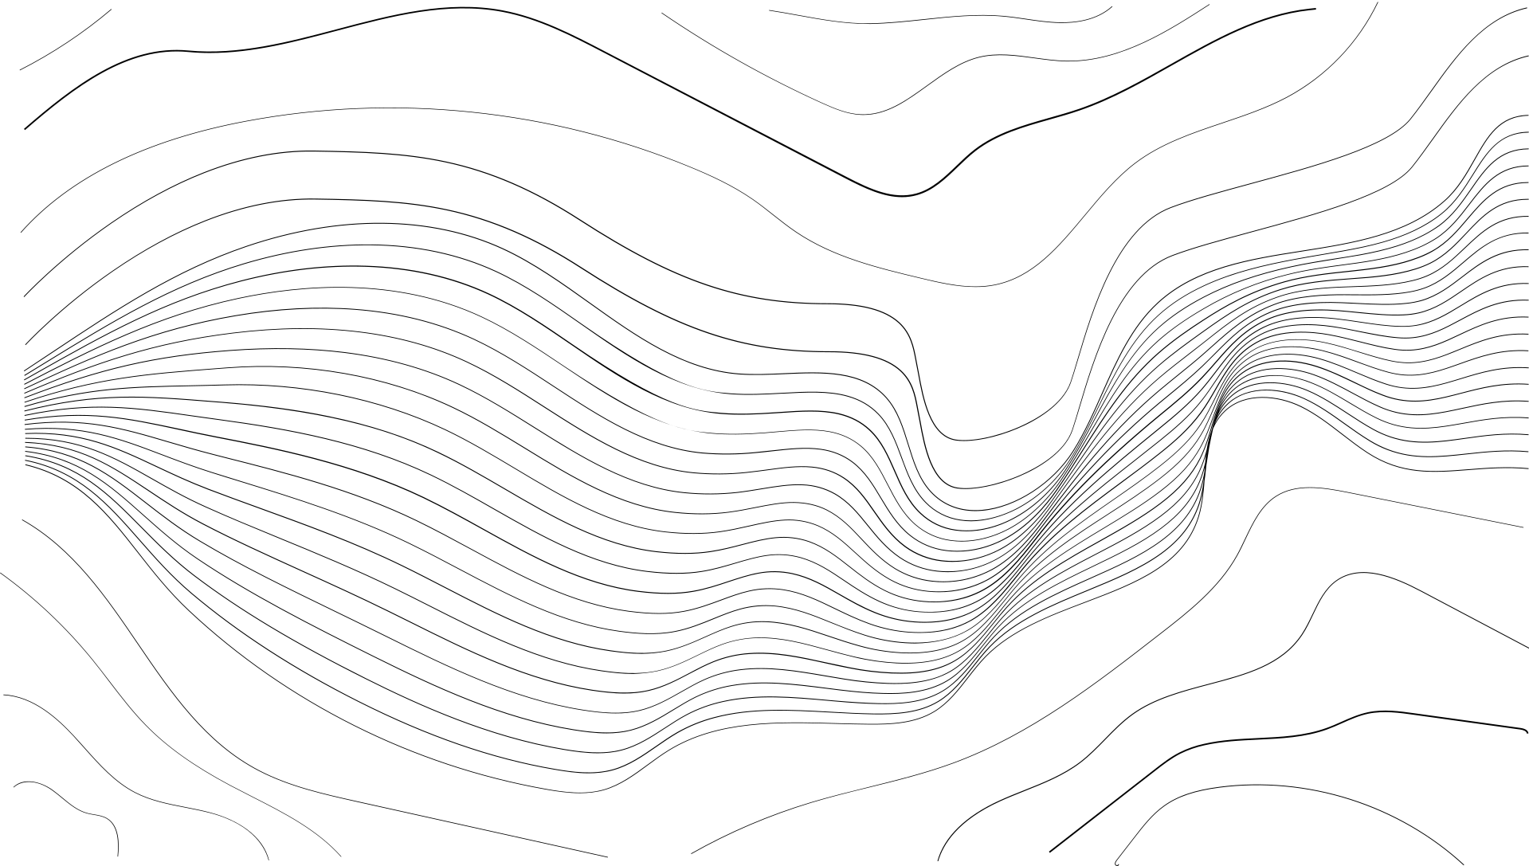



Coming soon...we will let you know!
PRZYBYLIŃSKI
ZDULSKA
KOSTERNA
Dawid
Hanna
Jakub

