Slide 1
Coin problem
Выполнила: Костенок Елизавета,
гр. Б01-904 ФРКТ
https://github.com/KostenokLisa/Coin_project

Slide 2
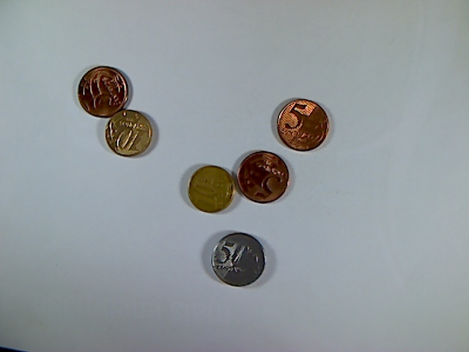
Input:
Output: 85 coins
Task: to develop a model
determining the total value of coins in the picture given
Assumptions:
The texture of table doesn’t contain circles
The optical axis of the camera is perpendicular to the table surface
Coins can’t overlap
Coins can be located both tales and eagles
Coins of all possible denominations can be in the picture
Strategy: circles detection + classification

Slide 3
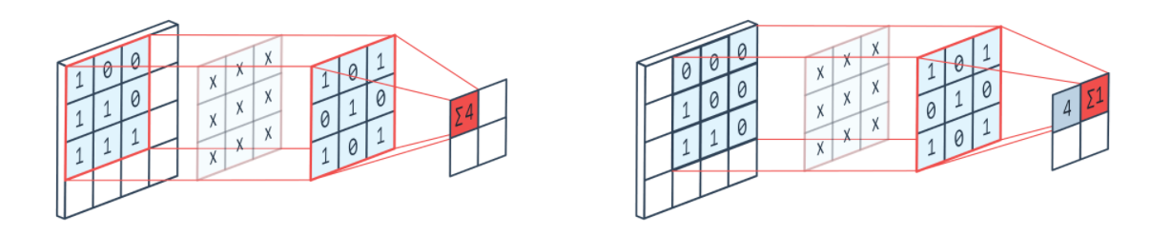
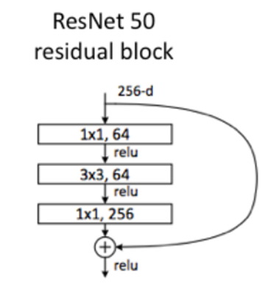
Convolution networks
Hyperparameters: stride, number of filters, amount of zero padding, size of filters
Training parameters: weights of filters
Bottleneck layer features:
-1x1 convolutions
-skip connection
-batch normalization

Slide 4
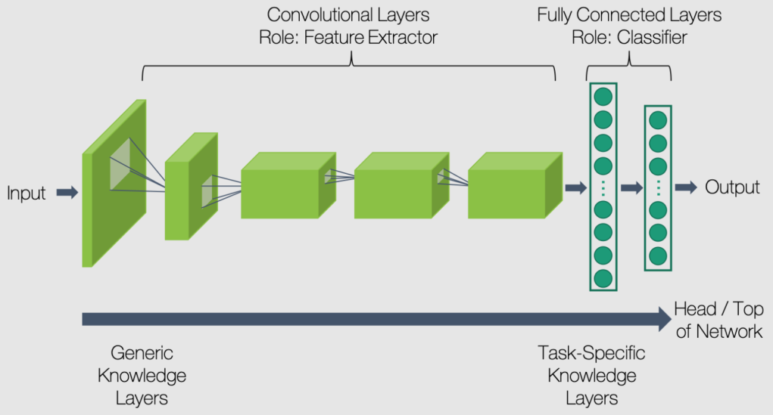


Transfer learning
Prepare data: resize, add augmentations, transforms to tensors
Load ResNet50 pretrained on ImageNet dataset
Change last layer - classifier
Train only last layers while weights of other layers are frozen
N classes: 5
Optimizer: AdamW
Activation fuction for classifier: Softmax
Loss: Cross Entropy

Slide 5
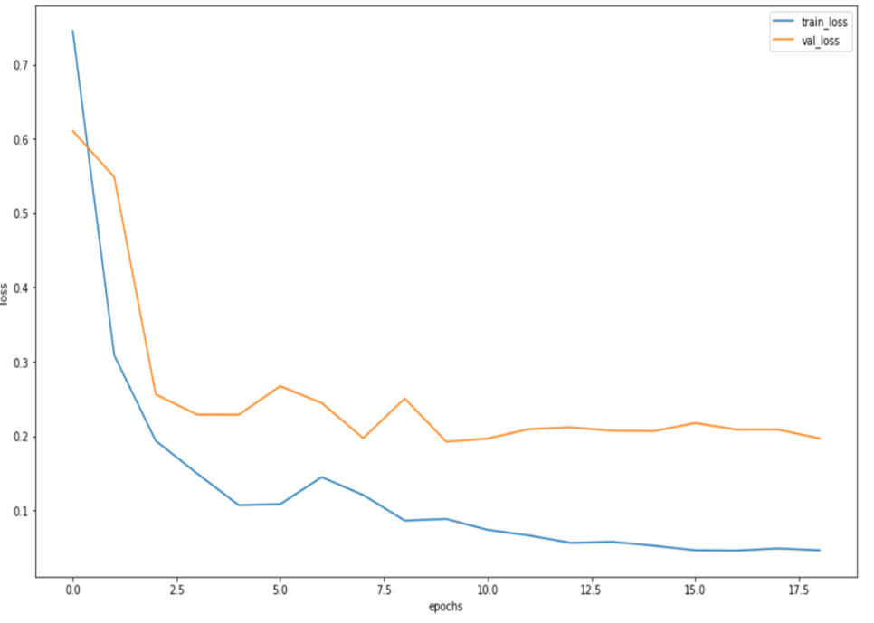
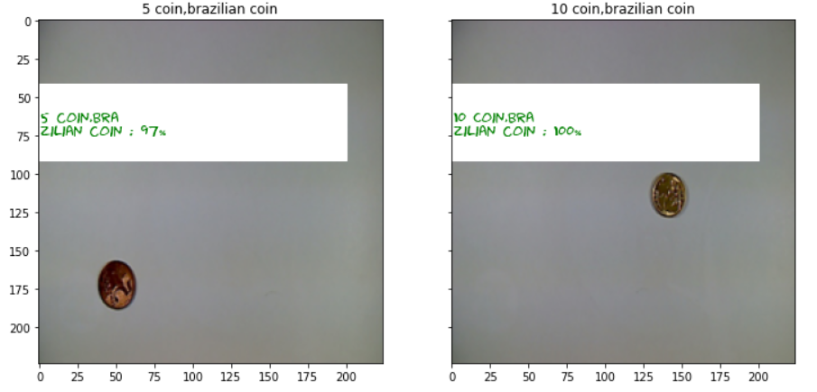
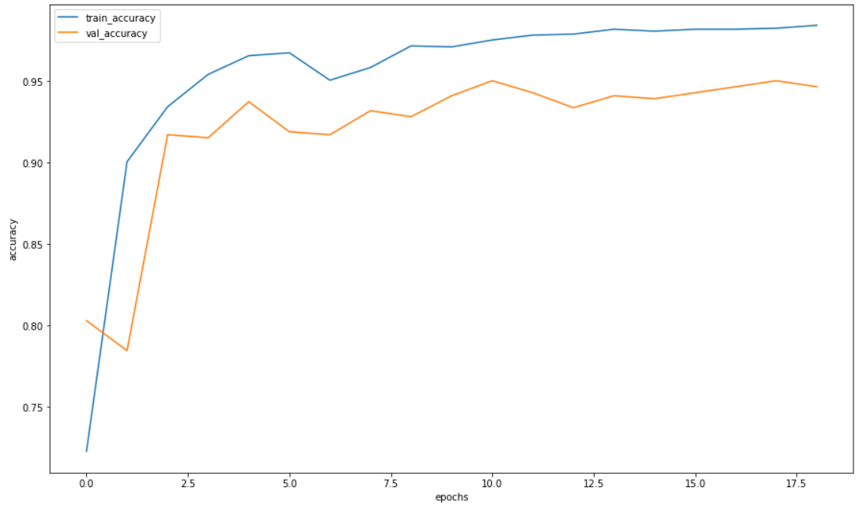
Outcomes
Visualization of classification: predicted labels and evidence are in white rectangles
Train accuracy: 0.97
Test accuracy: 0.95

Slide 6
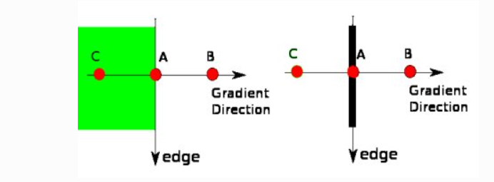
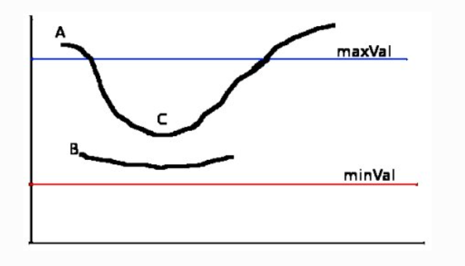
Circles detection using OpenCV
Canny edge detector:
removing noise in the image
finding edge gradient and direction for each pixel
non-maximum supression (pic 1)
hysteresis thresholding (pic 2)
Hough Transform:
detecting edge pixels
collecting evidence in a 3D accumulator array for the presence of circles with different centers and radii
thresholding for selecting the most confident circles
Pic 1: defining A as edge pixel, ignoring B, C non-edge pixels
Pic 2: defining line A as “sure” edge, line C as a part of “sure” edge, line B – non edge

Slide 7
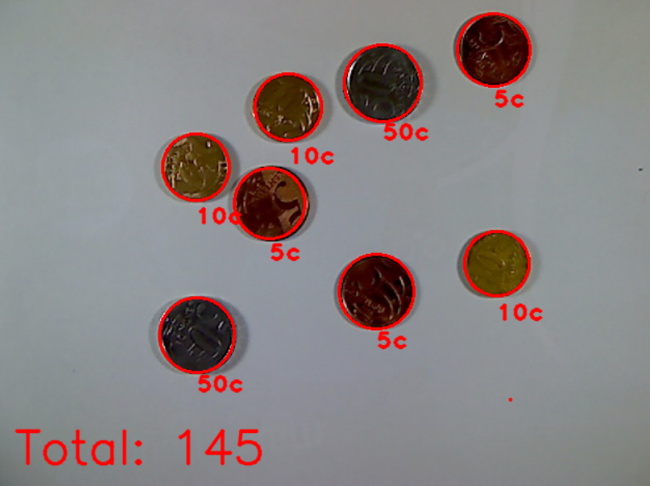
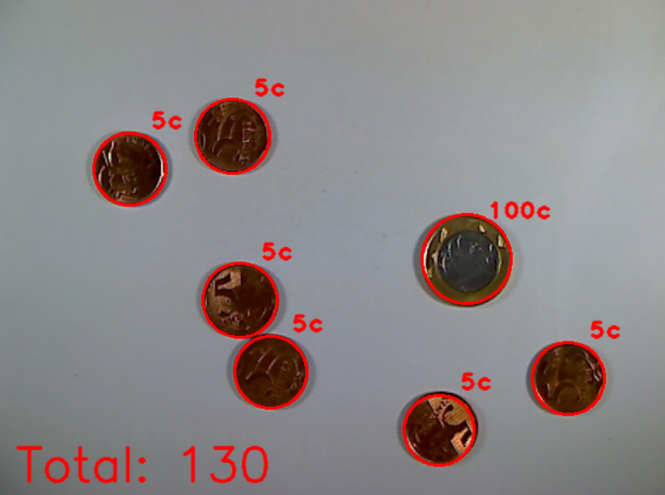
My results
Example of successful detection: all coins and their values are recognized correctly
Example of successful detection: all coins and their values are recognized correctly

