Slide 1

OAKESHOTT INSURANCE
NEW INSTITUTE CARGO CLAUSES:
CHANGES THAT REFLECT MARKET TRENDS
George V Grishin
Director, PhD, ACI

Slide 2
OAKESHOTT INSURANCE
- WE ARE:
UK INSURANCE AND REINSURANCE BROKERS
- WORK WITH EASTERN EUROPEAN TRANSPORT RISKS SINCE 1993
- PLACE RISKS WITH THE UK, CONTINENTAL AND
RUSSIAN INSURANCE COMPANIES
- SHIPOWNERS / CARGO INTERESTS FROM GERMANY, FRANCE, GREECE, TURKEY INSURED BY US WITH RUSSIAN CARRIERS

Slide 3
RUSSIAN INSURANCE- SOME FIGURES
-2007 WORLDWIDE PREMIUM INCOME –
US$ 4,1 Billion = Bn
- including P&C = USD 2.7 bn
- OF WHICH MARINE =US$ 22.8 Bn, OR 0.84 %
- RUSSIAN PREMIUM in 2007
US$ 31.2 Bn = 1.15 % OF WORLD
RUSSIAN MARINE MARKET ex CARGO, 2007 –
US$ 0.164 Bn = 0.54 % of Russia =
0.7 % of world marine

Slide 4
RUSSIAN INSURANCE- SOME FIGURES
- 2007 RUSSIAN MARINE INSURANCE INCOME ex CARGO – US$ 164,000,000
- PAID CLAIMS – US$ 88,000,000
- LOSS RATIO – 53 %
- LARGEST COMPANY – INGOSSTRAKH, 38 % MARKET SHARE
- PROFESSIONAL PLAYERS - VSK, SOGAZ, ROSGOSSTRAKH, RESO
- TOP 10 MARINE INSURERS – 86 % MARKET SHARE
- OVERALL 64 INSURERS WRITING RISKS – SOME ARE FAR FROM PROFESSIONALISM
- RUSSIAN RISKS (RE)INSURED WITH P&I CLUBS AND LONDON AND GERMAN MARKETS

Slide 5
MOSCOW’S POSITION IN HULL
-IN EUROPE, THE SECOND INTERNATIONAL
RISK CARRIERS AFTER LONDON
-WORK ON INTERNATIONAL RULES
-HAVE HIGH-QUALITY PROFESSIONALS
WITH INSURANCE AND MARINE BACKGROUND
-USE INTERNATIONAL TERMS – ITC, DNV
-LACK UNITY
-URGENT NEED FOR ROSMARUNI SET UP

Slide 6
WHAT DO RUSSIANS INSURE
-IN THE NEW TIMES, STARTED WITH P&I WITH LOCAL AND INTERNATIONAL INSURERS
- THE GOVERNMENT IS NOW PAYING MORE ATTENTION TO LIABILITY REGIME
- CALLS TO INTRODUCE OBLIGATORY POLLUTION COVER AT US$ 300 MN
- PROBLEMS FOR SMALLER OLDER VESSELS
- HULL INSURANCE DEVELOPED FROM 1990ies
- MOST OF SHIPBUILDING RISKS INSURED – NOT SHIPREPAIR
- CHARTERERS P&I A NEW SECTION

Slide 7
MORE EXOTIC COVERS
- POLITICAL OR FINANCIAL RISKS ON RUSSIAN YARDS – QUITE RARE
- SHIP MANAGERS’ LIABILITY
- SHIP BROKERS, SHIP AGENTS AND SURVEYORS LIABILITY
- PORTS, TERMNIALS, STEVEDORES AND PILOTS STARTING TO INSURE THEIR LIABILITY
- RECOVERY AGAINST THESE BODIES PRACTICALLY IMPOSSIBLE

Slide 8
INSURANCE LITTLE ISSUES
- TERMS AND CONDITIONS:
  *WESTERN CLAUSES KNOWN, SOMETIMES UNDERSTOOD
  *RUSSIAN TERMS SIMILAR BUT NOT IDENTICAL
- VALUES COVERED:
* MAJOR DIFFERENCE BETWEEN WESTERN AND EASTERN APPROACHES
* IN RUSSIA, SUM INSURED MAY NOT EXCEED MARKET VALUE. IN THE UK AGREED VALUE MAY BE HIGHER THAN MARKET VALUE

Slide 9
CARGO INSURANCE
-THE FIRST LINE PRACTICED SINCE 1922 – and EVEN EARLIER
-TERMS AND CONDITIONS:
AS PER THE LAW, EACH COMPANY
HAS TO USE ITS OWN TERMS
-ICC ARE WELL KNOWN AND USED
-2009 ICC ARE OF INTEREST

Slide 10
AN ARTILCE by GG on ICC’09
-CLAIM TO BE THE FIRST IN THE WORLD with:
- A LINE-BY-LINE 1982-2009 COMPARISON
-AN ATTEMPT TO CLASSIFY CHANGES
-Ins.DAY’s ARTICLE: 95 % on the RUSSIAN MARKET CRITICISM, 5 % on the ACTUAL 2009 COMPARISONS
-NEVER LEARN ON MISTAKES LET’S GO THE SAME WAY

Slide 11
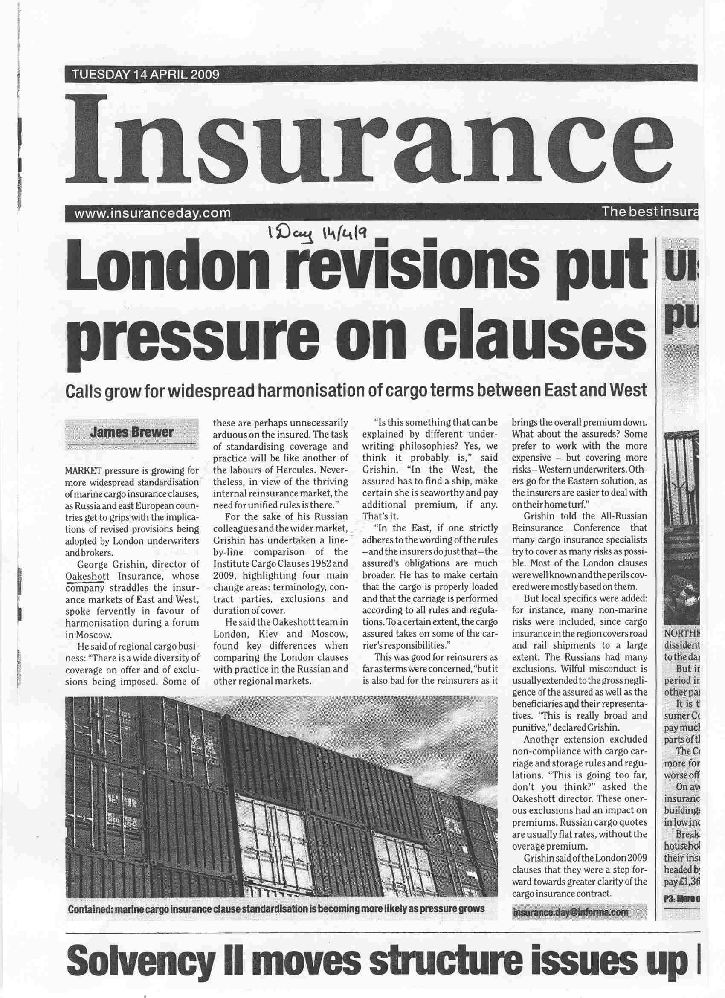

Slide 12
WE LOOKED AT 19 SETS of CLAUSES
from 3 COUNTRIES
HOW CAN A REGIONAL MARKET EXIST WITHOUT UNIFICATION?
WE HAVE THREE BASIC CARGO CLAUSES VARIANTS
BUT, RISKS COVERED UNDER (B) and (C) EQUIVALENTS DIFFER A LOT
INCLUDING TUNNELS COLLAPSE AND POULTRY ESCAPE
RAIL AND ROAD TRANSPORT

Slide 13
3 BASIC VARIANTS
(А) 1963 or even 1912 EQUIVALENTS WPA / WA / AR
(B) ICC’82 EQUIVALENTS
(C) THEY MARK THEM AS (АВС), BUT ACTUALLY THEY ARE THE GOOD OLD WPA etc.
A CALL FOR UNIFICATION?

Slide 14
RUSSIAN EXCLUSIONS
GOOD FOR the REINSURERS – NOT SO FOR THE ASSUREDS
TO START WITH, EXCLUDED ARE:
- GROSS NEGLIGENCE
- NON-COMPLIANCE WITH CARGO CARRIAGE RULES / REGULATIONS

Slide 15
BACK to 2009 ICC
IT’S STRANGE HOW LONG IT TAKES FOR ANY ANALYSIS TO ARRIVE
WE DECIDED TO CLASSIFY ALL MAJOR CHANGES INTO 4 GROUPS:
(1) TERMINOLOGY
(2) CONTRACT PARTIES
(3) EXCLUSIONS
(4) PERIOD OF COVER

Slide 16
(1) TERMINOLOGY
SOME “OLDIES GOLDIES” REMOVED:
- UNDERWRITERS – INSURERS
- GOODS - SUBJ.-MATTER INSURED
- TO INURE, LIFTVAN
BUT, AWARE-PRIVY DIFFERENCE UNCLEAR
TRANSPORT MEANS – 6 DIFFERENT TERMS: CONVEYANCE / CRAFT / VESSEL / SHIP / VEHICLE / CONTAINER / (LIFTVAN RIP)‏
HELD COVERED REMOVED

Slide 17
(2) CONTRACT PARTIES
(а) ASSURED ARE IN PLURAL!
A DEFINITION: “the person claiming indemnity either as the person by or on whose behalf the contract of insurance was effected or as an assignee
(b) GOOD FAITH BUYER
(c) INDEPENDENT CONTRACTOR
(d) TERRORIST… NOT A PARTY TO THE CONTRACT…

Slide 18
(3) EXCLUSIONS
(а) PACKING
(b) DELAY
(с) CARRIER’s DEFAULT
(d) NUCLEAR RISKS
(e) UNSEAWORTHINESS
(f) PIRACY COVERED under ICC(A)‏
(g) BROAD TERRORISM DEFINITION

Slide 19
EXCLUSIONS:
CAUSATION CLASSIFICATION
NUCLEAR RISKS – THE BROADEST:
- DIRECTLY CAUSED
  - INDIRECTLY CAUSED
- ARISING FROM
BUT WHAT IS THEN “RESULTING FROM”?
AND WHERE STANDS “ATTRIBUTABLE TO”?

Slide 20
(4) COVER PERIOD
THE MAIN IDEA:
ATTACHING AS EARLY AS POSSIBLE
FIRST MOVED IN THE WAREHOUSE
DELIVERY CHANGED TO UNLOADING
STORAGE IN A CONTAINER
CHANGE OF VOYAGE – NOW COVERED

Slide 21
IN GENERAL
MORE CLEAR
WE HAVE TO HARMONISE RUSSIAN AND INTERNATIONAL TERMS
ALTHOUGH THEY MIGHT BE UNCLEAR
LET’S MAKE OUR REGIONAL TERMS ATTRACTIVE!

Slide 22
INSURANCE LITTLE ISSUES
WHEN or THEN
If…
either the contract of carriage is terminated …
or the transit is otherwise terminated …,
then this insurance shall also terminate
unless prompt notice is given ….
and continuation of cover is requested
WHEN
this insurance shall remain in force…
THEN?

Slide 23
INSURANCE
- “WE ARE SUPPOSED TO BE
  UNDERWRITING A RISK –NOT A CERTAINTY!”
- DISPUTES ARE BOUND TO TAKE PLACE
- CHOOSE YOUR INSURER – AND YOUR BROKER!
WECANHELP
@OAKINSUR.COM

