Slide 1
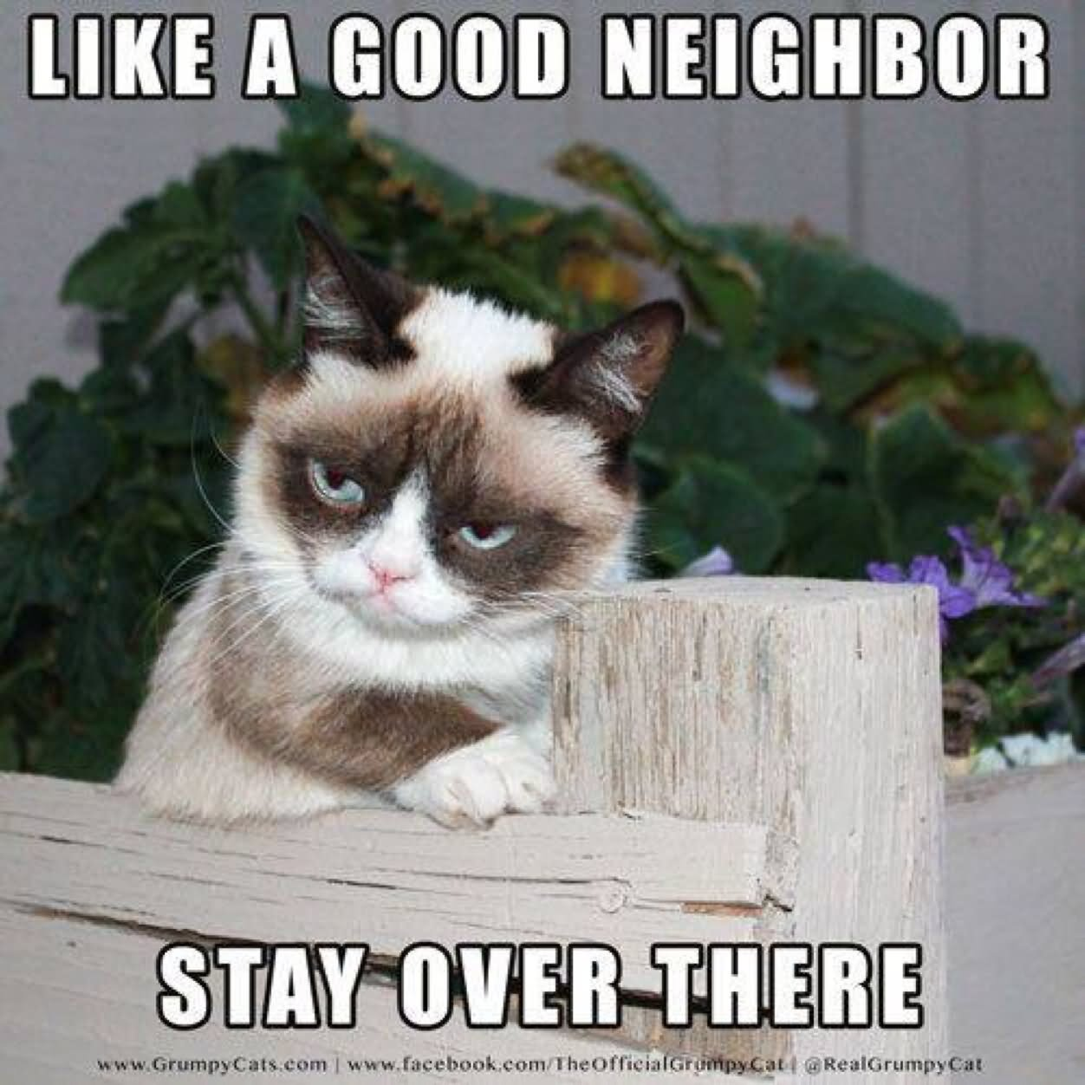
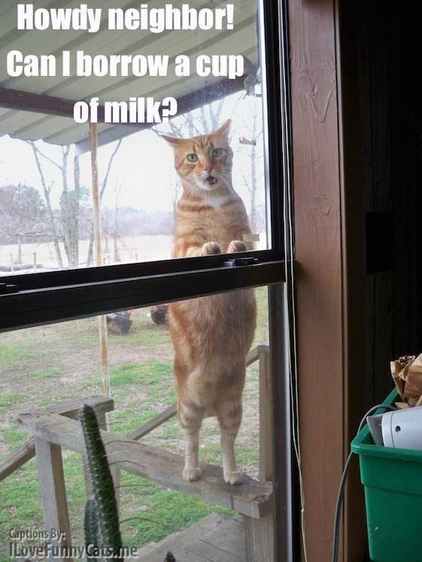
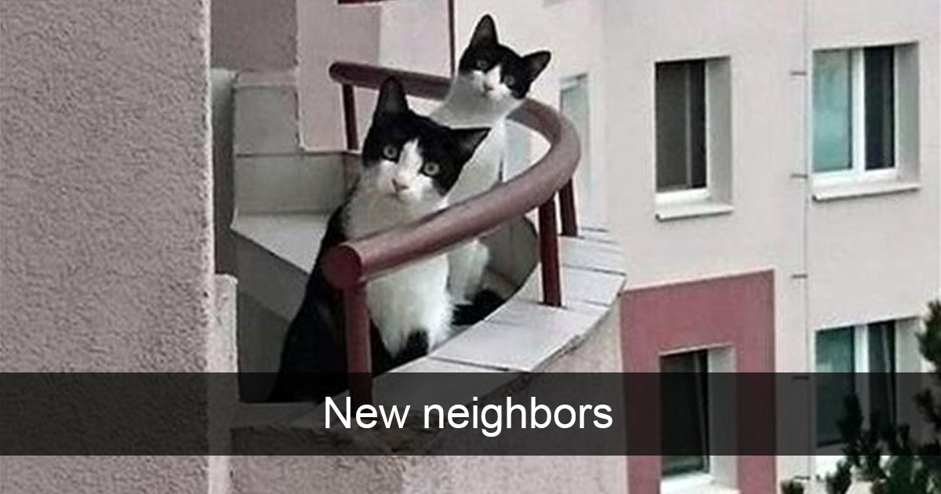
K
N
N

Slide 2
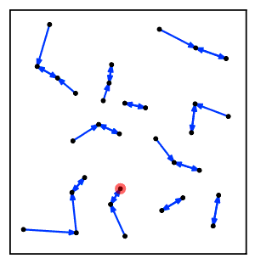
KNN
K Nearest Neighbors

Slide 3
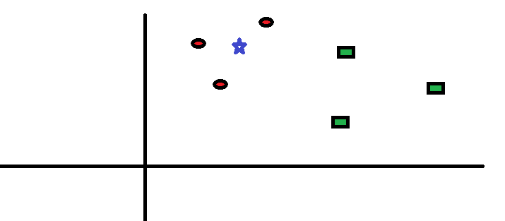
KNN
Ex. Find the class of the blue star

Slide 4
KNN
Say, we want the 3 (K = 3) nearest neighbors to be accounted for when determining class
3/3 closest neighbors are Red Circles
Blue Star is in the class of the Red Circles

Slide 5
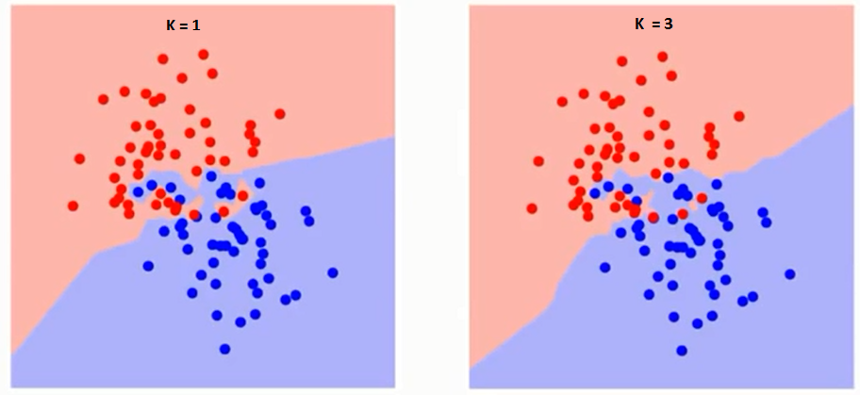
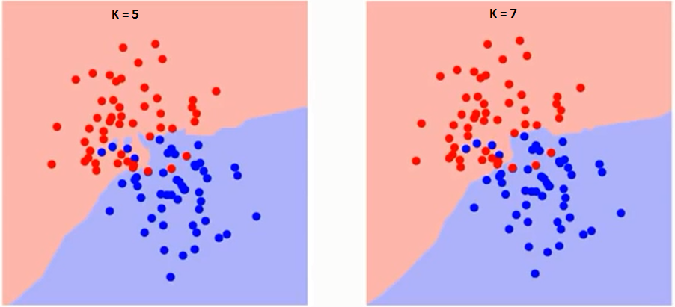
Boundary Becomes Smoother
All Red or All Blue

Slide 6
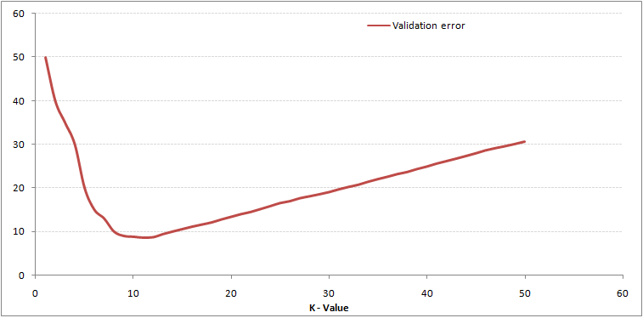
KNN
K = # classes
K = 1 ➔ OVERFITTING
K = 1000000000 ➔ UNDERFITTING

