Slide 1
WIPRO NGA Program-Data Center Batch 9
Capstone Project Presentation:-12th and 13th Aug
Project Title:-Appointment Booking with Doctor Application
Presented by:- 30492-Prem Dutt

Slide 2
Project Introduction: Appointment Booking System
The Appointment Booking System is a full-stack web application designed to streamline the process of scheduling appointments between patients and doctors. It allows users to view doctor listings, book appointments, and manage their bookings through an intuitive interface.
The backend is built using Spring Boot, with Spring Data JPA and MySQL for data management. The frontend is developed using Angular, providing a dynamic and responsive user experience. To ensure scalability and ease of deployment, the application is fully containerized using Docker and deployed locally using Kubernetes.
This project demonstrates the integration of modern web technologies, microservices principles, containerization, and orchestration in a real-world scenario.

Slide 3
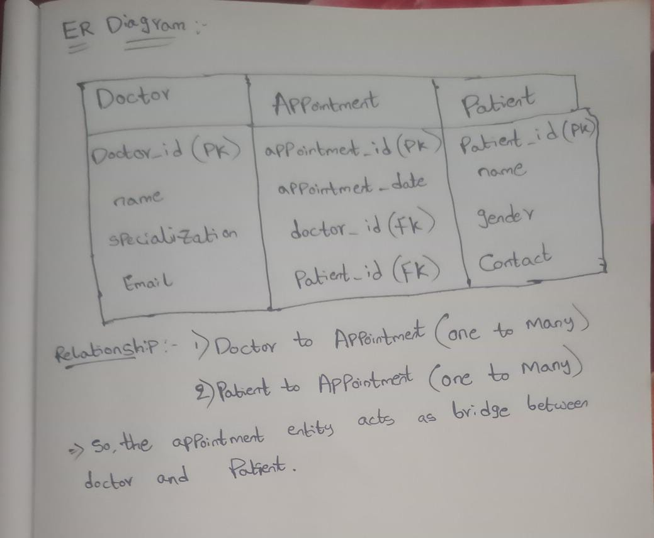
ER Diagram

Slide 4
Day 1: Backend Setup and Implementation
Spring Boot Project Initialization: Created a new Spring Boot project using Spring Initializer with dependencies such as Spring Web, Spring Data JPA, and MySQL Driver.
MySQL Configuration: Configured application.properties with database connection details and JPA settings.
Entity Creation:
Doctor: Fields like id, name, specialization, email.
Appointment: Fields like id, patientname , appointmentdate, doctorId.
Repository Interfaces:
DoctorRepository and AppointmentRepository extending JpaRepository for CRUD operations.
REST Controllers:
DoctorController: Endpoint to retrieve the list of doctors.
AppointmentController: Endpoints to create and retrieve appointments.

Slide 5
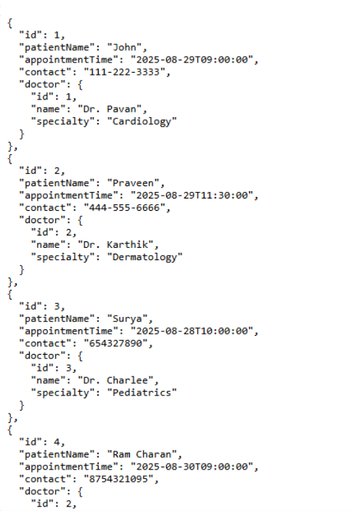
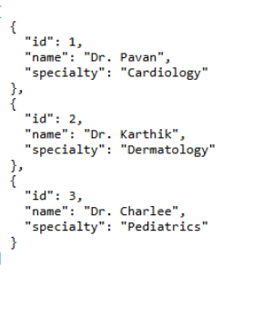

Slide 6
Day 2: Frontend Development and Integration
Angular Project Initialization: Created a new Angular project using Angular CLI.
Modules and Routing: Configured routing between components.
Components Developed:
DoctorListComponent: Displays list of doctors using data from backend.
AppointmentFormComponent: Form for booking appointments.
Services Created:
DoctorService: Handles API calls to fetch doctor data.
AppointmentService: Manages API calls for booking and viewing appointments.
API Integration: Used Angular’s HttpClient to connect frontend components with backend RESTful APIs.

Slide 7
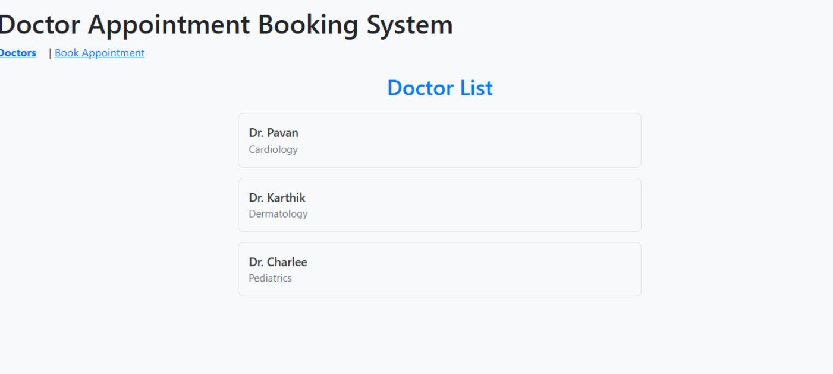
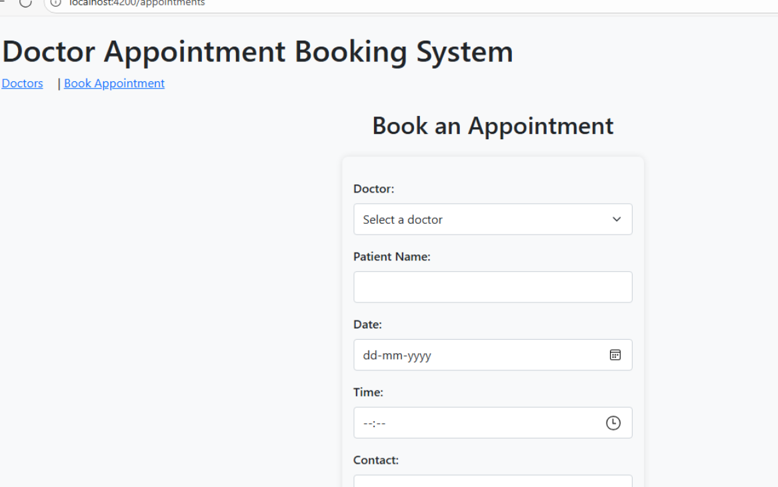

Slide 8
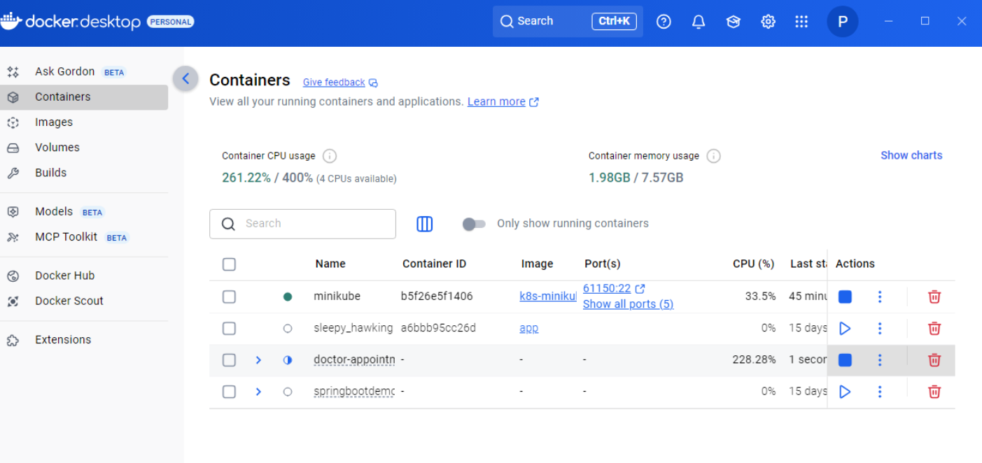
Day 3: Containerized the Spring Boot application using Docker and set up Docker Compose to run the backend alongside a MySQL container.

Slide 9
Day 4: Kubernetes Deployment
Kubernetes Deployment Setup:
Created mysql-deployment.yaml to deploy the MySQL database with environment variables for DB name, user, and password.
Created app-deployment.yaml for deploying the Spring Boot backend application, including container image, ports, and environment configuration for connecting to MySQL.
Created full-deployment.yaml to orchestrate the deployment of all components (MySQL and Spring Boot) in a single file for easier management.
Service Configuration:
Defined Kubernetes Services (ClusterIP or NodePort) within the YAML files to expose the backend and database internally within the cluster.

Slide 10
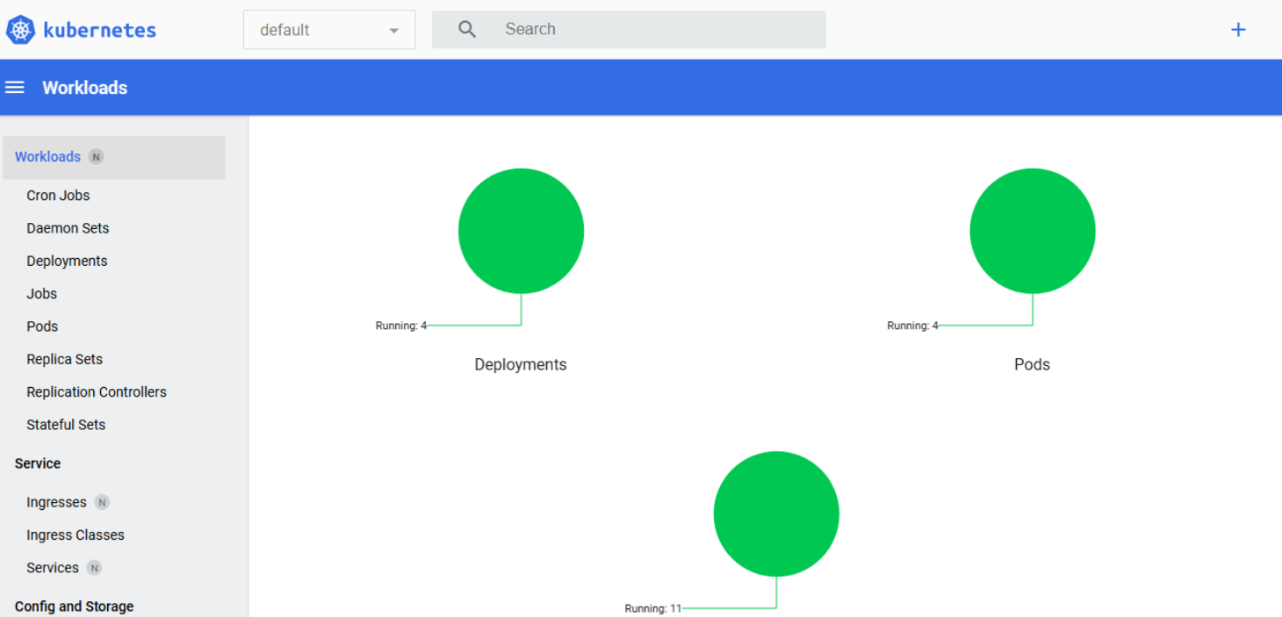
Day 5: Testing and Validation

