Slide 1

FIELD PROJECT
E CANTEEN
BATCH-12
SECTION - 19
241FA04257 PATHAN IMRAN KHAN
241FA04323 KHANISHQ VENKAT
241FA04484 RAKESH SAI

Slide 2
What is e-Canteen?
Definition: An online food ordering and management web application designed to facilitate seamless ordering in canteens/mess facilities.
Objective: To eliminate long queues and cash transactions by moving the entire process online.
Scope: Designed for schools, colleges, and corporate offices.
Core Concept: Order online -> Pay digitally -> Pick up instantly.

Slide 3
Issues with Traditional Canteens
Time Wastage: Employees/Students spend 15-20 minutes in queues during short breaks.
Cash Handling: Problems with loose change, risk of theft, and unhygienic handling of money near food.
Manual Errors: Cashiers often make calculation mistakes during rush hours.
Food Wastage: Canteen staff cooks blindly without knowing exact demand.
Lack of Feedback: No mechanism for customers to rate food quality instantly.

Slide 4
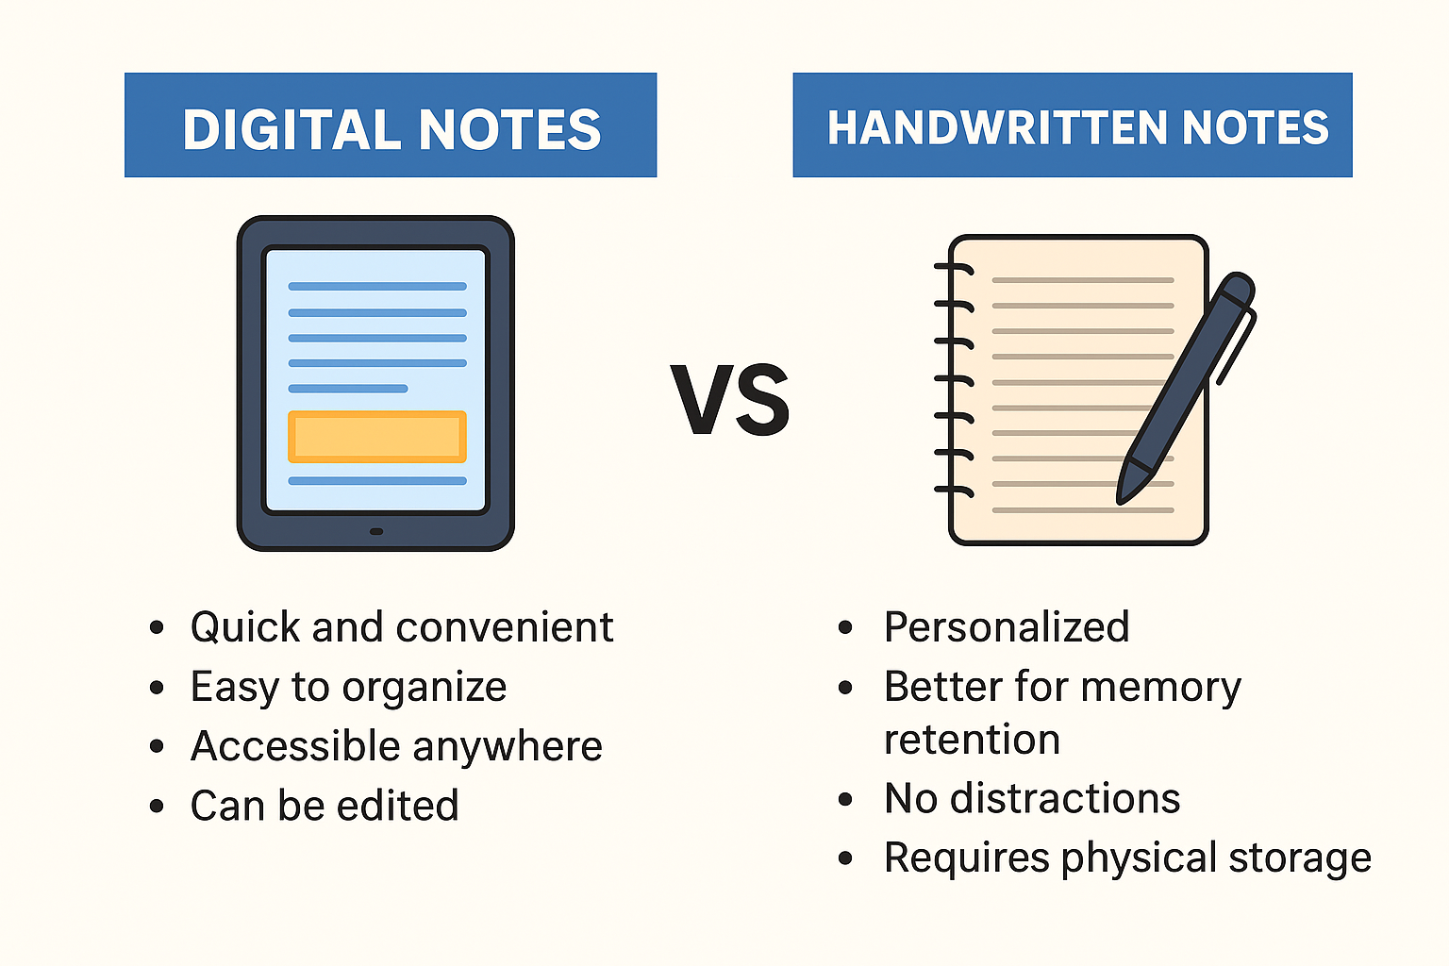
The e-Canteen Ecosystem
Web Portal: Accessible via desktop/laptop for office workers.
Mobile App (Android/iOS): For students and staff on the move.
Digital Wallet: Users preload money or use UPI/Net banking.
Smart Kitchen Display: Orders appear on the chef's screen instead of paper slips.
Real-Time Inventory: Menu items grey out when stock runs out.

Slide 5
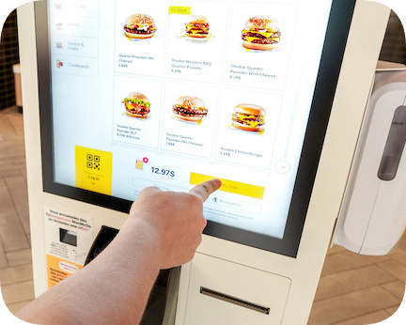
Features for the Customer
Live Menu: View today’s menu with prices and photos.
Cart System: Add multiple items, customize (e.g., "Extra cheese", "No sugar").
Pre-Ordering: Schedule lunch for a specific time (e.g., Order at 10 AM for 1 PM pickup).
Order History: View past orders and reorder favorites.
Ratings: Give 1-5 star ratings to dishes.

Slide 6
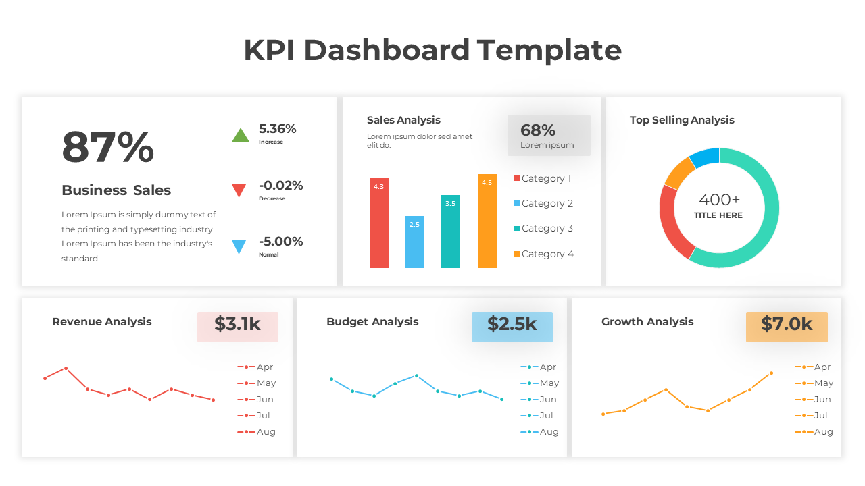
Features for the Canteen Admin:
Dashboard: Overview of total sales, daily revenue, and pending orders.
Menu Management: Add, remove, or update prices of dishes instantly.
User Management: View employee/student details and refund requests.
Reports: Generate monthly reports (Excel/PDF) for accounting.
Inventory Alert: Notifications when ingredients are running low.

Slide 7
How It Works (Workflow)
Login: User logs in with unique ID.
Select: User selects food items from the digital menu.
Pay: User pays via e-Wallet or Credit Card.
Notify: Kitchen receives an automated digital receipt.
Process: Chef prepares the order and updates status to "Ready."
Collect: User picks up order by showing a unique Order ID/QR Code.

Slide 8
Technical Specifications
Frontend: HTML5, CSS3, JavaScript, React.js (or Angular).
Backend: Python (Django) or Java (Spring Boot) or Node.js.
Database: MySQL or MongoDB for storing user data and orders.
Payment Gateway Integration: Stripe, Razorpay, or PayPal API.
Security: SSL Encryption and JWT Authentication for secure logins.

Slide 9
Real-Time Example: “KHAN’s Lunch"
Scenario: khan is an employee with a 30-minute lunch break.
10:30 AM: Rahul logs into e-Canteen from his desk. He sees "Thali" and "Cold Coffee" are available.
10:32 AM: He adds them to his cart and pays ₹150 using his Office Wallet.
12:45 PM: Rahul leaves his desk. He does not stand in the billing line.
12:50 PM: He walks to the "Pre-Order Pickup Counter," shows his QR code, collects his packed lunch, and finds a seat.
Result: Rahul saved 15 minutes!

Slide 10
Ensuring Data Safety
Secure Login: Two-Factor Authentication (2FA) for payments.
Data Encryption: All passwords and transaction details are encrypted.
Role-Based Access: Customers cannot see Admin panels; Admins cannot see user passwords.
SQL Injection Protection: Secure coding practices to prevent database hacking.

Slide 11
Conclusion
The Smart E-Canteen system successfully provides a user-friendly and efficient digital solution for college canteen management. It simplifies food ordering by allowing users to browse menus, add items to cart, and place orders online without standing in queues. The system enhances convenience, reduces manual errors, and supports cashless transactions.
By integrating features like real-time menu display, cart management, login functionality, and responsive design, the proposed system improves both student experience and canteen operations. It is scalable, secure, and adaptable for future enhancements such as online payments, inventory tracking, and admin dashboards.
Overall, the Smart E-Canteen platform modernizes traditional canteen services and contributes to a smarter, technology-driven campus environment

