Slide 1
UI/UX
PRESENTATION
TOPIC : IDEATION TECHNIQUES
PRESENTED BY:
241FA04284 – M. SIVA KUMAR
241FA04332- SK. AJMAL
241FA04323 – R. KHANISHQ VENKAT
241FA04335 – J. DEEPAK

Slide 2
IDEATION TECHNIQUES
Ideation means generating many ideas to solve a problem. The goal is to think creatively, without judging ideas in the beginning.
Example: Capturing Photo
Sometimes photos are:
Blurry.
Taken at the wrong moment
Poor lighting.
People are not ready or blinking.
New Ideas for Capturing Photos
Auto Best Shot Capture
Smile & Voice Detection
Light Alert System
Countdown with Pose Guide

Slide 3
IDEATION TECHNIQUES
Types of Ideation Techniques:
Brainstorming
Crazy 8s
Mind Mapping
SCAMPER

Slide 4
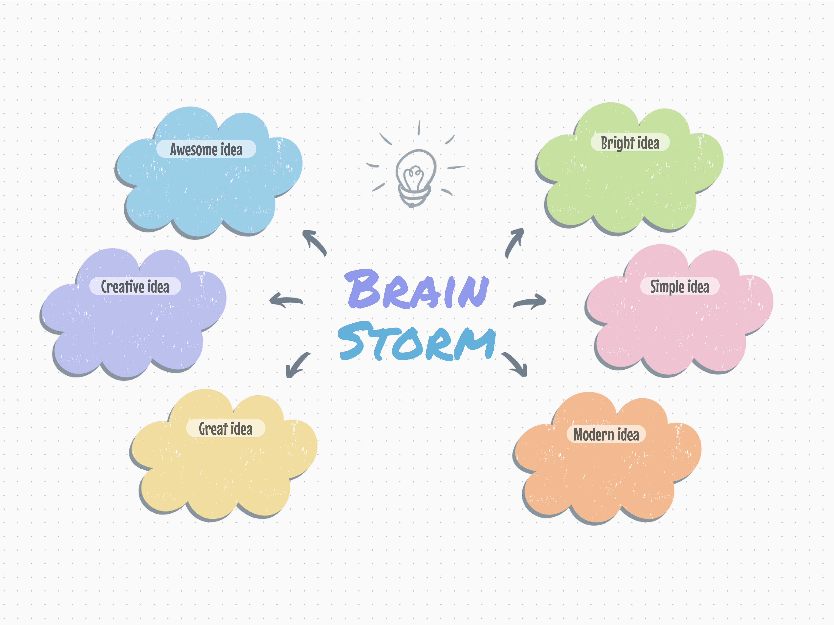
IDEATION TECHNIQUES
1. Brainstorming
Brainstorming is a group activity where participants share as many ideas as possible, without criticism.
The belief is: More ideas = More chances of good solutions.
How it works:
Define the problem.
Set a time limit (10–15 minutes).
Everyone writes or speaks ideas quickly.
No judging, no rejecting.
Collect all ideas on sticky notes / FigJam board.
Cluster and evaluate later.

Slide 5

Example:
Problem: How can we improve the food ordering app?
Ideas might include:
Voice-based ordering
Auto suggestion meals
One-click reorder
AI-based food recommendations

Slide 6
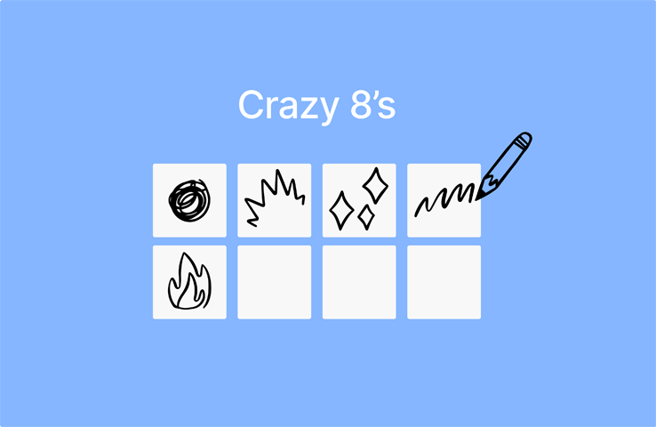
2. Crazy 8s
What is Crazy 8s?
Crazy 8s is a rapid sketching technique where a person draws 8 different ideas in 8 minutes.
It pushes creativity and forces quick thinking.
How it works:
Take an A4 sheet and fold into 8 equal boxes.
Set a timer for 8 minutes.
In each box, sketch one idea.
Do not worry about perfection, focus on variety.
Example: Designing a login page → Draw 8 different layouts in 8 minutes.

Slide 7
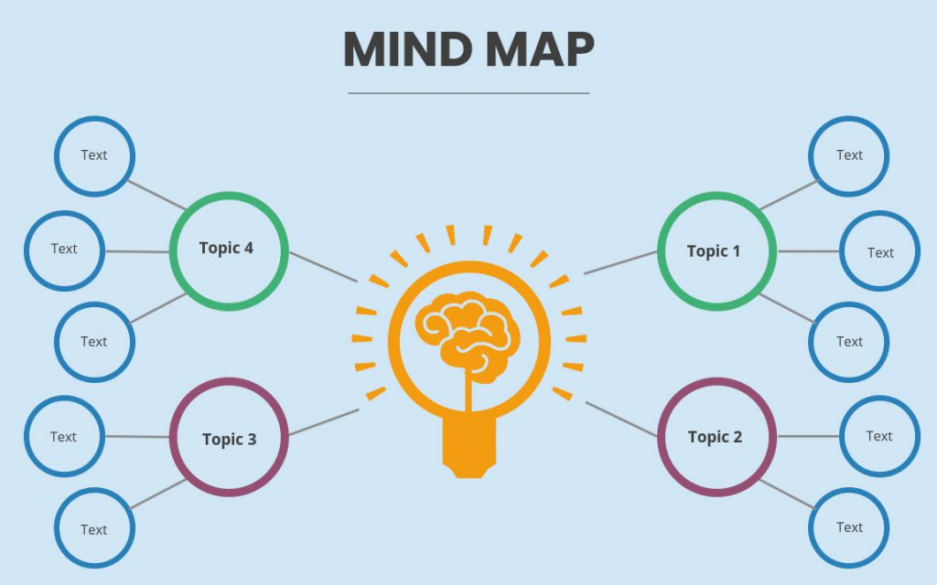
3. Mind Mapping
Mind mapping is a visual technique to show connections between ideas. You start with a central problem and create branches of related ideas.
How it works:
Write the main problem in the center.
Draw branches for categories (features, pain points, solutions).
Add sub-ideas around each branch.
Expand the map until all thoughts are covered.

Slide 8
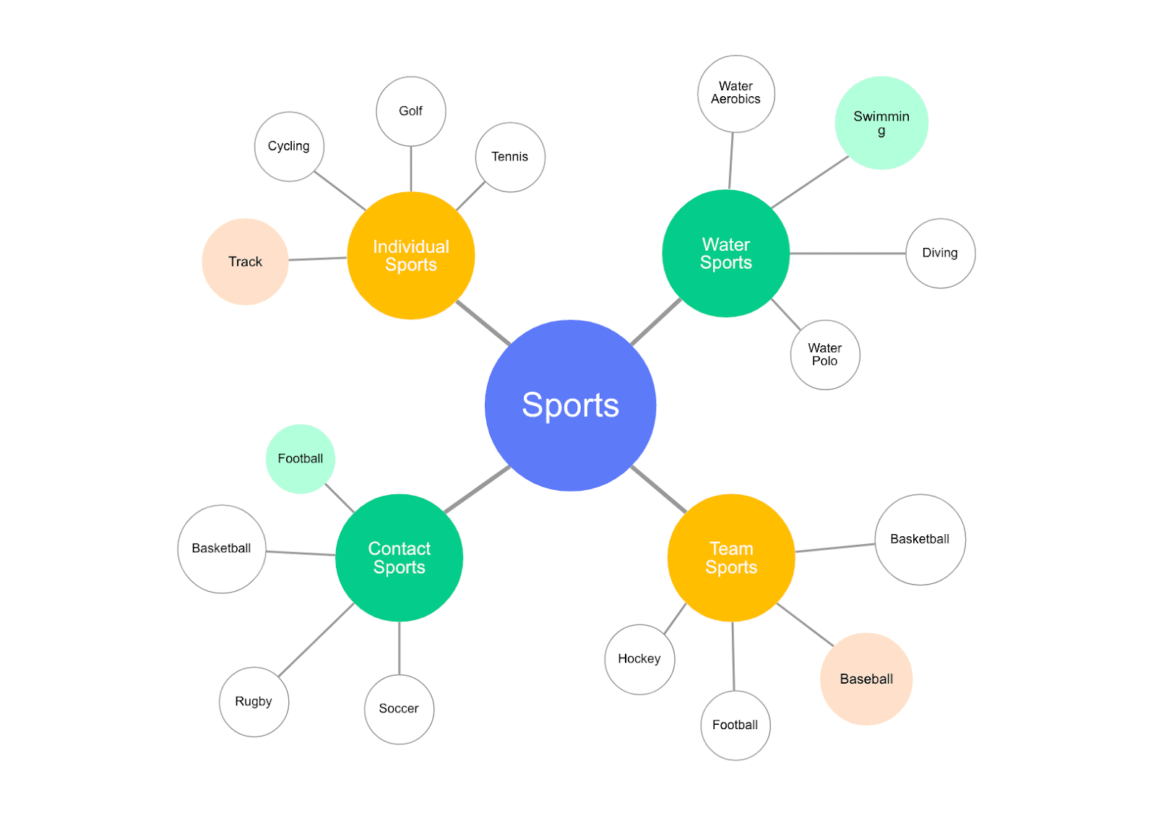

Slide 9
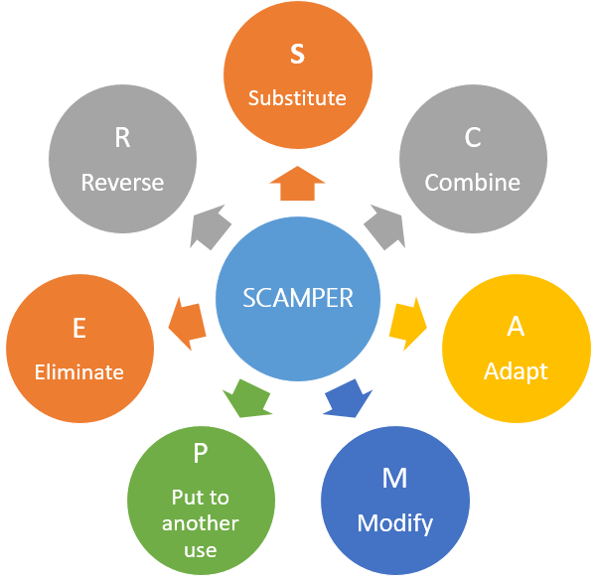
4. SCAMPER Technique
SCAMPER is a checklist-based method used to modify an existing idea creatively.
SCAMPER stands for:
S – Substitute
C – Combine
A – Adapt
M – Modify
P – Put to another use
E – Eliminate
R – Reverse
How it works:
Use each SCAMPER question to think of new versions of your idea.

Slide 10
Detailed Breakdown:
S – Substitute: Replace something with a better alternative. Example: Paper tickets → Mobile QR tickets.
C – Combine: Join two ideas to make something new. Example: Camera + Payment = Scan & Pay.
A – Adapt: Borrow ideas from another context. Example: Stories feature adapted from Snapchat → Instagram → LinkedIn.
M – Modify: Change size, shape, color, or features. Example: Increase the font size for better readability.
P – Put to Another Use: Use the product for a new purpose. Example: Google Maps used for tracking delivery partners.
E – Eliminate: Remove unnecessary steps. Example: Removing sign-up step → Login with Google/Phone OTP.
R – Reverse: Reverse order or direction of the process. Example: Instead of restaurant choosing the rider → rider chooses nearest order.

Slide 11
THANK YOU

