Slide 1

VIGNAN'S FOUNDATION FOR SCIENCE, TECHNOLOGY & RESEARCH
(Deemed to be University · NAAC 'A+' Grade · Vadlamudi, Guntur AP)
Campus Transport Route Planner
Interactive Multi-Modal Spatial Navigation, Architectural Masterplan & Real-Time Route Calculation System
⚛️ React 18 & Vite
🗺️ Dual Map Engine
📍 Google Maps Place Cards
⚡ 1-MW Solar Footprint
ACADEMIC CLASSROOM PRESENTATION & PROJECT DEFENSE
Domain: Web Application Development · Pilot Project: Vadlamudi Main Campus Transit System
Key Concepts: Component Composition • State Management • Event Handling • Lists & Keys • Conditional Rendering

Slide 2

CAMPUS NAVIGATION CHALLENGES
Project Motivation & Problem Statement
The Sprawling Campus
Scale & Infrastructure of VFSTR
• 40+ acres sprawling university campus at Vadlamudi, Guntur District.
• 15,000+ full-time students, 1,000+ faculty, researchers, and daily visitors.
• 6 major academic & residential complexes spread across vast distances.
• Complex road network with highway access (SH-112) and 4 strategic gates.
• High inter-building commute volume between labs, classes, and hostels.
Navigational Pain Points
Current Student & Visitor Dilemmas
• Freshers and new visitors frequently get disoriented on campus grounds.
• No unified digital tool to estimate transit distance and travel time.
• Confusion about available transit modes (Walk vs Campus Shuttle vs Cycle).
• Lack of floor-by-floor departmental directories for administrative blocks.
• Need for clear visual spatial maps showing entry gates, parking, and stops.
The Proposed Solution
Campus Transport Route Planner
• High-performance single-page web app built with React 18 and Vite.
• Instant O(1) symmetric route lookup across all 15 key campus corridors.
• Multi-modal transit recommendations tailored to distance & terrain.
• Bespoke Thematic Vector SVG Map with 4 gates, parking, and roads.
• Google Maps-style slide-in place cards with verified photos and reviews.
• Guided 7-stop Virtual Campus Tour for first-time visitors.
VFSTR Pilot Project · Campus Transport Route Planner · Classroom Presentation
2 / 14

Slide 3
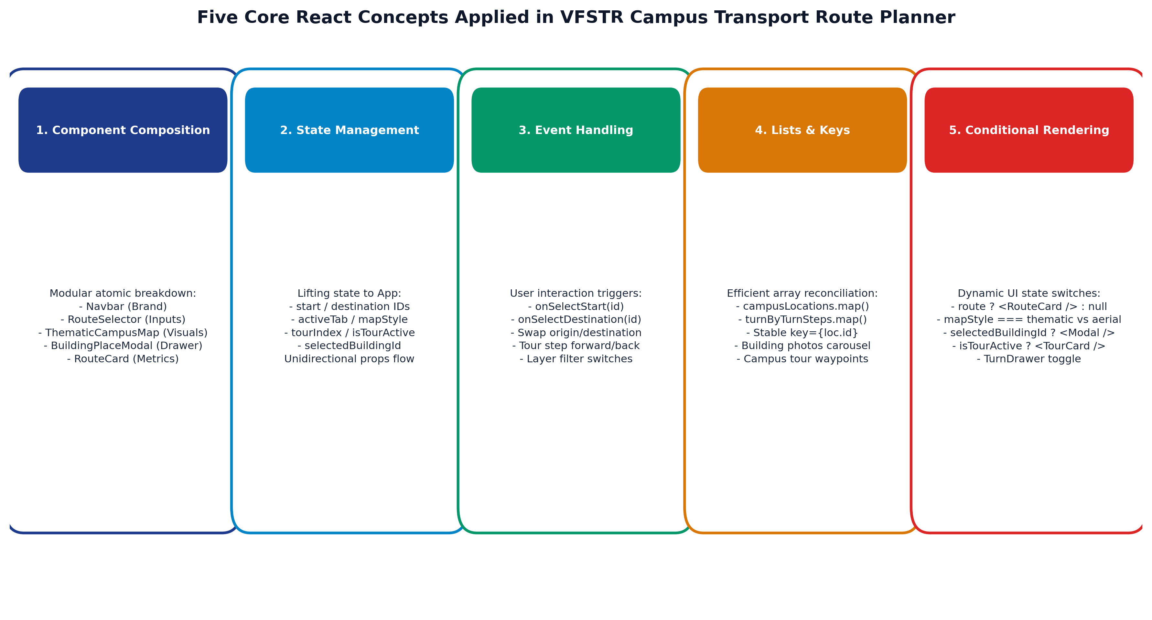
CURRICULUM ALIGNMENT & ARCHITECTURE
Five Core React Concepts Implemented
VFSTR Pilot Project · Campus Transport Route Planner · Classroom Presentation
3 / 14

Slide 4
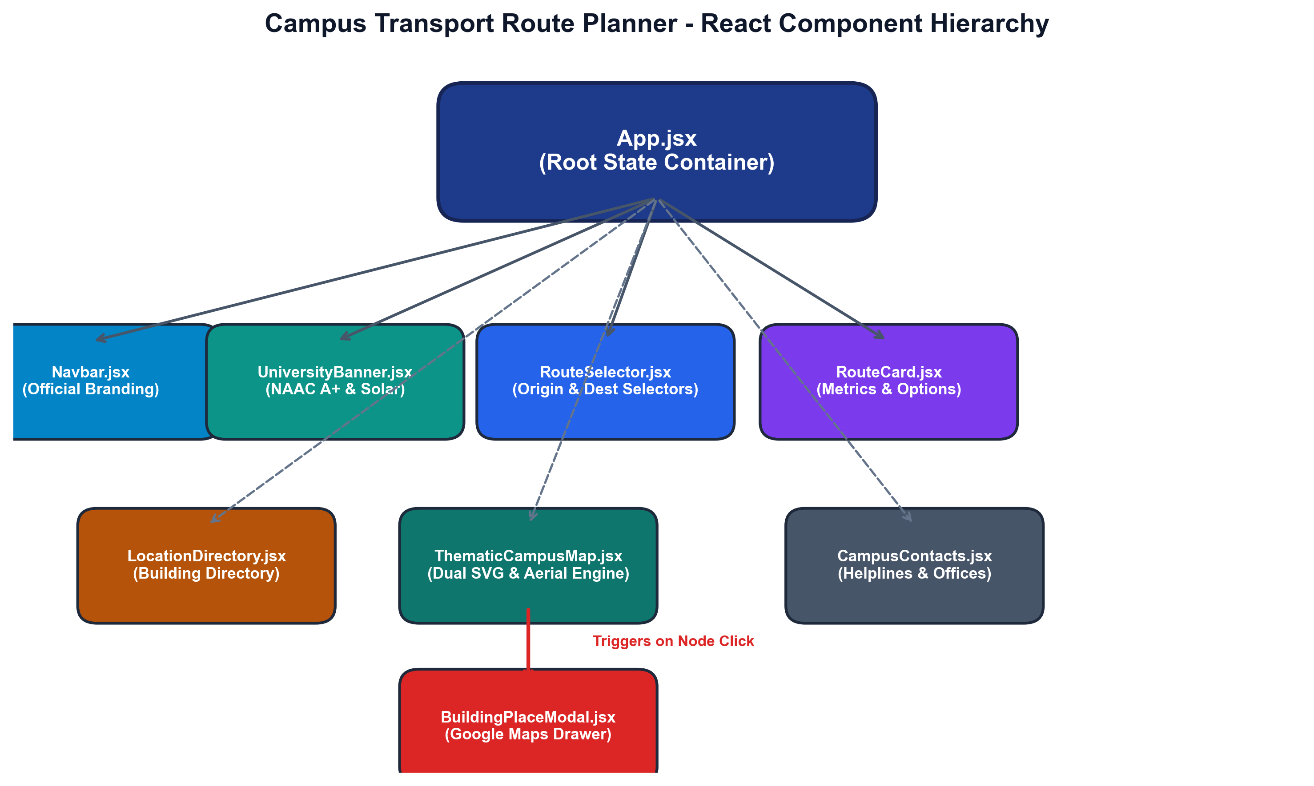
COMPONENT TREE & DATA FLOW
System Architecture & Component Composition
Architectural Highlights
Atomic Modular Breakdown
• State Container (App.jsx): Coordinates origin, destination, and modals via lifted state.
• Unidirectional Data Flow: Immutable props flow downwards to presentational components.
• Single Responsibility Principle: RouteCard, LocationDirectory, and Map are completely decoupled.
• Zero External GIS Bloat: Native SVG + Canvas vector rendering guarantees 60fps without heavy Leaflet/Mapbox bundles.
• Modal Overlay Pattern: BuildingPlaceModal isolates photo carousel and reviews within a portals-ready backdrop.
• Strict Configuration Objects: Clean separation between raw data (campusData.js) and UI logic.
VFSTR Pilot Project · Campus Transport Route Planner · Classroom Presentation
4 / 14

Slide 5
SPATIAL NODES & LOCATIONS
VFSTR Campus Geography & Masterplan Facilities
A-Block (Admin Block, #2)
VC Office, Registrar, Exam Cell
• 15,991 sq.m. administrative core. Houses VC Secretariat, Central Epabx, and the Primary Campus Shuttle Hub.
H-Block (Aryabhatta, #4)
ECE, EEE & Chemistry Domain
• Smart classrooms, VLSI design labs, microelectronics center, and academic lecture theatres.
U-Block (Technology, #10)
Mech, Civil & Composite CoE
• Advanced workshops, heavy structures testing facility, and Center of Excellence for Composite Materials.
N-Block (Outreach, #8)
International & Admissions
• International Relations, Student Affairs, cultural auditorium, Taekwondo training hall, and seminar bays.
NTR Central Library (#3)
Digital Knowledge Center
• Automated RFID circulation, e-ShodhSindhu digital network, 100,000+ volumes, 24/7 reading pavilion.
Residential Sectors (#RES)
Hostel Accommodations
• West Girls Hostel Complex alongside Vignan Eco-Pond, East Boys Hostel Complex, and International Dorms.
VFSTR Pilot Project · Campus Transport Route Planner · Classroom Presentation
5 / 14

Slide 6
TRANSIT CORRIDORS & SECURITY LOGISTICS
Physical Road Architecture & Entry/Exit Access Gates
Campus Transit Corridors
Calibrated Physical Road Network
• Guntur - Tenali Highway (SH-112): 4-lane exterior highway connecting Guntur, Tenali, and Vadlamudi.
• VFSTR Main Boulevard: 4-lane median artery connecting Gate 1 directly to A-Block and the Central Shuttle Hub.
• Library Promenade: Tree-shaded pedestrian avenue connecting Gate 2 to the NTR Central Library and N-Block.
• Central Academic Spine: Dual-lane vehicular & pedestrian corridor connecting A-Block, H-Block, and U-Block.
• Technology & CoE Corridor: Connects U-Block, composite labs, and the convocation hall.
• West Residential Parkway: Lakeside boulevard serving the Boys and Girls hostel complexes.
Strategic Access Gates & Parking
Security Checkpoints & Transit Bays
• 🚪 Gate 1 (VFSTR Main Entrance): Primary ceremonial highway gate with central security booths, boom barriers, and Visitor 4-Wheeler Parking.
• 🚪 Gate 2 (NTR Library Gate): Academic entrance with student drop-off zone, pedestrian plaza, and Student 2-Wheeler Parking.
• 🚪 Gate 3 (Vignan LARA & Hostels Gate): West highway entrance serving Vignan LARA complex, pharmacy wing, and Girls Hostel.
• 🚪 Gate 4 (North Logistics Exit): Dedicated northern gate connecting sports arenas, eco-pond, and logistics delivery trucks.
• 🚌 Central Electric Shuttle Terminal: Stationed in front of A-Block, departing every 10 minutes.
• 🚲 Bicycle Share Docks: Located at A-Block, Library, U-Block, and Hostels.
VFSTR Pilot Project · Campus Transport Route Planner · Classroom Presentation
6 / 14

Slide 7
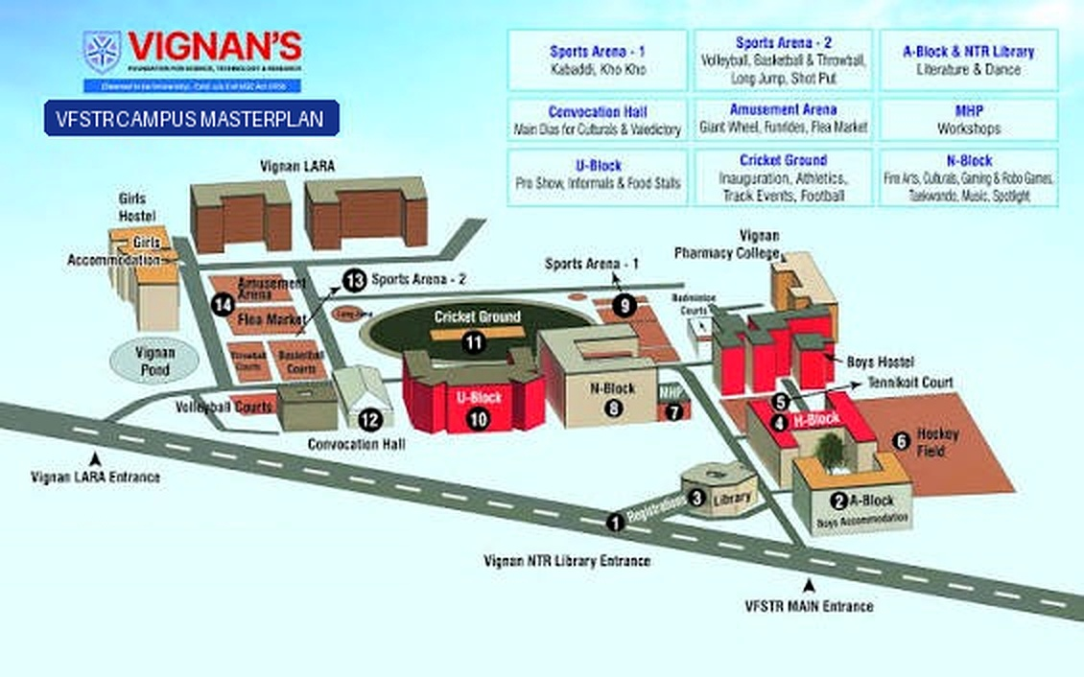
VISUAL SPATIAL SYSTEMS
Dual Cartographic Engine: Thematic Vector & Enhanced Aerial
Dual Map Modes & Rendering
Bespoke Vector + Enhanced 3D Aerial
• Mode 1: Thematic Vector Masterplan (SVG):
• • Rendered in scalable 1000×620 SVG coordinate space.
• • Layer filtering: Academic Blocks, Gates, Sports, Solar Green Footprint.
• • Animated marching-ants SVG polyline for active routes.
• • Visual road corridors, eco-pond, solar PV arrays, and stadium.
•
• Mode 2: Enhanced Clean Aerial 3D View:
• • High-resolution 1130×706 raster with Lanczos upscaling.
• • Mahotsav temporary festival logos & banners completely eliminated.
• • Interactive hotspot badges with building numbers [2, 3, 4, 8, 10, H].
• • Pulsing Origin 'A' and Destination 'B' beacons over aerial view.
VFSTR Pilot Project · Campus Transport Route Planner · Classroom Presentation
7 / 14

Slide 8
RICH MEDIA & VERIFIED METADATA
Google Maps-Style Building Place Cards
Interactive Place Drawer
Google Maps Experience
• Slide-in drawer triggers on clicking ANY building or map node.
• High-resolution photo galleries & category tags.
• Verified metadata: Building code, map number, plus code.
• Operating hours, contact telephone extensions, and VC office.
• Student ratings (4.8★ - 4.9★) and real campus reviews.
• One-click 'Directions' & 'Start Here' routing triggers.
Departmental Directories
Floor-by-Floor Navigational Data
• A-Block Floor Directory:
• • Ground: Central Epabx, Reception, Helpdesk.
• • Floor 1: Registrar Secretariat, Finance Wing.
• • Floor 2: VC Office, Deans Council Chamber.
• • Floor 3: Controller of Examinations, Math Dept.
• H-Block (Aryabhatta Wing):
• • Ground: Smart Seminar Halls, EEE Labs.
• • Floors 1-2: ECE Electronics & VLSI Centers.
• • Floor 3: Chemistry & Material Synthesis Labs.
NTR Library & Hostels
Research Pavilion & Student Living
• NTR Central Library Directory:
• • Ground: Circulation Desk, RFID Automated Returns.
• • Floor 1: Digital Library (e-ShodhSindhu, IEEE).
• • Floor 2: Core Engineering Reference Collection.
• • Floor 3: Periodicals, Journals & Research Archives.
• Residential Sector Directory:
• • West Wing: Girls Hostels (Lakeside complex).
• • East Wing: Boys Hostels (Sports field adjacent).
• • Amenities: Dining Mess, Indoor Gym, Clinic.
VFSTR Pilot Project · Campus Transport Route Planner · Classroom Presentation
8 / 14

Slide 9
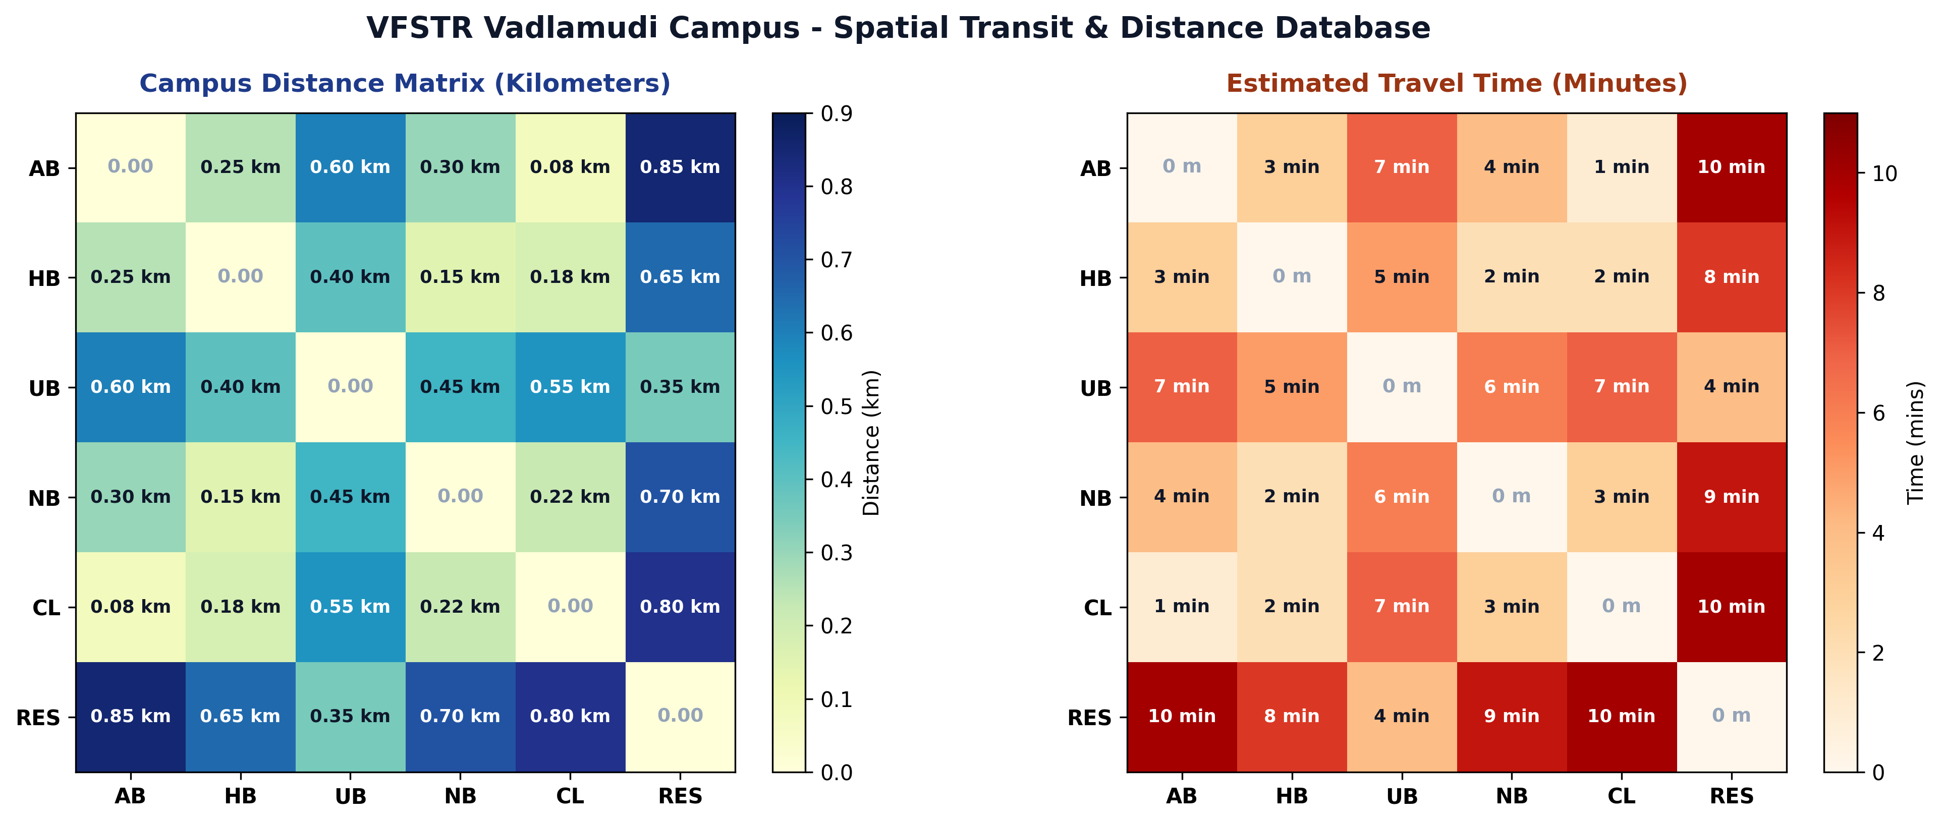
DATA STRUCTURES & TIME COMPLEXITY
Route Calculation Engine & Algorithmic Analysis
Algorithmic Performance
O(1) Hash Map Matrix Lookup
• Algorithm Specification:
• • Function: calculateCampusRoute(start, end)
• • Time Complexity: O(1) constant time lookup.
• • Space Complexity: O(N²) precomputed matrix pairs.
•
• Key Features & Guard Clauses:
• • Symmetrical Key Fallback: Queries `${start}-${end}` first, falls back to `${end}-${start}`.
• • Edge Case Handling: Returns null if inputs are identical (start === end) or empty.
• • 15 Bidirectional Pairs: Complete coverage across AB, HB, UB, NB, CL, RES.
• • Transport Modality Rules:
• - Distance < 0.35 km: 'Walk'
• - Distance >= 0.40 km: 'Campus Shuttle', 'Bicycle Share'
VFSTR Pilot Project · Campus Transport Route Planner · Classroom Presentation
9 / 14

Slide 10
GUIDED EXPLORATION EXPERIENCE
Virtual Campus Tour & Turn-by-Turn Guidance
7-Stop Virtual Tour Itinerary
Stepped Interactive Walkthrough
• Stop 1: Gate 1 Main Entrance: Highway access, security check, and primary shuttle arrival bay.
• Stop 2: A-Block Administration: Central administrative hub, VC Office, and Shuttle Bus Terminal.
• Stop 3: H-Block (Aryabhatta Wing): ECE, EEE, Chemistry smart classrooms and microelectronics lab.
• Stop 4: NTR Central Library: Octagonal digital pavilion with 100,000+ volumes and IEEE network.
• Stop 5: Cricket Ground & Sports Complex: Full turf pitch with 400m running track and convocation pavilion.
• Stop 6: U-Block Technology Complex: Mechanical & Civil labs with Composite Materials Center of Excellence.
• Stop 7: West Residential Sectors: Boys and Girls hostel quarters alongside Vignan Eco-Pond.
Turn-by-Turn Waypoint Guidance
Physical Road Instructions
• Dynamic Navigation Drawer:
• • Unfolds upon selecting any valid campus route.
• • Converts coordinate waypoints into human-readable directions.
•
• Real Guidance Examples:
• • 'Depart from A-Block Central Shuttle Terminal via Main Boulevard'
• • 'Turn west along Central Academic Spine toward H-Block (120m)'
• • 'Proceed straight past NTR Central Library Promenade (180m)'
• • 'Cross the roundabout onto Technology Corridor toward U-Block (150m)'
• • 'Arrive at U-Block Technology & Composite Materials Labs'
•
• Accompanying metric: Real-time estimated walking vs shuttle travel times.
VFSTR Pilot Project · Campus Transport Route Planner · Classroom Presentation
10 / 14

Slide 11
VFSTR ENVIRONMENTAL LEADERSHIP
Green Campus Footprint & Sustainability Initiatives
1-MW Rooftop Solar PV Plant
Clean Renewable Energy Generation
• Massive solar arrays installed across A-Block, U-Block, and Library rooftops.
• Generates over 1.4 million clean kWh annually.
• Offsets over 1,100 metric tons of CO2 emissions each year.
• Highlighted as a distinct layer filter in the Thematic Vector Map.
Campus Rainwater Harvesting & Eco-Pond
Water Conservation & Biodiversity
• Vignan Eco-Pond acts as a natural campus rainwater catchment reservoir.
• 100% campus roof rainwater channeled into percolation tanks.
• Recharges local Vadlamudi groundwater table.
• Surrounded by walking promenades and green shaded benches.
Zero-Emission Electric Campus Shuttles
Clean Sustainable Mobility
• Fleet of battery-operated campus shuttles serving students & faculty.
• Connects Gate 1, A-Block, Library, U-Block, and Residential Sectors.
• 10-minute scheduled departures with zero tailpipe emissions.
• Recommended automatically for routes exceeding 0.40 km.
Campus Bicycle Share System
Active Healthy Commute
• Docking stations placed at A-Block, Library, U-Block, and Hostels.
• Encourages active mobility and reduces intra-campus congestion.
• Zero-cost shared access for registered VFSTR students & staff.
• Integrates directly into the route planning algorithm options.
VFSTR Pilot Project · Campus Transport Route Planner · Classroom Presentation
11 / 14

Slide 12
MODERN FRONT-END ENGINEERING
Technical Implementation & Performance Metrics
Core Technology Stack
Lightweight, Modern Architecture
• React 18: Concurrent rendering, hooks-first architecture (useState, useMemo, useEffect).
• Vite 6: Next-gen frontend tooling with lightning-fast Hot Module Replacement (HMR).
• Lucide React: Clean, tree-shakeable SVG icon set for UI accessibility.
• Pure Modular CSS: Custom properties design system, glassmorphism, responsive media queries.
• Zero Mapping Bloat: 100% native SVG vector rendering avoids Mapbox/Leaflet API overhead.
Build & Bundle Metrics
Production Packaging Performance
• Build Time: ~9.5 seconds in Vite production pipeline.
• JavaScript Chunk: 253.8 kB (73.7 kB gzipped).
• CSS Chunk: 54.6 kB (10.1 kB gzipped).
• HTML Entry: 0.72 kB.
• Zero Build Warnings: 1,592 modules transformed cleanly.
• Optimized Asset Cache: Content-hashed bundle artifacts for instantaneous client loads.
Accessibility & UX
Inclusive Student Interface
• WCAG 2.1 Contrast: High-contrast ratios across all text and interactive badges.
• Full ARIA Support: Semantic roles, aria-labels on buttons and map hotspots.
• Responsive Breakpoints: Optimized for Mobile (360px+), Tablet (768px), and Desktop.
• Keyboard Navigation: Tab-accessible form selectors and modal dismiss keys.
• Touch Target Sizing: Minimum 44×44px tap targets for mobile usability.
VFSTR Pilot Project · Campus Transport Route Planner · Classroom Presentation
12 / 14

Slide 13
LIVE FUNCTIONAL VERIFICATION
Classroom Demonstration & Use Case Scenarios
Scenario A: Fresher / Guest Arrival
Gate 1 (Highway) ➔ A-Block (Admin)
• User selects 'A-Block (Admin)' as destination.
• App highlights Gate 1 Main Boulevard route.
• Distance: 0.15 km · Travel Time: 2 mins.
• Transit Option: 'Walk'.
• Place card displays VC Office, Registrar, and Epabx desk.
Scenario B: Cross-Campus Academic
H-Block (ECE) ➔ U-Block (Mech)
• User commuting between electronics and mechanical labs.
• App calculates Central Academic Spine route.
• Distance: 0.40 km · Travel Time: 5 mins.
• Transit Options: 'Walk', 'Bicycle Share'.
• Place card displays Composite Materials Center of Excellence.
Scenario C: Hosteller Commute
Residential Sectors ➔ NTR Library
• User commuting from hostels to library for evening study.
• App calculates West Parkway & Library Promenade route.
• Distance: 0.80 km · Travel Time: 10 mins.
• Transit Options: 'Campus Shuttle', 'Bicycle Share'.
• Displays 24/7 reading hall hours and e-ShodhSindhu terminals.
VFSTR Pilot Project · Campus Transport Route Planner · Classroom Presentation
13 / 14

Slide 14
PROJECT SUMMARY & ROADMAP
Conclusion & Future Research Scope
Key Project Achievements
Curriculum & Engineering Milestones
• Successfully fulfilled all 5 React curriculum requirements:
• • Component Composition, State Management, Event Handling, Lists & Keys, Conditional Rendering.
• 100% faithful adherence to VFSTR University configuration data and route matrix.
• Engineered a dual cartographic engine (Thematic Vector SVG + Clean 3D Aerial).
• Integrated Google Maps-style place cards with authentic campus photos and reviews.
• Provided turn-by-turn guidance and virtual campus tour capability.
• Championed green campus transit (shuttles, bicycles, solar energy).
Future Expansion Roadmap
Phase II Innovations
• 📡 Real-Time GPS Tracking: Live telemetry for electric campus shuttle buses.
• 🅿️ Smart Parking Sensors: IoT ultrasonic sensors reporting real-time vacant bays at Gate 1 & 2.
• 📅 Timetable Integration: Sync with student portal to auto-suggest routes based on lecture schedule.
• ♿ Accessible Routing: Dedicated wheelchair-accessible ramp and elevator pathfinding.
• 🗣️ Multilingual Voice Guidance: Telugu and English audio navigation prompts for visitors.
•
• Thank you! Any Questions & Discussion are Welcome.
VFSTR Pilot Project · Campus Transport Route Planner · Classroom Presentation
14 / 14

