Slide 1
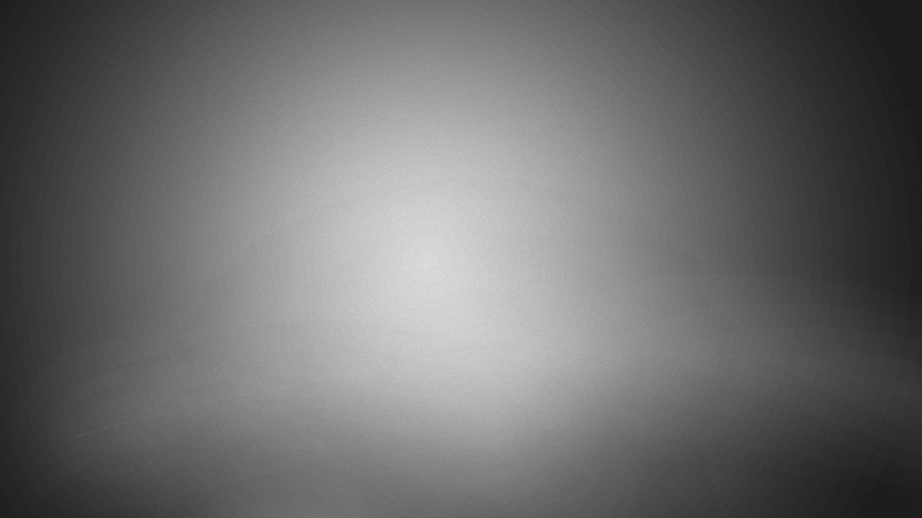

ID1054 Project
Stereographic projection model

Slide 2
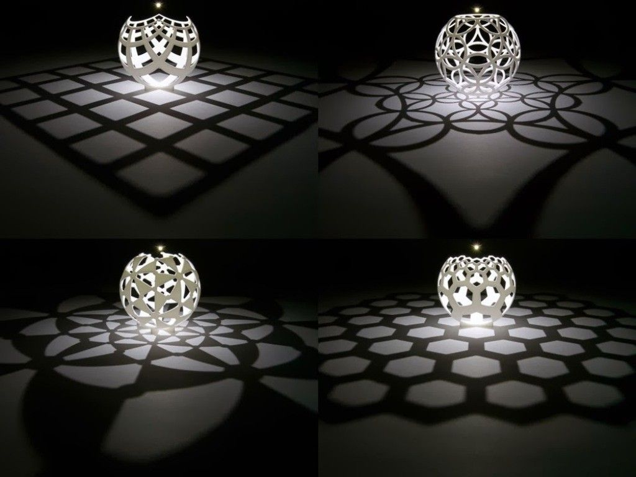
About Project
Our model is inspired from Henry segerman's lamp related orthographic projections of floor patterns on the sphere as show in the picture.
We tried to make a model with floor pattern of a 4 x 4 square grid
We made the model by creating the planes containing light source and the line on the floor then cutting the sphere appropriately.
We checked the accuracy of the model by creating an artificial lightning environment in keyShot.
Henry Segerman's lamp related orthographic projections of different floor patterns.(BG)

Slide 3
What are Stereographic Projections ?
In geometry, the stereographic projection is a particular mapping (function) that projects a sphere onto a plane. The projection is defined on the entire sphere, except at one point: the projection point. Where it is defined, the mapping is smooth and bijective. It is conformal, meaning that it preserves angles at which curves meet. It is neither isometric nor area-preserving: that is, it preserves neither distances nor the areas of figures.
Intuitively, then, the stereographic projection is a way of picturing the sphere as the plane, with some inevitable compromises. Because the sphere and the plane appear in many areas of mathematics and its applications, so does the stereographic projection.

Slide 4
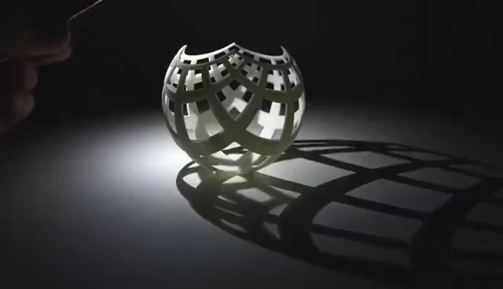
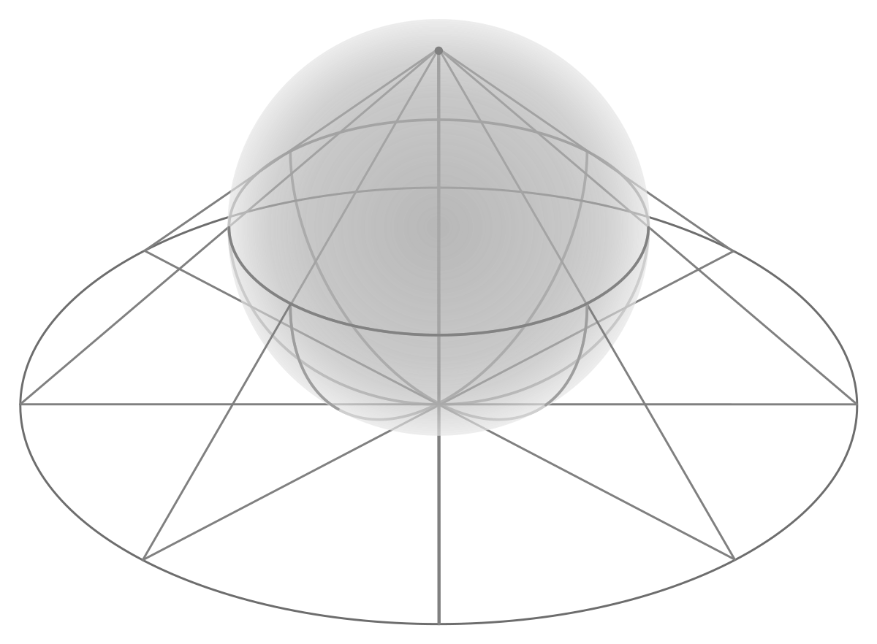
EXAMPLES
Above video shows how shadow projections change with the position of source of light.
Projection of a hemisphere onto the tangent plane of bottom most point

Slide 5
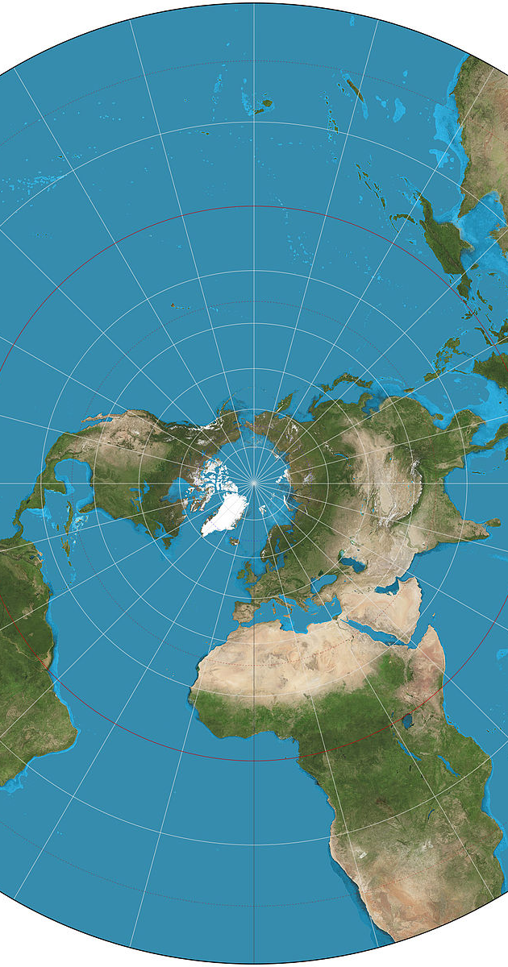
REAL-LIFE APPLICATIONS
Stereographic projection is used in crystallography and structural geology to depict the angular relationships between crystal faces and geologic structures, respectively.
It finds use in diverse fields including complex analysis, cartography, geology, and photography. In practice, the projection is carried out by computer or by hand using a special kind of graph paper called a stereographic net, shortened to stereonet, or Wulff net.
Stereographic projection of the world north of 30°S. 15° graticule.

Slide 6
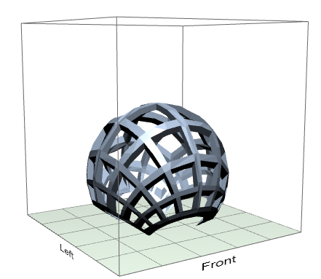
3D Printing Data
We can print the model in Mojo 3d printer
Orientation of the model which is efficient and suitable for better 3d printing is show in the image right.
Model dimensions :
3.54" x 3.54" x 3.06"
STL units : inches
Scale : 1.5
Support : SMART
Part Interior : Solid
Slice Height : 0.007 in
Build Estimates
Time : 12 hrs 58 min
Model Material: 1.83 in³
Support Material: 3.14 in³

Slide 7
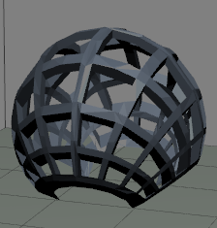
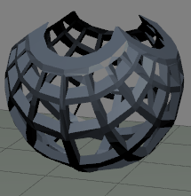
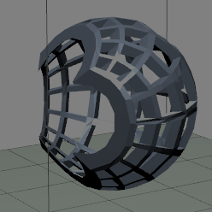
Comparisions of models based on orientations
Bottom Face Up(best orientation)
Bottom Face Down
Bottom Face Sideways
Time : 12 hours and 36 min
Model Material : 30 cm3
Support Material : 48.9cm3
Time : 14 hours and 34 min
Model Material : 29.3 cm3
Support Material : 58.9cm3
Time : 13 hours and 48 min
Model Material : 29.5 cm3
Support Material : 60.95cm3

Slide 8
Contributions
G.Pranav Sai – Designing 3d model
Rohan Atkurkar – Stereographic Projections definition and creating, editing and designing slides
Adil Salfi – 3d Print data and comparing orientations using Mojo 3d print software
Sarandeep Mannam – Real life Applications of the 3d model and creating slides
Kotesh Satvik – Designing 3d mode

