Slide 1

PRESENTED BY : Kotha Nithya (17UK1A0544) Poshala Amulya (17UK1A0502) Sharath Kumar Gongalla (17UK1A0557) Podila Madhu (17UK1A0542)
VAAGDEVI ENGINEERING COLLEGE
MAJOR PROJECT PRESENTATION
TEAM-A_1
PROJECT NAME:- AUTOMATED ESSAY GRADING USING DEEP LEARNING
PROJECT GUIDE:
Dr . Rakesh Nayak
professor

Slide 2
TABLE OF CONTENTS:
Abstract
Existing problem & Proposed solution
Requirements
Design
Result analysis
Input and Output screens
Conclusion
Future enhancement

Slide 3
ABSTRACT
Essays are crucial testing tools for assessing academic achievement, integration of ideas and ability to recall, but are expensive and time-consuming to grade manually.
Manual grading of essays takes up an amount of instructor’s valuable time and hence is an expensive process
The solution to grade a large number of papers effectively within a stipulated time is to let the machine do the grading.
The automated grading system will not only reduce the time of evaluation but comparing it with human scores will also make the score more realistic.
An automated grading system is built with the magical powers of neural networks. Using automation reduces time and effort in evaluation. NLTK libraries for feature extraction and LSTM are used for the learning process.
When an essay is loaded into the proposed grading system, the system accepts the essay given as the input and grades it using deep learning techniques and its layers such as LSTM and dense layers.

Slide 4
EXISTING PROBLEM:
The previous models have high time complexity and space complexity.
Previous models have used classification algorithms based on which provided prediction accuracies for only a small subset of essays instead of an average one.
PROPOSED SOLUTION:
DEEP LEARNING –NLP AND LSTM:
Deep learning is the subfield of machine learning, supporting algorithms that are inspired by the structure and function of the human brain, and named as artificial neural networks.
NLP aims at converting unstructured data into computer-readable language by following attributes of natural language.
Machines employ complex algorithms to break down any text content to extract meaningful information from it. The collected data is then used to further teach machines the logics of natural language.
Recurrent neural network is a network designed to capture temporal behavior.
LSTM stands for long short-term memory networks, used in the field of Deep Learning.
It is a variety of recurrent neural networks (RNNs) that are capable of learning long-term dependencies, especially in sequence prediction problems.
LSTMs can use gates to decide whether to let information through and drop certain information when necessary
LSTM is a special kind of RNN, which shows outstanding performance on a large variety of problems.

Slide 5
SOFTWARE REQUIREMENTS :
Jupyter Notebook Environment
Spyder Ide
Flask
HARDWARE REQUIREMENTS:
Windows 7,8 or 10(32 or 64 bit)
RAM-8GB
Processor:1.5Hz or above
HDD:100GB or above

Slide 6
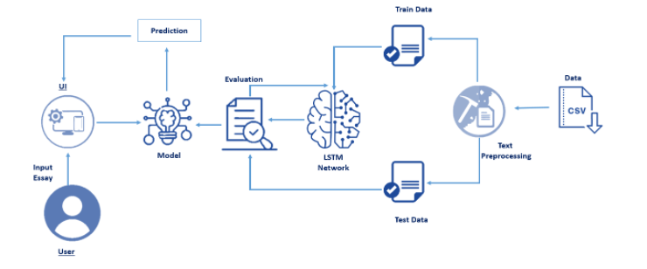
DESIGN

Slide 7
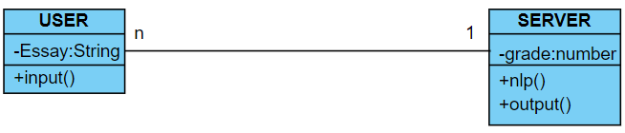
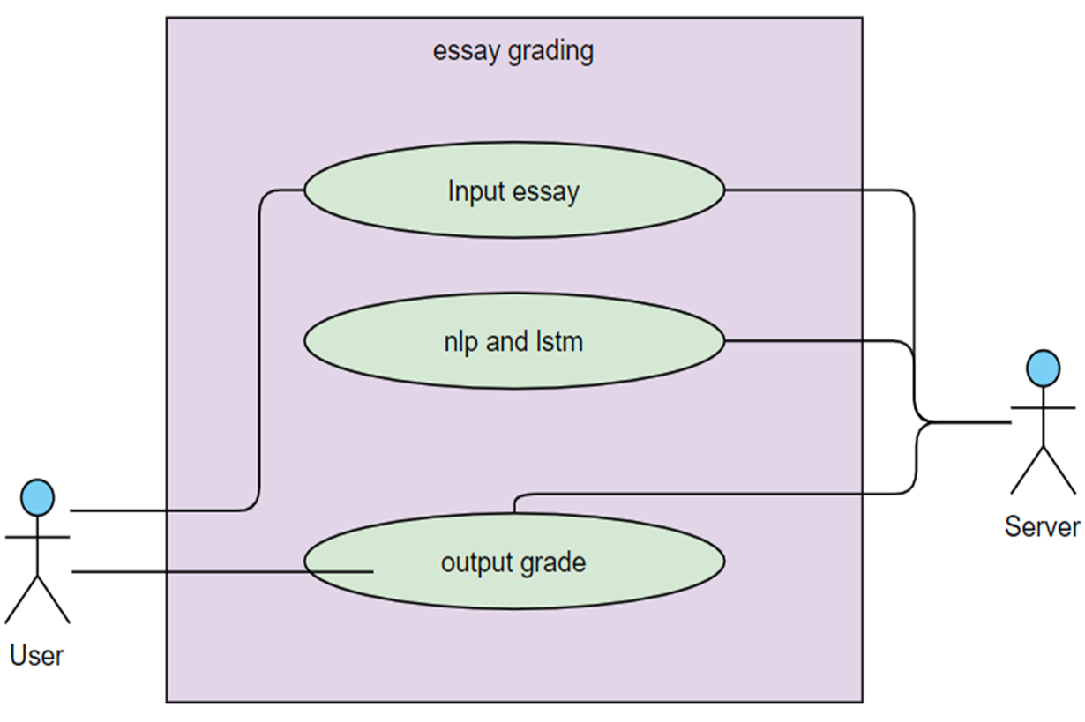
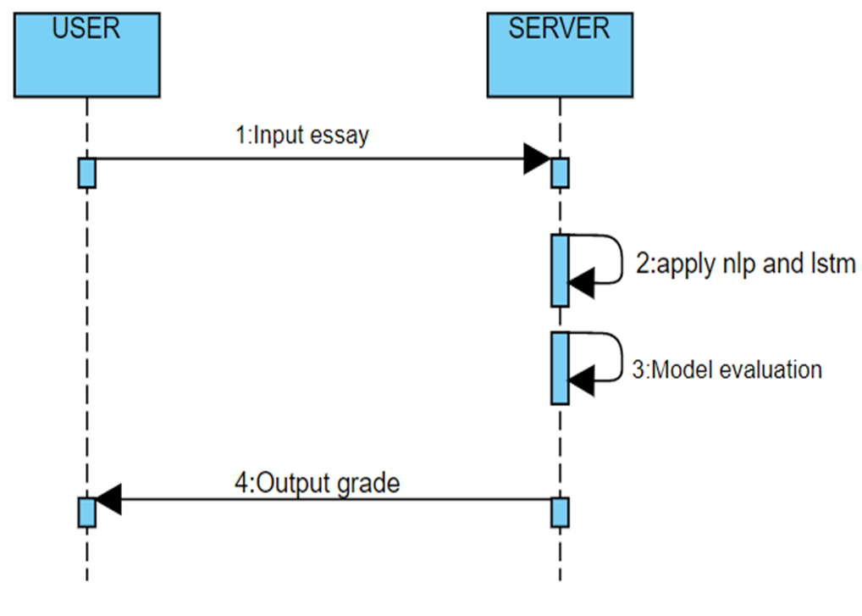
UML DIAGRAMS
CLASS DIAGRAM
USECASE DIAGRAM:
SEQUENCE DIAGRAM:

Slide 8
RESULT ANALYSIS
The essay taken as input will be pre-processed i.e. numbers, symbols and stop words are removed; the cleaned essay will be converted into feature vectors.
The feature vectors will be passed as input to the neural network consisting of the layers and the score or grade of the essay according to the features considered (word count, character count, average word length, misspelled words, and prevalence) will be displayed on the screen.
The model shows that Recurrent Neural Networks-LSTM performs best in predicting the grades

Slide 9
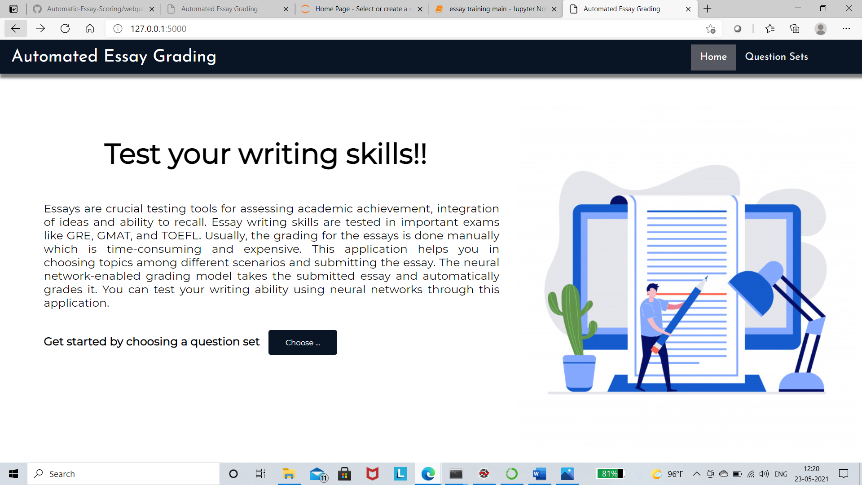
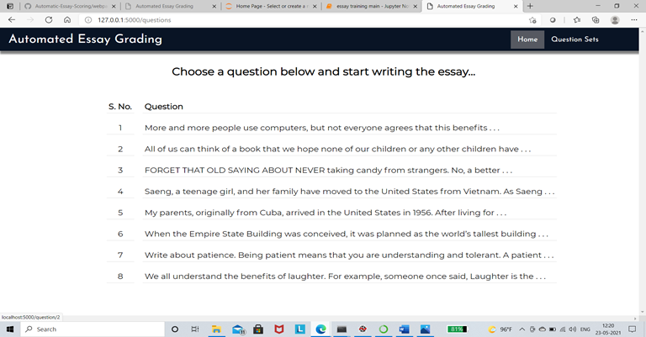
INPUT AND OUTPUT SCREENS

Slide 10
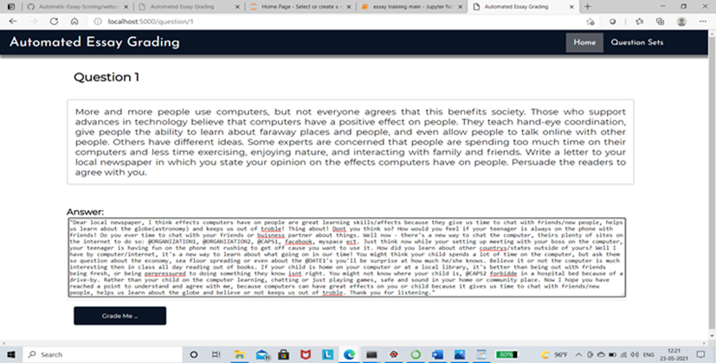
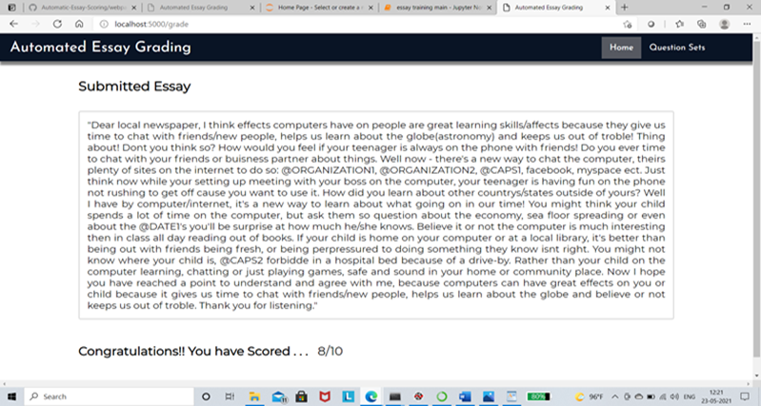

Slide 11
CONCLUSION
The essay grading task is a laborious task which can be automated with the help of Deep Learning.
The grader which is proposed in the project has an accuracy of 73% which is the highest that has been observed until now.
The grader is very good in differentiating between ambiguous sentence formations and the new vector representation is very good in implementing the NLP translations.
This project helps in easy evaluation thus it is efficient in time saving.

Slide 12
FUTURE SCOPE
The essay grader can be used by teachers for grading student essays. It can also be used by testing agencies for test of English writing to take the burden off the human graders.
The concept can be extended to other languages too if the dataset is available. Lastly, the accuracy of the model can still be increased if more data is feeded to the LSTM network while training.
More sophisticated models can be developed using transfer learning at the cost of using more resources required to train the model.

Slide 13
THANK YOU

