Slide 1


GMR Institute of Technology, Rajam
Department Of CSE
Smart Mirror Using Machine Learning Algorithms
Prepared by
Name :K S K S Vamsi
Roll No: 17341A0588
Batch No: 12
Under the Guidance :
Dr V PRASAD
4-Oct-19
1
4-Oct-19
1

Slide 2

Introduction
Everyone knows what a mirror is. It is an object found in most people’s homes. In mirrors, we see our reflections.
Since we all know that time is more precious than all, and now-a-days maximum of our time is wasting on the selection of clothes for kids.
By this mirror idea is there any chance of saving time???

Slide 3

YES
Since for every dress selection they are going to check whether it is suitable for that person or not.
In the ease of reducing time we are going to study on Smart Mirror using Machine Learning Algorithms.
This smart mirror helps to check whether shirt or dress is comfortable or become loose .

Slide 4
Abstract
Clothing is a typical task for everyone at younger age. This study mainly focusses on how to develop a smart mirror (virtual mirror) using Machine Learning Algorithms(MLA) for regularizing the way of choosing. Several methodologies of choosing clothing are represented in this study and followed by an objective of developing an android application with embedded ML techniques which gives the best suggestions. This review deals with MLA, embedded sensors, image processing algorithms as needed. The existing concepts which are already developed on smart mirror are studied on the basis of Internet of Things, Artificial Intelligence and advanced algorithms. This android application helps to identify the clothing, whether it is suitable or not. Thus, the app reduces the selection/choosing time with any kind of physical disturbance of the clothes which are available in the wardrobe. The setup inexpensive and easy to handle among the larger spectrum of society. Materials used in the smart mirror are affordable and durable.

Slide 5
This deals with
About smart mirror
Usage of present technology with smart mirror
Minimization of time.
This smart mirror helps not only in offline shopping but also helps in online shopping.
By this smart mirror everyone can check whether it is suited for him or not.
This study is going to develop an android application.
To work this android application, didn’t require any internet connection.

Slide 6
Literature Survey
Nikita Deshmukh et.al;(2016); implemented a virtual dressing room by using machine learning algorithms. To detect face in image they used FDA by using Haar Classifier. After detection of face they used skin colour detection algorithm to find the face of the customer. To find the shoulder positions they used lower body detection algorithm.
Bhalekar Sourabh et.al;(2017); implemented virtual dressing room by using Newton’s Mechanics. In this study, they used motion sensor, skeleton sensor, image based rendering techniques and low level image features for fitting the clothes to the customer.
Zambare Triveni V et.al;(2018); detected the customer upper and lower body by using Laplacian filter and then edge detection. After that they extracted the positions of customer by human basic structure. By those positions the dress model is warped to fit to the customer.

Slide 7
Saurabh Botre, et.al;(2014); discussed about different methodologies for detecting face of the customer. The techniques used for face detection of the customer are finding faces using images with controlled background, finding faces by colour and finding faces by motion.
Ms. Kirti N et.al(2017),. developed a virtual try-on system by using Augmented Reality(AR). This virtual try-on system uses accessories like eyeglasses which is developed by image processing and other some augmented reality techniques. They had developed some more extra features like selecting a multiple number of clothes at a time, changing background image, etc.
Krishna Gunjal, et.al,. had developed a website for cloning and dressing to customer. This website is developed by using some machine learning algorithms like Frame Extraction, Current Frame Subtraction, Thresholding, Blob detection, Gesture Estimation, Post Processing.

Slide 8
Architecture
Start
If image
Appears infornt
of screen
Take photos of clothes
Shows gallery
Choose pictures
Check
Dress or
not
invalid
Close mirror
Fitting dress to user
stop

Slide 9
Methodologies
Real Time Virtual Dressing Room:
Nikita Deshmukh, et.al(2016): implemented a Real Time Virtual Dressing Room by using Machine Learning Algorithms.
The following algorithms are used in this implantation are as follows
Face Detection Algorithm
Skin Colour Detection Algorithm
Lower Body Detection Algorithm
Face Detection Algorithm(FDA):
It is a one of the most popular Machine Learning Algorithm used for Image Processing.
They are so many techniques for face detection like OpenCV, Neural Networks, MATLAB, etc.
This algorithm is performed by using Haar Classifier.
Since, face is the most important and easiest thing for identifying the face of customer.
This algorithm is used for detection of faces of customer in given image(photo).
If any face is identified it returns a location of face, that is it returns a (x, y, w, h) values where (x, y) are starting position, w is width and h is height of face.

Slide 10
Skin Colour Detection Algorithm:
In skin color detection we are using YCbCr color space.
It is widely used in image processing. Component Y is used for representing luminance information and color information is stored in two components, Cb and Cr.
Cb is difference between the blue component and reference value.
Cr is difference between red component and reference value.
Cr and Cb are the red-difference and blue-difference chroma components respectively.
The corresponding skin pixel is in the range which is specified below
Y>80,
85<Cb<135 ,
135<Cr<180

Slide 11
Lower Body Detection Algorithm(LBDA):
Lower body detection is done by using Haar classifiers.
Haar Classifier is used to detect the humans in a moving video; features like eye detection, face detection, upper body, lower body and full body detection.
Haar classifier are instructed with the help of negative and positive samples of images and saved as .xml files.
Haar cascades is Haar classifiers one of the function. Some cascades used in OpenCV to detect human are haar cascade_upperbody, haar cascade_lowerbody, haarcascade_fullbody, haarcascade_frontalface etc.
Haar classifier uses Region of Interest (ROI) for detecting lower body.

Slide 12
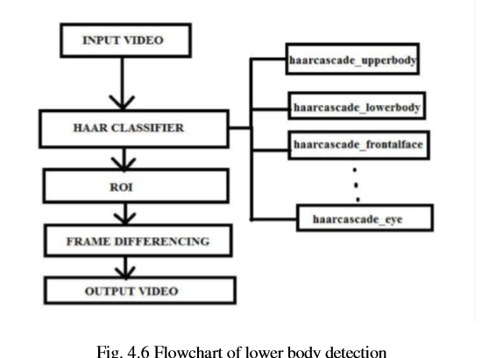
Figure 4.5 shows the flowchart for lower body detection using haar classifier.[5]

Slide 13
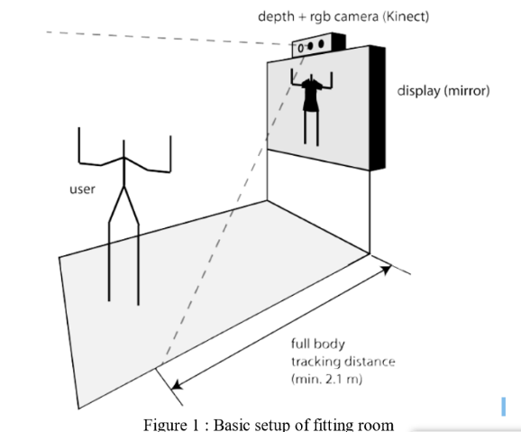
Implementation of Virtual Dressing Room using Newton’s Mechanics :
In this paper Bhalekar Sourabh, developed an virtual dressing room , by using motion sensor, skeleton tracking, and newtons’s mechnics.
Motion Sensor:
Kinect is a sensor by Microsoft Corp.
That mainly aims at depth calculations.
The following subsections will take a look at the tracking procedure and will discuss the frameworks that are needed in order to successfully use the Kinect.

Slide 14
Skeleton Tracking:
A substantial part in the tracking process is the retrieval of the particular body joint positions.
This is achieved by an algorithm introduced in Real-Time Human Pose Recognition in Parts from Single Depth Images .
The system computes each frame independently from every other frame, furthermore implicating information between.
The algorithm allows a full rotation of the body and a robust distinction between the left and right side of a body.
By inputting the depth data of the Kinect device, special regions of the body are recognized and based on this the joint positions are defined.
The joint positions are needed in order to move a skeleton, for instance, or in case of the Virtual Dressing Room, a piece of garment in respect to the motion of a user.
The human body can be captured accurately and robustly even processing different sizes of a person’s body correctly.

Slide 15
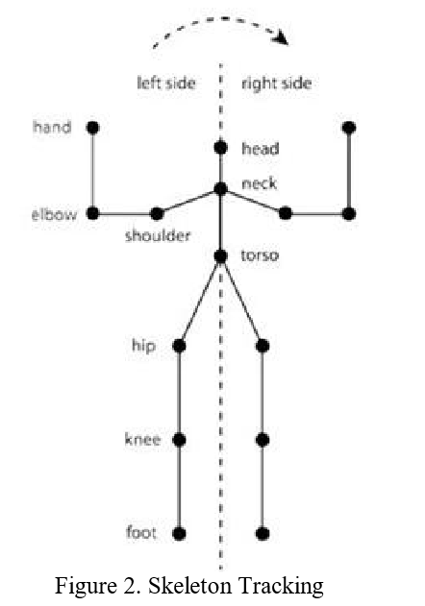
s

Slide 16
Results:
Real Time Virtual Dressing Room:
In this paper he developed a virtual dressing room by using some machine learning algorithms like face detection algorithm for detecting user face, skin colour detection algorithm for identifying exact user face, lower body detection for identifying the user body position.
Euclidian formulae is used to find the distance between the user and mirror.
Let (a,b), (x,y) are the points in the 2-D of user and camera. Then, the distance between the user and customer is,
Distance ((x,y),(a,b))= √(x - a)² + (y - b)²

Slide 17
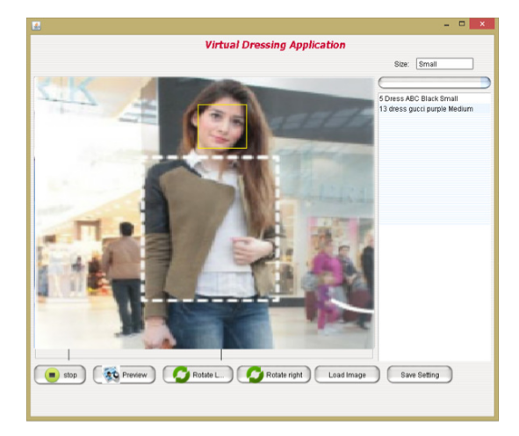
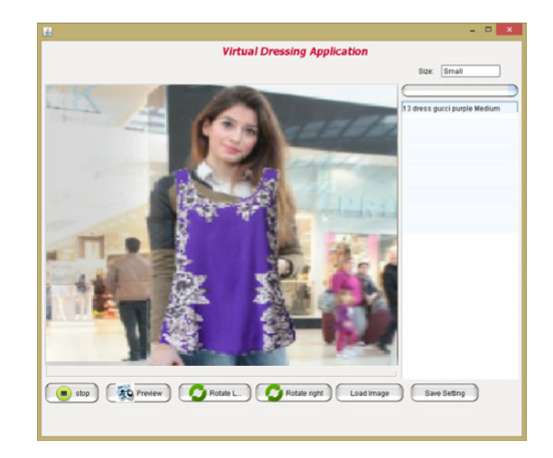
Experimental Results:

Slide 18
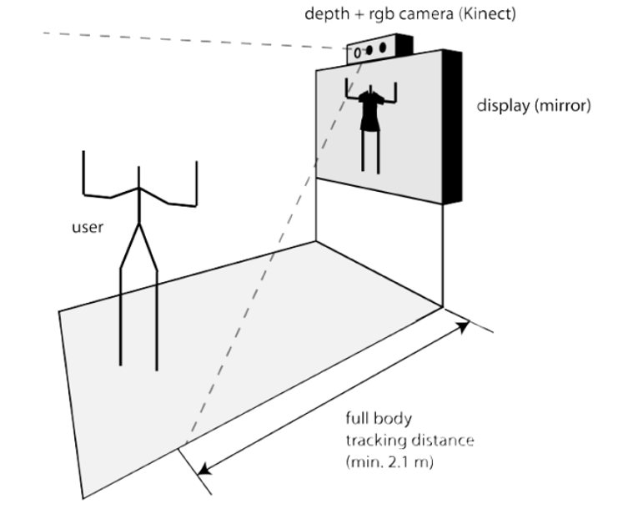
Implementation of Virtual Mirror using Newton’s Mechanics:
In this paper motion sensor is used to detect the position of a user. By this method we can detect the full body of customer.

Slide 19
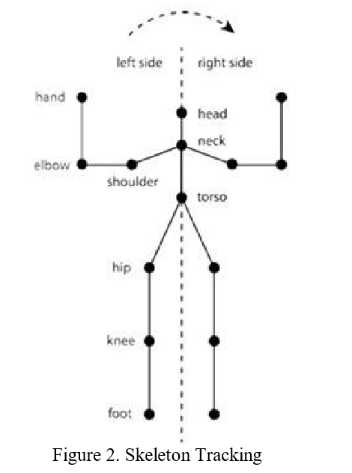
By skeleton tracking method we can find the positions of customer as shown below.

Slide 20
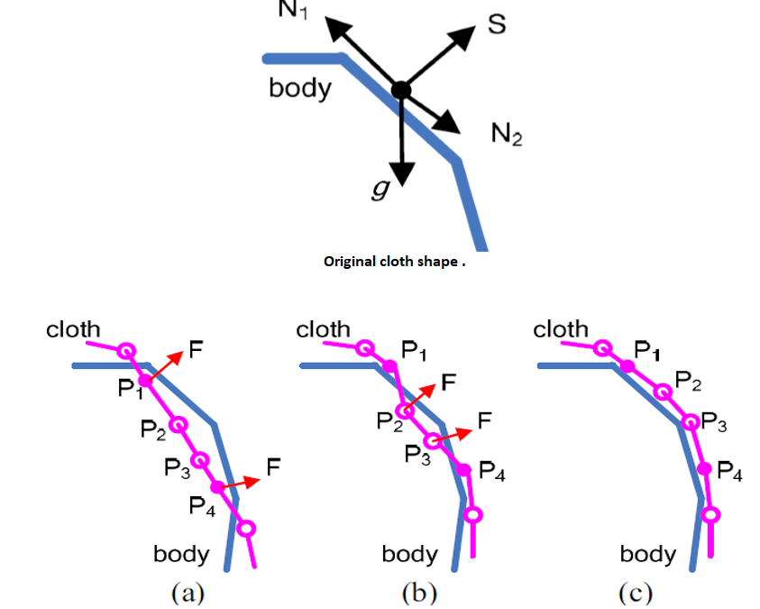
After this, we can easily superimpose the clothes to the customer can be done by using newton’s mechanics that is by automatic dressing method i.e, by applying force to the clothe on the customer body.

Slide 21
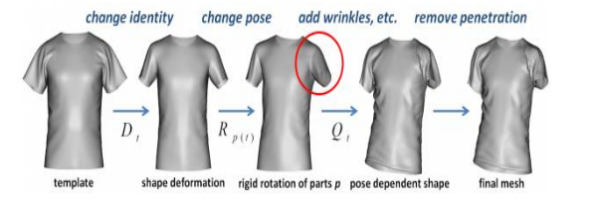
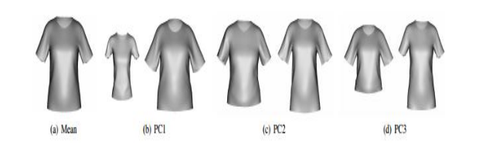

Slide 22
Conclusion:
As explained in above two methods 1st methodology gives more accuracy than 2nd methodology.
1st method gives around 95% accuracy while 2nd gives 70% accuracy.
Because in 1st method they used Euclidian formulae for finding the distance between the user and customer, as the per the distance they get they increased/decreased the clothe size.
But in 2nd method if the user is more away form the mirror then the output is not appropriate output.

Slide 23
References
1. Nikita Deshmukh, Ishani Patil, Sudehi Patwari, Aarati Deshmukh, Pradnya Mehta,” Real Time Virtual Dressing Room”, International Journal of Computer Science and Network, Volume 5, Issue 2, April 2016
2. Bhalekar Sourabh, Chitte Darshan, Dhamal Hemant, Ganeshwade Priyanka, Rankhambe J.P.,” Implementation of Virtual Dressing Room using Newton’s Mechanics”, International Journal of Advanced Research in Computer Science and Software Engineering, Volume 7, Issue 5, May 2017
3. Kokni Aaliya Samsamuddin, Jejurkar Nishigandha Shamrao, Sawashere Reshma Sanjay, Sonawane Vrushali Shantaram,” VIRTUAL CHANGING ROOM USING IMAGE PROCESSING”, International Research Journal of Engineering and Technology, Volume: 05 Issue: 10, Oct 2018

Slide 24
4. Ms. Kirti N. Datar, Ms. Prajakta V. Jogdand, Ms. Neha M. Kadam, Ms. Chaitali R. Mohokar,” Virtual Try-on System using Image Processing and Augmented Reality”, Volume 3,Issue 09 , March 2017
5. Krishna Gunjal, Prasad Patil, Akash Phalle, Prof. A.V. Kanade,” A survey on virtual changing room using augmented reality”, Volume 6, Issue 10, October 2017
6. K.-L. Cheng, R.-F. Tong, M. Tang, J.-Y. Qian, and M. Sarkis, ‘‘Parametric human body reconstruction based on sparse key points,’’ IEEE Trans. Vis. Comput. Graphics, vol. 22, no. 11, pp. 2467–2479, Nov. 2016..

Slide 25
THANK YOU

