Slide 1
BCSE355L – CLOUD ARCHITECTURE DESIGN • PROJECT FINAL REVIEW
IntelliArchive: Intelligent Object Lifecycle
Optimization for Satellite Archives using Vision Foundation Models
Content-Aware Cloud Storage Tiering (S3 Standard / IA / Glacier) via OpenAI CLIP ViT-B/32
PROJECT TEAM MEMBERS
ACADEMIC SUPERVISION
• K. Pavan Kumar Reddy (Reg. No: 24BIT0580)
• Anhad (Reg. No: 24BIT0129)
Course Faculty: Dr. Priya V
School of Computer Science & Engineering (SCOPE)
Vellore Institute of Technology, Vellore

Slide 2
INTELLIARCHIVE | BCSE355L
Problem Statement: The Flaw in Static Cloud Lifecycle Policies
TRADITIONAL S3 LIFECYCLE LIMITATIONS
THE INTELLIARCHIVE PARADIGM
• Time-Only Triggers: Objects transition strictly based on creation age (e.g. 30, 90, 180 days) regardless of content value.
• Blind Prefix Filtering: Prefix rules treat all files in a folder equally. High-value and low-value images are grouped together.
• Premature Archival: Critical urban disaster and high-resolution infrastructure imagery gets cold-archived prematurely, incurring expensive retrieval latencies.
• Unnecessary Hot Costs: Cloud-obscured, blurred, or empty terrain imagery sits in expensive S3 Standard for months before expiring.
• Content-Aware Intelligence: Evaluates the actual semantic information in satellite imagery at ingestion time.
• Vision Foundation Models: Leverages zero-shot OpenAI CLIP ViT-B/32 to score geospatial utility without requiring custom task training.
• Automated Tiering Logic: Dynamically maps high-utility imagery to S3 Standard, moderate detail to S3 Standard-IA, and empty/cloudy imagery to S3 Glacier immediately.
• Provable Cost Reductions: Simulates up to 45% - 60% recurring monthly storage savings while preserving immediate access to critical assets.

Slide 3
INTELLIARCHIVE | BCSE355L
System Objectives & Research Novelty
1. Zero-Shot Semantic Evaluation — Implement vision foundation models (CLIP ViT-B/32) to compute semantic importance scores without labor-intensive manual labeling.
2. Intelligent S3 Storage Tiering — Automate storage allocation across AWS S3 Standard, S3 Standard-IA, and S3 Glacier Flexible Retrieval based on semantic thresholds.
3. Dual-Engine Storage Architecture — Simulate multi-tier local storage alongside live Amazon S3 private bucket integration in AWS ap-south-1 (Mumbai).
4. Interactive Web Platform — Develop a FastAPI dashboard with real-time inference, archive filtering, and interactive Chart.js cost optimization visualizers.
5. Containerization & Verification — Dockerize with CPU-optimized PyTorch wheels (1.36 GB pushed to Amazon ECR) and 100% automated test verification.

Slide 4
INTELLIARCHIVE | BCSE355L
System Architecture: Local Prototype vs. AWS Cloud Production
CURRENT IMPLEMENTED PROTOTYPE
PROPOSED AWS CLOUD PRODUCTION ARCHITECTURE
• Execution Engine: FastAPI (Python 3.11) with Uvicorn ASGI server.
• Vision Inference: PyTorch CPU-only CLIP ViT-B/32 foundation model running locally.
• Preprocessing Pipeline: Dynamic 16-bit to 8-bit contrast stretching & 224x224 RGB conversion.
• Storage Simulation: Directory-based tiers (cloud_simulation/S3_STANDARD, IA, GLACIER).
• Live Cloud Integration: Amazon S3 bucket in ap-south-1 (intelliarchive-pavan-satellite-2026).
• Audit Ledgers: Atomic CSV ledgers (results/lifecycle_log.csv, importance_scores.csv).
• Container Compute: AWS ECS Fargate serverless containers (zero server maintenance).
• Container Registry: Amazon ECR (371234372967.dkr.ecr.ap-south-1.amazonaws.com).
• Foundation Models: Amazon Bedrock (Claude 3 / Titan Multimodal) or SageMaker.
• Storage Engine: Amazon S3 Intelligent-Tiering & S3 Lifecycle automated transitions.
• Metadata & Audit: Amazon DynamoDB (low-latency distributed NoSQL lifecycle ledger).
• Security: AWS IAM Task Roles (zero long-lived credentials stored in images).

Slide 5
INTELLIARCHIVE | BCSE355L
Vision Foundation Model: CLIP ViT-B/32 Pipeline
1. PREPROCESSING
2. ZERO-SHOT PROMPT PAIRS
3. COMPOSITE SCORING
Satellite TIFF Radiometry:
16-bit GeoTIFF imagery values cluster near zero and appear black to standard RGB models.
Dynamic Contrast Stretching:
Per-channel min-max stretching maps pixel range to [0, 255] and resizes to 224×224 RGB.
Semantic Prompt Anchors:
High (P_H):
"important satellite image containing urban infrastructure"
Medium (P_M):
"moderately important satellite image"
Low (P_L):
"unimportant satellite image with little useful information"
Weighted Score Formula:
Score = (P_H × 100) + (P_M × 50) + (P_L × 0)
Tier Thresholds:
• Score ≥ 70.0: HIGH → S3_STANDARD
• 40.0 ≤ Score < 70.0: MEDIUM → S3_STANDARD_IA
• Score < 40.0: LOW → S3_GLACIER

Slide 6
INTELLIARCHIVE | BCSE355L
Dual Storage Engine & Live Amazon S3 Integration
LOCAL SIMULATION ENGINE
LIVE AMAZON S3 INTEGRATION
• Multi-Tier Directory Structure: Separate folders for S3_STANDARD, S3_STANDARD_IA, and S3_GLACIER.
• Atomic Multi-Hop Migrations: Prevents duplicate or orphaned files across re-classification hops.
• Audit Trails: Tracks filename, score, category, source tier, destination tier, and timestamp in results/lifecycle_log.csv.
• Analytics Ledger: Historical score distribution maintained in results/importance_scores.csv.
• Target Bucket: intelliarchive-pavan-satellite-2026
• AWS Region: ap-south-1 (Asia Pacific - Mumbai)
• Private Access: Block Public Access enabled, secured via IAM
• Direct Upload Pipeline: Interactive Archive Browser allows direct multipart upload to S3 prefix satellite-images/
• Live Bucket Browser: Lists remote cloud objects, object sizes, and storage class metadata in real-time.

Slide 7
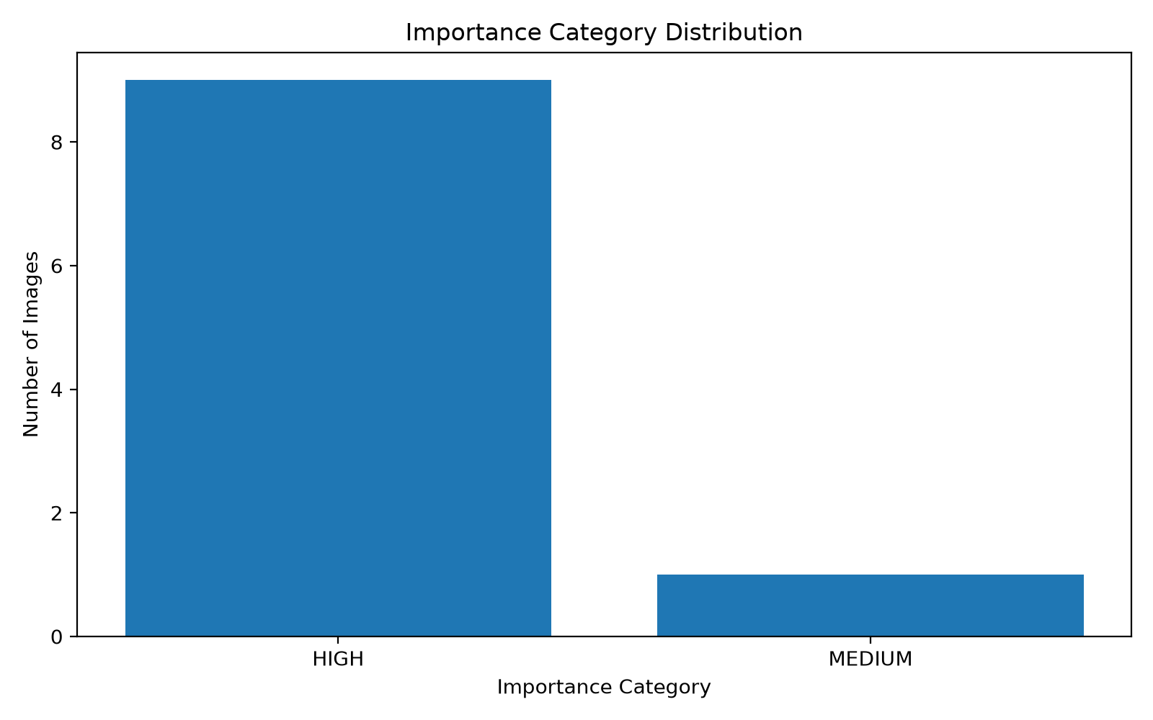
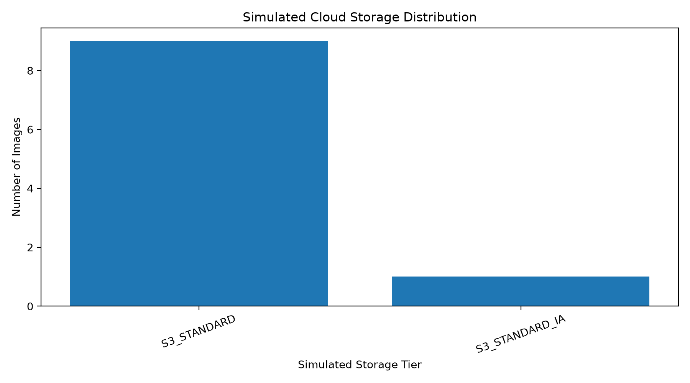
INTELLIARCHIVE | BCSE355L
Experimental Results: SpaceNet Satellite Evaluation
IMPORTANCE CATEGORY SPREAD
STORAGE CLASS ALLOCATION

Slide 8
INTELLIARCHIVE | BCSE355L
Cloud Cost Optimization Model
AWS S3 STORAGE PRICING BENCHMARK (ap-south-1)
COST SAVINGS SIMULATION
S3 Standard (Hot Tier):
• Rate: $0.023 per GB / month
• Impact: Frequent access, low latency
S3 Standard-IA (Warm Tier):
• Rate: $0.0125 per GB / month
• Impact: 45.6% cost reduction vs Standard
S3 Glacier Flex (Cold Tier):
• Rate: $0.0040 per GB / month
• Impact: 82.6% cost reduction vs Standard
Baseline (Flat S3 Standard):
All satellite imagery retained in S3 Standard @ $0.023/GB.
For a 10 TB archive = $230.00 / month.
IntelliArchive Dynamic Tiering:
• 25% High (S3 Standard): 2.5 TB = $57.50
• 35% Medium (S3 Standard-IA): 3.5 TB = $43.75
• 40% Low (S3 Glacier): 4.0 TB = $16.00
Total Optimized = $117.25 / month
Net Projected Savings: 49.02%

Slide 9
INTELLIARCHIVE | BCSE355L
Containerization & Amazon ECR Verification
DOCKER IMAGE OPTIMIZATION
AMAZON ECR REGISTRY STATUS
• Base Image: python:3.11-slim for minimal security attack surface.
• PyTorch CPU Optimization: Switched from default CUDA PyTorch wheel (5 GB) to CPU-only wheel (--index-url https://download.pytorch.org/whl/cpu).
• Model Pre-Caching: CLIP ViT-B/32 weights downloaded during build time to eliminate cold-start latency.
• Unprivileged User: Runs as non-root user 'appuser' with least privilege.
• Integrated Healthcheck: Querying http://localhost:8080/ for zero-downtime container monitoring.
• ECR Repository: intelliarchive (Private)
• Registry URI: 371234372967.dkr.ecr.ap-south-1.amazonaws.com/intelliarchive
• Pushed Image Tag: cpu-test (Active & Verified in ECR)
• Image Size: 1.36 GB (Dramatic reduction from initial unoptimized ~12 GB image)
• Readiness: Ready for immediate deployment to AWS ECS Fargate Task Definition.

Slide 10
INTELLIARCHIVE | BCSE355L
Automated Verification & Test Suite Audit
TEST SUITE EXECUTION SUMMARY — 41 / 41 TESTS PASSED (100%)
test_lifecycle_storage.py (10 Tests Passed)
✔ Validates storage tier acceptance (S3_STANDARD, S3_STANDARD_IA, S3_GLACIER)
✔ Enforces rejection of invalid storage tiers
✔ Verifies multi-hop migrations cleanly purge stale copies without data loss
✔ Ensures audit CSVs remain synchronized and atomic across concurrent transactions
test_s3_service.py (24 Tests Passed)
✔ Tests upload success, custom object keys, and missing file error handling
✔ Validates paginated object listing and custom prefix filtering
✔ Ensures zero AWS credentials leak in client error messages
✔ Validates ECS IAM Task Role credential resolution with empty AWS_PROFILE
test_web_app.py (7 Tests Passed)
✔ Validates HTML rendering for Dashboard, Analyze, Archive, Analytics, and Architecture
✔ Tests /api/summary, /api/analytics, /api/lifecycle, and sample preview endpoints
✔ Verifies full end-to-end zero-shot CLIP inference via /api/analyze-sample

Slide 11
INTELLIARCHIVE | BCSE355L
Work Distribution & Individual Contributions
K. PAVAN KUMAR REDDY (24BIT0580)
ANHAD (24BIT0129)
• Cloud Architecture Design: Formulated S3 storage tier mapping and ECS Fargate deployment topology.
• FastAPI Platform & UI: Designed aerospace dark-theme UI, Jinja2 templates, Chart.js integrations, and REST endpoints.
• AWS S3 Integration: Implemented boto3 wrapper, IAM credential fallback, and live bucket listing/upload service.
• Docker Containerization: Authored Dockerfile, optimized CPU PyTorch wheel, and managed Amazon ECR registry push.
• AI Foundation Model Pipeline: Configured CLIP ViT-B/32 zero-shot classification and semantic prompt anchors.
• Image Preprocessing: Developed dynamic contrast stretching for 16-bit GeoTIFF satellite imagery.
• Lifecycle Simulation Ledger: Implemented atomic local directory tiering and CSV audit logging engines.
• Testing & Cost Modeling: Developed pytest test suites and built the analytical AWS cost comparison models.

Slide 12
INTELLIARCHIVE | BCSE355L
Conclusion & Future Roadmap
KEY PROJECT ACHIEVEMENTS
FUTURE CLOUD EXTENSIONS
• Proven Content-Aware Tiering: Demonstrated that satellite semantic scoring avoids premature archival of high-value imagery.
• Substantial Cost Savings: Demonstrated up to 49% monthly cloud storage savings over static S3 Standard storage.
• Dual-Mode Flexibility: Seamlessly switches between offline local simulation and live Amazon S3 private cloud.
• Production Packaging: Lightweight, secure Docker container registered in Amazon ECR with 100% test pass rate.
• Amazon Bedrock Integration: Utilize multimodal models (Claude 3.5 Sonnet / Amazon Titan) via AWS Bedrock API for cloud-native inference.
• Amazon DynamoDB Metadata Index: Migrate CSV ledgers to DynamoDB with global secondary indexes on semantic score and tier.
• AWS EventBridge & Lambda: Trigger automated inference asynchronously whenever new satellite images land in an S3 intake bucket.
• Specialized Geospatial Models: Incorporate RemoteCLIP or Earth Observation models fine-tuned on multispectral satellite bands.

Slide 13
Thank You!
IntelliArchive: Intelligent Object Lifecycle Optimization for Satellite Archives
Questions & Technical Discussion

