Slide 1
CrowdsreplaceExperts: BuildingBetter Location-based Services using Mobile SocialNetwork Interactions
Group 9 Nagendra Kotharu
Sandeep Dussa

Slide 2
Crowds replace Experts
Location-based service by leveraging user interactions in location-based
social networks.
Introduced an algorithm for ranking places based on their popularity among users, weighted by user expertise score in the query string.
A location-based service based on the above ideas, using user interactions on Twitter and FourSquare.

Slide 3
Crowds replace Experts
Crawling into twitter to gather the data,
Data clean up, parsing the data and identifying four square checkins in tweets.
Building the repository with extracted data from second step.
Calculate user expertise score.
Return top k results ordered by user expertise score

Slide 4
User expertise score
Q is the universe of search terms, and U is the universe of users in the system.
n_{q,u} the number of visits by user u to any place matching search term q.
The fraction of total visits by user u to places matching search term q is computed as:
F(q,u) =n_{q,u} / ∀i∈Qn_{i,u}
The relative importance of search term q is computed as:
I(q) = log |Q|
∀j∈Un_{q,j}
the user expertise score, S _{q,u}, as:
S _{q,u} = F(q,u).I(q)

Slide 5
Tweets are collected with in the radius of 50km around the city's
central geolocation
Using Twitter4J, an unofficial Java library for the Twitter
API, tweets are collected during
Nov 21 - Nov 24 2014
Dec 01 - Dec 07 2014

Slide 6
Twitter records from crawler
Identifying foursquare check ins .
Swarm checkin example - https://t.co/zcxHaBOosJ
Total Tweets | ~ 7000
Newyork | 5338
SanJose, Sandiego, Honalulu, Plano Tx | 1529
Beginning on Aug 7 2014, Foursquare launched its new app Swarm for checkins

Slide 7
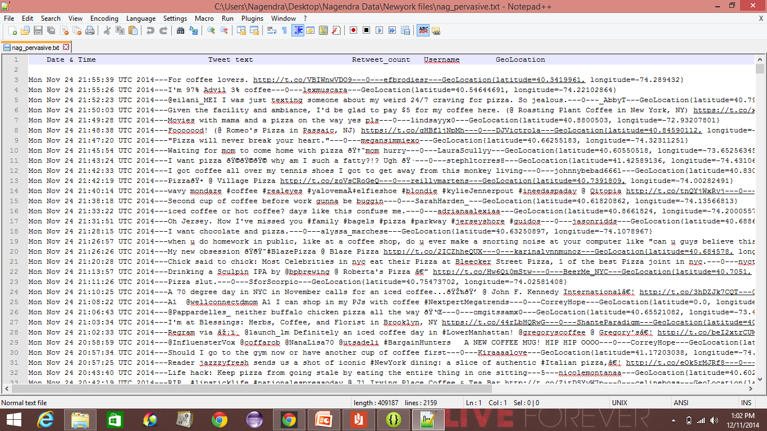

Slide 8
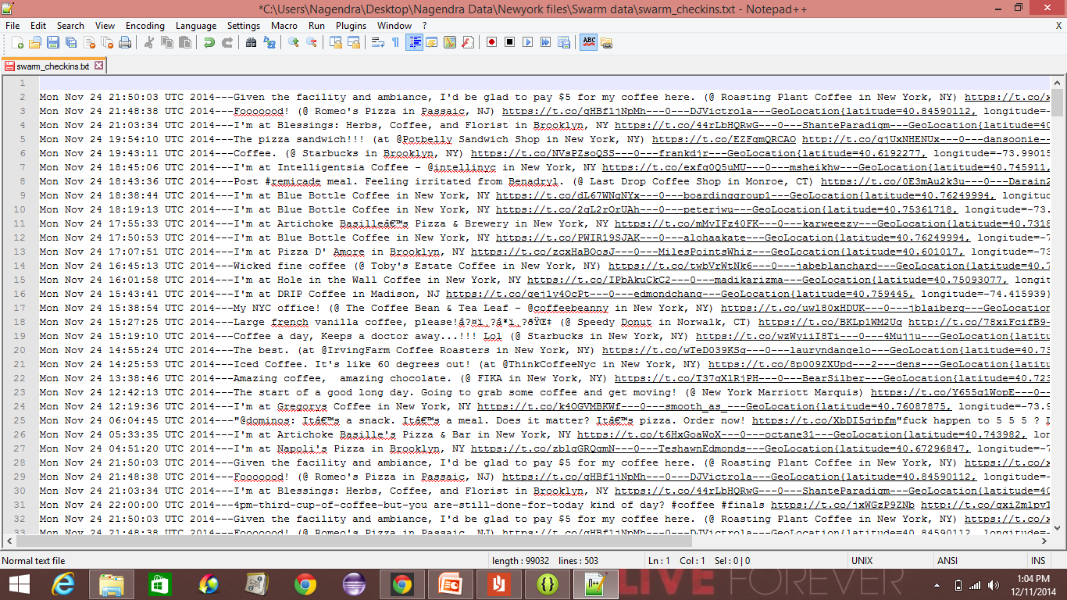

Slide 9
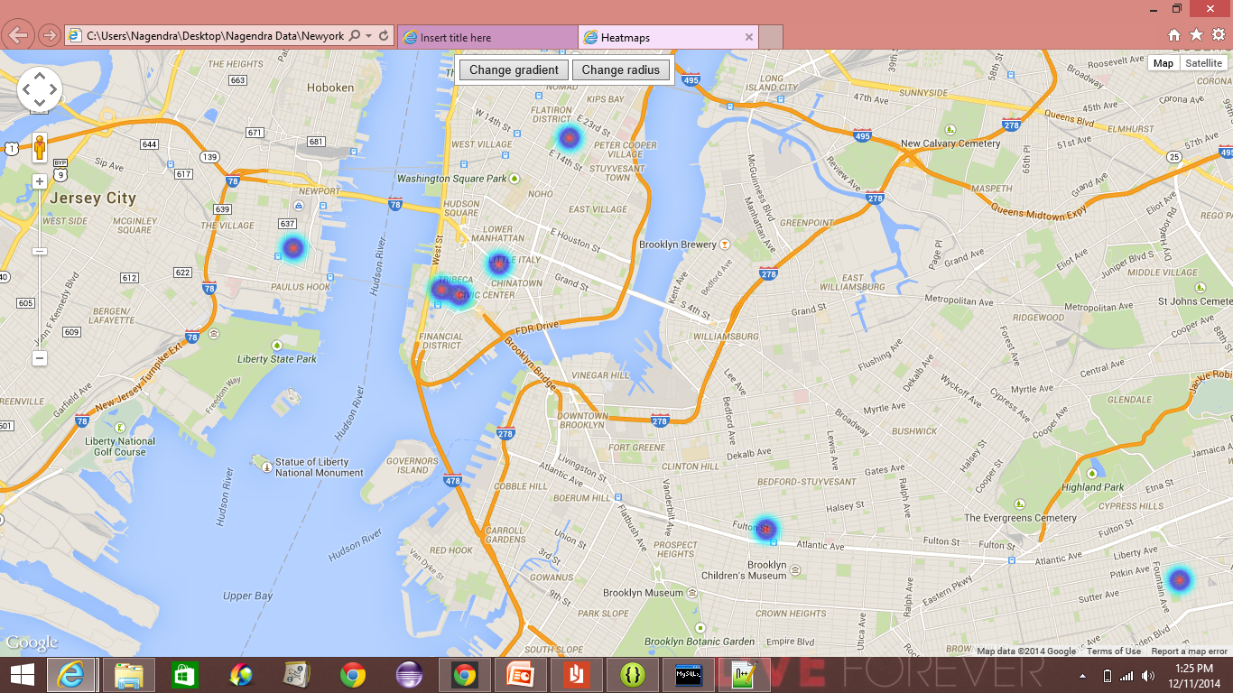

Slide 11
Conclusion
Explored Twitter ,Foursquare , swarm API’s. Generated heatmaps for the swarm checkin dataset with top K results.
Analyzed the hourly trends of users in twitter. This can be combined with location services to find out most happening places at a particular time.
Tried to focus on Retweet count to assess popularity of a tweet by user. (Requires NLP technique to analyze the tweets further).
Observed that users are now also checking in through other sources like Instagram.
Crowdsourcing based on social networks is to be researched further.

Slide 12
References
Shankar, Pravin, et al. "Crowds replace experts: Building better location-based services using mobile social network interactions." Pervasive Computing and Communications (PerCom), 2012 IEEE International Conference on. IEEE, 2012.
Twitter API, Foursquare API, Google Maps API.

