Slide 1
INCOME_EVALUATION
PROJECT VISUALIZATION
PRESENTED BY
K.Neeraja-DS

Slide 2
INTRODUCTION:
To Understand Income Evaluation data we are going to present here
Visualization by using Power BI.Here iam going to take line and stacked
column chart.
Our aim is to show income of every country based on various parameters like Education,occupation,workclass,age.

Slide 3
DATA KEY VARIABLES:
Income(<=50k or <50k)
Native country
Occupation
Capital gain/loss
Workclass
Gender
Work hours per week

Slide 4
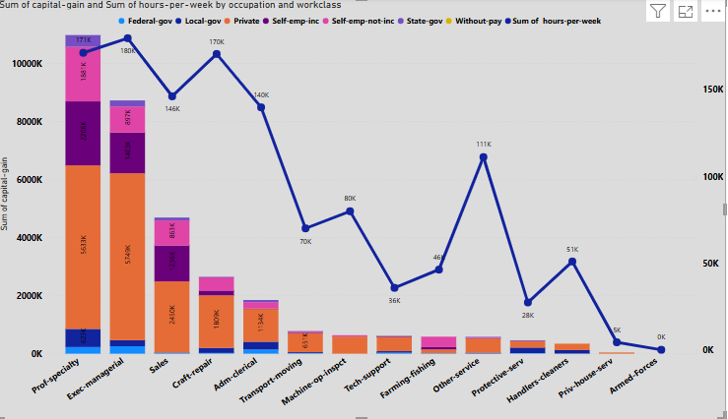
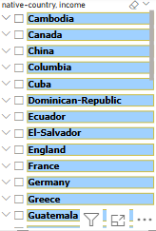
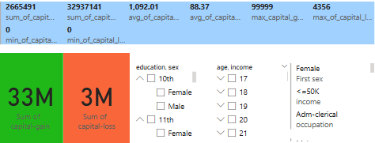
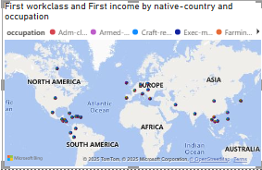
GRAPHICAL VISUALIZATION

Slide 5
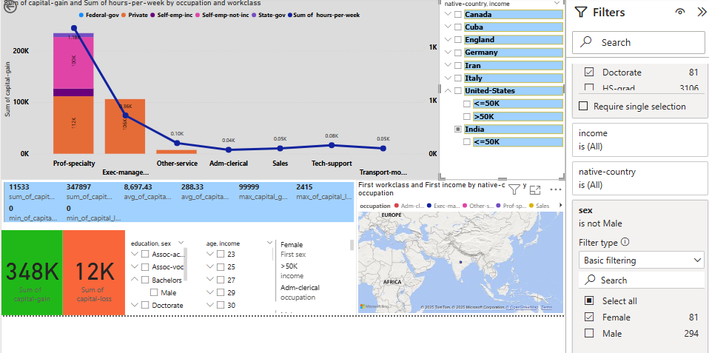
EXPLAINATION & REPORT:
Here this data shows the income evaluation of countries
Comparing with every parameter
based on different parameters the income will changes and also capital_gain ,capital_loss of each and every country.
And also we can show how many of private sectors,self employed,state_gov etc..,
According to education,age,gender relationships we can show visualizations clearly.
This is the visualization of india doctorates only female.

Slide 6
Conclution:
I here by conclude that we can visualize each and every element based on income.
Every sector is linked with income and also we easily visualize and report.
Understanding deeply and clearly about income evaluation data.

Slide 7


